Slide 1
A Performance Study of Near-Memory Processing Under Garbage Collection
Samuel Thomas*, Jiwon Choe, Ofir Gordon, Erez Petrank, Tali Moreshet, Maurice Herlihy, R. Iris Bahar

Slide 2
Outline
Overview of Near-Memory Processing
Overview of Garbage Collection in JDK
Proposed Solution
Evaluation

Slide 3
Outline
Overview of Near-Memory Processing
Overview of Garbage Collection in JDK
Proposed Solution
Evaluation

Slide 4
Bus
Controller
Controller
Controller
DRAM Vault
DRAM Vault
DRAM Vault

Slide 5
Bus
NMP
NMP
NMP
DRAM Vault
DRAM Vault
DRAM Vault

Slide 6
Outline
Overview of Near-Memory Processing
Overview of Garbage Collection in JDK
Proposed Solution
Evaluation
Concluding Remarks

Slide 7
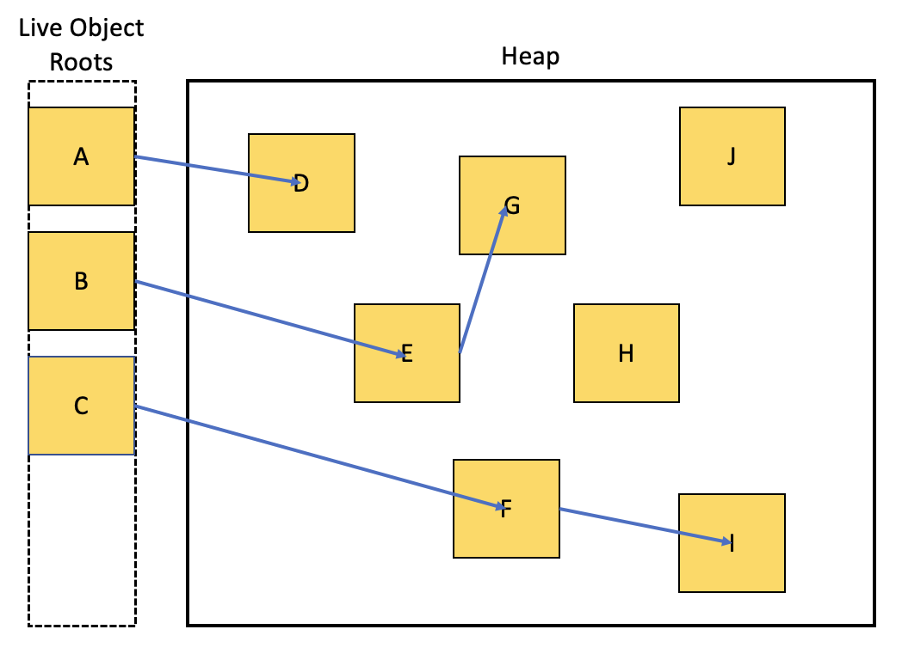

Slide 8
Outline
Overview of Near-Memory Processing
Overview of Garbage Collection in JDK
Proposed Solution
Evaluation

Slide 9
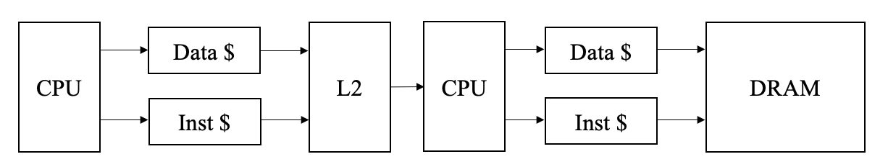
45% hit rate
NMP
95% hit rate

Slide 10
NMP
Running the application
Running the sweep phase of garbage collection
Running the marking phase of garbage collection
Otherwise idle

Slide 11
Outline
Overview of Near-Memory Processing
Overview of Garbage Collection in JDK
Proposed Solution
Evaluation

Slide 12
CPU (in order)
I$ - 48kB
D$ - 32kB
L2 - 512MB
Memory Bus
NMP (in order)
I$ - 48kB
D$ - 32kB
DRAM Vault - 2GB

Slide 13
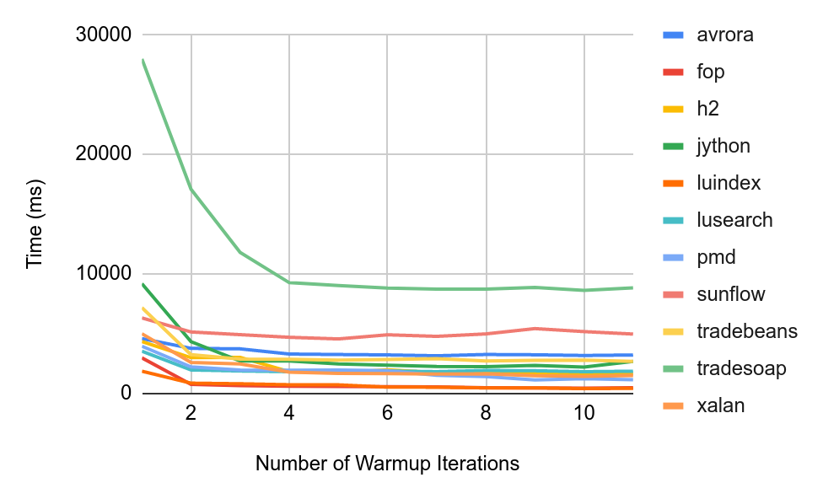
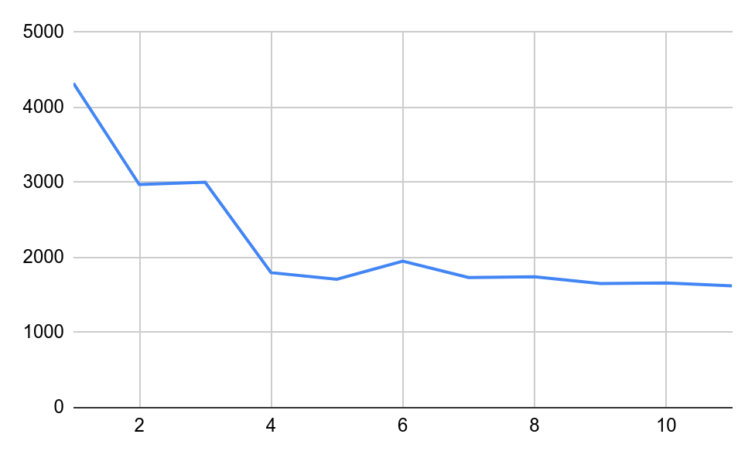
h2

Slide 14
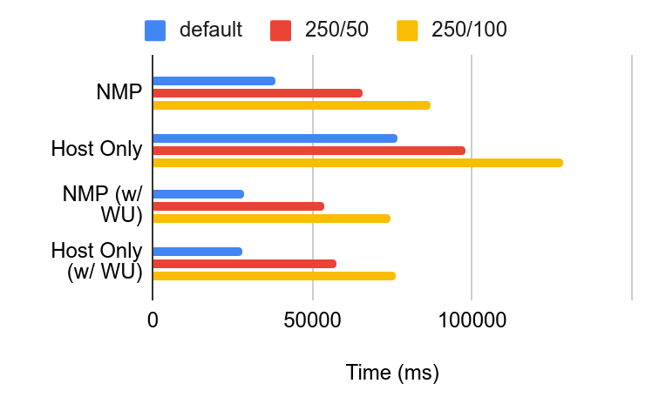

Slide 15
70% of L2 accesses occur in first iteration
77% of L2 accesses occur in first iteration

Slide 16
Future Work
Just-in-time compiler, etc…
Short-lived vs long-running applications
Hardware-software co-design

