Slide 1
Customer Behavior Modeling for Loan Targeting
By
Shashikant Shirke
Nabin Pun
Medunoye Gbenga

Slide 2
Overview
AllLife Bank
AllLife Bank is a mid-sized, growing retail bank offering savings accounts, checking accounts, fixed deposits and personal loans.
Its main revenue comes from interest earned on loans.
Business Objective
To increase profitability, the bank wants to convert existing deposit customers into personal loan customers and grow its loan portfolio.
Marketing Strategy Improvement
Instead of targeting customers based only on static factors like age or income, the bank wants to analyze customer spending behavior for better decision-making.

Slide 3
Current Challenge
The bank has many deposit customers (liabilities) but fewer loan customers (assets). This imbalance limits its ability to maximize interest income.
Goals
- Predict each customer’s expected monthly credit card spending.
Use this predicted spending along with demographic and financial data to identify customers most likely to accept a personal loan offer.
Regression Model: Used to predict customers’ expected monthly credit card spending (continuous outcome).
Classification Model: Used to predict the likelihood of a customer accepting a personal loan offer (binary outcome: Yes/No).
Business Impact
This combined regression and classification approach enables more precise targeting, higher loan conversion rates and improved profitability.

Slide 4
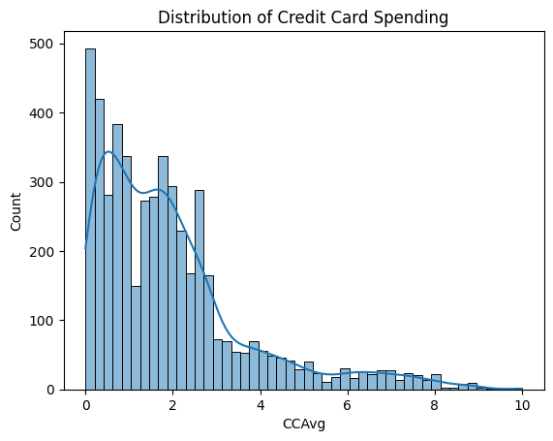
Univariate Analysis

Slide 5
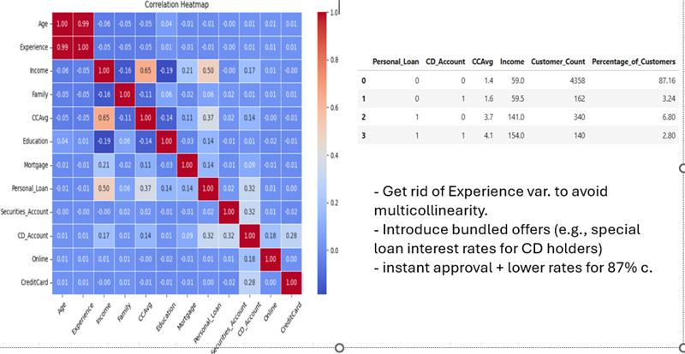
Bivariate Analysis

Slide 6
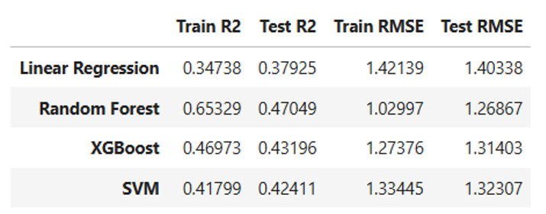
Regression:

Slide 7
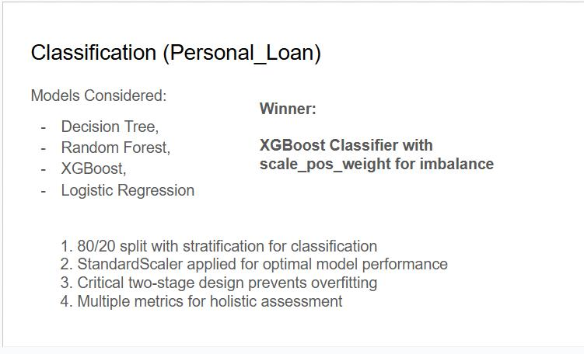
.

Slide 8
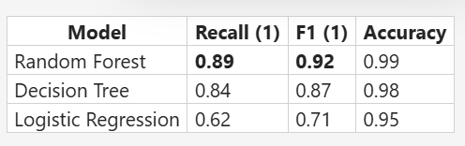
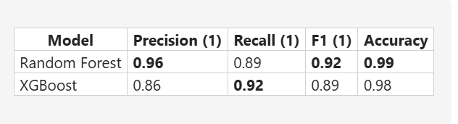

Slide 9
Why Chose XGBoost?
As a bank, we want to capture as many people who will accept the loan
This implies Precision has a higher weight than Recall

Slide 10
EXECUTIVE SUMMARY: KEY FINDINGS
Target Customer Characteristics
HIGH PRIORITY (Loan Acceptance Rate: 40-50%)
- Income: >$120K
- Monthly CC Spending: >$3K
- Education: Advanced/Professional degree
- Has CD Account: Yes
- Has Securities Account: Yes
- Estimated market size: 300-500 customers

Slide 11
MEDIUM PRIORITY (Acceptance Rate: 15-25%)
- Income: $75-120K
- Monthly CC Spending: $2-3K
- Education: Graduate degree
- Active online banking
Estimated market size: 1,200-1,500 customers
LOW PRIORITY (Acceptance Rate: <5%)
- Income: <$60K
- Monthly CC Spending: <$1.5K
- Education: Undergraduate
- Minimal banking product usage
- Estimated market size: 2,500+ customers

Slide 12
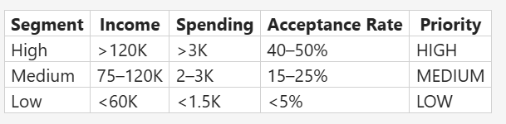

Slide 13
Strategic Recommendations
1. SEGMENTED MARKETING APPROACH
- Deploy 3-tier targeting strategy based on segments above
- Allocate 60% of marketing budget to high-priority segment
Expected ROI: 3-5x improvement in conversion vs. mass marketing
2. PRODUCT BUNDLING**
- Cross-sell loans to existing CD account holders (30% acceptance rate)
- Create "Premium Banking" bundle: CD + Loan + Investment advisory
- Target customers upgrading from basic to premium accounts

Slide 14
3. BEHAVIORAL TRIGGERS
- Monitor credit card spending increases as early signal
- Trigger loan offers when spending crosses $2K/month threshold
- Use spending patterns to predict future loan interest
4. CHANNEL OPTIMIZATION
- Focus digital channels for high online banking usage segment
- Personalize offer amounts based on income & spending
- A/B test messaging complexity by education level
5. RISK MITIGATION
- High-income customers show lower default risk (verify with credit scores)
- Spending behavior indicates financial discipline
- Existing product usage shows banking relationship strength

Slide 15
Expected Business Impact
If recommendations implemented
- Conversion rate improvement: **2-3x** (from ~10% to 20-30% in target segments)
- Marketing efficiency gain: **40-50%** (reduced waste on low-probability customers)
- Customer lifetime value increase: **25-35%** (cross-sell opportunities)
- Portfolio risk reduction: **15-20%** (better customer selection)

Slide 16
Next Steps
1. Validate insights with small pilot campaign (500 customers)
2. Develop predictive model using regression/classification
3. Create automated scoring system for real-time targeting
4. Monitor KPIs Conversion rate, cost per acquisition, portfolio quality
5. Iterate quarterly based on actual results

Slide 17
Thank You !!

