Slide 1
1. What feature is affecting the campaign most?

Slide 2
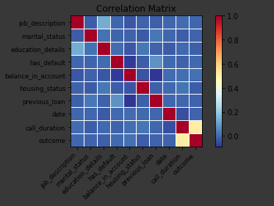
Correlation
By plotting the correlation between the columns we see that call_duration has the highest coefficient of correlation with outcome. Balance and previous loan factors follow it. Followed by Balance_in_account
import statsmodels.api as sm
import matplotlib.pyplot as plt corr = df.corr()
sm.graphics.plot_corr(corr, xnames=list(corr.columns))
plt.show()

Slide 3
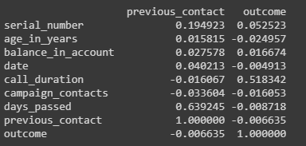
From the values
We can analyze which factor is affecting the most to outcome. The factor having maximum absolute correlation between itself and outcome affects the outcome the most
Lack of proper advertisement also created a short client range, so many could not be aware of the campaign ahead
The longer calls duration helps the bank to understand better about its clients and modify its mode of contact or their investment plans
Note: This snip was taken on the total data frame. So if you see Serial Number do not worry. Serial Number is a useless criteria.

