Slide 1
2. Analyze the performance of this company, and provide your insights regarding the same.

Slide 2
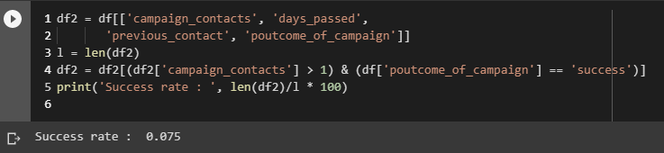
Success Rate in the previous campaign
The previous campaign was disastrous one for the company with most number of unknown data for the success or failure

Slide 3
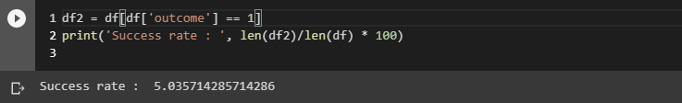
Present Campaign
The present campaign is better than the previous one with nearly 5 percent success rate and lesser unknown outcomes.

Slide 4
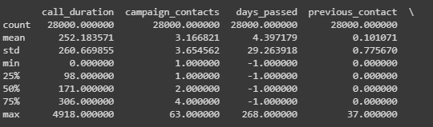
Previous Contacts
The bank is focusing on a few people for informing about it s campaign. A person was contacted 37 times I before the campaign who ended up not buying the debit card. So a considerable amount of time should be given between the calls which will annoy the clients less
The average number of calls made to distinct averages 0.1 across 28000 entries with max going to 37

Slide 5
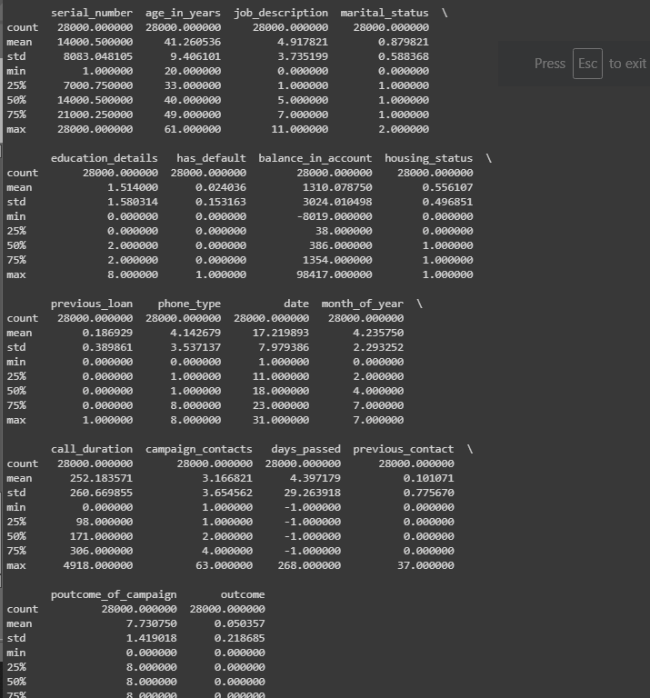
Where it lacked?
Lesser number of pre campaign calls (presently with 75 percent of the customers having heard 4 calls from the company)
The data shows that having longer Calls with the customer is helping the banks to Sell the debit cards. Having calls made to distinct clients increases the range of advertisement.
The customers must be contacted often for the deals presently with more of the customers having not received any calls during the previous campaign or during pre campaign.
The month plays an important role for the outcome prediction, most of the calls were made during Jan ( these would get rejected since it is the holiday season and people would be enjoying their vacation).

