Slide 1
3.Based on your analysis of the data, what are potential areas of improvement for the business?

Slide 2
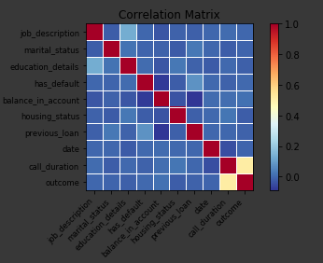
How can it be improved?
Tries should be done on customers having higher balance in their account
Calls should be made to people of lesser years than of 50-60years
Marital Status should be considered as it made a significant improvement in accuracy
Having a personal loan has the least effect on the customers into taking a debit card

Slide 3
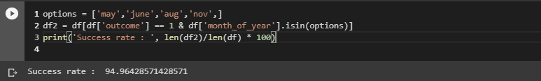
Month plays an important role
The success rate during the period between June to November has been the highest due to the freedom during the holidays
During the winter vacation, people tend to travel in search of warmer places so they seldom accept the calls from the bank

Slide 4
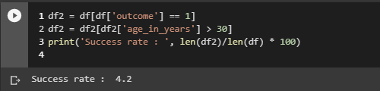
Age group to target
30-40 years is the ideal age group taking approximately 33 percent of the total success outcomes
20-30 years take for 15 percent of the total success outcomes
Greater than 60 has literally no value to contact since they may be nearing retirement

Slide 5
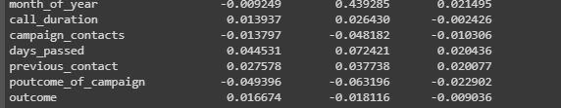
Loans
People with a burden of loans ranging from housing loans to personal loans are not susceptible to taking a debit card due to negative correlation coefficient

