Slide 1
4.What are additional business problems that can be analyzed using this data. Support with explanation.

Slide 2
According to hiscox.co.uk
The biggest challenges businesses face today (and need consultants for) are
Uncertainty about the future
Being able to predict customer trends, market trends, etc. is vital to a changing economic climate, but not every CEO has Warren Buffett-like predictive powers. Bringing in a consultant trained in reading and predicting those all-important trends could be the difference between a bright future and a murky one.

Slide 3
Uncertainty about the future
This dataset give us crucial insights on customer spending and balance pattern based on their age, job and education
The technicians spend money higher between the age of 20 to 30
Married person is a stable one wrt. Bank balance and credit card issual – He could be persuaded for investments like taking a credit or debit cad or Stock Investment
The people above the age of 30 are taking housing loans. So the market of housing loans could use this info of their target consumers

Slide 4
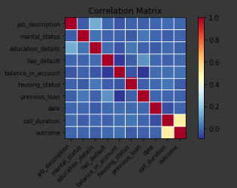
Customer service or Advertisement
In a world of instant gratification, customers expect instant customer service — and can take to the web to share their displeasure at less than satisfactory service just as quickly.
Consultants can find ways to improve customer service and bring it into the 21st century.
The data given here shows that having longer
Calls with the customer is helping the banks to
Sell the debit cards

Slide 5
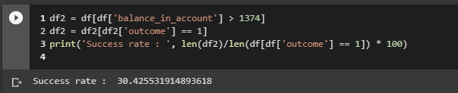
Customer service or Advertisement
Higher the number of times the customer is contact between the campaigns is helping the bank to sell the cards during campaign to them
People with higher balance have a tendency to take cards so credit cards could be suggested to them. So calls to richer clients are successful most of the time

Slide 6
Financial management
Many CEOs we know are ideas people; that means they’re great at the big picture and disruptive thinking, but less good with things like cash flow, profit margins, reducing costs, financing, etc.
Small and medium businesses may not require a full-time CFO, but would do better to employ a financial consultant who can step into the role as needed.
Entrepreneurs and CEO’s are having higher salaries in their bank accounts. This may be attributed to their higher salaries. Small and medium business have a difficult time catering to the salaries of CEO
So they could use the help of CFO on contract rather than full time CFO for cash management

Slide 7
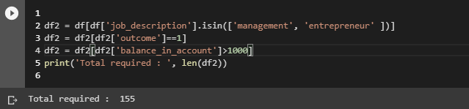
Market for Investors
People in Management and Entrepreneurship have higher salaries that all with married ones setting the bar nearly 155 of them higher salaries than 75 percent of the population
This can be attributed to higher stabilities among married individuals
So they could be the target for their investment or pull them into money investing schemes

Slide 8
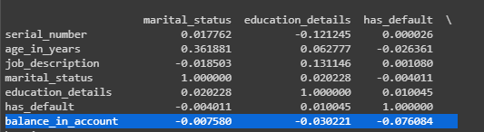
Younger Population
The population between the age of 20 and 30 are having higher bank balances
The correlation between the educations and bank balances is highly negative
So youth could be targeted for money investment schemes and for credit and debit cards. In other sense, customers above the age of 30 have ben having lower bank balance (maybe due to family burderns)

Slide 9
Advertise your idea
Due to social media sites like Twitter, customers can voice any displeasure so much more publicly and loudly than ever before, businesses have to monitor and maintain their online reputations.
And while it’s an important task, it’s one best suited to a third party who can monitor and mediate with a certain amount of distance.
The trend of success has increased from the previous campaign to 5 percent, this could be attributed to lower contacts in the previous year. It was like 63 in the previous campaign

Slide 10
Education and Housing Loans
This attribute is having negative correlation with the outcome.
The more educated the person is the lower the chance of convincing him for a credit card
The clients having a housing loan are less probable to take a housing Loan.
The Banks could target on customers having lower education level and are having a housing loans for investment into them

Slide 11
Conclusion
It may not convincing to all but the clients with lower primary education levels, having less number of loans and an average amount of balance in their accounts by the end of the year could be targeted for other investments like stocks
Advertisement plays a key part in dragging the investors and clients to your business

