Slide 1
Potential Areas of Improvement

Slide 2
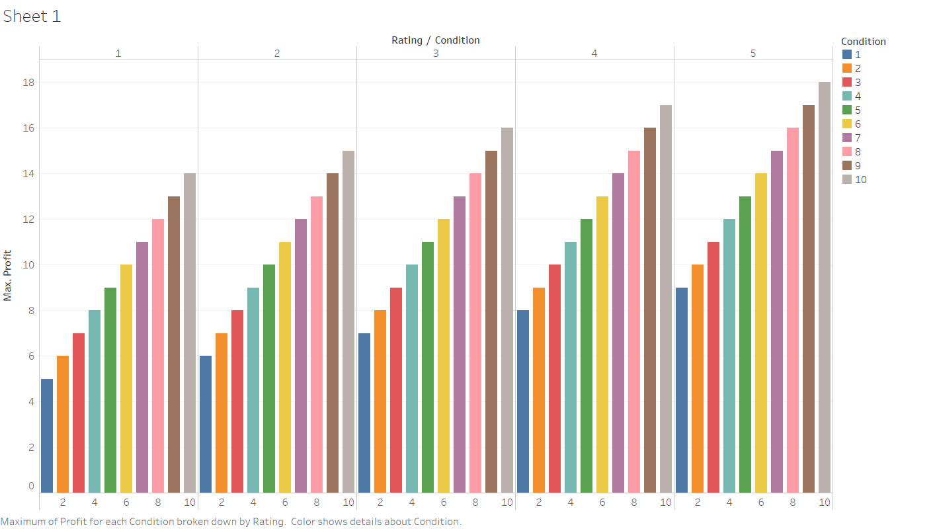

Slide 3
The company should focus on selling cars with a higher rating so as to earn higher profit.
The company should focus on selling cars in a better condition so as to earn higher profit.

