Slide 1
PhD Research Proposal
Relating audio and 3D scenarios in audiovisual productions
David García Garzón
Advisors: Toni Mateos, Vicente López

Slide 2
Outline
Motivation
State of the art and proposal
  Audio rendering
  Physical encoding
  3D decoding
  3D acoustic inference

Slide 3
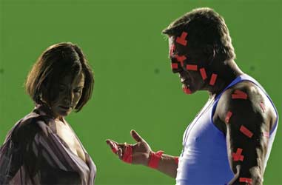
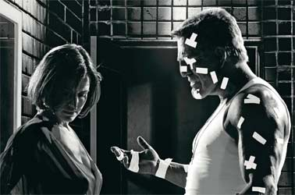
Problem context:
Audiovisual productions
Audiovisual productions combine synthetic and recorded materials.
Synthetic material achieves great realism both in audio and graphics.
Post-production (films, commercials) but also real-time (video games) prods.

Slide 4
Problem context:
Video production process
Synthetic video is generated from an scene definition.
  Geometry, materials, lights, cameras, animations...
Advantages:
  Easy high level modification: Re-lightening, enlarging rooms, removing objects...
  Any exhibition format can be generated: 4:3, 16:9, stereoscopic...

Slide 5
Problem context:
Audio production process
Audio is essential for immersive experience
Still too hand-crafted process
Input: Only final video, scene definition totally lost!
  Create an artificial reverb that suits the scenario
  Locate the sources according to the video
  Take care of many channels, and make one post-production for every exhibition system: 5.1, 7.1, 22.2

Slide 6
Global research goal
Improve the audio work-flow for media productions by focusing on the digital processing of synthetic audio elements
  In contrast to focusing on audio recordings which deals with mechanical concerns (microphones, loudspeakers and other transducers)
Improving means automation, universality and quality

Slide 7
Research Fronts
Audio Rendering:
  Capturing the acoustic properties of a synthetic 3D scenario
Physical Coding:
  Coding all physical magnitudes of the acoustic field needed in later stages.
3D Decoding:
  Faithfully reproduce the acoustic field given an exhibition system
3D Acoustics Inference:
  Inferring a plausible 3D scenario from auditive information.

Slide 8
Research Fronts
Audio
Rendering
Physical
Coding
Encoded
acoustic
field
Annechoic
Audio
and SFX
3D Scene
Definition
In situ
Recordings
3D
Decoding
3D Acoustics
Inference
Exhibition
Mix

Slide 9
Audio Rendering:
State of the art
How does the scenario modify a given anechoic sound?

Slide 10
Audio rendering:
Wave equation and IR
Linear regime: Po >> (P-Po)
Given the system response to an impulse signal (Impulse Response), the response to any other input signal is computed by convolving the signal by the Impulse Response:

Slide 11
Audio Rendering:
State of the art
How does the scenario modify a given sound?
  How an impulse generated at any source point affects the pressure at any listening point.
Two main families of algorithms:
  Wave-based methods
  Geometrical methods

Slide 12
Audio Rendering:
Wave based methods
Approximation based on a discretization of space and time/freq.
  Finite-Difference Time Domain (FDTD)
  Finite Elements Methods (FEM)
  Boundary Elements Methods (BEM)
Validity: wave length >> discretization cell
  Expensive computationally, polynomial order
  Low frequencies

Slide 13
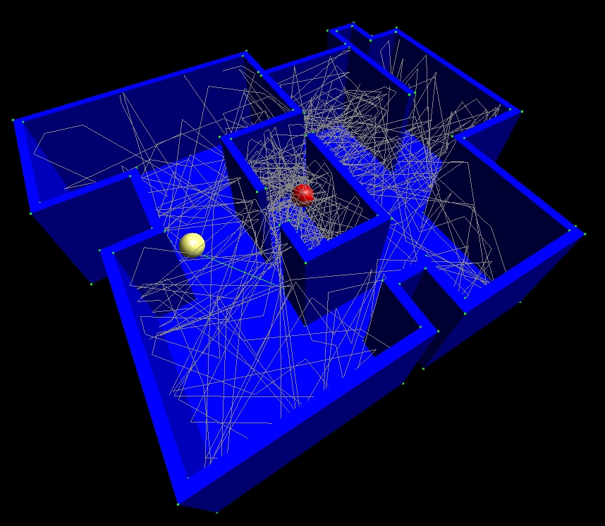
Audio Rendering:
Geometrical Methods
Approximation assuming very high freq.ﾺﾺ
  Validity: wave length << scene objects
  Computationally cheaper
Borrow computer graphics methods (light)
  Image source
  Ray tracing
  Beam Tracing

Slide 14

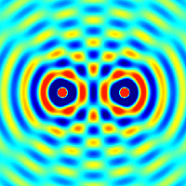
Audio Rendering:
Geometrical Methods
Neglected wave phenomena:
  Diffraction: You can hear a source even behind an obstacle.
  Interference: Two audio sources can cancel each other.

Slide 15
Audio Rendering:
Research proposal
Enhancing physical accuracy and performance of existing methods.
  Introducing effective approximations for diffraction and interference in geometrical methods
  Hybrid algorithms (FDTD+Ray Tracing)
Validation: Comparing with measurements on simple rooms

Slide 16
Physical encoding:
State of the art
Which are the magnitudes of the acoustic field that have to be recorded/stored for later stages.
  Related to microphone technologies to capture the acoustic field
Ordinary microphones measure just acoustic pressure at one point.
  Pressure has no information of directionality
  No extrapolation to other points

Slide 17
Physical encoding:
State of the art
Ambisonics: Encode first order spherical harmonics: velocity at orthogonal directions.
  Directionality and allows some extrapolation
  Soundfield microphone (in all football stadiums)
Limitations:
  Extrapolation from recording point still limited (small sweet-spot)
  Angular resolution (spread of the source)

Slide 18

Physical encoding:
State of the art
High Order Ambisonics (> 9 channels)
  No microphone technology yet, challenging mechanics

Slide 19
Physical encoding:
Research proposal
Goal: Enhance resolution and sweet-spot
Simulation by using geometrical methods enables the encoding of higher order ambisonics. No mechanical limitations.
Still limited channels → Hybrid encodings:
  Metadata that encode the direct sound
  Reverberation using limited order ambisonics
  Source spread management

Slide 20
3D Decoding:
State of the art
Reproducing the acoustic field with a given exhibition system
Binaural technologies
  Simulate the sound as it would reach the ear entrance. Reproduced using headphones.
Loudspeaker array technologies
  Reproduce the wave field using many speakers around the listener.

Slide 21
3D Decoding:
State of the art
Binaural: Head Related Transfer Function
  Impulse responses generated from different direcctions around the head recorded at the ear entrance. Encode most localization cues.
Arrays: Ambisonics to any exibition system

Slide 22
3D Decoding:
Research proposal
Enhancing binaural systems (done)
  Ambisonics (B-Format) to binaural conversion
  Compensates recorded HRTF DB's deficiencies
  Next step: Explore HRTF simulated DB's
Apply physical encoding enhancements:
  Different algorithm for direct sound (VBAP) and reverberation (HOA decoding researched at BM)
Performing psychoacoustic tests

Slide 23
3D Acoustic inference:
State of the art
Finding a 3D environment (geometry and materials) with acoustic properties as close as possible those in a given audio.
Some research exists on inferring the position of the sound sources.
  Binaural inference (reproduce human perception)
  Multiple microphone to compute time differences
But room inference is a new field of research

Slide 24
3D Acoustic inference:
State of the art
Applications:
  Introducing new spacialized sources just by having other recordings not the original 3D model
  Turning commercial reverb libraries into 3D environments for spacialization and navigation
  High level reverb manipulation (changing room parameters)
No need to match the original room, just being acoustically indistinguishable.

Slide 25
3D Acoustic inference:
Research proposal
Designing a cost function to compare the target and the simulated impulse response
Room parametrization, Search space analysis
Exploring several search algorithms
Two fold validation: Convergence and psychoacoustic tests

Slide 26
Research Fronts
Audio Rendering:
  Capturing the acoustic properties of a synthetic 3D scenario
Physical Coding:
  Coding all physical magnitudes of the acoustic field needed in later stages.
3D Decoding:
  Faithfully reproduce the acoustic field given an exhibition system
3D Acoustics Inference:
  Inferring a plausible 3D scenario from auditive information.

Slide 27
Questions?

Slide 28
Thanks

Slide 29
Extra data
Human hearing: 20Hz-20KHz so, 17m-17mm
Wave-based: rooms 800Hz, heads full range
Ambisonics encode coefficients of an expansion of the pressure field in spherical harmonics.

Slide 30
Binaural technologies
Encoding localization cues that the brain uses to localize sounds
    Inter-aural Time Differences (ITD) for LF
    Inter-aural Level Differences (ILD) for HF
    Body and head shadowing and rebounds
    Pinna filtering
    Head and source motion cues

Slide 31
Binaural technologies
HRTF: Head related transfer functions
  Impulse responses recorded at subject's ear channel coming from several directions
  They encode most of the cues
  Recorded with a manikin, or real subject
Hard to record and subject dependant
  Simulations,
  Recorded DB's parametrized by anthropometry

Slide 32
Binaural technologies
For direct sound:
  Direct convolution with the closer HRTF
With ambisonics encoding
  Simulate a speaker set-up and apply HRTF at speaker location
  Given an HRTF DB an IR can be computed for each spherical harmonic

Slide 33
Loudspeaker array technologies
Monaural until 1931
Stereo phony (Blumlein) locating sounds in 60º
90's Surround, 5.1 standarization in cinema theaters
  Good localization just at the horizontal plane
  Deficiencies on the back (few speaker coverage)
7.1, 10.2, 22.2 (in standardization process by NHK Japan)
TODO: Setup figures

Slide 34
Loudspeaker array technologies
Ambisonics (Gerzon, 73)
  Besides a recording and encoding technology it provides the basis for decoding in an arbitrary loudspeaker setup
  Aim: reproduce all the encoded spherical harmonics coefficients at the sweetspot

Slide 35
Conclusions
Direct application to the audiovisual industry.
Four research fronts with tight dependencies among them.
Future achievements on the community could focus the research in a subset of them.
3D-AI: new research field with clear applications

