Slide 1
Relative Position of Pilot
Achieve/approach the desired position of the suit
Force applied by & to Exoskeleton
Controls and Decision Making
Observe and apply currently required change in commands
Communications
Outside of Scope
Observe current state of suit
Observe current state of pilot/desired state of suit
Determine action required
Communicate Desired Action
OUTSIDE OF SCOPE
Measure position of suit
Measure suit interaction with environment (force)
Measure pilot interaction with suit (force)
Measure position of limbs in relation to origin
Derive required action of the suit from any given state
OUTSIDE OF SCOPE
Regulate torque output of actuators
Measure force applied at external contact points
Measure force applied at internal contact points
Measure position of limbs in relation to fixed rotational axis on suit
Develop control method based on kinematics of the suit
Transmit Message over communications system

Slide 2
SS1: Relative Position of Pilot
Observe current state of pilot/desired state of suit
Measure position of limbs in relation to origin
Define Origin / Rotational Axis
Measure position of limbs in relation to fixed rotational axis on suit
Parse readings into useable data
Create fixed measurement point
Detect distance / proximity
Map from ADC readings to meters
Detect Signal
Remove Noise
Apply Sufficient Amplification
Read Signal

Slide 3
C
D
B
A
E

Slide 4
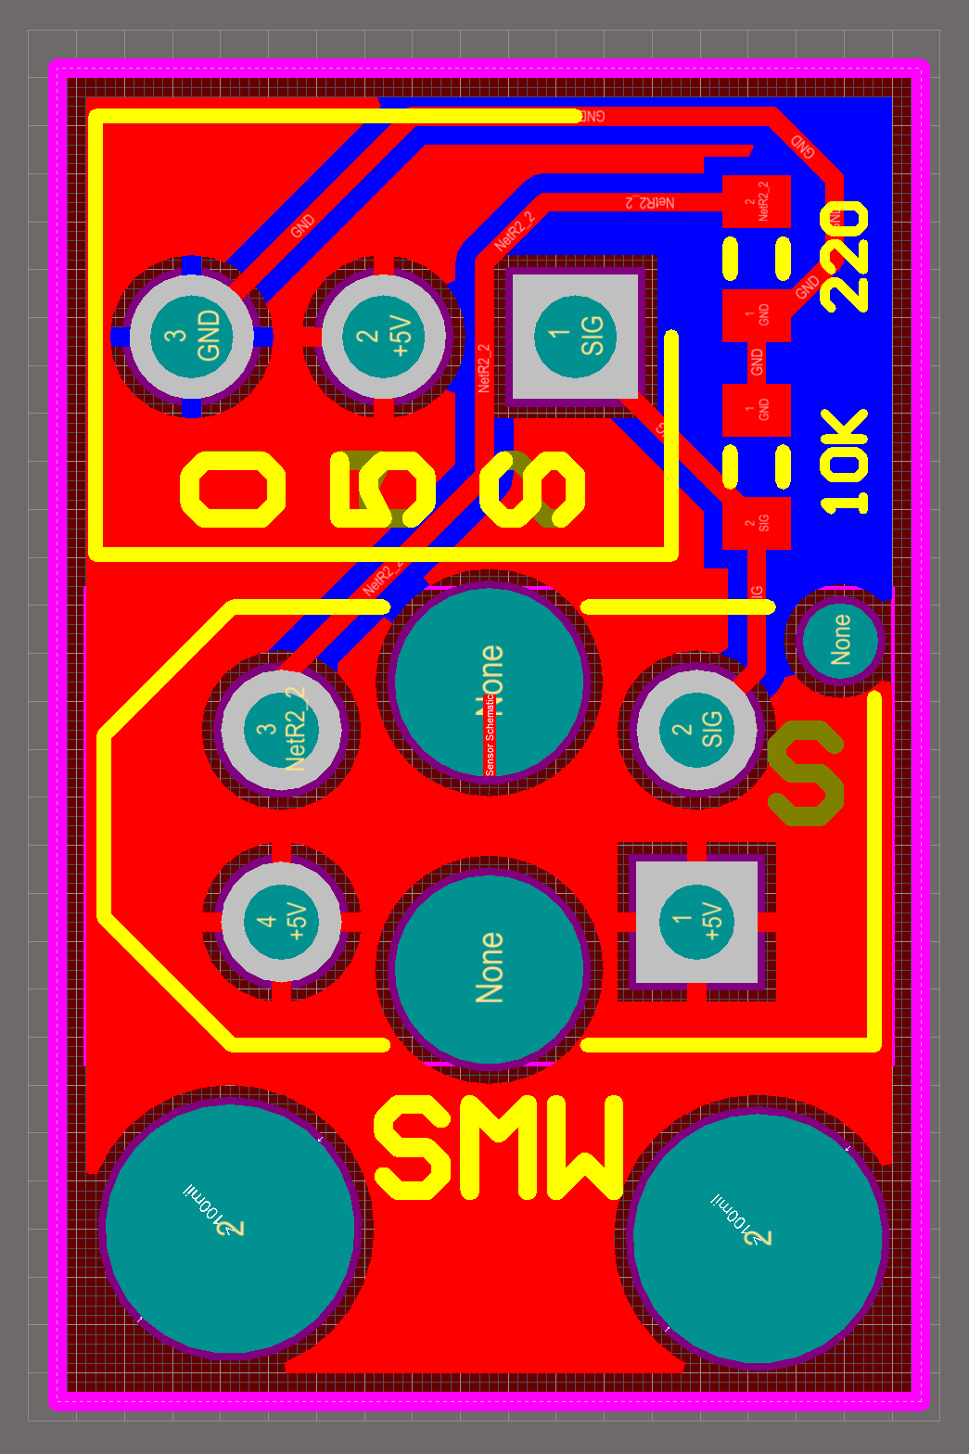
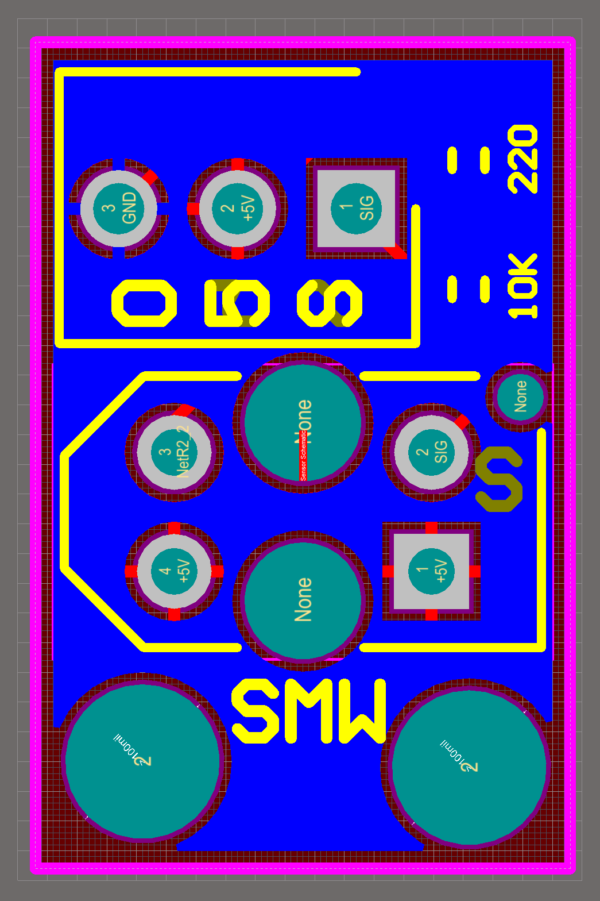
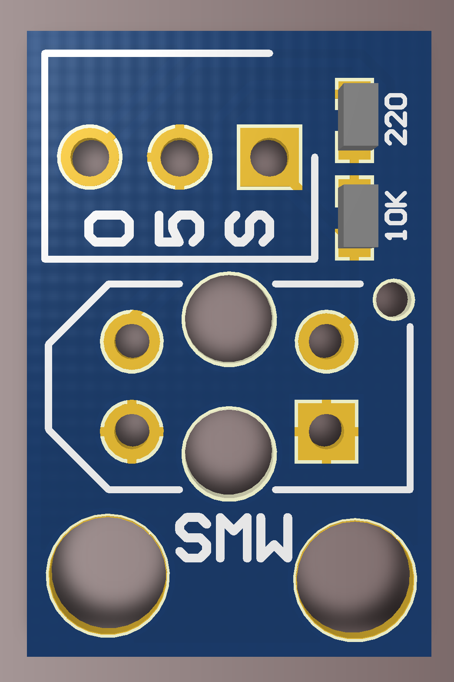
Top Layer
Bottom Layer
Top Layer Render

Slide 5
Force applied by & to Exoskeleton

Slide 6
Controls & Decision Making

Slide 7
Communications

Slide 8
Actuation Systems

