Slide 2
Pelvis
{0}
1
1
Left
Thigh
Right
Thigh
LT
RT
2
2
Left
Shin
Right
Shin
LS
RS
Left
Foot
Right
Foot
LF
3
3
RF

Slide 3












Thigh Link
Shin Link
Foot Link
$$θ_{2},\dot{θ_{2}},\overset{⃛}{θ_{2}}$$
$$l_{2}$$
P2
$$I_{3}.m_{3}$$
$I_{2}$, $m_{2}$
$$L_{1}$$
$I_{1}$,$m_{1}$
P3
$$l_{3}$$
$$L_{3}$$
$$L_{2}$$
P1
$$l_{1}$$
$$θ_{3},\dot{θ_{3}},\overset{⃛}{θ_{3}}$$
Pelvis (Inertial Reference) {0}
$$θ_{1},\dot{θ_{1}},\overset{⃛}{θ_{1}}$$

Slide 4
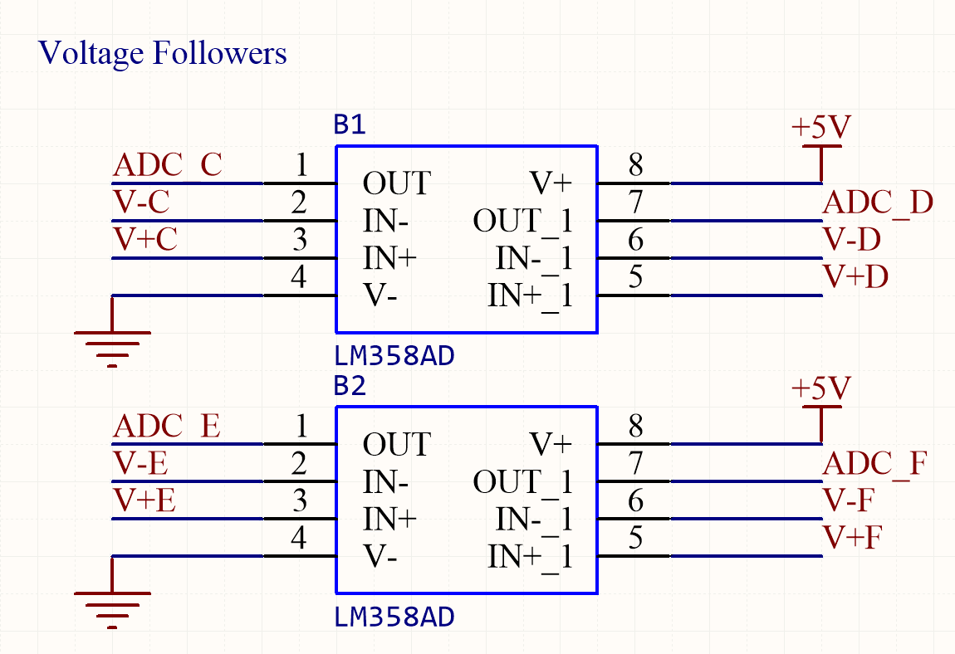




$$V_{in (C,E)}$$
3
+
1
$$V_{out(C,E)}$$
2
-
$$V_{in(D,F)}$$
5
+
7
$$V_{out(D,F)}$$
6
-

Slide 5
Desired Output
+
Error
Controller
Actuator
Process
Actual Output
-
Measurement Output
Sensor
Feedback
Desired Output
+
Error
Controls K(s)
Transfer Function G(S)
Actual Output
-
Measurement Output
Sensor
Feedback
Desired Output
R(s)
+
Error E(s)
System H(S)
Actual Output
C(s)
-
Measurement Output B(s)

Slide 6
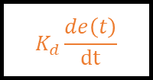
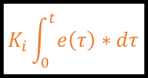
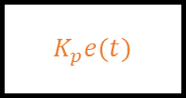
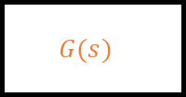



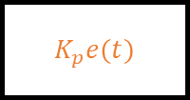
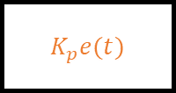
P
$$K_{p}e(t)$$
I
+
Desired Output
R(s)
+
Error E(s)
$$K_{i}\int_{0}^{t}{e\left(τ\right)∗dτ}$$
+
$$G(s)$$
Actual Output
C(s)
-
+
D
$$K_{d}\frac{de\left(t\right)}{dt}$$
Measurement Output B(s)
P
Desired Output
R(s)
+
Error E(s)
$$K_{p}e(t)$$
+
$$G(s)$$
Actual Output
C(s)
-
+
D
$$K_{d}\frac{de\left(t\right)}{dt}$$
Measurement Output B(s)
P
Desired Output
R(s)
+
Error E(s)
$$K_{p}e(t)$$
$$G(s)$$
Actual Output
C(s)
-
Measurement Output B(s)
P
Desired Output
R(s)
+
Error E(s)
$$K_{p}e(t)$$
+
$$G(s)$$
Actual Output
C(s)
-
+
I
$$K_{i}\int_{0}^{t}{e\left(τ\right)∗dτ}$$
Measurement Output B(s)

Slide 7


C
A
B
Short Distance $→$ Strong Signal
A
B
Long Distance $→$ Weak Signal

Slide 8
SS1: Relative Position of Pilot
Achieve/approach the desired position of the suit
SS2: Force applied by & to Exoskeleton
SS3: Controls and Decision Making
Observe and apply currently required change in commands
SS4: Communications
Outside of Scope
Observe current state of suit
Observe current state of pilot/desired state of suit
Determine action required
Communicate Desired Action
OUTSIDE OF SCOPE
Measure position of suit
Measure suit interaction with environment (force)
Measure pilot interaction with suit (force)
Measure position of limbs in relation to origin
Derive required action of the suit from any given state
OUTSIDE OF SCOPE
Regulate torque output of actuators
Measure force applied at external contact points
Measure force applied at internal contact points
Measure position of limbs in relation to fixed rotational axis on suit
Develop control method based on kinematics of the suit
Transmit Message over communications system

Slide 9
SS1: Relative Position of Pilot
Observe current state of pilot/desired state of suit
Measure position of limbs in relation to origin
Define Origin / Rotational Axis
Measure position of limbs in relation to fixed rotational axis on suit
Parse readings into useable data
Create fixed measurement point
Detect distance / proximity
Map from ADC readings to meters
Modulate Emitted Signal
Detect Signal
Remove Noise
Apply Sufficient Amplification
Read Signal

Slide 10
C
D
B
A
E

Slide 11
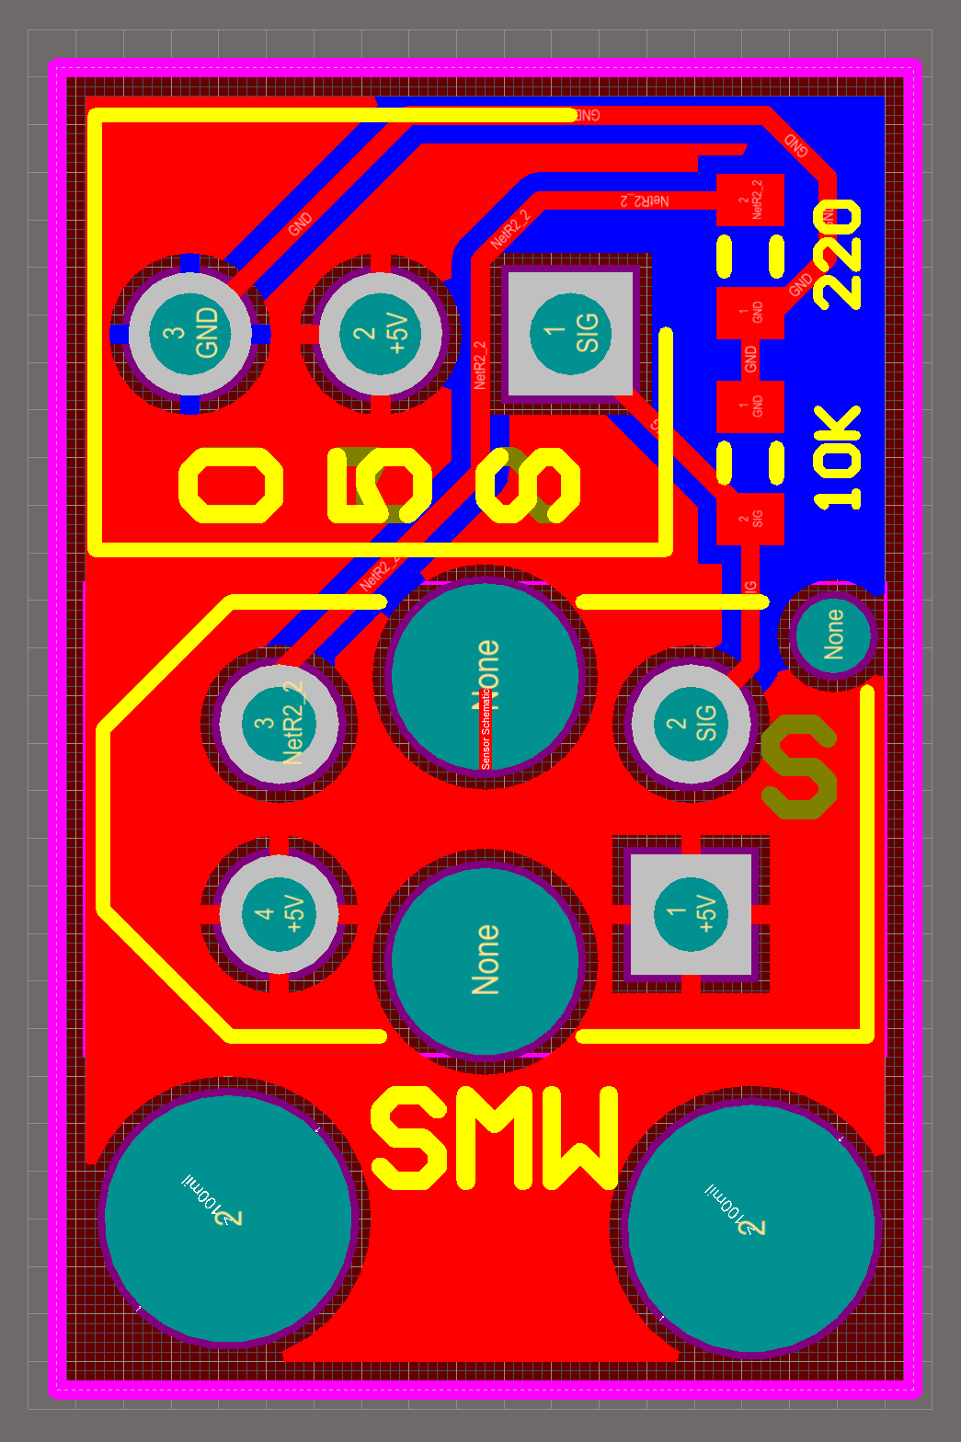
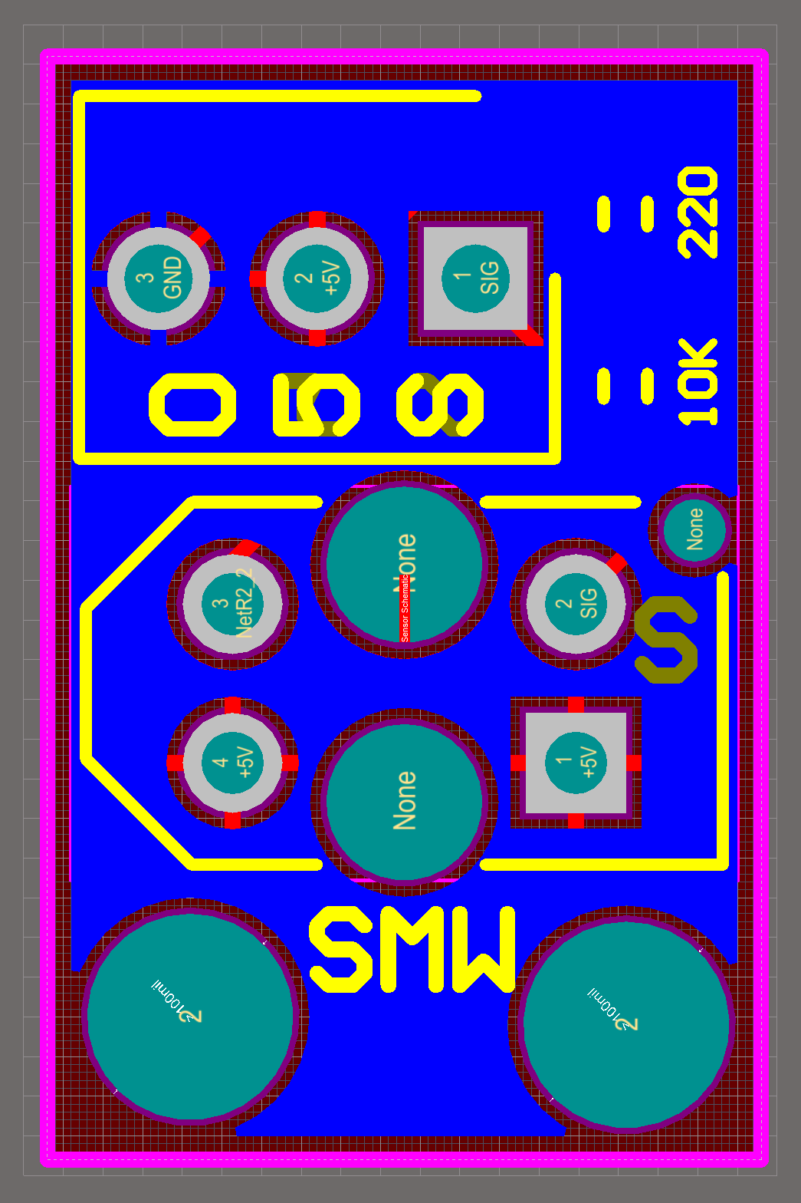
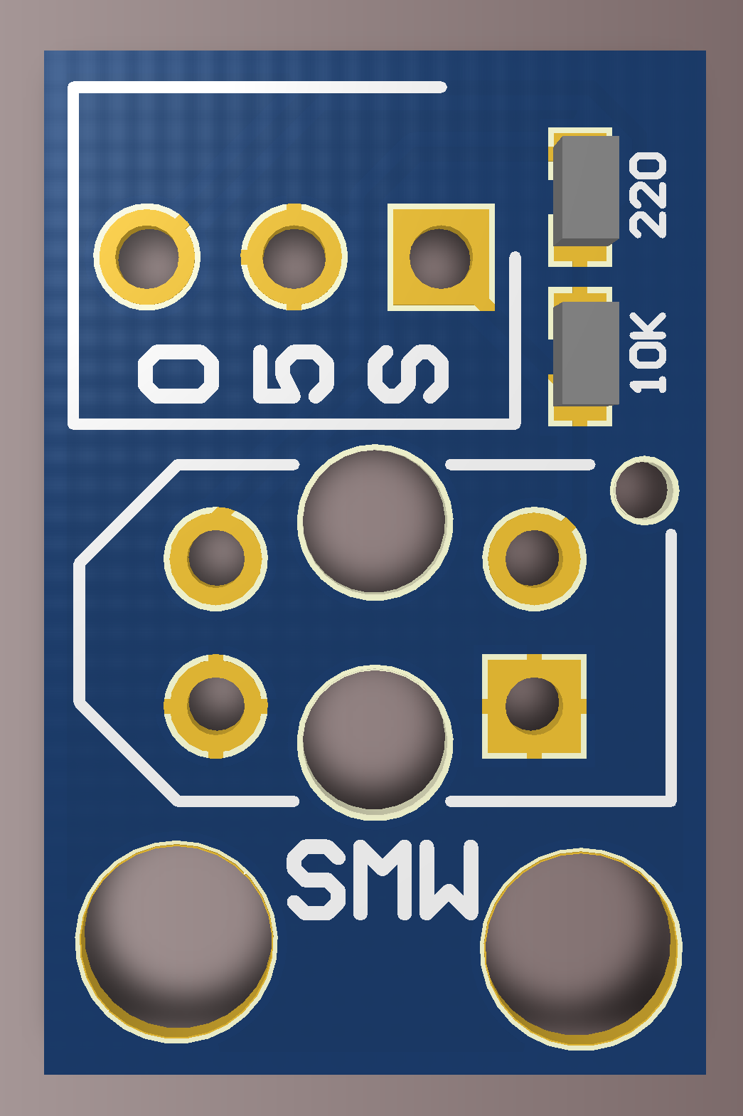
Top Layer
Bottom Layer
Top Layer Render

Slide 12
B
F
P1a
P2a
A
C
P1b
P2b
D

Slide 13
Force applied by & to Exoskeleton
Observe current state of suit
Measure suit interaction with environment (force)
Measure pilot interaction with suit (force)
Measure force applied at external contact points
Measure force applied at internal contact points
Create rigid contact points
Parse readings into useable data
Measure Force Applied
Create frame
Create Sensor Mount
Map from ADC readings to meters
Amplify Signal
Measure Force via Load Cell

Slide 14




















E+
A+
A-
E-
E+
To 5V
Sensor 1
Sensor 2
Sensor 3
Sensor 4
$$Z_{1C}$$
$$Z_{2C}$$
$$z_{3C}$$
$$Z_{4C}$$
$$Z_{1−}$$
$$Z_{1+}$$
Signal Low
Signal High
$$Z_{3−}$$
$$Z_{2+}$$
A-
A+
$$Z_{1+}$$
$$Z_{2+}$$
$$Z_{3+}$$
$$Z_{4+}$$
$$Z_{3+}$$
$$Z_{2−}$$
$$Z_{4+}$$
$$Z_{4−}$$
$$Z_{1−}$$
$$Z_{2−}$$
$$Z_{3−}$$
$$Z_{4−}$$
E-
To Ground

Slide 15
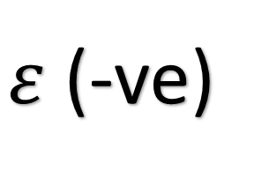

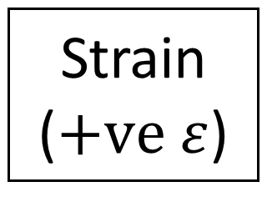
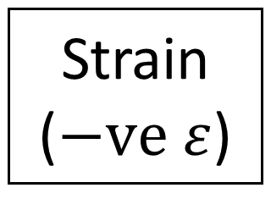
White/+
$$ε \text{(+}\text{ve}\text{)}$$
Strain ($−ve ε$)
Strain ($+ve ε$)
Red/C
$ε$(-ve)
Black/-
Red/C
White/+
Black/-

Slide 16
V+
1
16
V 10 REF
INA125
SLEEP
2
15
V 5 REF
V-
3
14
V 2.5 REF
V REF OUT
4
13
V BG REF
IA REF
5
12
V COMM REF
VIN+
6
11
SENSE
VIN-
7
10
V OUT
RG
8
9
RG

Slide 17
A
B
Top Plate
Internal Load Cells
F(int) = 1
F(ext) = 1
F(int) = 0
F(ext) = 1
Centre Plate
External Load Cells
GO
STOP

Slide 18
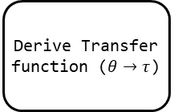
Controls & Decision Making
Determine action required
Derive required action of the suit from any given state
Develop control method based on kinematics of the suit
Tune PID Parameters
Derive Equations of Motion (EOM)
Derive Transfer function ($θ→τ$)
Laplace Transform
Derive PID parameters

Slide 19
Communications
Communicate Desired Action
Transmit Message over communications system
Receive Messages
Transmit Messages
Read values into memory (DMA)
Parse Messages
Create Messages
Read values from memory (DMA)
Create Messaging Protocol
Establish DMA

Slide 20
Address
Payload
Stop
1
2
1
> 0
1
> 0
1
M
0
4
+
1
2
.
3
4
;
Type Designator
Decimal
End Character
ID
Sign
Value

Slide 21
Actuation Systems
Demonstrate functionality of subsystems
Demonstrate functionality of distance measurement (SS1)
Demonstrate functionality of force measurement (SS2)
Demonstrate functionality of control system (SS3)
Demonstrate functionality of communication (SS4)
Demonstrate force application trigger safety stop
Demonstrate system responding appropriately to stimulus
Demonstrate messages being transmitted over UART
Demonstrate system behaviour being adjusted via comms
Show actuator position adjusting due to distance measurement
Show sensor readings adjusting actuator over UART
Adjust actuator position in response to system command

Slide 22
A
B
S
E
C
F
D

Slide 23
C
B
D
A
S

Slide 24
Actuation
Supersystem
Achieve/approach the desired position of the suit
Controls
SS5
Demonstrate functionality of subsystems / Adjust actuator position in response to system command
Observe and apply currently required change in commands
Read sensor signals
Communicate Signals to system
SS1
Observe current state of pilot/desired state of suit
Sense Relevant Locations
SS2
Observe current state of suit
SS3
Determine action required
SS4
Communicate Desired Action
Perception

Slide 25
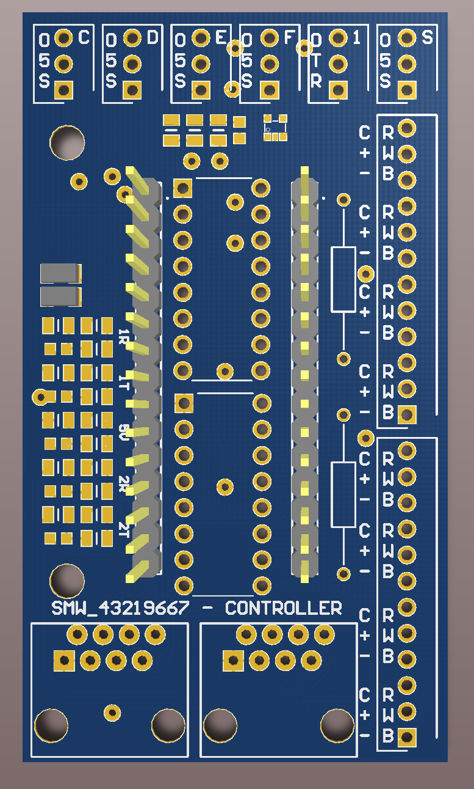
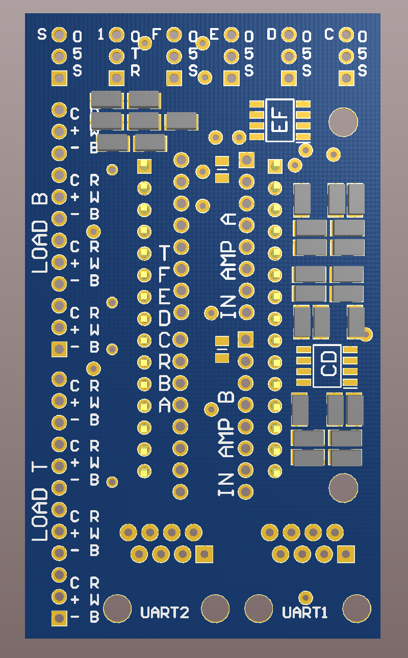
IR Header
UART Debugging Header
Servomotor Header
1
2
3
3
2
1
10
7
4
4
5
5
8
6
8
6
6
8
6
8
5
9
10
12
11
11

Slide 26
IR Header
AND Gate
Bandpass Filter
1
1
2
3
3
3

Slide 27
IR Header
AND Gate
Bandpass Filter
1
1
2
3
3
3

Slide 28
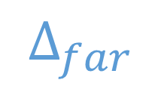

$$∆_{close}$$
$$∆_{far}$$

Slide 29
T03
T06
LT
RT
F03
Comms.
F06
C02
C06
P03
T02
T05
P06
LS
RS
P02
P05
C01
C02
C04
C05
P01
T01
T04
P04
LF
RF
F01
F04
T: Actuator Torque
C: Controller Module
F: Force Sensor
P: Position Sensor

Slide 30
Previous
Controller
Next
Controller
4x Vishay TRCT5000 IR Sensor
Previous Controller
Next Controller
Serial
[Baud 9600]
Serial
[Baud 9600]
UART [Baud 9600]
UART [Baud 9600]
Signal (P1..P4) 0-5V
RX(PA3), TX(PA2)
RX(PA10), TX(PA9)
RX(PA3), TX(PA2)
RX(PA10),TX(PA9)
UART [Baud 9600]
UART [Baud 9600]
Serial
[Baud 9600]
Serial
[Baud 9600]
LM358AD Op Amp x2
UART1
UART2
Messages [ASCII]
UART1
UART2
Messages [ASCII]
Proximity (P1..P4)
0-5V
DMA
Messages [ASCII]
Messages [ASCII]
Messages [ASCII]
Control & Status
Memory
DMA
Messages [ASCII]
Messages [ASCII]
PA4..PA7
Proximity
(P1..P4)
PA4..PA7
Control & Status
Memory
Proximity
(P1..P4)
Messages [ASCII]
Proximity (P1..P4) 0-5V
System State
LM358AD Op Amp x2
NUCLEO-F303K8 Controller Software
Load (Top, Bottom)
Control Routines
PA0, PA1
Signal (P1..P4) 0-5V
Control
Load (Top, Bottom)
Load (Top, Bottom) 0-5V
Timer 3 Channel 1
4x Vishay TRCT5000 IR Sensor
PWM Interface
50kHz
2x INA125PA
Instrumentation Amp
Load (T1..T4, B1..B4)
Digital Control
Load (Top, Bottom) 0-5V
Port A Pin 0,1
8x YZC-161B
50kg Load Cell
Port B Pin 4
PXY = GPIO Port X Pin Y
Voltage 50kHz
INA125PA
In. Amp
Servomotor Control
Power 50kHz
Load (T1..T4, B1..B4)
YZC-161B
50kg Load Cell
Servomotor

Slide 31
