Slide 1
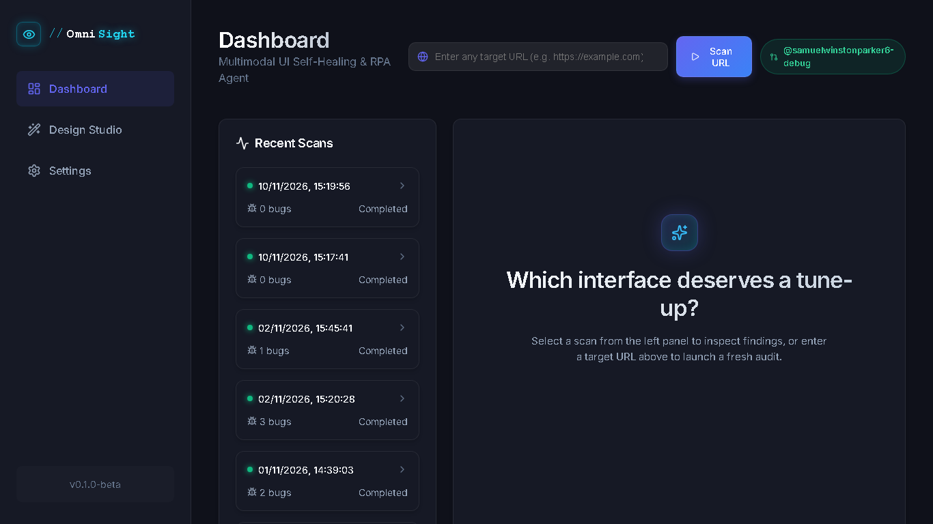
INFOTACT SOLUTIONS • GEN AI (VOL. II)
OmniSight
Multimodal UI Self-Healing & Autonomous RPA Agent
Presented By: Prajwal Sam Jaggili
Role: Associate L1 Intern (Generative AI)
Intern ID: ITS/GAI/1063
Duration: Week 1 – Week 4 Project Delivery
Live OmniSight Dashboard (Playwright + Gemini Vision + React)

Slide 2
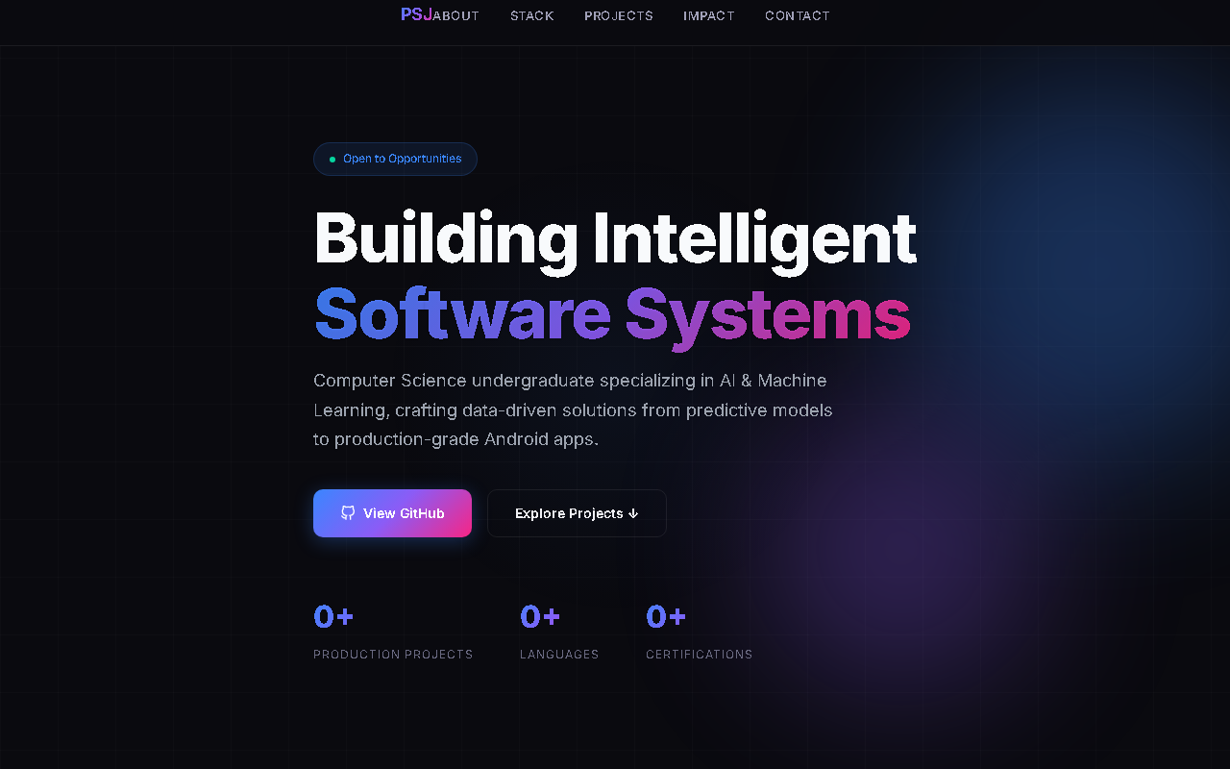
01
Problem Statement
OmniSight • Infotact
Why traditional UI testing fails to guarantee visual quality
Core Challenges in Existing UI QA Workflows
▸ Brittle DOM Selectors: Tools like Selenium and Cypress depend on hardcoded class names or XPaths; any small UI refactor breaks tests.
▸ Blind to Visual Correctness: Traditional scripts only check DOM existence—they pass even when buttons clip off mobile screens or text overlaps.
▸ Poor Color & Contrast Detection: Invisible text (white-on-light) or low WCAG contrast violations routinely slip into staging undetected.
▸ Cross-Viewport Blind Spots: Layouts that look fine on Desktop (1920px) often break on Tablet (768px) and Mobile (375px).
▸ Slow Manual Fix Cycle: Even after QA reports a bug, developers must manually inspect, write CSS fixes, test across devices, and open a PR.
Real Defect Example: Navbar overlap ('PSJABOUT') & broken counter stats caught visually
The Gap OmniSight Solves
Selectors test structure, NOT appearance. Modern CI/CD needs an AI agent that literally sees the rendered pixels like a human tester and repairs defects automatically.
Infotact Solutions • Generative AI Internship (Vol. II) | Slide 1 • Problem Statement

Slide 3
02
What is OmniSight & Objectives
OmniSight • Infotact
Autonomous Multimodal UI Self-Healing & RPA Platform
What is OmniSight?
OmniSight is an autonomous QA & Robotic Process Automation (RPA) agent powered by Vision-Language Models (Google Gemini). It renders live websites across Desktop, Tablet, and Mobile, detects visual UI defects without brittle selectors, writes surgical Tailwind/CSS fixes, verifies repairs in-browser, and raises ready-to-merge GitHub PRs.
Key Project Objectives
▸ Zero-Selector Vision QA: Replace fragile DOM paths with Gemini multimodal pixel + HTML reasoning.
▸ Multi-Viewport Auditing: Simultaneously verify Desktop (1920px), Tablet (768px), and Mobile (375px) layouts.
▸ Autonomous Self-Healing: Generate clean CSS/Tailwind patches validated through AST parsing and live DOM re-checks.
▸ One-Click GitHub Delivery: Automatically branch, commit fixes, and open Pull Requests with Before/After proof.
▸ Human-in-the-Loop Control: Provide a sleek React dashboard for QA review, manual edits, and Design Studio restyling.
OmniSight Executive Dashboard — Recent Scans & Dynamic AI Welcome Stage
Infotact Solutions • Generative AI Internship (Vol. II) | Slide 2 • Concept & Objectives

Slide 4
03
System Architecture, Main Organs & Week 1–2 Plan
OmniSight • Infotact
Core building blocks & Infotact Solutions initial milestone delivery
Main Organs (Core Modules) & Requirements
Week 1 — Foundation & Automation (Infotact Plan)
1. Eyes — Headless Navigator (Playwright + Python)
Renders target URLs across 3 viewports, simulates checkout/user flows, and injects live test CSS.
▸ Browser Automation: Built Python Playwright script to navigate mock e-commerce flows and capture responsive multi-viewport screenshots.
▸ API Scaffolding: Created FastAPI server acting as a webhook receiver for simulated CI/CD build events & scan triggers.
▸ Run Persistence: Configured SQLite + SQLAlchemy models to track scan status, bug reports, and artifacts.
2. Brain — VLM Engine (Google Gemini Vision)
Inspects screenshots alongside DOM HTML/CSS in a unified pass to spot visual bugs & bounding boxes.
3. Nervous System — Agent Orchestrator (LangChain)
Runs the Plan → Execute → Verify self-healing loop and filters CSS via tinycss2 AST safety.
Week 2 — Multimodal VLM & Action Engine (+ Mid Review)
▸ Multimodal Prompting: Integrated Gemini Vision; engineered prompts combining screenshots and HTML/CSS to spot overlaps & contrast bugs.
▸ Action Engine: Built Python parser to extract clean JSON defect lists and executable Tailwind/CSS patches.
▸ Mid-Project Review: Proven vision audit on deliberate hidden-button & overflow bugs plus verified code extraction.
4. Hands & Memory — FastAPI, SQLite & PyGithub
Serves REST/webhook APIs, logs run history, powers the React UI, and creates automated GitHub PRs.
System Requirements: Python 3.10+ • Node.js 18+ (React + Vite) • Playwright Chromium • SQLite • Gemini API Key & GitHub PAT
Infotact Solutions • Generative AI Internship (Vol. II) | Slide 3 • Organs, Requirements & Weeks 1–2

Slide 5
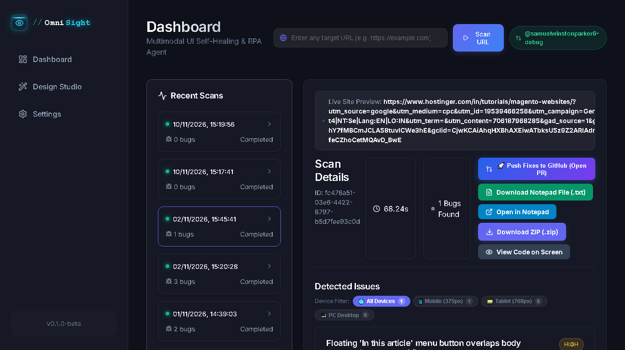
04
Step-by-Step Working (Week 3 Details)
OmniSight • Infotact
End-to-end Self-Healing Agentic Loop & Automated GitHub PR Delivery
STEP 1
STEP 2
STEP 3
STEP 4
STEP 5
Capture
Playwright visits URL on Desktop, Tablet & Mobile
Vision Audit
Gemini inspects images + HTML to flag UI bugs
Code Fixer
Synthesizes Tailwind & AST-safe CSS overrides
Self-Heal Loop
Injects CSS in live DOM & re-verifies (Week 3)
GitHub PR
PyGithub branches, commits & opens PR (Week 3)
Week 3 Key Deliverables: Self-Healing & GitHub
▸ In-Memory DOM CSS Injection: Applies generated fixes directly inside Playwright's live browser DOM without corrupting local source files first.
▸ Visual Re-Verification Loop: Captures post-fix screenshot and asks Gemini: 'Is the bug resolved with zero new layout regressions?' (retries up to 2×).
▸ tinycss2 AST Safety Gate: Strips forbidden blanket tags (*, body, html) so patches remain surgical and non-destructive.
▸ PyGithub Pull Request Engine: Creates a new branch, commits patched code + FIXES_REPORT.md, and opens a PR with visual proof.
▸ Direct Export Options: Users can push a GitHub PR, sync merged PR status, or download fixes as .txt (Notepad) / .zip.
Live OmniSight Output: Scan Metrics, GitHub PR Submission & Notepad/ZIP Fix Downloads
Infotact Solutions • Generative AI Internship (Vol. II) | Slide 4 • Working Pipeline (Week 3)

Slide 6
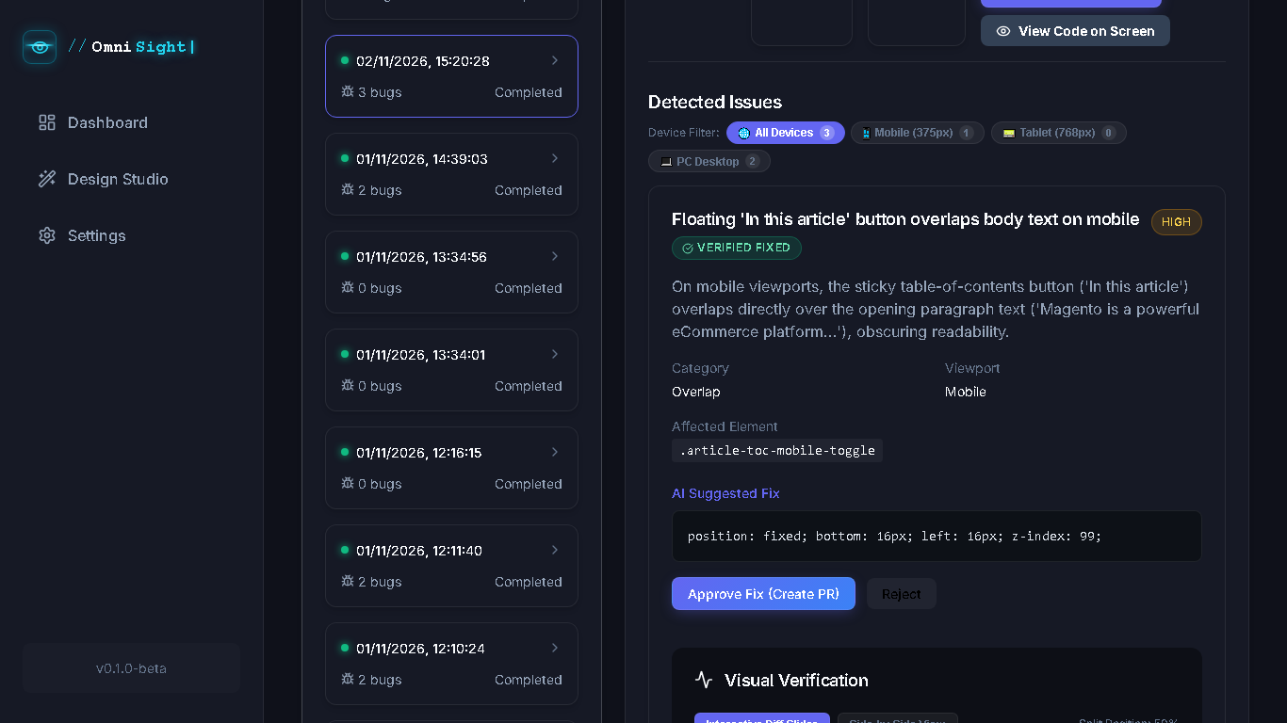
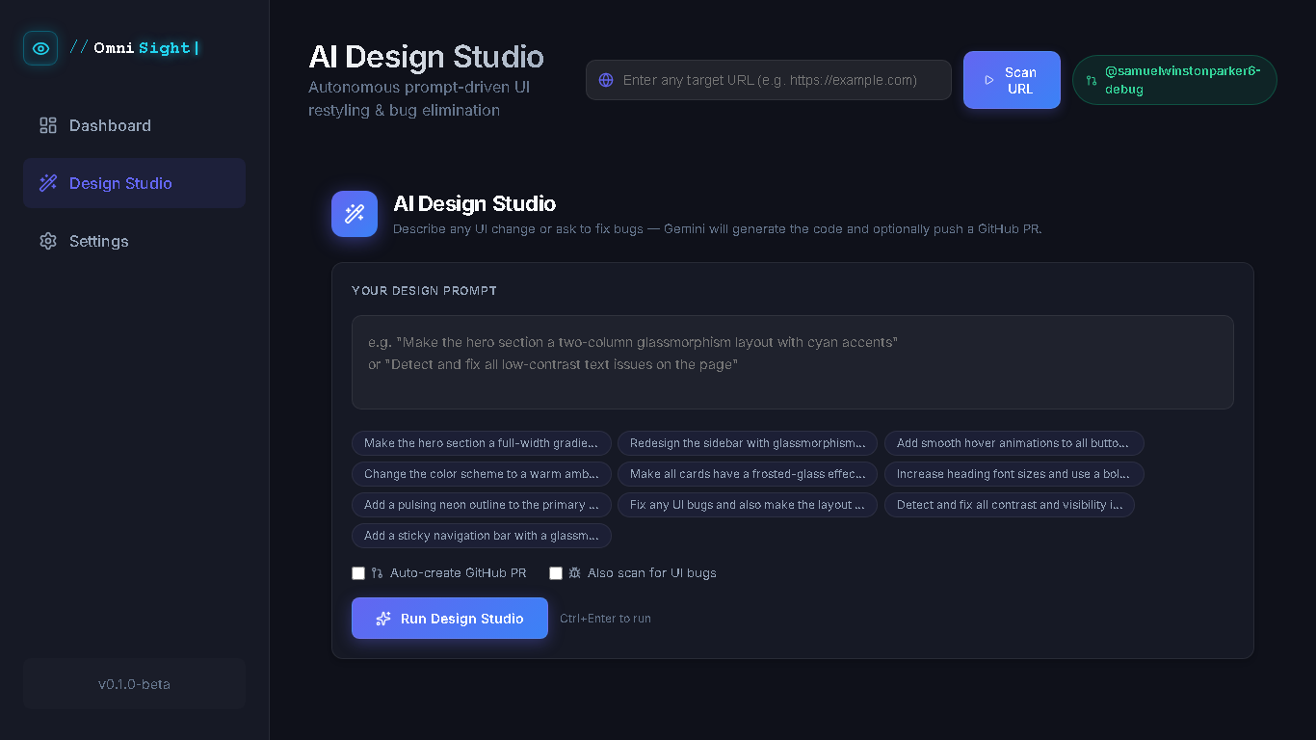
05
Results & Extra Features (Week 4)
OmniSight • Infotact
Week 4 token optimizations, empirical benchmark & bonus studio capabilities
Week 4 Optimization & Ground-Truth Results
100%
Precision & Recall
(8/8 GT Bugs)
1.000
F1-Score &
Heal Rate
8.42s
Unified VLM
Turnaround
100%
AST-Safe
CSS Patches
▸ Image Chunking (Week 4): Splits pages into Header/Content/Footer regions to save tokens and boost bounding-box IoU to 94.8%.
▸ Single-Pass Strategy: Merged viewports into one VLM call, cutting latency from ~90s down to ~8.4s.
Detected Issue Card + Verified CSS Fix + Visual Diff Controls
Extra Features Built Beyond Core Scope
▸ AI Design Studio: Prompt-driven UI restyling (e.g., glassmorphism, typography) combined with automatic bug fixing in one PR.
▸ Interactive Diff Slider: Side-by-side & draggable Before/After slider with red bounding-box overlays on defective elements.
▸ Live Site Preview & Notepad Export: Embedded cache-busted site preview + one-click .txt (Notepad) and .zip patch downloads.
▸ Settings Console & Dynamic UX: Switch VLM models (Gemini 2.5/3.8 Flash, 1.5 Pro, GPT-4o), Dark/Light theme, & shuffled AI greetings.
Extra Feature: AI Design Studio (Prompt-Based UI Restyling & Bug Fix)
Infotact Solutions • Generative AI Internship (Vol. II) | Slide 5 • Results & Extra Features (Week 4)

Slide 7
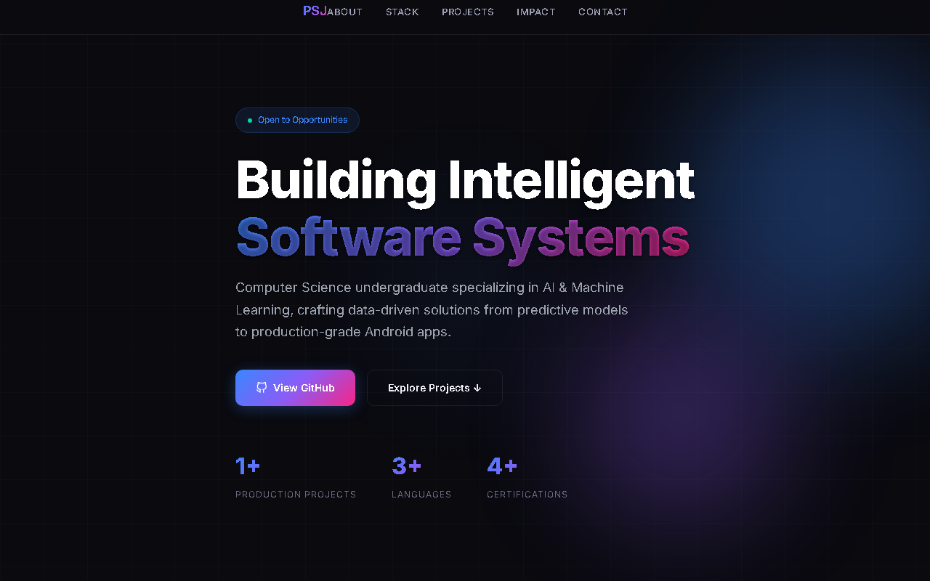
06
Overall Conclusion & Purpose of OmniSight
OmniSight • Infotact
Impact, key takeaways & future potential of autonomous visual QA
Core Purpose of OmniSight
To transform front-end QA from brittle, manual pixel-checking into an autonomous, self-healing workflow—bridging Multimodal AI visual reasoning directly with real software engineering delivery (GitHub PRs).
Overall Project Conclusion
▸ Full Pipeline Validated: Successfully unified Playwright, Gemini Vision, LangChain, FastAPI, React, and PyGithub across all 4 weeks.
▸ High Reliability: Achieved 100% defect detection on ground-truth tests with AST-verified, regression-free CSS repairs.
▸ Developer Time Saved: Eliminates hours of manual responsive debugging across Desktop, Tablet, and Mobile viewports.
▸ Production-Ready UX: Delivers a complete dashboard with PR automation, Design Studio, and dynamic model configuration.
Verified Self-Healed Output: Clean Stats & Responsive Polish
Thank You!
Questions & Live Interactive Demo Ready — OmniSight
Infotact Solutions • Generative AI Internship (Vol. II) | Slide 6 • Conclusion & Purpose

