Slide 1
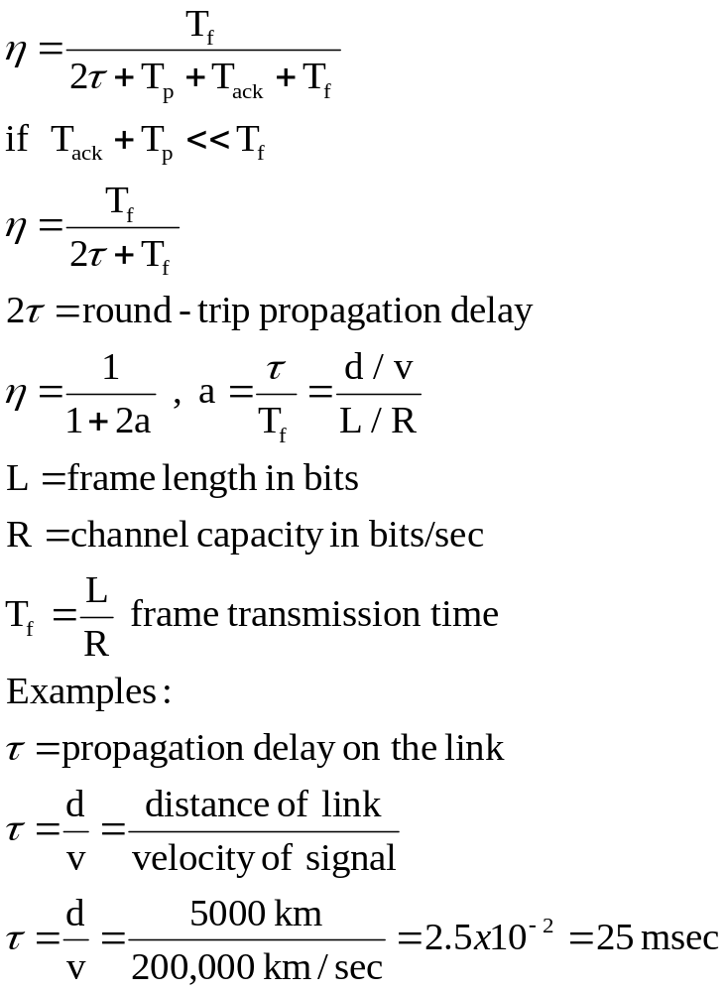
Throughput ( efficiency ) analysis of D.L. Protocols
I. STOP-AND-WAIT
a) No bit error case:
A
B
distance d
τ
Tf
Tp Tack}τ
Tf +
2τ +
Tp + Tack
τ

Slide 2
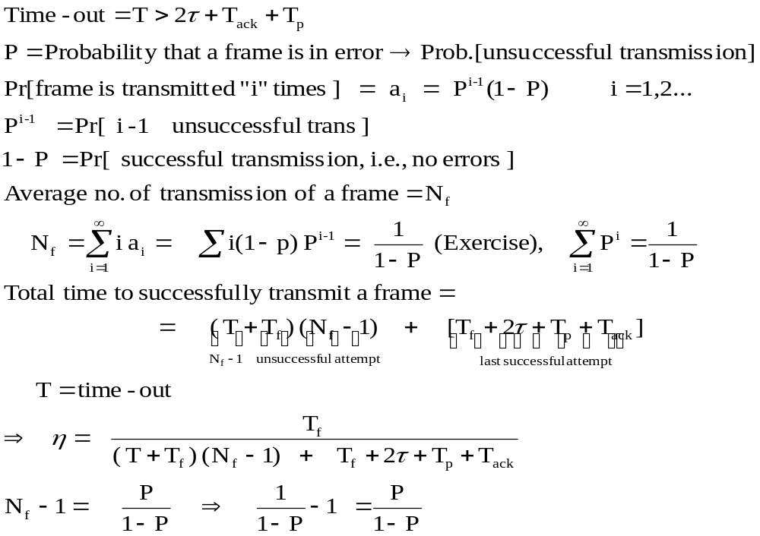
b) Case of bit error ( noisy channel )

Slide 3
Tf
Tf +
T
(Nf – 1)unsuccessful transmission
Tf
Tf +
T
τ
Tf
Tp Tack}τ
Tf +
2τ +
Tp + Tack
τ

Slide 4
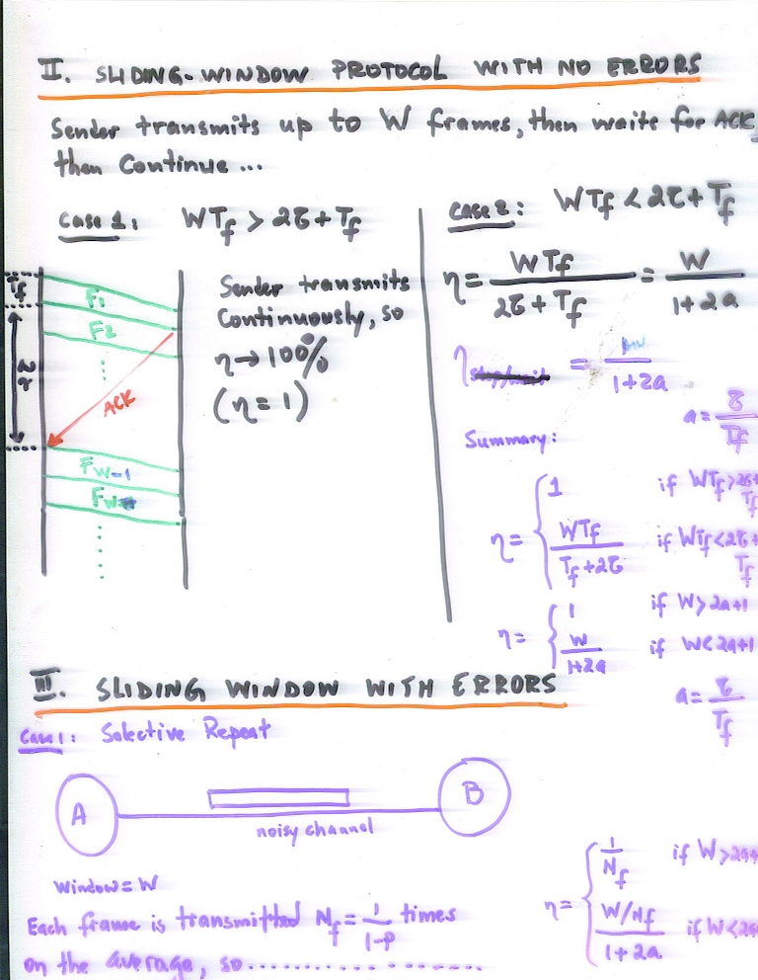
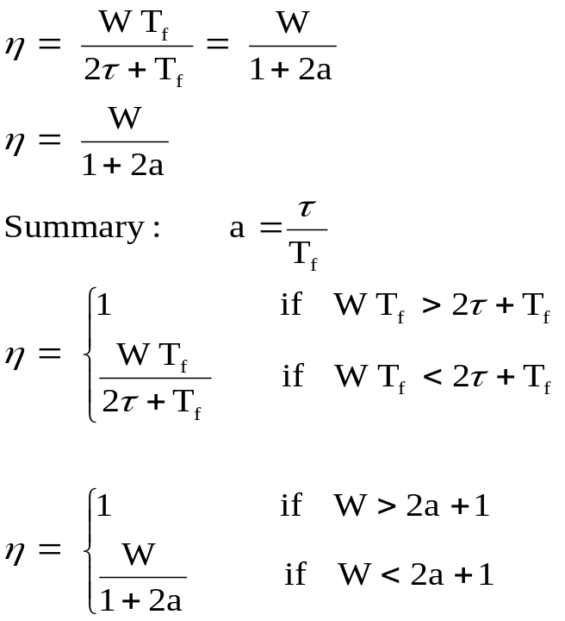
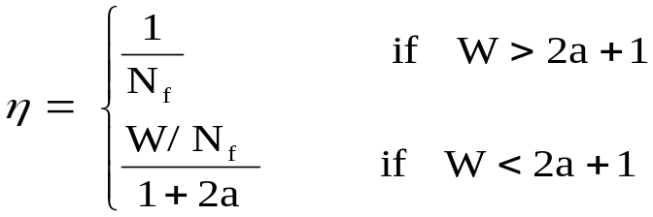
II. SLIDING WINDOW PROTOCOL WITH NO ERRORS
Sender transmits up to W frames, then waits for ACK, then continue….
Case 1: W T_{f} > 2τ+ T_{f} Case 2: W T_{f} < 2τ+ T_{f}
Sender transmits
Continuously, so
→ 100%
(η=1)
T_{f}
F₁
F₂
2τ
ACK
Fw -1
Fw
SLIDING WINDOW PROTOCOL WITH ERRORS
Case 1 : Selective Repeat
A
B
Window = W
Each frame is transmitted N_{f} =1 / 1-P times on the average , so……
Noisy channel

Slide 5
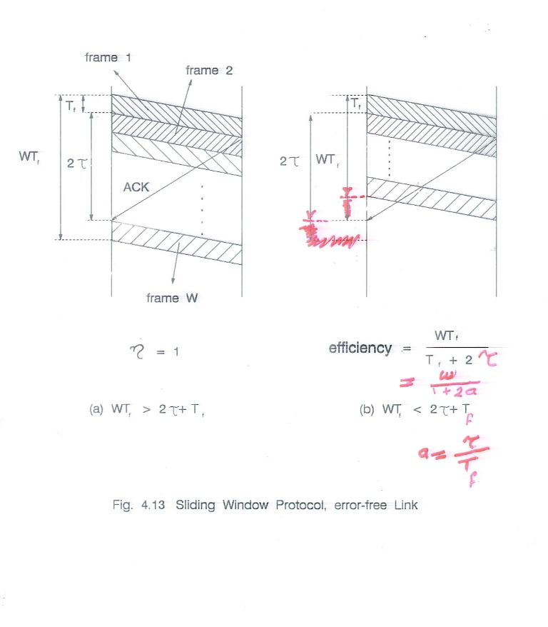
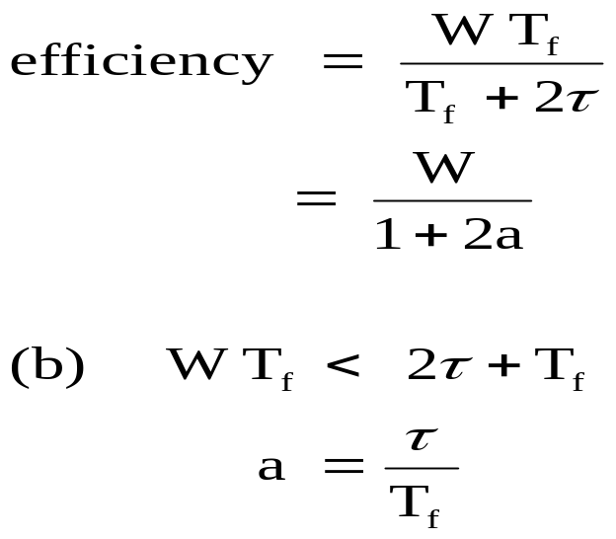
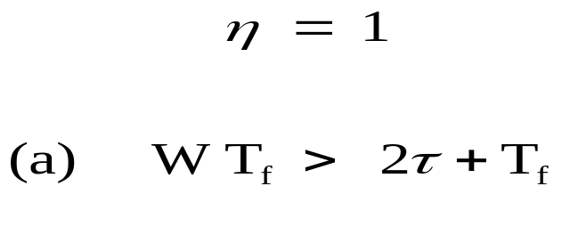
Fig. 4.13 Sliding Window Protocol, error-free Link

Slide 6
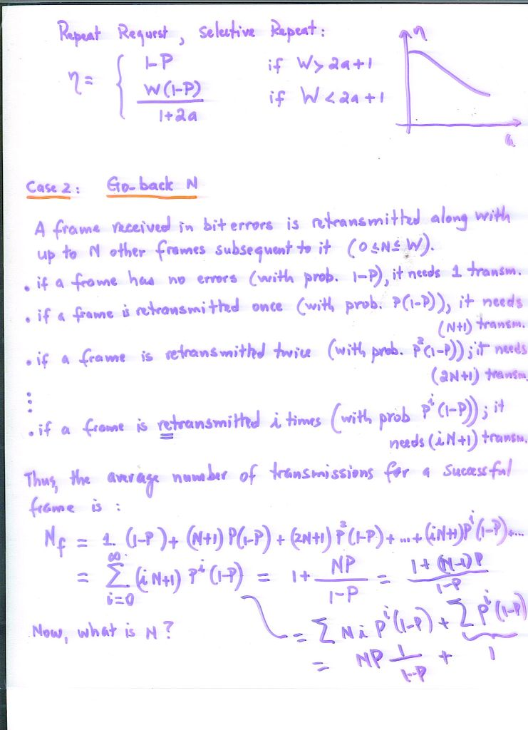
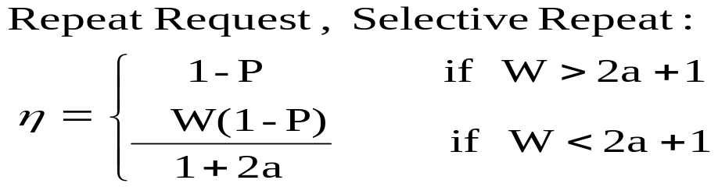

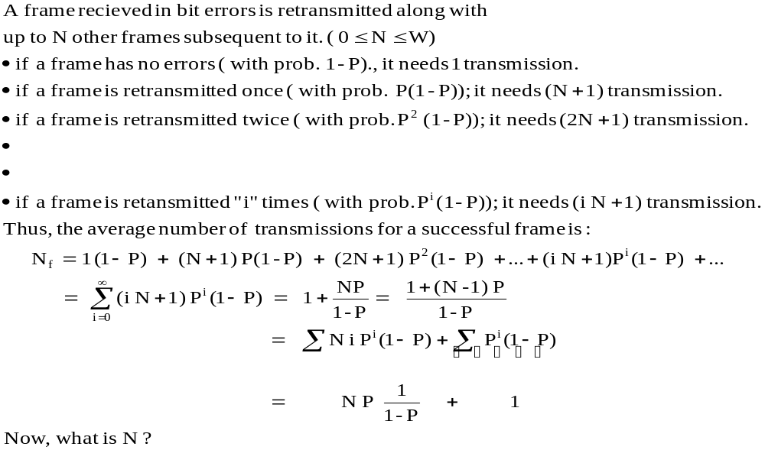
Case 2 : Go-back N
a

Slide 7
