Slide 1
Routing in Packet Switched Networks
- The Routing Function
    Virtual Circuit and Datagram Routing
    A Typical switching Node
    Determining the “Best” Path
    A Classification of Routing Procedures
- Shortest Path Routing Procedures
    Centralized Procedures
      Shortest Forward Path Tree
      Shortest Backward Path Tree
    Distributed Procedures
      A Distributed Inter-nodal Distance Exchange Procedure
      A Distributed Link State Exchange Procedure
- Hierarchical Routing
- Table-Free Routing
- Multi-Destination Routing
- Problems

Slide 2
Two Major Types of Network Service:
1- Datagram
Each datagram is delivered independent
of the other.
2- Virtual Circuit
The network maintains the order of packet
delivery to match the order of packet entry.

Slide 3
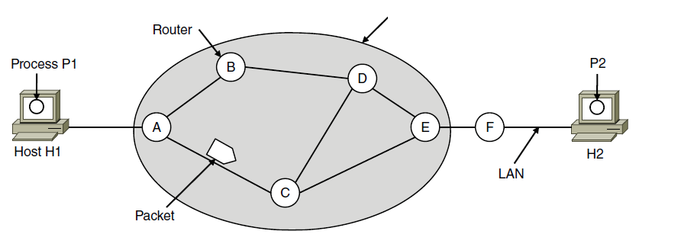
Store-and-Forward Packet Switching
ISP’s equipment
The environment of the network layer protocols.

Slide 4
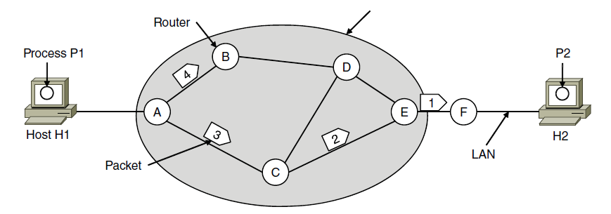
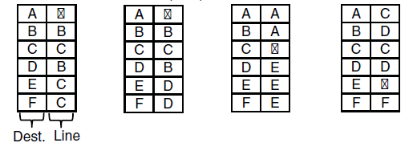
Implementation of Connectionless Service
ISP’s equipment
A’s table (initially) A’s table (later) C’s Table E’s Table
Routing within a datagram network

Slide 5
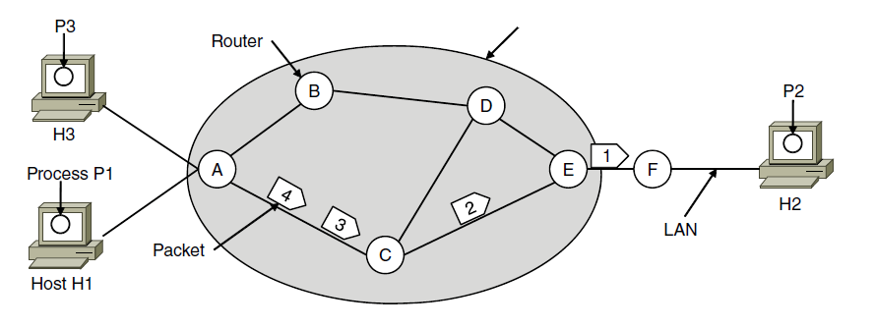

Implementation of Connection-Oriented Service
ISP’s equipment
A’s table C’s Table E’s Table
Routing within a virtual-circuit network

Slide 6
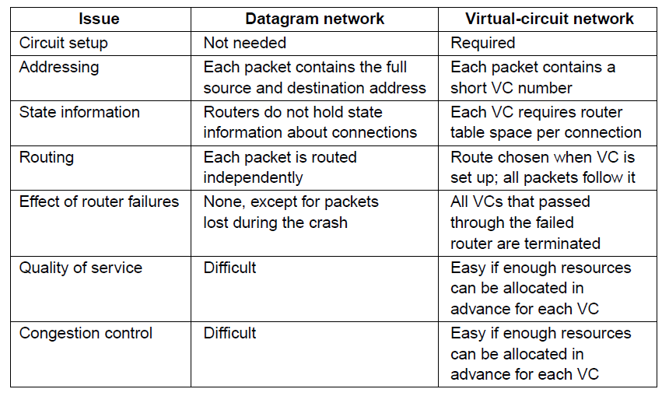
Comparison of datagram and virtual-circuit networks

Slide 7
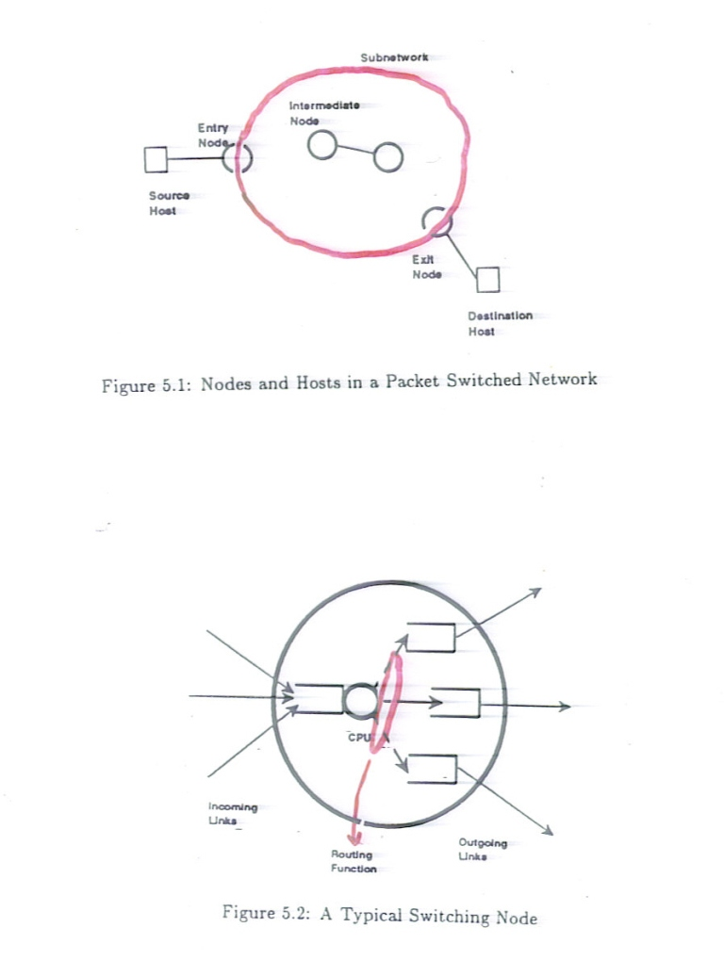

Slide 8
ROUTING ALGORITHM
Routing Protocol: Is an algorithm that provides the best collection of paths (paths of minimum delay) between source and destination, given the traffic requirements and the network configuration.

Slide 9
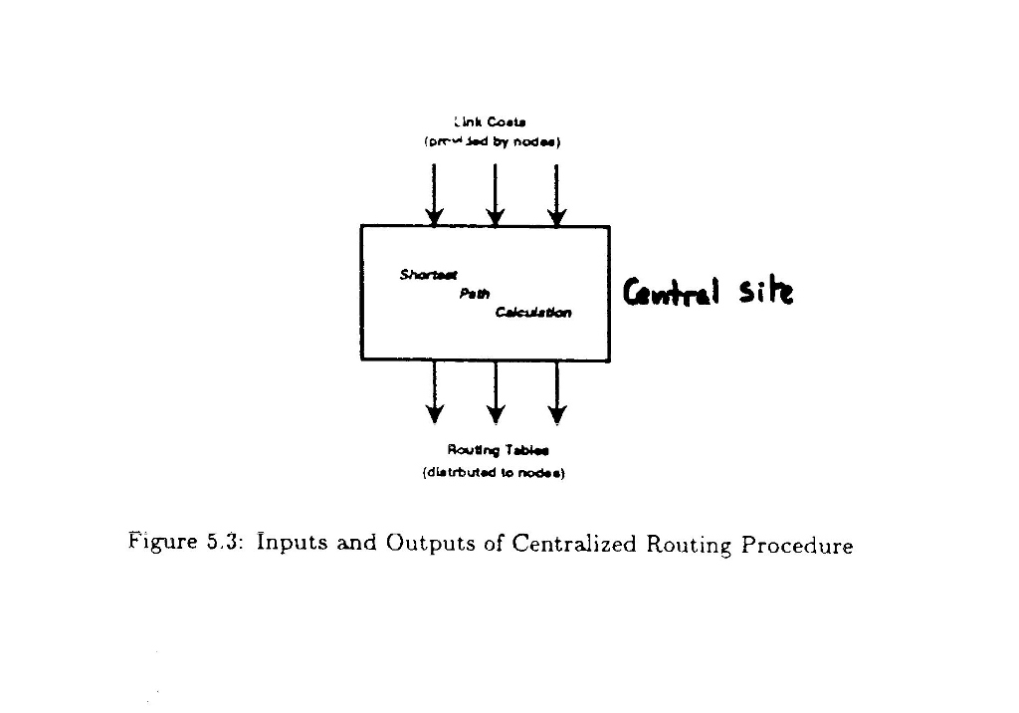

Slide 10
Centralized -versus- Distributed Routing
Centralized Routing
- Decision is carried by Network Control Center (NCC).
  NCC has complete Knowledge → better decision
  Computations are done by NCC and not by the node
Disadvantages: 1- Control traffic travels to NCC
2- Vulnerability of NCC
3- Time lag for every node
Isolated or Distributed Routing
Hot Potato (Shortest Queue)
May lead to Looping
Combination of Static Routing & hot Potato: based on static weighting of the line and Q length

Slide 11
Static versus Adaptive Routing
Static Routing is used when; - Network topology is not subject to
changes.
- Traffic inputs are stationary.
Good in initial stage of network design.
Routing Table Representation
1
1
.
.
.
1 2 ……….j…………Aj
i
ρi (k,j)
i
j
k
j
k
1
2
.
.
.
K
.
.
N
Multi-Path Routing
.
.
.
N; Total number of nodes in network
Ai; Number of neighbors of node k
Ai
ρi (k,1) ……ρi (k,j)
For single Path
Ρπ (k,j) =
1 ; j=jπk
0 ; j҂jπk
{Ρi (k,j)} N*Ai
Ρi (k,j); Fraction of Traffic directed to k from i through neighbor j

Slide 12
Shortest Path Algorithm
Dijkastra
Global Knowledge
Shortest Forward Path Tree
Link State Routing
Find shortest path from a single source node to all other nodes.
Cυω ; Cost (length) of a link from node υ to node ω.
Cυυ = 0, Cυω = ∞ i.e. the link doesn't exist
N; Set of shortest paths to the k nodes closest to the source.
Csω ; Distance from the source to node ω along the shortest path restricted to nodes within N.
Procedures: s=1
1) Set N={1} ; source node. For every node υ not in N, Set Csυ = csυ

Slide 13
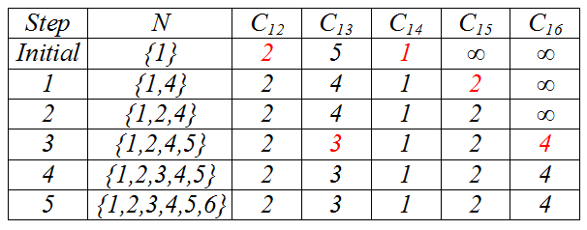
2-) Find a node ω , not in N, such that Csω is minimum.
- Add ω to N
- Update Csv for the remaining nodes not in N by computing
Csv ← min [Csv , Csω + Cωv]
5
2
3
3
5
2
1
2
3
1
6
1
4
1
5
2
2
2
2
2
4
4

Slide 14
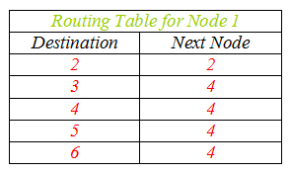
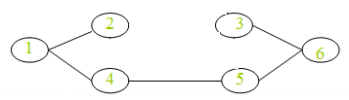

Slide 15
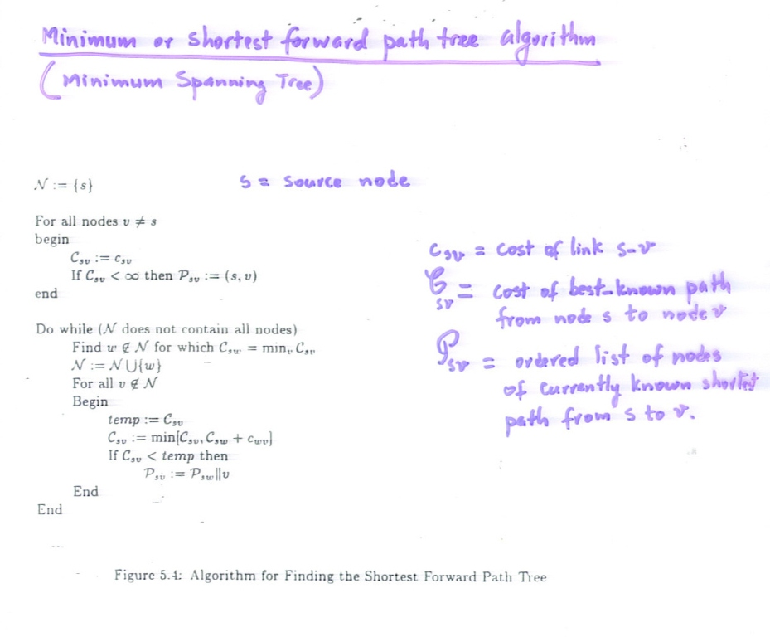

Slide 16
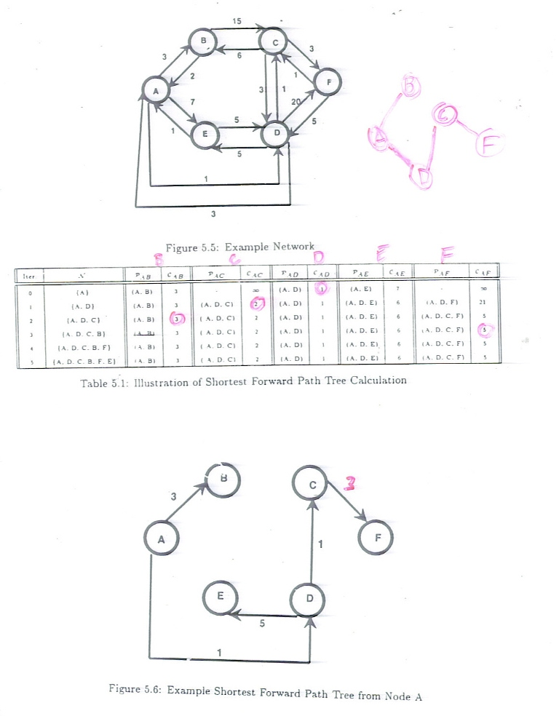

Slide 18
B) Fulkerson (Shortest Backward Path Tree) / Distance – Vector Algorithm
Label each node v with a pair (nvd, evd );
evd ; current iterate for the shortest distance from node v to the
destination node d.
nvd; # of next node along the currently computed shortest path.
Procedures
1- Set Cost of node d = 0, Label all other nodes (. , +∞)
2- Update Cvd ; Compute Cvd ← min (Cvw + Cwd )
- Update the label; replace n with # of adjacent node which
minimize the above.
- Algorithm terminates when no further changes.

Slide 19
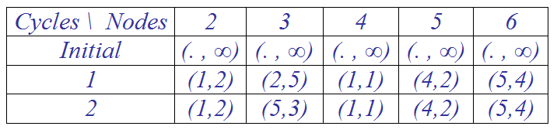
Same Example (now for Distance Vector, Ferkuson algorithm);
d = 1
2
3
3
5
2
1
2
3
1
6
1
4
1
5
2
2
2
3
3
1
6
4
5
4
1
2

Slide 20
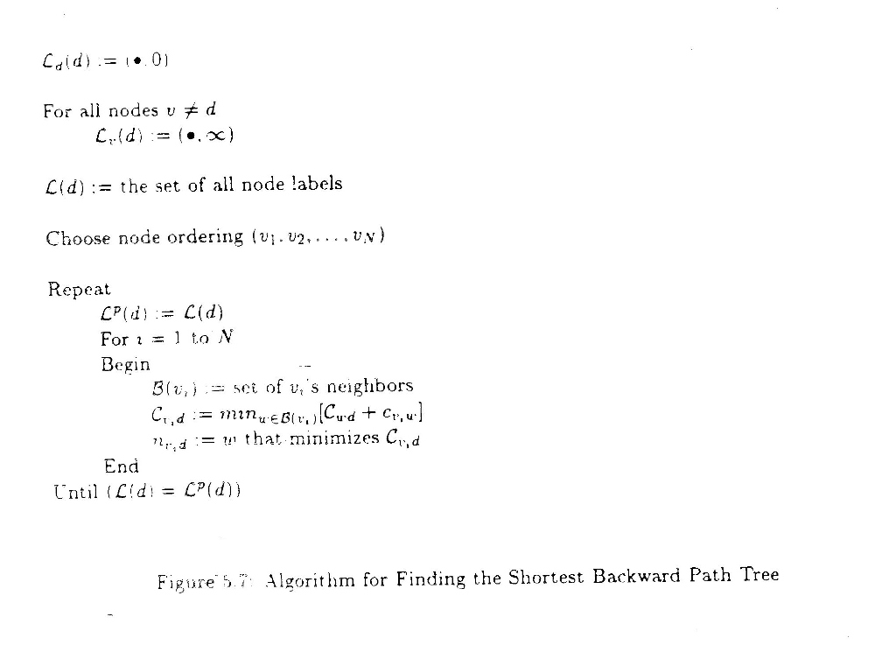

Slide 21
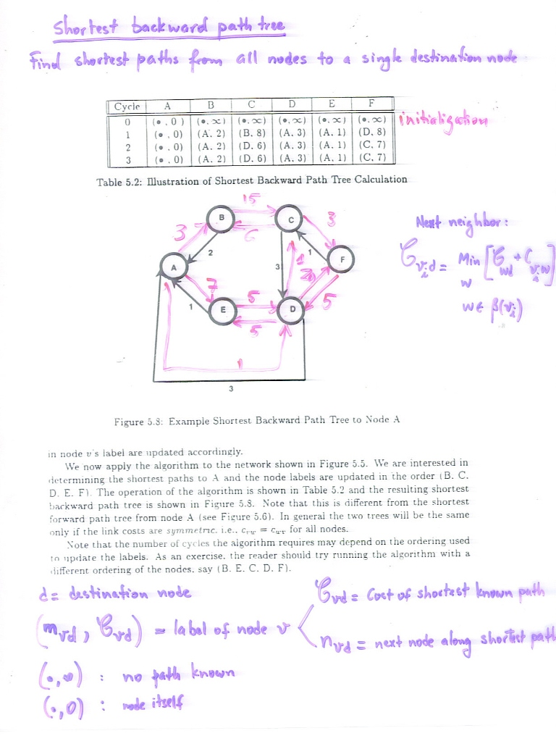

Slide 22
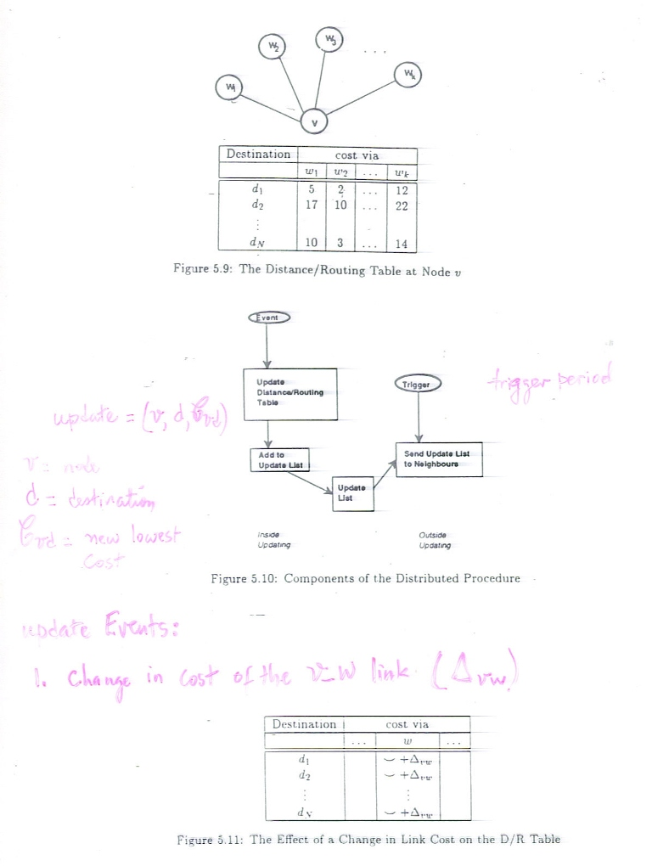

Slide 24
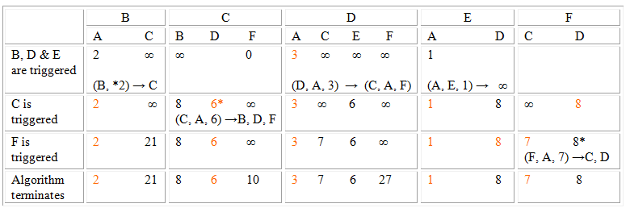
C, E, F
D
The algorithm terminates
B
C
F
A
E
D

Slide 25


Assume that D detects an increase of delay 7 on DA, D updates its D/R Table.
Assume delay on DE changes from 5 to 7
B
C
Looping
A
D
F
E

Slide 26
Outside trigger results in; D sends message (D, A, 7) to C, E, and F.
B
C
F
A
E
D
C sends (C, A, 8) to B, D, and F
D sends (D, A, 8) to E, C, and F and F sends (F, A, 9) to D and C
B
C
A
F
E
D

Slide 27
Advantages of Distance Vector routing;
It eventually converges. Time needed to converge is fuction of the outside trigger policy, detection time, transmit process
Loops may develop
Overhead

Slide 28
ROUTING ENHANCEMENT
Originally, Adaptive Shortest Path routing algorithm, distributed.
- Based on local information (Algorithm B).
- Updates every 128 msec long, high priority packets.
Measured delays were determined by Queue length.

Slide 29
New Distributed Adaptive Routing
.
1- Routing Calculation
2- A mechanism for measuring delay
3- Scheme for propagating information
4- Routing table implementation
1- Routing Calculation
An incremental calculation rather than a complete re-calculation of all shortest path; (Modifications to Dijkastra’s algorithm, A global information).
1- Case of an increase of delay on line AB by X sec:
1- Identify nodes in B’s sub-tree and increase and increase their delays from I (root node), by X.
2- For each node S in the sub-tree, find the possible shortest path

Slide 30
If line AB not in the tree, check to see if B can take advantage of their delay increase.
2- Case of decrease of delay on line AB by X sec:
1- Identify the nodes in the sub-tree and decrease their distance
from I by X.
2- Find shorter distance for each node K not in the sub-tree but
neighbor to a sub-tree node.

Slide 31
EXAMPLE
3
2
2
1 + 5
4
7
1
3
2
1
5 - 3
3
6
4
3
3
5
2
4

Slide 32
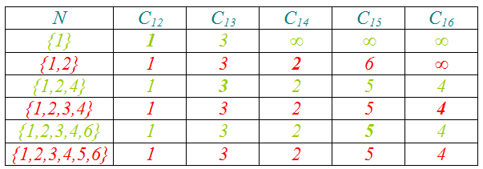
1
1
1
2
3
2
3
2
3
A
5
Modified Tree / with additional decrease in line 2-5
4
Shortest Path Tree
5
B
4
6
4
6
5
6
Shortest Path Tree after length of line 2→4 increased to 6.

Slide 33
2- DELAY MEASUREMENT
    Time Stamp
    - The arrival time
    - The sent time
    - In case of re-transmission, write the new sent time.
    Upon receiving an ACK, calculate
    Packet Delay = (Sent time – Arrival time) + Propagation time
    + Packet’s Transmission time
    Average all packet delays every 10 sec (Trade off between Longer and shorter measurement periods)
    Measurement periods are randomized
    Transmits the update if it exceeds a threshold

Slide 34
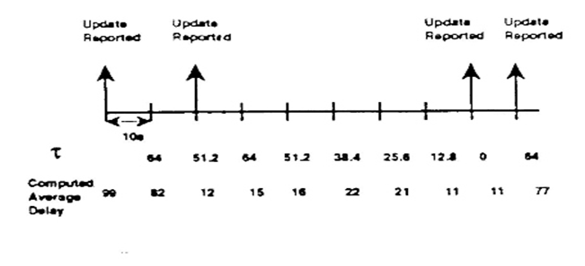
| Last Reported Link Cost – Recently computed Link Lost | > τ

Slide 35
3- Updating Policy
1- High Efficiency Total Overhead ≈ 1%
2- High Reliability Flooding technique
..

Slide 36
Hierarchical Routing
D/R table requires 2 resources;
  Storage for table
  Processing power for calculations & lookup tables
Hierarchical routing requires less table routing sizes (however on the expense of longer paths thru the network): Divide nodes into levels of clusters (domains);
First level cluster, second level clusters,….mth level clusters
With clustering, table enetries are Log₂ N (N is the # of nodes in the network)
Criteria: Nodes in the same level cluster are reachable from each other.
Example: 17 Nodes network (see Figure),
Source at node 1.1.1 to destination node 3.2.2
Hierarchical routing results in smaller tables, yet it may use longer paths in the network.
Trade off between large tables and longer paths

Slide 37
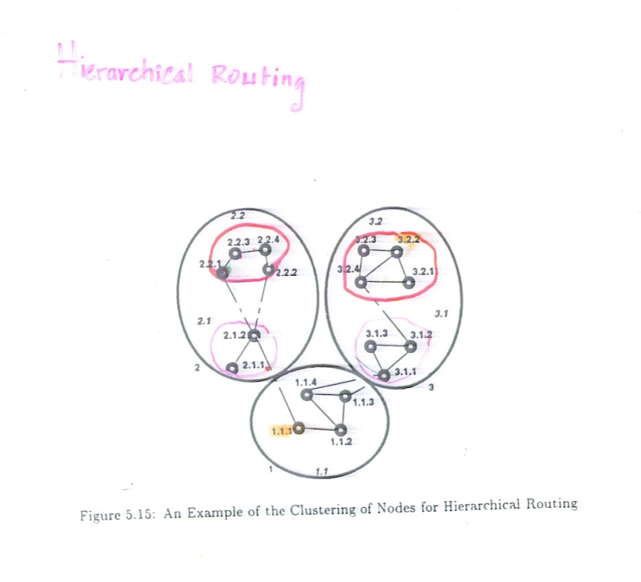

Slide 38
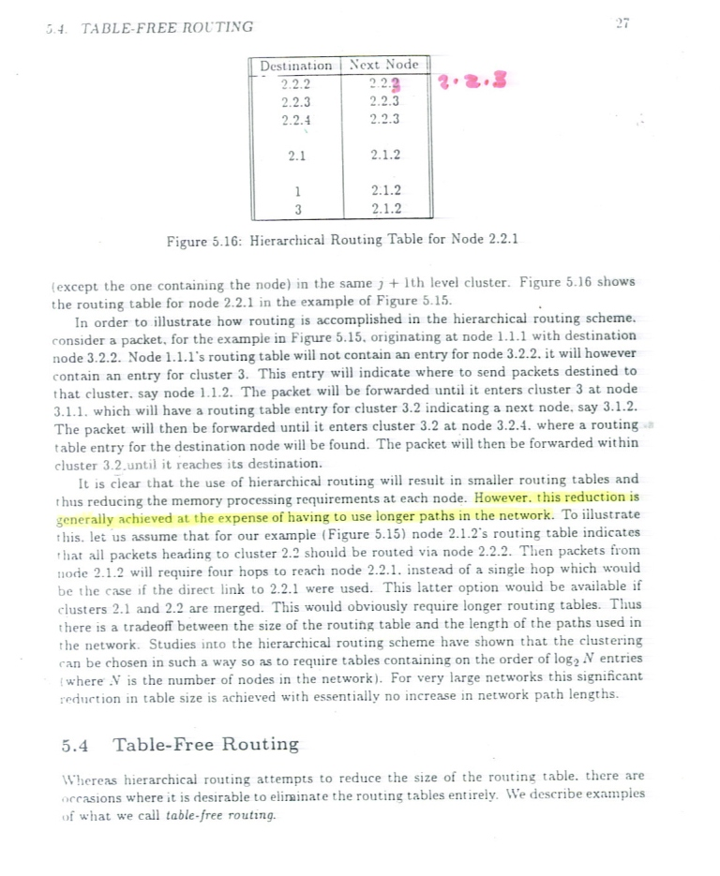

Slide 39
Table Free Routing
Random Routing:
Sends packet randomly…Leads to longer routes, loops, however it’s robust
Improvements: maintain routing tales only for neighbors or K-hops away…..More than K hops, use random routing
2) Source Routing:
Source determines the packet’s path thru the network (and specifies the path in the packet header)
Path specifications: Source, X1, X2, X3, ….Xk,…, Destination

Slide 40
Source Routing (continued)
How Source can find out the path?:
1) Path Server
(Path server receives information about the state of the network links and computes the shortest path.. However server is vulnerable to failures
2) Path Discovery Packet (PDP), (using controlled flooding)
Two important issues;
Which path the destination chooses:
  Use first packet arrived (it indicates shortest path
  Wait for a time window and then choose the best (could be minimum number of hops
B)How often the source should do PDP
  Best path may change over time
  Connection-oriented: Do that at every new connection establishment
  Connectionless: Compromise between overhead and being sensitive to network changes.

Slide 41
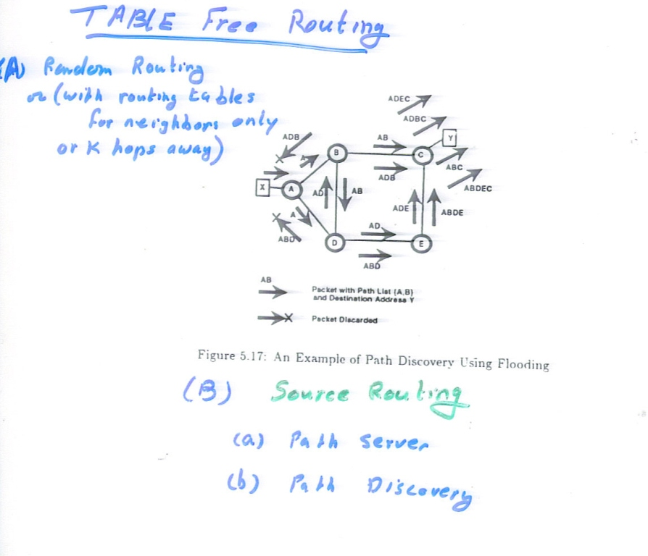

Slide 42
Multi Destination Routing (Multicasting)
Flooding
Separately addressed packets; source sends a copy to each destination (replication of single destination routing)
Multi-destination addressing; modify packet format so it can hold a set of destination addresses, not just one. Efficient in bandwidth consumption, minimal info at the nodes. However, it requires modification to the packet format.
Spanning tree forwarding
Reverse path forwarding

Slide 43
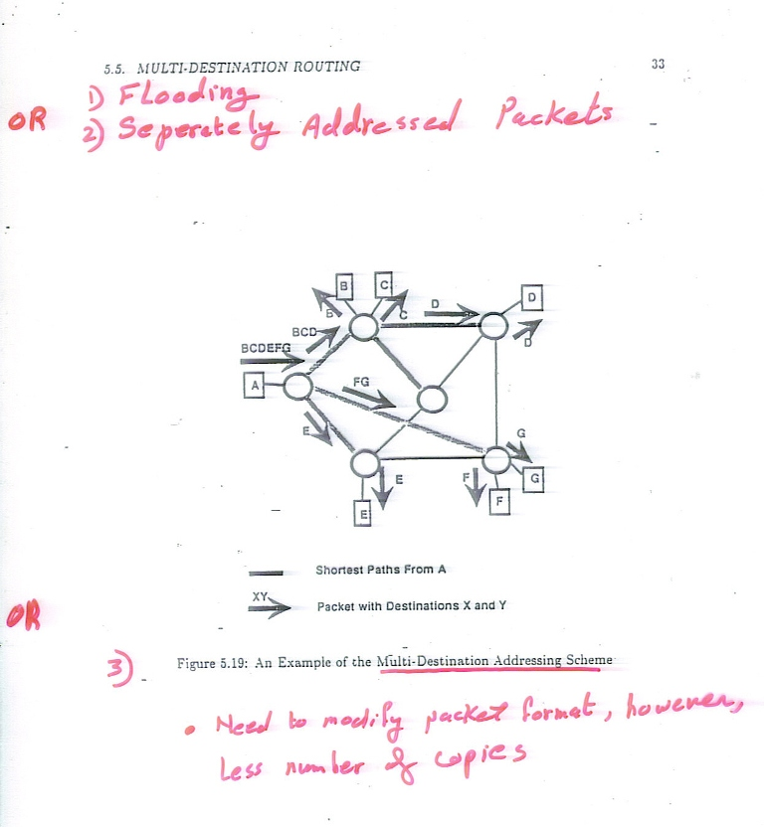

Slide 44
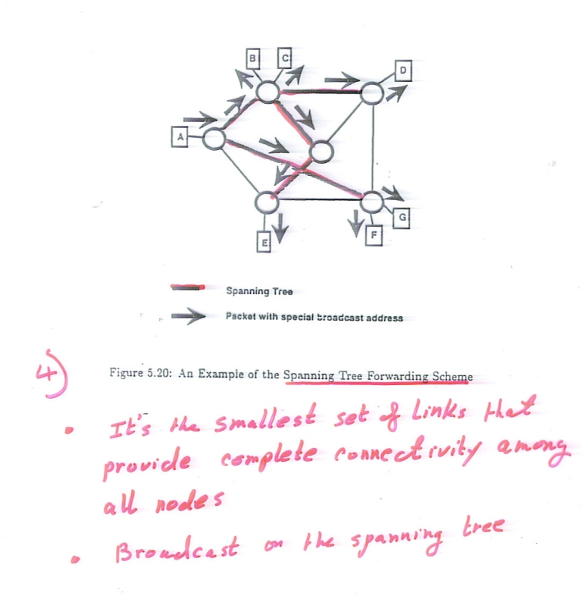

Slide 45
5) Reverse Path forwarding
Forward packet if it only came on the path that would have been used to reach the source.
Reasonable in bandwidth consumption, no changes in packet format or routing tables.

Slide 46
