Slide 1
Flow and Congestion Control

Slide 2
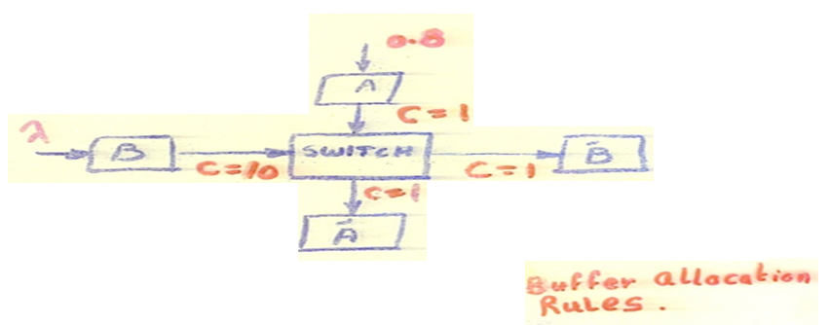
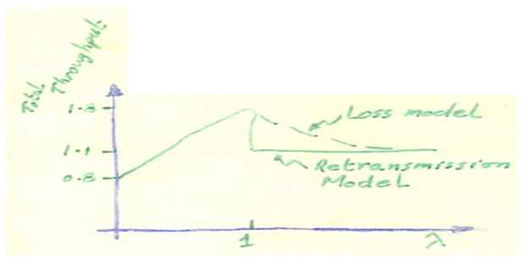
Flow Control
Congestion Problems caused by Lack of Control
1-) LOSS OF EFFICIENCY
Wastage of resources Throughput Degradation
Channel Capacity
Storage Capacity
Example of Buffer Wastage
Example of Channel Wastage
Multi Access Channel (ALOHA)
Looping
- Un-necessary retransmission of packets

Slide 3
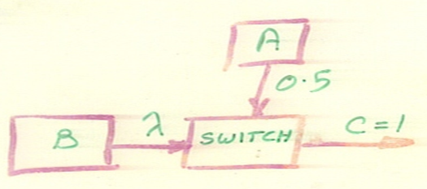
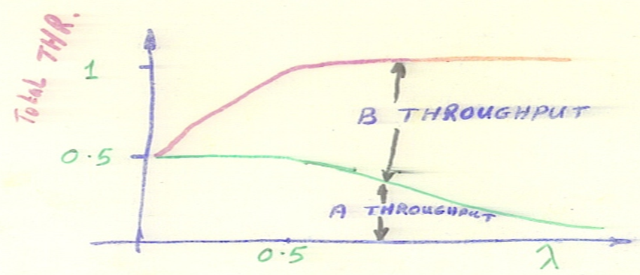
2-) UNFAIRNESS
-In the previous example; BB’ throughput is 10 times than that of AA’.
- Another Example

Slide 4
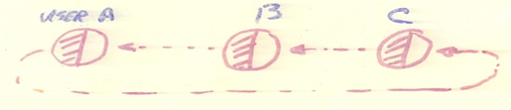

3-) DEADLOCKS
Portion of resources held by a user
Portion of resources needed by a user
Ex: Direct Store–and–Forward Deadlock (Retransmit model)
A
B
- Restriction on buffer usage
- Lossy networks are dead-lock free

Slide 5
PERFORMANCE MEASURES
- Throughput (THR)
( THR – vs – Offered load)
- Combined delay and THR
* THR – vs – Delay
* Power ≡ func. (THR / Delay)

Slide 6
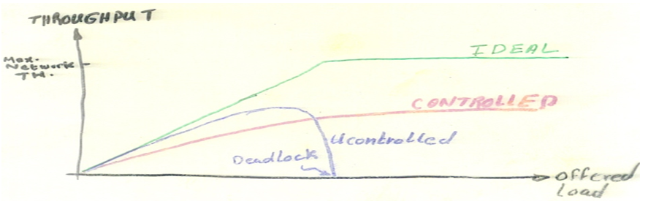
FLOW CONTROL COSTS
Information Exchange
Commands Exchange
Channel, Processor and Storage Overhead
Limited Resource Sharing
Trade Off
Gain of efficiency (due to Control)
Loss of efficiency (due to overhead and limited sharing)

Slide 7
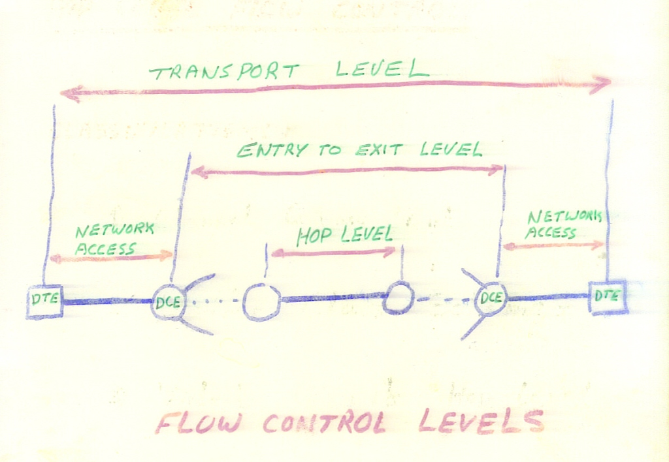

Slide 8
HOP LEVEL FLOW CONTROL
1- Channel Queue Limit
2- Buffer Class Schemes
3- Virtual Circuit HOP level
4- Others, based on:
Traffic Source
Traffic Destination
Source - Destination

Slide 9
1- Channel Queue Limit
A- Complete Partitioning
N; # of output queues
ni ; # of total packets on the ith queue
B; Total Buffer size
0 ≤ n i ≤ B/N for every i
B- Sharing the Maximum Queues
bmax = max. Q size allowed for the i th Q
B < N.bmax
Constraints: 0 ≤ ni ≤ bmax
Σni ≤ B
i th link
ni

Slide 10
C- Sharing with Min Allocation
bmin = min. buffer allocation guaranteed to each Q
N.bmin ≤ B
Constraints:
Σi max.(0, ni – bmin) ≤ B – N.bmin
D- Sharing with Min Allocation and Max Q
Previous examples

Slide 11
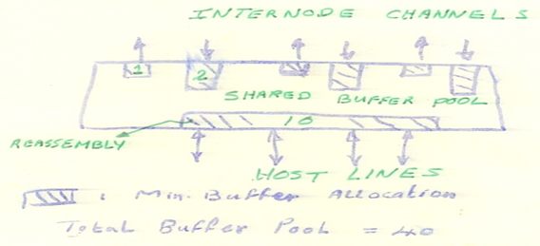
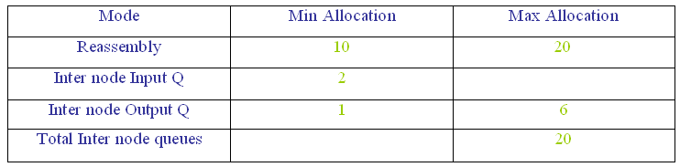
Buffer Allocation in ARPANET Node

Slide 12
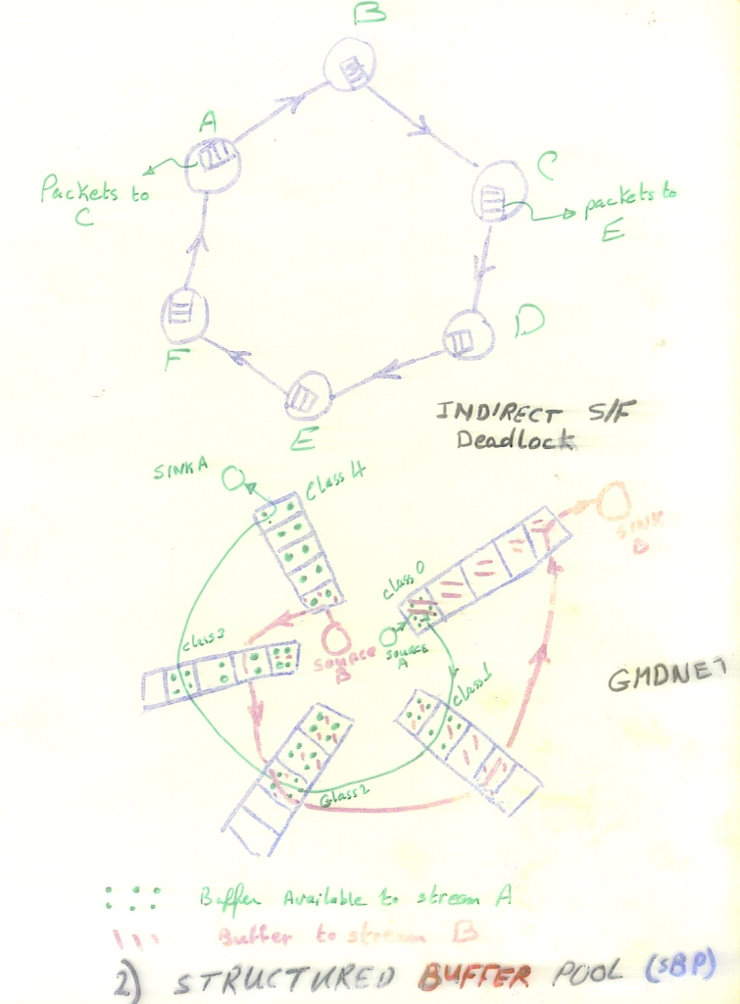

Slide 13
Network Access Control Schemes
Isarithmic control
Permit control
Leaky Bucket

Slide 14
