Slide 1
PSNA Pneumonia Detection Challenge
Teng-Te Yu, Zheng-Yan Chen, Yi-Hsin Chen
Team 19
Project repository: https://github.com/samuelyutt/Selected-Topics-in-Visual-Recognition-using-Deep-Learning-course/tree/final-project/FinalProject

Slide 2
Outline
Introduction
Related Work
Methodology
Experiments
Conclusion
Future Work

Slide 3
Outline
Introduction
Related Work
Methodology
Experiments
Conclusion
Future Work

Slide 4
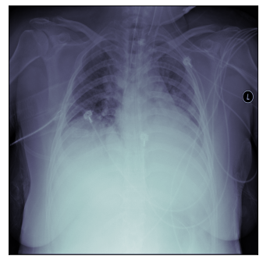
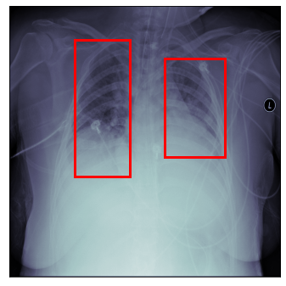
Introduction
Background
Pneumonia is top 10 causes of death in both United States and Taiwan
Analysis patient's chest radiographs (CXRs) is time consuming
Task
Build a model to detect lung opacities on CSRs
Detection

Slide 5
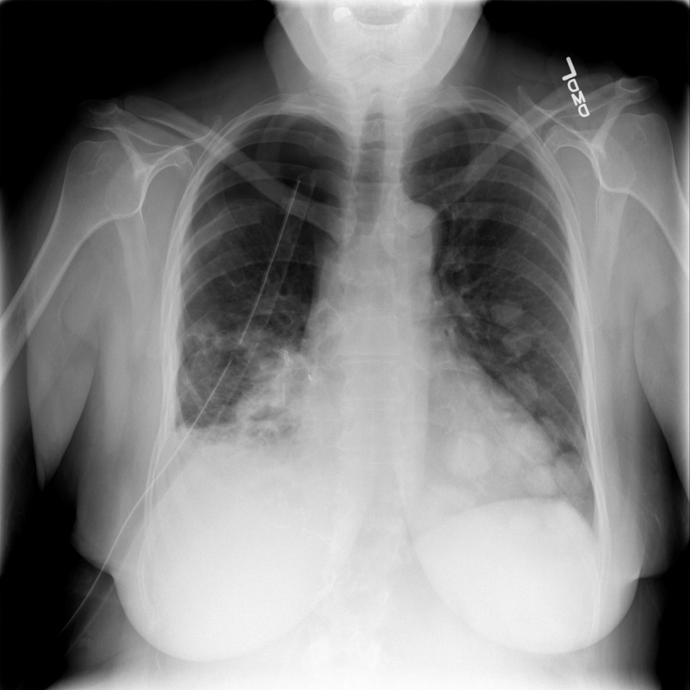
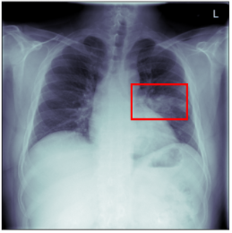
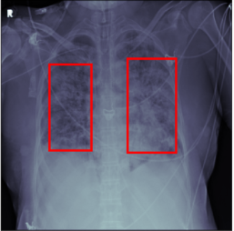
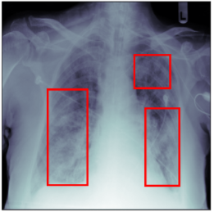
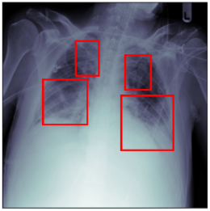
Challenge
Not all of the input images contain lung opacities
We can not predict 100% like ground truth
Not sure is there exists noise data
Hard to debug from the detection results

Slide 6
Outline
Introduction
Related Work
Methodology
Experiments
Conclusion
Future Work

Slide 7
Related Work
 | YOLOv5 | Faster R-CNN
stage | One-stage | Two-stage
Speed | Faster | Slower
Accuracy | ? | ?

Slide 8
Outline
Introduction
Related Work
Methodology
Experiments
Conclusion
Future Work

Slide 9
Overview
Data Pre-processing
Detection
YOLOv5
or
Faster R-CNN
Cleaning
Transformation
CLAHE
In this project, we focus on data processing

Slide 10
Data Pre-processing – Cleaning
Contain 26,684 image training dataset
Use those images with lung opacity only

Slide 11
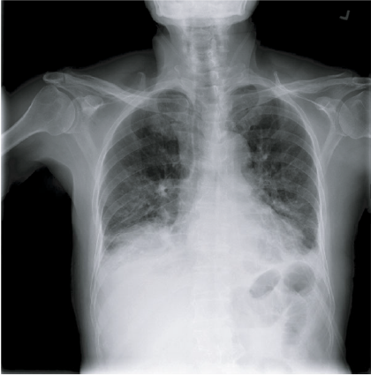
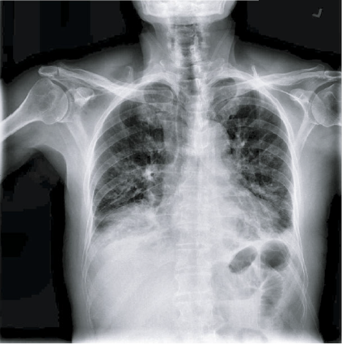
Data Pre-processing – CLAHE
Contrast Limited Adaptive Histogram Equalization (CLAHE)
Improve contrast in images
Widely used in medical images
CLAHE

Slide 12

Data Pre-processing – Transformation
Resize: $1024×1024→500×500$ for saving computational resources
Flip: randomly flipping for data augmentation
Rotate: randomly rotate 90 degree for data augmentation

Slide 13
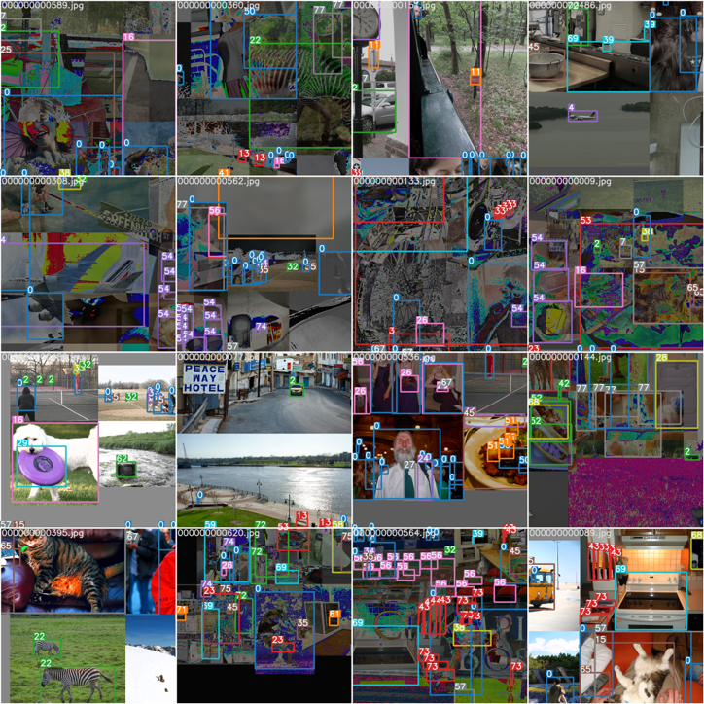
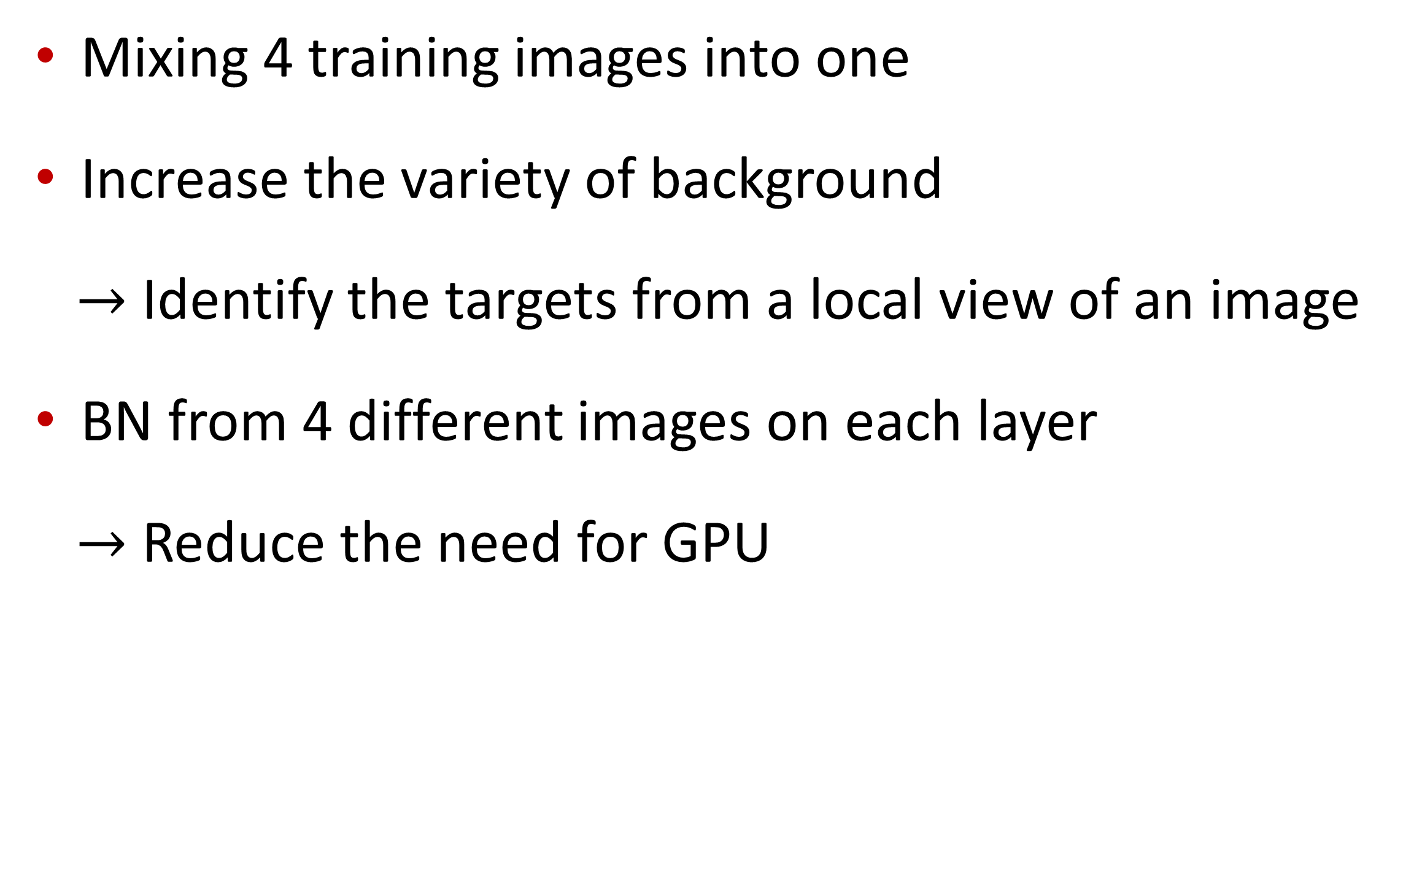
Mosaic in YOLOv5
Mixing 4 training images into one
Increase the variety of background
$→$ Identify the targets from a local view of an image
BN from 4 different images on each layer
$→$ Reduce the need for GPU

Slide 14
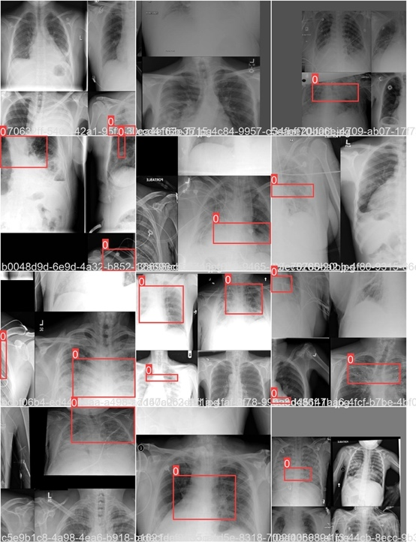
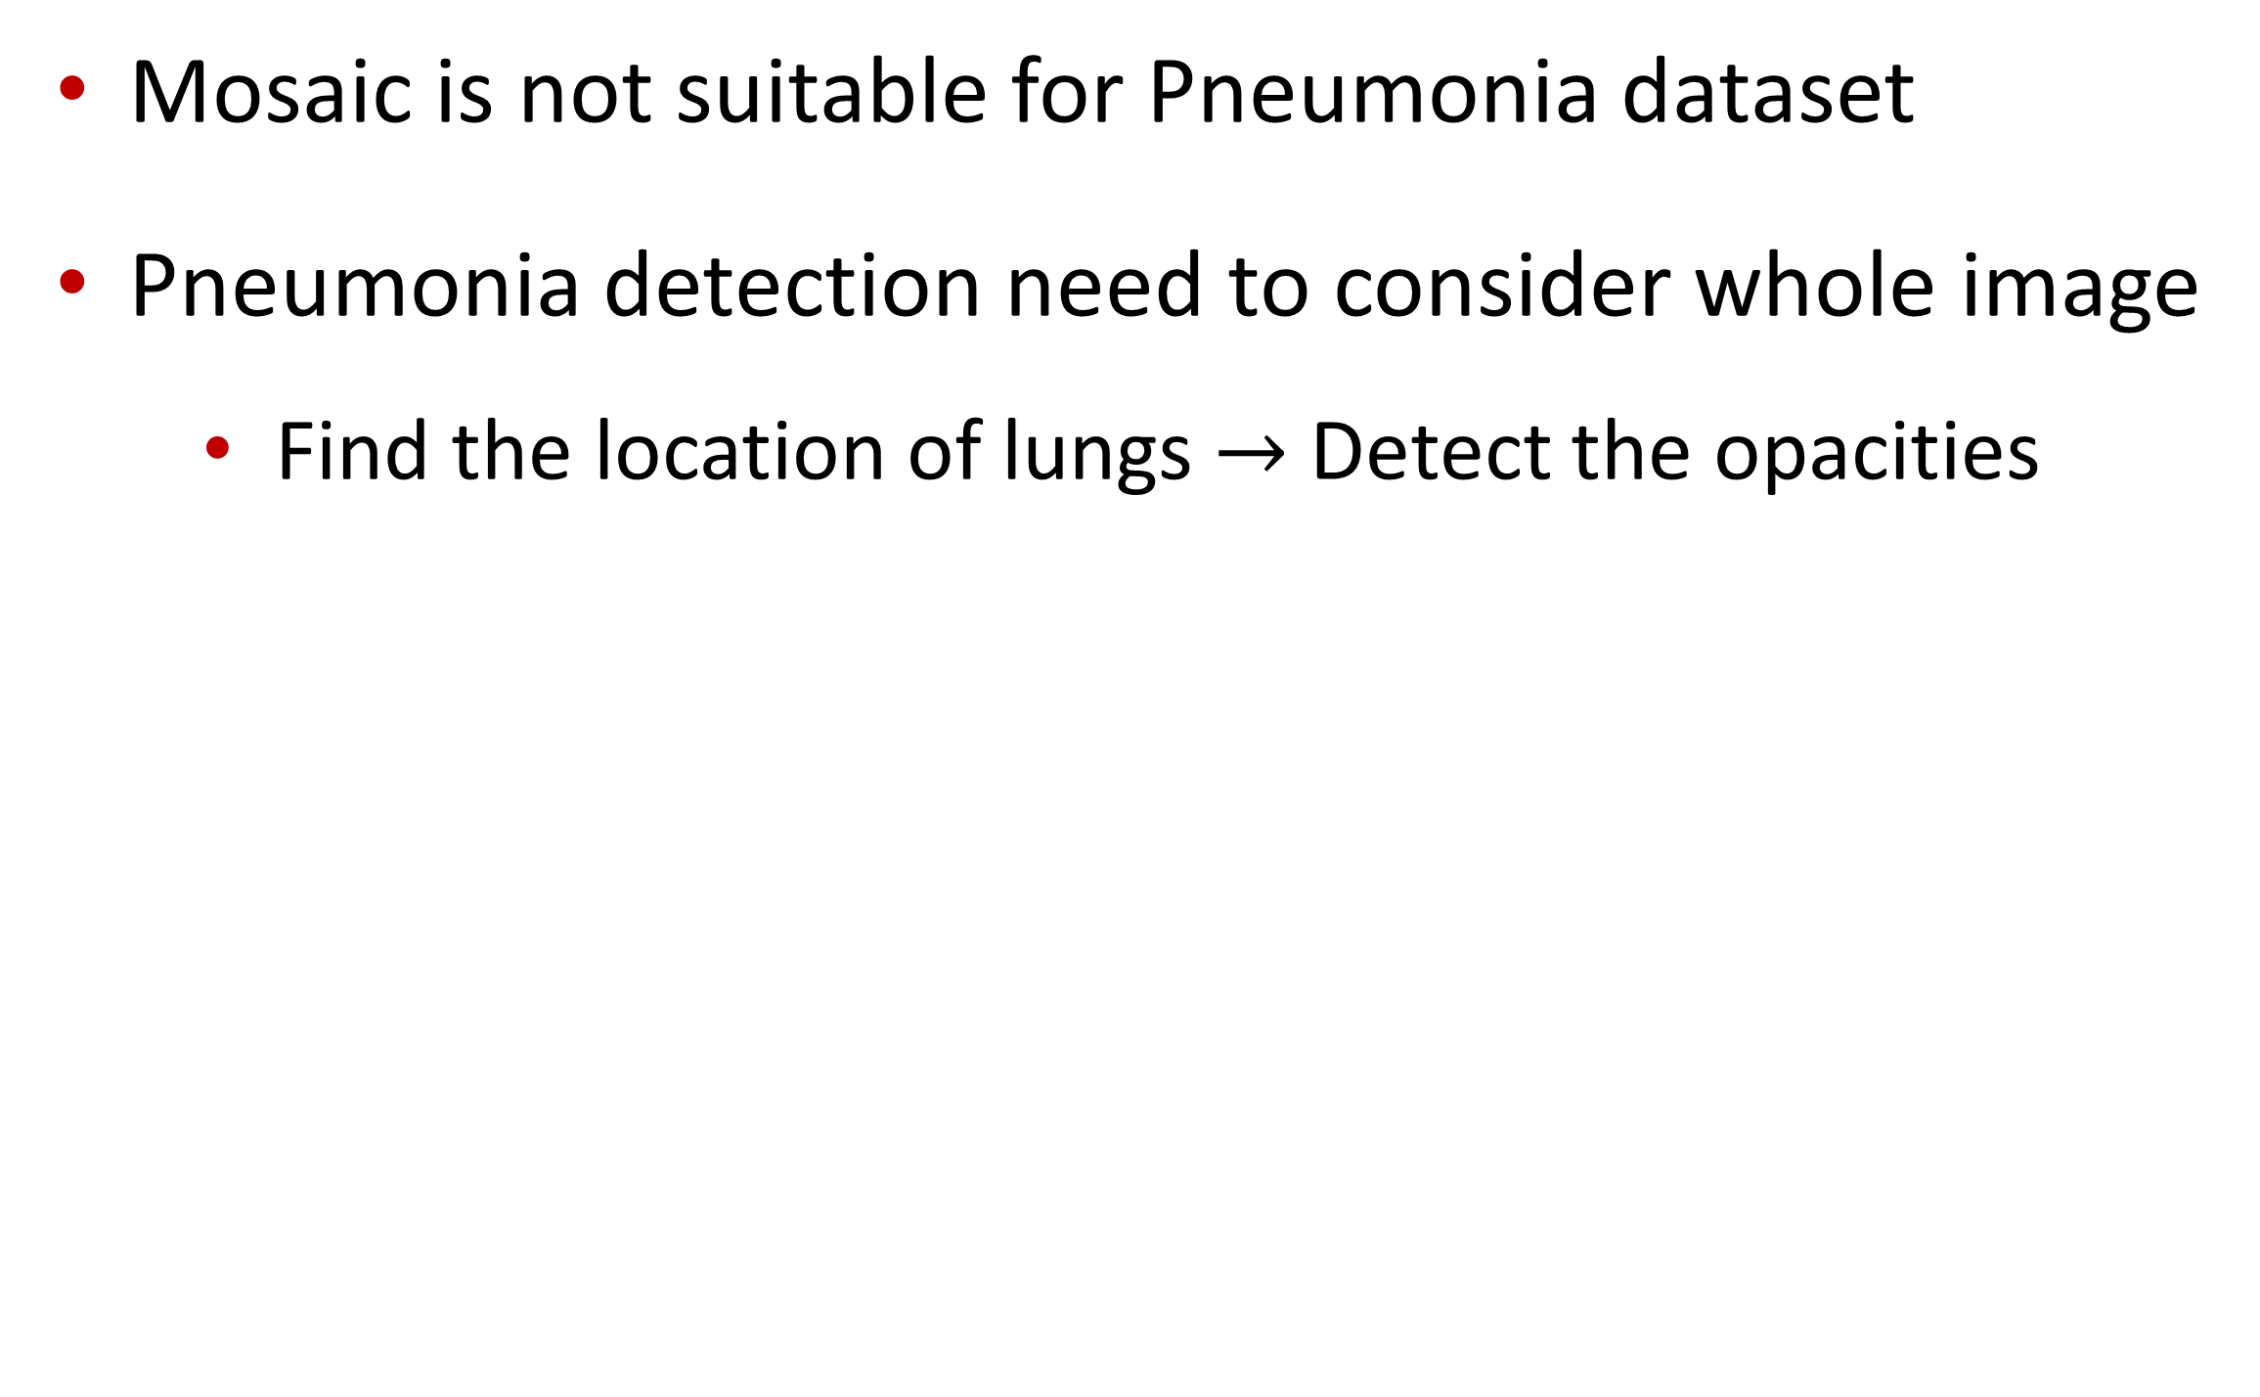
Issue of Using Mosaic in Pneumonia dataset
Mosaic is not suitable for Pneumonia dataset
Pneumonia detection need to consider whole image
Find the location of lungs $→$ Detect the opacities

Slide 15
Outline
Introduction
Related Work
Methodology
Experiments
Setup
Experimental Results
Ablation Studies
Discussion
Conclusion
Future Work

Slide 16
Setup
Dataset
Training: 26,684 images (only 6,012 images are used for training after data cleaning)
Testing: 3,000 images
Evaluation Metric
Mean Average Precision (mAP)
Model
YOLOv5: Pre-trained YOLOv5X with CSPDarknet53 as the backbone
Faster R-CNN: Pre-trained Faster R-CNN with ResNet50 as the backbone

Slide 17
Experimental Results
Model | mAP
Baseline | 0.20125
YOLOv5 | 0.05240
Faster R-CNN | 0.14062
Baseline > Faster R-CNN > YOLOv5

Slide 18
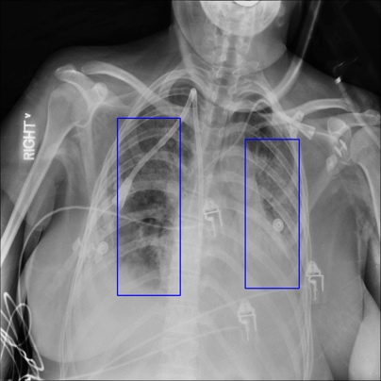
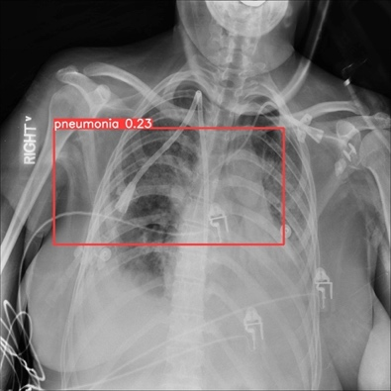
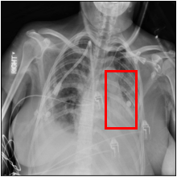
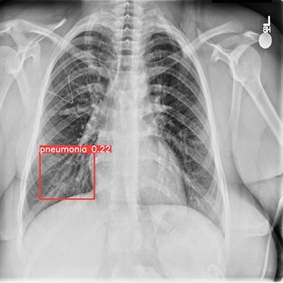
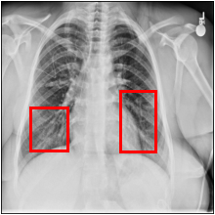
Qualitative Detection Results
Type | Ground Truth | YOLOv5 | Faster R-CNN
Training
Test

Slide 19
Ablation Studies
w/o Mosaic v.s. w/ Mosaic (YOLOv5)
w/o Data cleaning v.s. w/ Data Cleaning (Faster R-CNN)
w/o CLAHE v.s. w/ CLAHE (Faster R-CNN)
w/o Resizing v.s. w/ Resizing (Faster R-CNN)
w/o Rotation v.s. w/ Rotation (Faster R-CNN)

Slide 20
w/o Mosaic v.s. w/ Mosaic
Setting | mAP
w/o Mosaic | 0.05240
w/ Mosaic | 0.01470
+ 0.0354 mAP without using Mosaic
Mosaic is not suitable for this dataset

Slide 21
w/o Data cleaning v.s. w/ Data Cleaning
Setting | mAP
CLAHE + rotate90 + resize | 0.12755
CLAHE + cleaning + rotate90 + resize | 0.14062
+ 0.01305 mAP with data cleaning

Slide 22
w/o CLAHE v.s. w/ CLAHE
Setting | mAP
cleaning + rotate90 + resize | 0.13948
CLAHE + cleaning + rotate90 + resize | 0.14062
+ 0.00114 mAP with CLAHE
The gain of CLAHE is quite limited

Slide 23
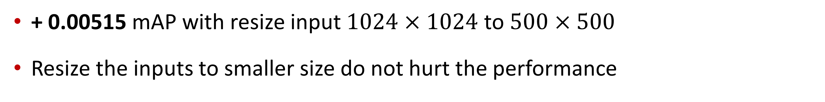
w/o Resizing v.s. w/ Resizing
Setting | mAP
CLAHE + rotate90 _ | 0.12240
CLAHE + rotate90 + resize | 0.12755
+ 0.00515 mAP with resize input $1024×1024$ to $500×500$
Resize the inputs to smaller size do not hurt the performance

Slide 24
w/o Rotation v.s. w/ Rotation
Setting | mAP
cleaning + resize | 0.09697
cleaning + rotate90 + resize | 0.13948
+ 0.04251 mAP with randomly rotate input 90 degree as data augmentation

Slide 25

Small Conclusion for Ablation Studies
w/o Mosaic v.s. w/ Mosaic (YOLOv5)
w/o Data cleaning v.s. w/ Data Cleaning (Faster R-CNN)
w/o CLAHE v.s. w/ CLAHE (Faster R-CNN)
w/o Resizing v.s. w/ Resizing (Faster R-CNN)
w/o Rotation v.s. w/ Rotation (Faster R-CNN)
$→$ + 0.03540
$→$ + 0.01305
$→$ + 0.00114
$→$ + 0.00515
$→$ + 0.04251

Slide 26
Discussion
Test performance stays flat or even drops as training epoch increase
Overfitting to training data or inappropriate hyper-parameter (e.g. schedule of LR)

Slide 27
Outline
Introduction
Related Work
Methodology
Experiments
Conclusion
Future Work

Slide 28
Conclusion
Faster R-CNN performs better than YOLOv5 in our experiment
Proper data processing does help improve the performance
Mosaic in YOLOv5 is not suitable for this dataset

Slide 29
Outline
Introduction
Related Work
Methodology
Experiments
Conclusion
Future Work

Slide 30
Future Work
Modification on Faster R-CNN
Apply K-Means++ to obtain the initial anchor box size
Use multi-scale features to generate region of interests (original Faster R-CNN only use one scale feature)

