Slide 1
FUEL CELL TECHNOLOGY
Fuel Cells
How they work, what they produce, and where they belong — the low-temperature cells, PEMFC and DMFC.
1.23 V
0.70 V
47 %
63 kW
the ceiling
what you get
efficiency
of heat
the most the chemistry
can ever give
loaded, at the design
operating point
and it is simply
those two divided
from a stack making
56 kW of electricity
WHAT THIS COVERS
1 – 4
What a fuel cell is, the main types, and what they look like
5 – 6
How a PEMFC works, the direct-methanol variant, and how to choose
7 – 8
The polarisation curve, and the numbers it produces
9 – 10
The system around the stack, and where the technology belongs, embedded part of (µC)
11 – 14
Advantages, Drawbacks and Applications with future scope
15 – 18
The methanol system: components, operation, CC-CV charging and safety
Notes:
[0:25]
A fuel cell turns stored chemical energy straight into electricity — no combustion, no heat engine in the path. These four numbers are the whole deck. The chemistry offers 1.23 volts. You actually get 0.70. That ratio is your efficiency. And everything you did not get comes out as heat — more heat than electricity, as we will see.

Slide 2
01 · FOUNDATIONS
What is inside a fuel cell
A layered device. The membrane passes protons and blocks electrons — that one asymmetry is what makes a current.
e- around the outside
Flow
plate
GDL
Catalyst
Membrane
(PEM)
Catalyst
GDL
Flow
plate
ANODE
H₂ in
CATHODE
air in
H+ through the membrane
Membrane
Catalyst layers
GDLs and flow plates
Conducts protons, blocks electrons. It forces them out through your load — that detour is the electricity.
Split hydrogen at the anode, reduce oxygen at the cathode. This is where the platinum is.
Gas Diffusion Layer spread the gas, conduct electrons, carry coolant, and move product water out.
Hundreds of these in series make a stack — one cell gives well under a volt, so the stack is what produces a usable bus voltage.
The mental model: a thin wet ion conductor between two porous reactive layers. Everything else feeds it, cools it, or collects its current.
Notes:
[0:40]
One idea on this slide. The membrane is a selective barrier: protons pass through it, electrons cannot. Without that, hydrogen and oxygen simply burn and you get heat. With it, the electrons are forced to take the long way round — out through your load — and that detour is the electricity. The catalyst layers either side host the reactions, and the plates feed and cool the whole thing. One cell gives well under a volt, so hundreds go in series to make a usable bus voltage.

Slide 3
01 · FOUNDATIONS
Six types — the electrolyte decides
Which ion moves sets the temperature, which sets the materials, the fuel, and the application.
Full name
Abbr.
Electrolyte · ion
Temperature
Fuel
Where it is used
Proton Exchange Membrane
PEMFC
Polymer · H+
60 – 80 °C
Pure H₂
Transport, backup — fast start
Alkaline
AFC
KOH · OH-
< 100 °C
Pure H₂
Space, specialist
Phosphoric Acid
PAFC
Phosphoric acid · H+
≈ 200 °C
Reformed H₂
Mature stationary CHP
Molten Carbonate
MCFC
Molten carbonate · CO₃²-
≈ 650 °C
H₂ · gas · biogas
Large stationary power
Solid Oxide
SOFC
Ceramic oxide · O²-
500 – 1000 °C
H₂ · CO · hydrocarbons
High-efficiency stationary
Direct Methanol
DMFC
Polymer · H+
60 – 130 °C
Methanol + water
Portable, low power, long runtime
The two highlighted rows share a membrane
Read it by column, not by row
PEMFC and DMFC are both low-temperature polymer-membrane cells, so both start quickly and follow load. They differ only in the fuel.
Electrolyte → which ion moves → what temperature the materials need → which fuel is tolerated. The whole table follows from column three.
A DMFC is best understood as a PEMFC fed a liquid — which is why the rest of this deck takes those two.
Notes:
[0:30]
I will not read this table. The point is that the electrolyte is the design decision, and everything else follows from it — which ion moves sets the temperature, which sets the materials, the fuel and the application. Look at the two highlighted rows: PEMFC and DMFC share the same polymer membrane. Same physics, different fuel. Those are the two this deck takes, because low temperature means quick start and load following.

Slide 4
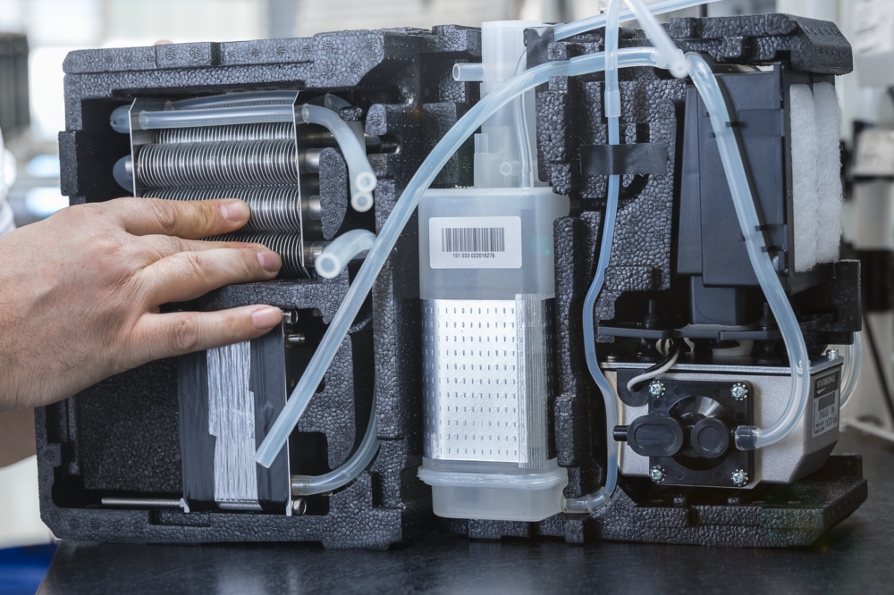
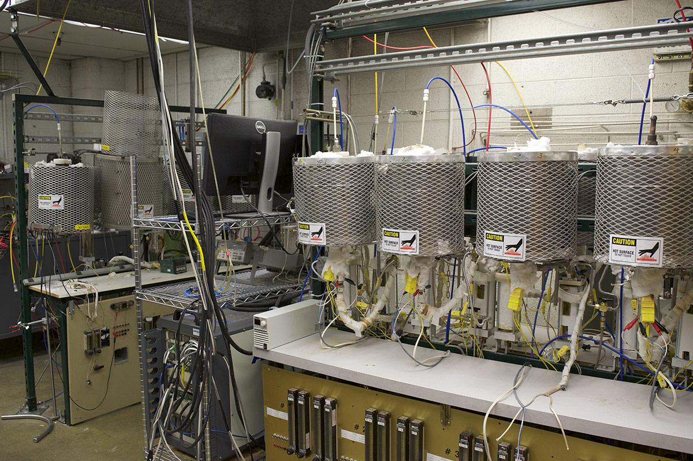
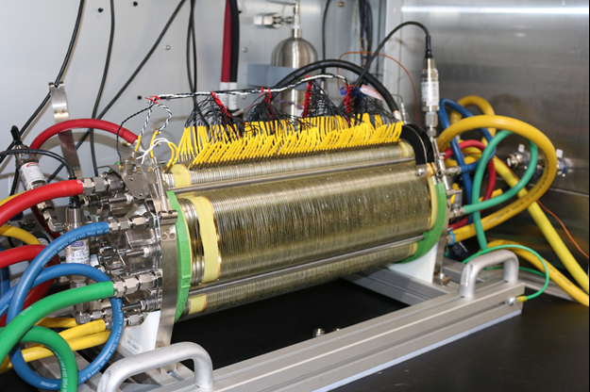
01 · FOUNDATIONS
What they actually look like
Three of those six types as real machines. Temperature decides the packaging far more than the chemistry does.
Portable DMFC module
SOFC cells on a test rig
PEMFC stack on a bench
The ribbed block is the stack. The rest — cartridge, pump, tubing — is balance of plant, and it is larger than the stack.
The mesh cages are insulation. At 500–1000 °C a ceramic cell needs what is effectively a furnace — hence stationary.
You can count the cells. The yellow wires are per-cell voltage taps — what the controller monitors.
Same three-layer sandwich in all three. What differs is everything built around it — and in the portable module, the stack is the small part.
Notes:
[0:25]
Worth pausing here, because layer diagrams leave the impression that a fuel cell is a tidy sandwich. It is not. On the left is a portable methanol module — the ribbed block is the stack, and it is the smallest part of the box. In the middle, solid-oxide cells need what is effectively a furnace. On the right, a hydrogen stack: you can count the cells, and those yellow wires are per-cell voltage taps.

Slide 5
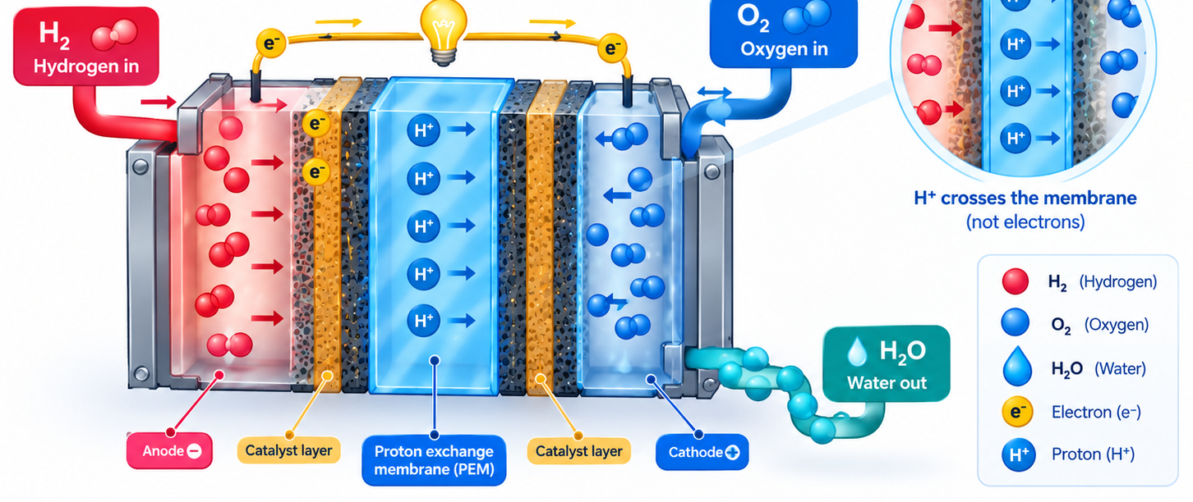
02 · HOW IT WORKS
How a hydrogen PEMFC creates electricity
Split the hydrogen, separate the two charge paths, and let them recombine as water on the far side.
THE TWO HALF REACTIONS
ANODE · OXIDATION
H₂ → 2H+ + 2e-
Each H₂ gives up two protons and two electrons.
CATHODE · REDUCTION
½O₂ + 2H+ + 2e- → H₂O
Oxygen, protons and electrons recombine into water.
OVERALL
H₂ + ½O₂ → H₂O + electricity + heat
Hydrogen is never burned here. The reaction is deliberately split in two so the electrons have to take the long way round — through the load.
Notes:
[0:40]
Oxidation is loss of electrons, reduction is gain. At the anode each hydrogen molecule gives up two protons and two electrons. The protons cross the membrane; the electrons cannot, so they go around through your load. At the cathode the two recombine with oxygen into water. The important word is deliberately — hydrogen is never burned here. The reaction is split in two on purpose, so the electrons have to do useful work on the way round.

Slide 6
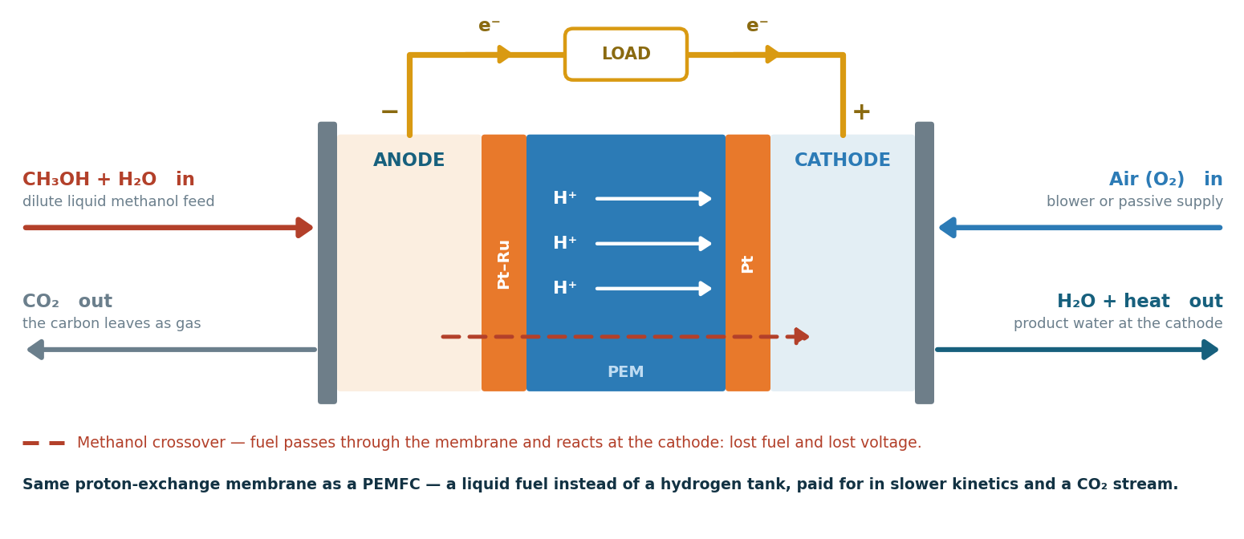
02 · HOW IT WORKS
The direct-methanol cell, and choosing
Same membrane, same cathode, liquid fuel. That one change decides every trade-off.
PEMFC
DMFC
Fuel
Hydrogen gas
Methanol, liquid
Cell voltage
≈ 0.70 V
0.3 – 0.5 V
Power density
High
≈ 10× lower
Fuel storage
700 bar or cryogenic
Ambient, like any liquid
At the stack
Water only
Water + CO₂
Best for
Vehicles, high power
Portable, long runtime
THE ANODE IS THE ONLY CHANGE
The trade in one line
CH₃OH + H₂O → CO₂ + 6H+ + 6e-
You accept a tenth of the power density to avoid a pressurised hydrogen tank. That is the whole DMFC argument.
If you can supply hydrogen, take the PEMFC. The DMFC exists because supplying hydrogen is usually the hard part.
Notes:
[0:40]
The direct-methanol cell is the same cell with a different meal. Same membrane, same cathode, same product water — only the anode changes, and it changes badly. Six electrons per molecule instead of two, much slower kinetics, and a carbon dioxide stream to get rid of. The table shows the consequence: about half the cell voltage and a tenth of the power density. What you buy is a fuel you can pour, instead of a seven-hundred-bar tank.

Slide 7
03 · THE METHANOL SYSTEM
What the system is made of
Three paths meet at the stack: fuel and air come in, power goes to the battery, and a controller watches all of it.
recovered water goes back to dilute the fresh fuel
Methanol canister
sealed, high-purity CH₃OH
Dosing pump
meters the pure fuel
Mixing loop
dilutes to ≈1 mol/l, circulates
DMFC stack
anode: methanol → CO₂
cathode: O₂ → H₂O
Condenser + separator
CO₂ + vapour out
Air pump
raw DC
What the controller measures
fuel level · methanol concentration · stack voltage, current, temperature · battery voltage, current, temperature · air flow
DC/DC charger
CC-CV regulation
Battery
buffers the load
Load
the consumer
Controller (µC) state machine · fuel dosing and concentration · air and temperature · charge setpoints · fault detection and shutdown
■ fuel path ■ air, water and exhaust ■ electrical path ■ control
Notes:
Four groups of parts. The fuel path: a sealed canister of high-purity methanol, a dosing pump, and a mixing loop. A DMFC cannot run on pure methanol because too much of it would cross the membrane, so the pure fuel is diluted to about one mole per litre, using water recovered from the cathode exhaust. That is why only pure methanol has to be carried and no water tank is needed. The stack turns methanol and air into DC power, CO2 and water. The air pump supplies oxygen. The condenser and separator recover water and vent the CO2. On the electrical side, the stack voltage changes with load, so a DC/DC converter does the CC-CV charging into the battery, and the battery supplies the load. A microcontroller ties it all together.

Slide 8
03 · THE METHANOL SYSTEM
The battery supplies the load; the fuel cell recharges it
The fuel cell does not follow the load. It runs only to recharge the battery, at a steady operating point.
1
2
3
4
5
Standby
Start
Run
Charge
Stop
The battery supplies the load. The controller watches battery voltage and state of charge.
The battery drops below a threshold. The air pump and fuel dosing start, and the stack warms up on its own heat.
The stack holds its operating point. Dosing keeps the methanol concentration steady; water is recovered.
The DC/DC charges the battery in CC then CV, and never draws more current than the stack can give.
Charge current falls below the cut-off. Fuel stops, the stack runs down, and the system returns to standby.
↺ repeats every time the battery runs down
Why the methanol must be high-purity
The canister fuel goes straight to the catalyst. Impurities such as ions, metals or other alcohols poison the catalyst and the membrane, and they build up in the loop because water is recycled. Pure fuel keeps the stack lifetime predictable.
Why a battery and a fuel cell together
A DMFC has low power density and responds slowly. The battery covers the peaks and the fuel cell provides the energy. The stack sees one steady load, which is best for efficiency and for wear.
The fuel cell provides the energy, the battery provides the power, and the charger decides how much current goes from one to the other.
Notes:
This is a hybrid. The battery always supplies the load. The fuel cell charges the battery. The controller sits in standby until the battery voltage or state of charge drops below a threshold. It then starts the air pump and fuel dosing, and the stack heats itself to its operating temperature, roughly 60 to 70 degrees for a portable DMFC. While running, the controller keeps the methanol concentration steady, using a concentration sensor or a sensorless estimate from stack behaviour, and water from the cathode is fed back into the loop. The charger performs CC-CV and caps the current at what the stack can deliver. When the charge current tapers below the cut-off, fuel stops and the system goes back to standby.

Slide 9
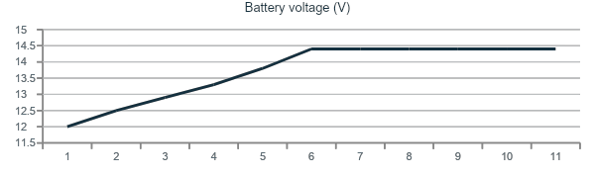
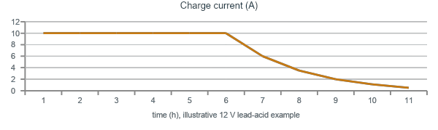
03 · THE METHANOL SYSTEM
Constant current first, then constant voltage
The DC/DC holds the current until the battery reaches its voltage limit, then holds that voltage.
CC phase
The current is held at its limit, the lower of the battery's rating and the stack's capacity. The voltage rises as the battery fills.
CV phase
At the limit (for example 14.4 V for 12 V lead-acid, 3.6 V per LiFePO₄ cell) the voltage is held and the current falls on its own.
End of charge
Stop when the current drops below about C/20, with a backup timer. Lead-acid can move to a float voltage; lithium must not.
Why it matters here
The current limit keeps the stack at its efficient operating point. The voltage limit protects the battery from overcharge.
Setpoints depend on the battery chemistry and should be temperature-compensated for lead-acid. The battery temperature sensor is part of the charger.
Notes:
CC-CV is two control loops in the DC/DC converter. In the constant-current phase, the current is held at a limit. That limit is the smaller of what the battery accepts and what the stack can deliver at a good operating point. The voltage rises as the battery charges. Once it reaches the chemistry limit, for example 14.4 volts for a 12 volt lead-acid battery, the converter switches to constant voltage and the current falls. Charging ends when the current is below about C/20, with a timer as a backup. For lead-acid the voltage limit is temperature-compensated, a few millivolts per degree per cell, which is why the battery temperature sensor matters. The chart is illustrative, not measured.

Slide 10
03 · THE METHANOL SYSTEM
Safety at every level: fuel, stack, electrical, control
Methanol is flammable and toxic, the stack runs hot, and a battery can be overcharged. Each hazard gets its own protection.
1
Fuel handling
2
Stack and thermal
Sealed, factory-filled canisters: no one handles liquid methanol.
Keyed, leak-tight coupling that seals itself when removed.
Little fuel inside the unit; CO₂ vented through one defined outlet.
Flash point ≈11 °C, near-invisible flame: no ignition sources nearby.
Temperature limits on stack and electronics; derate, then stop.
Minimum stack voltage: a low reading means fuel or air starvation.
Concentration control prevents crossover and hot spots.
Frost protection: water in the loop must not freeze.
3
Battery and electrical
4
Control and software
CC-CV limits in the charger, plus a hardware overvoltage cut-off.
Battery temperature window: no charging when too hot or too cold.
Fuse, reverse-polarity and short-circuit protection.
A charge timer stops a charge that never reaches its cut-off.
Every fault → one safe state: pump off, charger off.
Watchdog; the pump enable must be kept alive by the software.
Cross-checks between sensors, e.g. fuel used vs energy out.
Faults logged and reported; designed to IEC 62282-5-100.
Fail safe: removing power or losing the software must lead to the safe state on its own, without relying on the software to shut the system down.
Notes:
Safety is organised by hazard. Fuel: methanol is flammable, with a flash point around 11 degrees, burns with an almost invisible flame, and is toxic if swallowed or absorbed through the skin. So it stays in sealed, factory-filled canisters with a keyed, self-sealing coupling, and the amount of fuel inside the unit is kept small. Stack: temperature limits, a minimum stack voltage to detect starvation, and concentration control to prevent crossover and hot spots. Frost protection is needed because there is water in the loop. Battery: the CC-CV limits live in the charger, backed by a hardware overvoltage cut-off, a temperature window, a charge timer, and fuses. Control: every fault goes to one safe state, and it is fail safe. The watchdog and the pump enable both need the software to stay alive, so a hung controller stops the fuel. The relevant product safety standard for this class is IEC 62282-5-100.

Slide 11
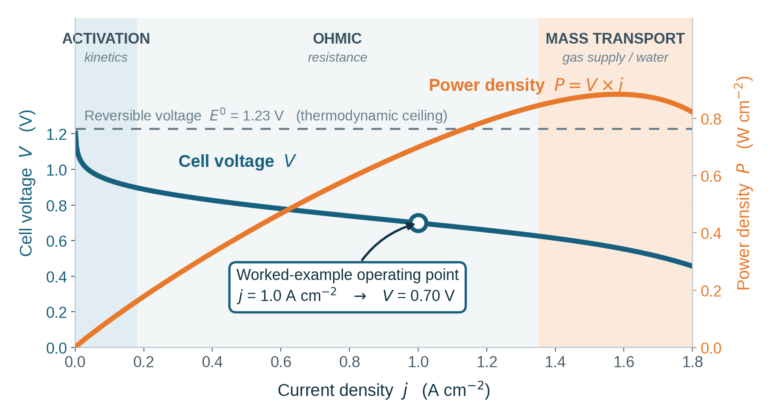
04 · WHAT IT PRODUCES
The polarisation curve: the cell's price list
The single most important characteristic. Every extra ampere costs voltage — and past the peak, more than it is worth.
Activation · low current
The reaction is slow to start and the push comes out of your voltage. This is the loss platinum exists to reduce.
Ohmic · mid-range
Just resistance — protons through the membrane, electrons through the plates. A straight line, because it is Ohm's law.
Mass transport · high current
Gas cannot reach the catalyst fast enough and product water floods the pores. Voltage falls away sharply.
Where we choose to sit
Left of the power peak — 1.0 A/cm² and 0.70 V. Higher current means lower voltage, which means lower efficiency and a shorter stack life.
Power is the two axes multiplied, so it rises, peaks and collapses. The peak is simply where the falling voltage starts to outweigh the rising current.
Notes:
[0:50]
This is the slide I would spend most time on. Voltage only ever falls, for three different reasons that dominate in three ranges. At low current the reaction is simply slow to start, and that push comes out of your voltage — the loss platinum exists to reduce. In the middle it is just resistance, and that section is a straight line, which is the giveaway that it is Ohm's law. At high current the gas cannot reach the catalyst fast enough and water floods the pores. Power is those two axes multiplied, so it rises, peaks and collapses — and note we sit left of the peak, giving up power density to buy efficiency and stack life.

Slide 12
04 · WHAT IT PRODUCES
What that gives you, in numbers
Current comes from area, voltage from cell count, and efficiency is just the cell voltage rescaled.
ONE WORKED EXAMPLE
200 cm² × 1.0 A/cm²
400 cells × 0.70 V
280 V × 200 A
area sets the current
cell count sets the voltage
gross stack power
I = 200 A
V = 280 V
P = 56 kW
EFFICIENCY IS TWO NUMBERS DIVIDED
WHERE 119 KW OF HYDROGEN GOES
1.48 V
if none of the fuel energy became heat
Fuel in
119 kW
1.23 V
the most that can become electricity
Electricity
56 kW
0.70 V
what the cell actually gives, from the curve
Heat
63 kW
0.70 / 1.48 = 47 %
More heat than electricity — and at only 60–80 °C
No Carnot limit, but 1.23 / 1.48 = 83 % is still a hard ceiling, and the curve takes the rest. Figures are illustrative.
Notes:
[0:40]
Three multiplications and one division. Area gives current: two hundred square centimetres at one amp per square centimetre is two hundred amps. Cell count gives voltage: four hundred cells at 0.70 volts is two hundred and eighty. Multiply, and the stack makes fifty-six kilowatts. Efficiency is then not a separate topic — it is the cell voltage divided by 1.48, which is 47 per cent. And the part people miss is on the right: sixty-three kilowatts leave as heat, at only sixty to eighty degrees. That means a physically large radiator.

Slide 13
05 · THE SYSTEM
A stack is not a system
Auxiliaries take a share of the power, the electronics condition the rest, and a controller supervises all of it.
PEMFC stack
DC-DC
Battery
Inverter
Motor / load
variable DC
regulated
transients
DC → AC
useful output
THE STACK FEEDS THESE FIRST
NET USABLE POWER
Air compressor
Coolant pump + fan
Humidification
H₂ recirculation
56 kW
− 7 kW
− 2 kW
47 kW
The thermal design is sized by the heat, not by the electricity.
gross
auxiliaries
conversion
net
Gross ≠ net
The compressor dominates
Conditioning costs too
Quoting stack power without naming the auxiliary load overstates the system by a wide margin.
Air supply is usually the largest single parasitic load, and it grows with pressure.
Every conversion stage - DC-DC, inverter, takes its own percentage on the way to the load.
NET USABLE POWER - gross stack power - auxiliary demand - conversion losses. Illustrative figures only - 56kW - 7kW - 2kW = 47kW
Notes:
[0:40]
Two corrections to the naive picture. First, gross is not net — the air compressor alone takes several kilowatts and scales with pressure, so fifty-six becomes about forty-seven by the time the load sees it. Quoting stack power without naming the auxiliary load overstates a system badly. Second, this is where my software background connects. The controller sits entirely on the low-power side of an isolation boundary: it measures the energy path and commands the converters and contactors, but hundreds of amps never pass through it.

Slide 14
05 · THE SYSTEM
Where the microcontroller and sensors sit
The ECU supervises the system through isolated sensing and low-power commands - the high stack current never passes through it
REACTANT SUPPLY
HIGH-POWER ENERGY PATH — high current, high voltage, no controller in the loop
H₂ tank
+ regulator
PEMFC
stack
Contactors
+ DC-DC
Battery /
buffer
Inverter
Motor /
final load
Air supply
+ compressor
H₂ / air
pressure, flow
stack V, I
cell voltages, T
bus V, I
contactor state
SOC, V, I
temperature
DC-link V
torque feedback
power demand
from the load
LOW-POWER SIGNAL LAYER · measurements up ↑ · commands down ↓ · galvanically isolated from the power path
the ECU's only connection to the energy path
SENSOR INPUTS →
· Stack voltage and current
· Individual cell voltages
· H₂ pressure and flow
· Air pressure and flow
· Stack and coolant temperature
· Humidity / hydration proxy
· Coolant flow
· Hydrogen leak detection
MICROCONTROLLER / ECU
state machine · closed-loop control
operating limits and derating
diagnostics · fault response · safe shutdown
CAN to the vehicle or site controller
→ ACTUATOR OUTPUTS
· H₂ shut-off, regulator, purge valves
· Recirculation pump or ejector
· Air compressor / blower
· Coolant pump and fan
· Humidification or bypass
· Contactors + emergency shutdown
· DC-DC voltage / current setpoint
· Inverter torque or load interface
The ECU never carries the stack current - It measures the energy path, commands the converters and contactors, and can open the path in a fault.
Notes:
[0:40]
Two corrections to the naive picture. First, gross is not net — the air compressor alone takes several kilowatts and scales with pressure, so fifty-six becomes about forty-seven by the time the load sees it. Quoting stack power without naming the auxiliary load overstates a system badly. Second, this is where my software background connects. The controller sits entirely on the low-power side of an isolation boundary: it measures the energy path and commands the converters and contactors, but hundreds of amps never pass through it.

Slide 15






06 · WHERE IT FITS
Advantages — where these systems create value
Strongest where utilisation is high, refuelling must be quick, or autonomy must be long.
High efficiency
Low local emissions
Quiet operation
Direct electrochemical conversion — no combustion, no Carnot ceiling.
Pure hydrogen gives water and heat at the point of use.
The stack has no moving parts, so the acoustic signature is low.
but it falls as you draw more power
lifecycle depends on how the H₂ was made
compressors and fans still add noise
Rapid refuelling
Modular scaling
Long-duration duty
Minutes, not hours — it runs as long as fuel is supplied.
Add area, add cells, or add stacks to reach the power you need.
Sustained power and long autonomy from stored fuel.
needs accessible hydrogen infrastructure
packaging and cooling scale too
storage volume and cost still matter
Read the grey line under each claim — every advantage is conditional at system level. Clean at the point of use does not mean clean upstream.
Notes:
[0:25]
Do not sell this slide. The grey line under each card is the more interesting half — it is what separates someone who read a brochure from someone who thought about the system. The efficiency is real, but it falls as you load the stack. Zero emissions is true, but only at the tailpipe.

Slide 16
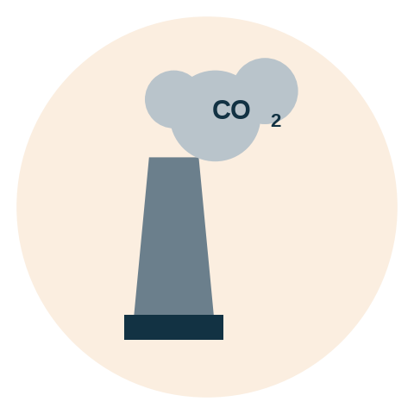
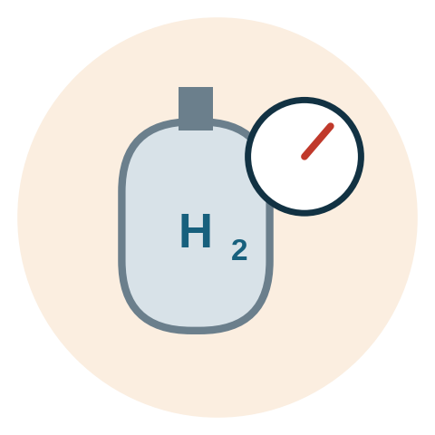

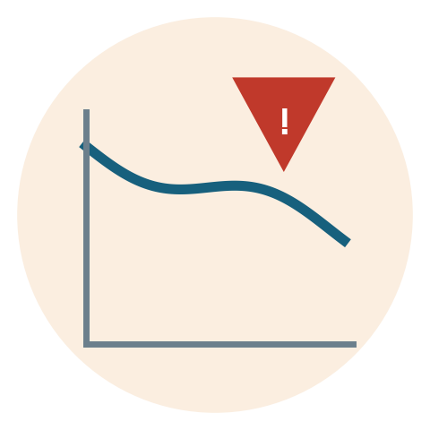

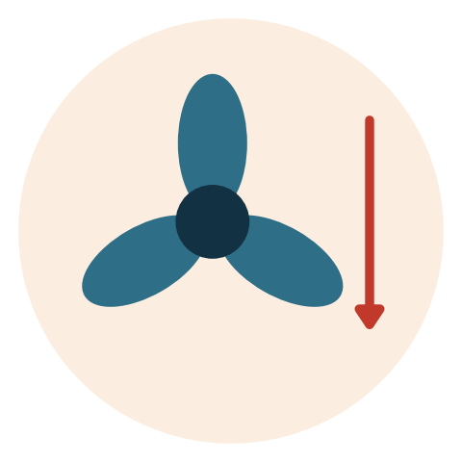


06 · WHERE IT FITS
Limits and engineering challenges
The simple net reaction hides a demanding fuel, thermal, water, safety and cost problem.
Carbon intensity
Storage and infrastructure
Cost and platinum
Durability
Lifecycle emissions depend on how the hydrogen was produced.
Low volumetric density forces high pressure, cryogenics or carriers.
Catalysts, membranes, tanks and balance-of-plant all add cost.
Load cycling, start–stop and impurities shorten stack life.
Water and heat
Parasitic loads
Cold start
Safety engineering
Dry-out raises resistance; flooding blocks gas. A narrow window.
Compressors, pumps and cooling eat into net output.
Freeze conditions and delivery limits demand careful sequencing.
Leak detection, ventilation, isolation and safe shutdown.
Two separate problem families
The honest comparison
Four of these are about hydrogen the fuel and sit outside the stack. The other four are electrochemical.
For short-range or grid-connected duty, batteries remain more efficient and considerably simpler.
Notes:
[0:25]
Group these rather than reading them. Four of the eight are about hydrogen the fuel rather than the fuel cell — carbon intensity, storage, cost, infrastructure — and those are the ones currently holding the technology back. The other four are genuinely electrochemical. And I would end on the honest comparison: for a short-range car a battery wins, and saying so is what makes the rest credible.

Slide 17






06 · WHERE IT FITS
Applications: where the duty cycle fits
Strongest when demand is high and hydrogen can be supplied at concentrated nodes.
Heavy-duty road
Material handling
Stationary backup
Trucks and buses.
Forklifts and warehouse fleets.
Data centres and microgrids.
Long range, fast turnaround
Central fuelling, multi-shift use
Quiet, modular resilience
Rail
Maritime and ports
Remote and specialised
Selected non-electrified routes.
Ferries and harbour equipment.
Telecoms and field power.
Predictable routes and fuelling nodes
High utilisation, constrained routes
Long autonomy, low local emissions
THE COMMON PATTERN
Every strong case shares three traits: high utilisation, a predictable route or site, and one concentrated fuelling node. Passenger cars have none of the three — which is why that market has not followed.
Notes:
[0:20]
The pattern is the payload here, not the six examples. High utilisation, a predictable route or site, and one concentrated fuelling node. If a duty cycle has all three, a fuel cell makes sense. If it has none, it does not — and that single test explains both the successes on this slide and the passenger-car disappointment.

Slide 18
06 · WHERE IT FITS
Future scope - the next generation of fuel cell technology
Progress will depend on efficiency, durability, cost, manufacturing scale, and intelligent system control
KEY TECHNOLOGY DIRECTIONS
BETTER MATERIALS
HIGHER EFFICIENCY
LONGER LIFETIME
LOWER SYSTEM COST
Membranes, Catalysts, MEAs
Less fuel, Less heat, Better utilization
Durability, Degradation management
Scale, Integration, Manufacturability
Power Density
More output from smaller, lighter stacks
Dynamic Response
Faster response to changing loads
Therman and Water control
Better operating stability and efficiency
Digital control
Smarter diagnostics and optimization
Scalable Manufacturing
Automation and volume production reduce cost
BALANCED OUTLOOK
Fuel cell technology is evolving towards cleaner, cheaper, longer-lived and more intelligent energy systems and applications include Mobility, Backup power systems and much more.
Notes:
[0:20]
The pattern is the payload here, not the six examples. High utilisation, a predictable route or site, and one concentrated fuelling node. If a duty cycle has all three, a fuel cell makes sense. If it has none, it does not — and that single test explains both the successes on this slide and the passenger-car disappointment.

Slide 19
07 · CONCLUSION
Recap - Fuel cell as an energy source
A converter, not a source
No combustion
Voltage always falls
Hydrogen stores the energy; the cell releases it on demand.
Efficiency is set by thermodynamics and not by heat engine. So no Carnot ceiling — but a 1.23 V one instead.
Efficiency and power density are the same axis, read two ways.
Power is not energy
A stack is not a system
As clean as its fuel
Area and cell count set the power; the tank sets the runtime.
Auxiliaries and heat decide what the load receives.
The stack is clean; the upstream pathway decides the rest.
What it competes with
A fuel cell replaces an engine or a diesel generator — not a battery. It wins wherever stored energy, long autonomy and fast refuelling matter more than round-trip efficiency, and it loses wherever they do not.
Hydrogen belongs where direct electrification is difficult. For short-range and grid-connected duty, batteries remain the better answer — and being precise about that is what makes the rest credible.
Notes:
[0:30]
To close on the position rather than the technology. A fuel cell is a converter, not a source — hydrogen stores the energy and the cell releases it. It competes with an engine or a diesel generator, not with a battery. And it wins on a narrow, identifiable set of duty cycles. Hydrogen belongs where direct electrification is difficult, and being precise about where it does not belong is what makes everything else credible.

