Slide 1
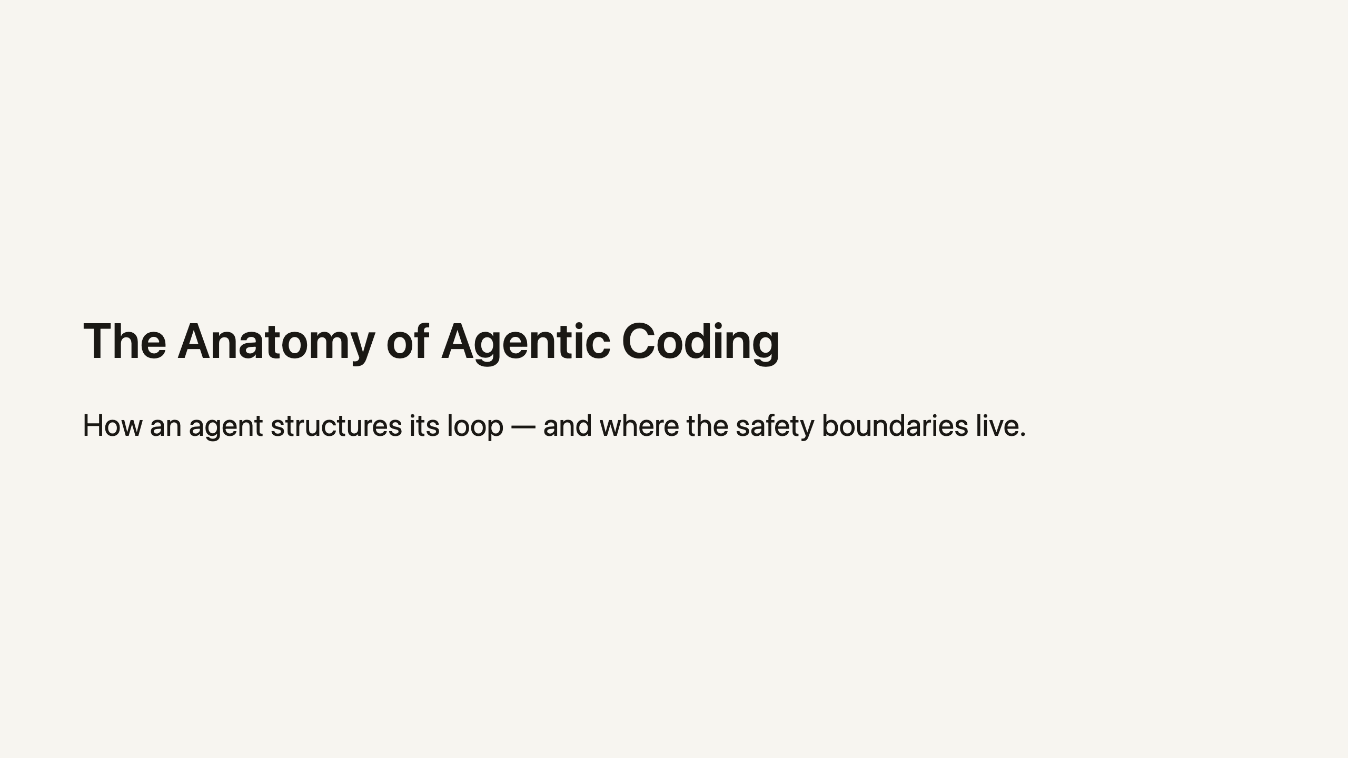
Notes:
Welcome. Five slides, five minutes. We'll cover the loop, the tools, the one historical benchmark, and how human review matches risk.

Slide 2
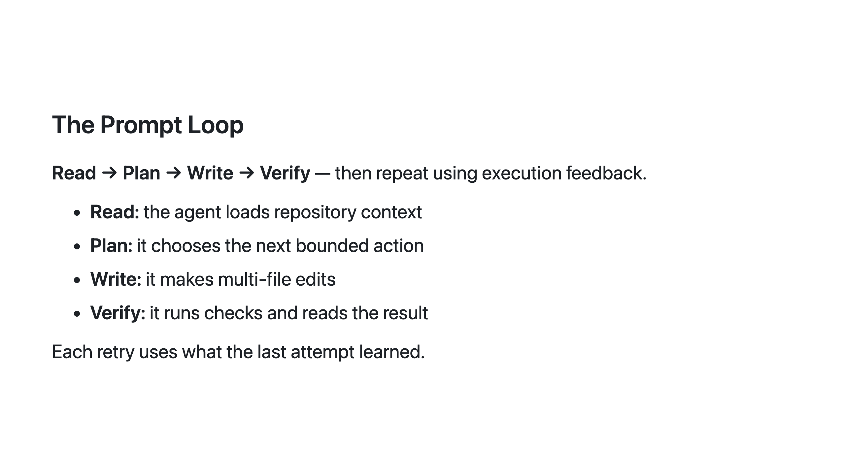
Notes:
This is the core mental model. The loop is bounded, not autonomous — each turn is one action, verified, before the next.

Slide 3
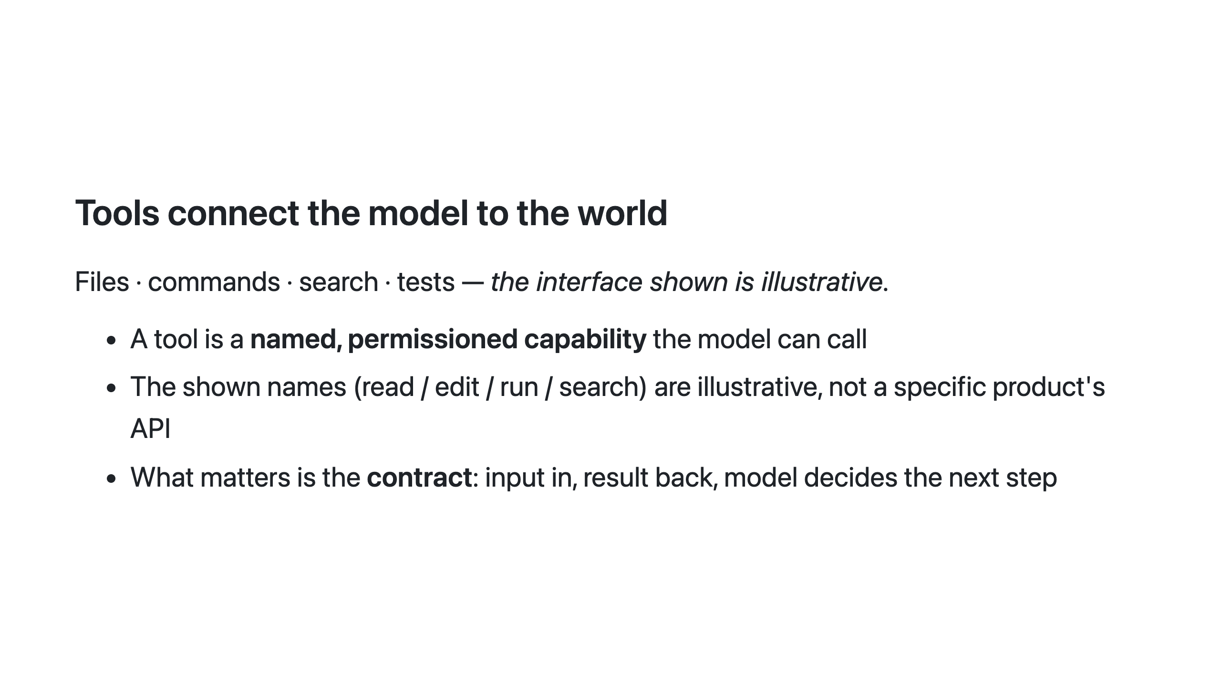
Notes:
Tool names here are placeholders. The point is the shape: the model never executes directly — it calls a tool that a runtime guards.

Slide 4
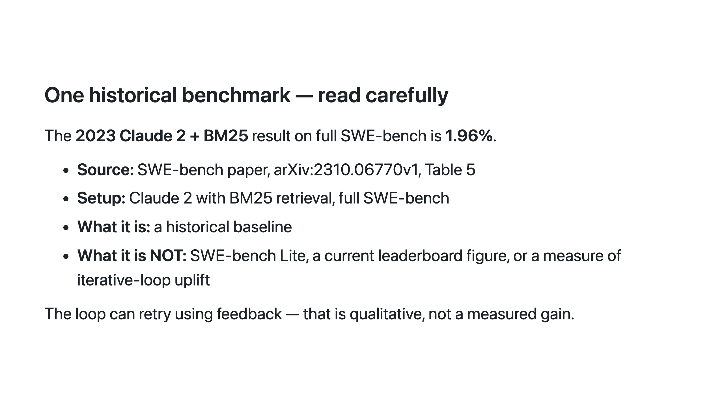
Notes:
claim-01 (the 1.96% figure) is safety level A: supportable as historical fact, but only with date, dataset, and retrieval caveats. Do not let it read as a performance promise.

Slide 5
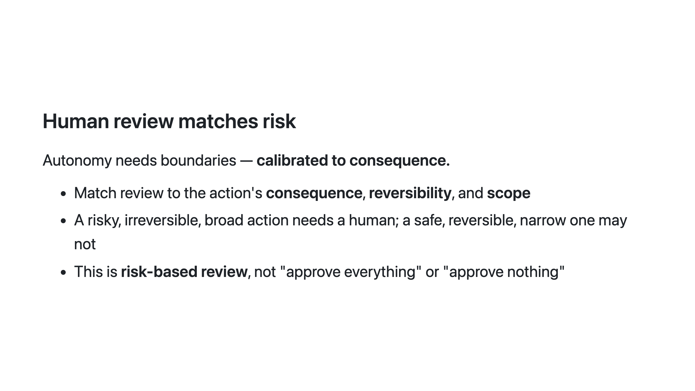
Notes:
The closing principle: the loop's safety is not a switch but a dial, turned per action.

