Slide 1
Object Oriented Programming: Exception Handling and Threads

Slide 2
Exception Handling

Slide 3
Java Exception Handling
Exceptions are some errors in a program, but not all errors are exceptions, and errors can sometimes be avoided.
For example, if your code is missing a semicolon, the result is java.lang.Error;
If you use the System.out.println(11/0), because you do with zero divisor, throws Java. Lang.ArithmeticException.
Exceptions usually occur for the following reasons:
The user entered illegal data.
The file to open does not exist.
The connection is down during network communication, or the JVM runs out of memory.
Notes:
Java 异常处理
异常是程序中的一些错误，但并不是所有的错误都是异常，并且错误有时候是可以避免的。
比如说，你的代码少了一个分号，那么运行出来结果是提示是错误 java.lang.Error；如果你用System.out.println(11/0)，那么你是因为你用0做了除数，会抛出 java.lang.ArithmeticException 的异常。
异常发生的原因有很多，通常包含以下几大类：
用户输入了非法数据。
要打开的文件不存在。
网络通信时连接中断，或者JVM内存溢出。
这些异常有的是因为用户错误引起，有的是程序错误引起的，还有其它一些是因为物理错误引起的。

Slide 4
Java Exception Handling
Checking exceptions: The most representative checking exceptions are those caused by user errors or problems that the programmer could not have foreseen.
For example, when trying to open a non-existent file, an exception occurs that cannot simply be ignored at compile time.
Runtime exceptions: Runtime exceptions are exceptions that can be avoided by programmers. In contrast to checking exceptions, runtime exceptions can be ignored at compile time.
Errors: Errors are not exceptions, but problems outside the programmer's control. Errors are generally ignored in code.
For example, when a stack overflow occurs, an error occurs that is not detected at compile.
Notes:
检查性异常：最具代表的检查性异常是用户错误或问题引起的异常，这是程序员无法预见的。例如要打开一个不存在文件时，一个异常就发生了，这些异常在编译时不能被简单地忽略。
运行时异常： 运行时异常是可能被程序员避免的异常。与检查性异常相反，运行时异常可以在编译时被忽略。
错误： 错误不是异常，而是脱离程序员控制的问题。错误在代码中通常被忽略。例如，当栈溢出时，一个错误就发生了，它们在编译也检查不到的。

Slide 5
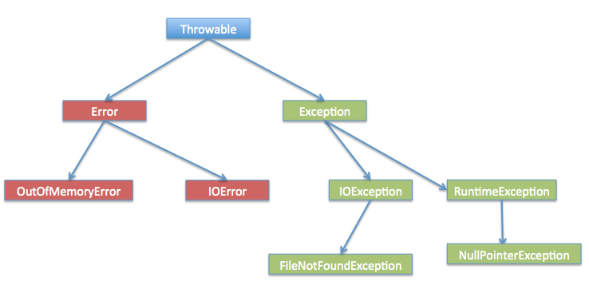
Notes:
Exception 类的层次
所有的异常类是从 java.lang.Exception 类继承的子类。
Exception 类是 Throwable 类的子类。除了Exception类外，Throwable还有一个子类Error 。
Java 程序通常不捕获错误。错误一般发生在严重故障时，它们在Java程序处理的范畴之外。
Error 用来指示运行时环境发生的错误。
例如，JVM 内存溢出。一般地，程序不会从错误中恢复。
异常类有两个主要的子类：IOException 类和 RuntimeException 类。

Slide 6
Catch exceptions
Use the try and catch keywords to catch exceptions. Try /catch blocks are placed where exceptions can occur.
The code in a try/catch block is called protected code, and the syntax for using try/catch is as follows:
try {
// code
}
catch( ExceptionName e1)
{
//Catch block
}
The Catch statement contains the declaration of the type of exception to Catch. When an exception occurs in the protected code block, the catch block after the try is checked.
If an exception occurs that is contained in a catch block, the exception is passed to that catch block, just as an argument is passed to a method.
Notes:
捕获异常
使用 try 和 catch 关键字可以捕获异常。try/catch 代码块放在异常可能发生的地方。
try/catch代码块中的代码称为保护代码，使用 try/catch 的语法如下：
Catch 语句包含要捕获异常类型的声明。当保护代码块中发生一个异常时，try 后面的 catch 块就会被检查。
如果发生的异常包含在 catch 块中，异常会被传递到该 catch 块，这和传递一个参数到方法是一样。

Slide 7
import java.io.*;
public class demo1{
public static void main(String args[]){
try{
int a[] = new int[2];
System.out.println("Access element three :" + a[3]);
}catch(ArrayIndexOutOfBoundsException e){
System.out.println("Exception thrown :" + e);
}
System.out.println("Out of the block");
}
}

Slide 8
Multiple capture block
A try block followed by multiple catch blocks is called multiple catch.
try{
// code
}catch(exception type1 exception var1){
// code
}catch(exception type2 exception var2){
// code
}catch(exception type3 exception var3){
// code
}
Notes:
多重捕获块
一个 try 代码块后面跟随多个 catch 代码块的情况就叫多重捕获。
上面的代码段包含了 3 个 catch块。
可以在 try 语句后面添加任意数量的 catch 块。
如果保护代码中发生异常，异常被抛给第一个 catch 块。
如果抛出异常的数据类型与 ExceptionType1 匹配，它在这里就会被捕获。
如果不匹配，它会被传递给第二个 catch 块。
如此，直到异常被捕获或者通过所有的 catch 块。

Slide 9
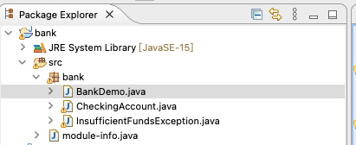
The simulation of bank account, through the number of the bank card to complete the identification, you can deposit and withdraw money operations.
Notes:
银行账户的模拟，通过银行卡的号码完成识别，可以进行存钱和取钱的操作。

Slide 10
package bank;
import java.io.*;
//simulated bank account
public class CheckingAccount
{
//number is card number
private double balance;
private int number;
public CheckingAccount(int number)
{
this.number = number;
}
//method: deposit money
public void deposit(double amount)
{
balance += amount;
}
//method: withdraw money
public void withdraw(double amount) throws
InsufficientFundsException
{
if(amount <= balance)
{
balance -= amount;
}
else
{
double needs = amount - balance;
throw new InsufficientFundsException(needs);
}
}
//method return banlance
public double getBalance()
{
return balance;
}
//return card number
public int getNumber()
{
return number;
}
}

Slide 11
package bank;
import java.io.*;
//Custom Exception class that inherits the Exception class
public class InsufficientFundsException extends Exception
{
//The amount here is used to store money that is not available when an exception occurs
//(when more money is withdrawn than the balance)
private double amount;
public InsufficientFundsException(double amount)
{
this.amount = amount;
}
public double getAmount()
{
return amount;
}
}

Slide 12
package bank;
public class BankDemo
{
public static void main(String [] args)
{
CheckingAccount c = new CheckingAccount(101);
System.out.println("Depositing $500...");
c.deposit(500.00);
try
{
System.out.println("\nWithdrawing $100...");
c.withdraw(100.00);
System.out.println("\nWithdrawing $600...");
c.withdraw(600.00);
}catch(InsufficientFundsException e)
{
System.out.println("Sorry, but you are short $"
+ e.getAmount());
e.printStackTrace();
}
}
}

Slide 13
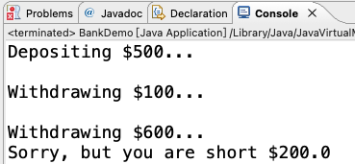

Slide 14
Threads

Slide 15
Java Multi-thread programming
Java provides built-in support for multi-thread programming.
A thread is a single sequential control flow in a process, and multiple threads can be concurrent in a process, each performing a different task in parallel.
Multi-thread is a special form of multitasking, but it uses less resource.
Process: a process consists of memory allocated by the operating system and contains one or more threads.
A thread cannot exist on its own and must be part of a process. A process runs until all non-daemons thread have finished.
Multi-thread can satisfy programmers to full use of CPU.
Notes:
Java 多线程编程
Java 给多线程编程提供了内置的支持。 一条线程指的是进程中一个单一顺序的控制流，一个进程中可以并发多个线程，每条线程并行执行不同的任务。
多线程是多任务的一种特别的形式，但多线程使用了更小的资源开销。
这里定义和线程相关的另一个术语 - 进程：一个进程包括由操作系统分配的内存空间，包含一个或多个线程。一个线程不能独立的存在，它必须是进程的一部分。一个进程一直运行，直到所有的非守护线程都结束运行后才能结束。
多线程能满足程序员编写高效率的程序来达到充分利用 CPU 的目的。

Slide 16
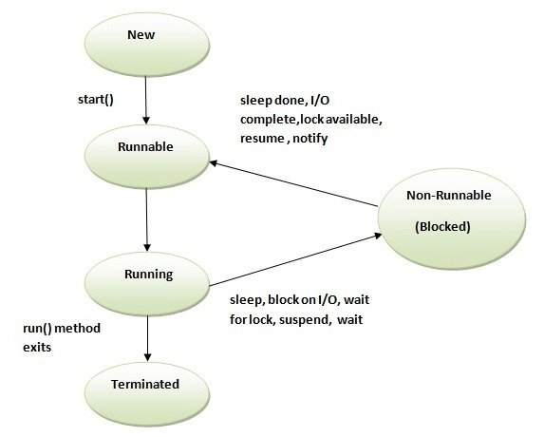
The life cycle of a thread
Notes:
新建状态:使用 new 关键字和 Thread 类或其子类建立一个线程对象后，该线程对象就处于新建状态。它保持这个状态直到程序 start() 这个线程。
就绪状态:当线程对象调用了start()方法之后，该线程就进入就绪状态。就绪状态的线程处于就绪队列中，要等待JVM里线程调度器的调度。
运行状态:如果就绪状态的线程获取 CPU 资源，就可以执行 run()，此时线程便处于运行状态。处于运行状态的线程最为复杂，它可以变为阻塞状态、就绪状态和死亡状态。
阻塞状态:如果一个线程执行了sleep（睡眠）、suspend（挂起）等方法，失去所占用资源之后，该线程就从运行状态进入阻塞状态。在睡眠时间已到或获得设备资源后可以重新进入就绪状态。可以分为三种：
等待阻塞：运行状态中的线程执行 wait() 方法，使线程进入到等待阻塞状态。
同步阻塞：线程在获取 synchronized 同步锁失败(因为同步锁被其他线程占用)。
其他阻塞：通过调用线程的 sleep() 或 join() 发出了 I/O 请求时，线程就会进入到阻塞状态。当sleep() 状态超时，join() 等待线程终止或超时，或者 I/O 处理完毕，线程重新转入就绪状态。
死亡状态: 一个运行状态的线程完成任务或者其他终止条件发生时，该线程就切换到终止状态。

Slide 17
New: When a Thread object is created by using the new keyword and the Thread class or its subclasses.. It remains in this state until the program starts() thread.
Runnable: When the thread object calls the start() method, the thread enters this state. A thread in runnable state means in a ready queue, waiting to be scheduled by the thread scheduler in the JVM.
Running: If the runnable thread acquires CPU resources, run() can be executed and the thread is running. The running thread is the most complex, and can be blocked, ready, or dead.
Blocked: If a thread executes methods such as sleep or suspend and loses occupied resources, the thread goes from running to blocked. You can re-enter the runnable state when sleep over or after obtaining device resources. It can be divided into three categories:
Wait to block: A running thread executes wait() to put the thread into blocked state.
Synchronized block: a thread fails to acquire a synchronized lock (because it is occupied by another thread).
Other block: The thread is blocked when an I/O request is made by calling the thread's sleep() or join(). When the sleep() state times out, join() waits for the thread to terminate or time out, or the I/O process completes, and the thread reverts to the runnable state.
Terminated: finish or terminated by other condition
Notes:
新建状态:使用 new 关键字和 Thread 类或其子类建立一个线程对象后，该线程对象就处于新建状态。它保持这个状态直到程序 start() 这个线程。
就绪状态:当线程对象调用了start()方法之后，该线程就进入就绪状态。就绪状态的线程处于就绪队列中，要等待JVM里线程调度器的调度。
运行状态:如果就绪状态的线程获取 CPU 资源，就可以执行 run()，此时线程便处于运行状态。处于运行状态的线程最为复杂，它可以变为阻塞状态、就绪状态和死亡状态。
阻塞状态:如果一个线程执行了sleep（睡眠）、suspend（挂起）等方法，失去所占用资源之后，该线程就从运行状态进入阻塞状态。在睡眠时间已到或获得设备资源后可以重新进入就绪状态。可以分为三种：
等待阻塞：运行状态中的线程执行 wait() 方法，使线程进入到等待阻塞状态。
同步阻塞：线程在获取 synchronized 同步锁失败(因为同步锁被其他线程占用)。
其他阻塞：通过调用线程的 sleep() 或 join() 发出了 I/O 请求时，线程就会进入到阻塞状态。当sleep() 状态超时，join() 等待线程终止或超时，或者 I/O 处理完毕，线程重新转入就绪状态。
死亡状态: 一个运行状态的线程完成任务或者其他终止条件发生时，该线程就切换到终止状态。

Slide 18
Create a thread
Java provides three ways to create threads:
By implementing the Runnable interface;
By inheriting the Thread class itself;
Create threads through Callable and Future.
Runnable:
public void run()
Notes:
创建一个线程
Java 提供了三种创建线程的方法：
通过实现 Runnable 接口；
通过继承 Thread 类本身；
通过 Callable 和 Future 创建线程。

Slide 19
class RunnableDemo implements Runnable {
private Thread t;
private String threadName;
RunnableDemo( String name) {
threadName = name;
System.out.println("Creating " + threadName );
}
public void run() {
System.out.println("Running " + threadName );
try {
for(int i = 4; i > 0; i--) {
System.out.println("Thread: " + threadName + ", " + i);
// let thread sleep...
Thread.sleep(50);
}
}catch (InterruptedException e) {
System.out.println("Thread " + threadName + " interrupted.");
}
System.out.println("Thread " + threadName + " exiting.");
}

Slide 20
public void start () {
System.out.println("Starting " + threadName );
if (t == null) {
t = new Thread (this, threadName);
t.start ();
}
}
public static void main(String args[]) {
RunnableDemo R1 = new RunnableDemo( "Thread-1");
R1.start();
RunnableDemo R2 = new RunnableDemo( "Thread-2");
R2.start();
}
}

Slide 21
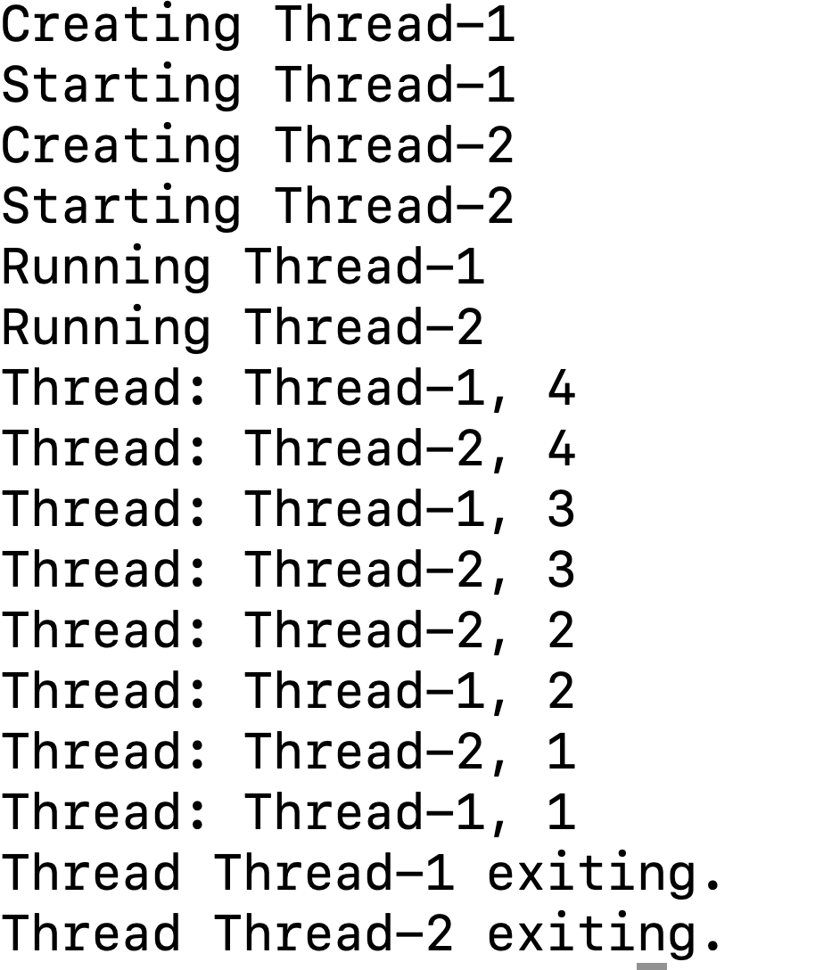

Slide 22
Threads are created by inheriting threads
class ThreadDemo extends Thread {
private Thread t;
private String threadName;
ThreadDemo( String name) {
threadName = name;
System.out.println("Creating " + threadName );
}
public void run() {
System.out.println("Running " + threadName );
try {
for(int i = 4; i > 0; i--) {
System.out.println("Thread: " + threadName + ", " + i);
// let thread sleep...
Thread.sleep(50);
}
}catch (InterruptedException e) {
System.out.println("Thread " + threadName + " interrupted.");
}
System.out.println("Thread " + threadName + " exiting.");
}
Notes:
通过继承Thread来创建线程

Slide 23
public void start () {
System.out.println("Starting " + threadName );
if (t == null) {
t = new Thread (this, threadName);
t.start ();
}
}
public static void main(String args[]) {
ThreadDemo T1 = new ThreadDemo( "Thread-1");
T1.start();
ThreadDemo T2 = new ThreadDemo( "Thread-2");
T2.start();
}
}

Slide 24
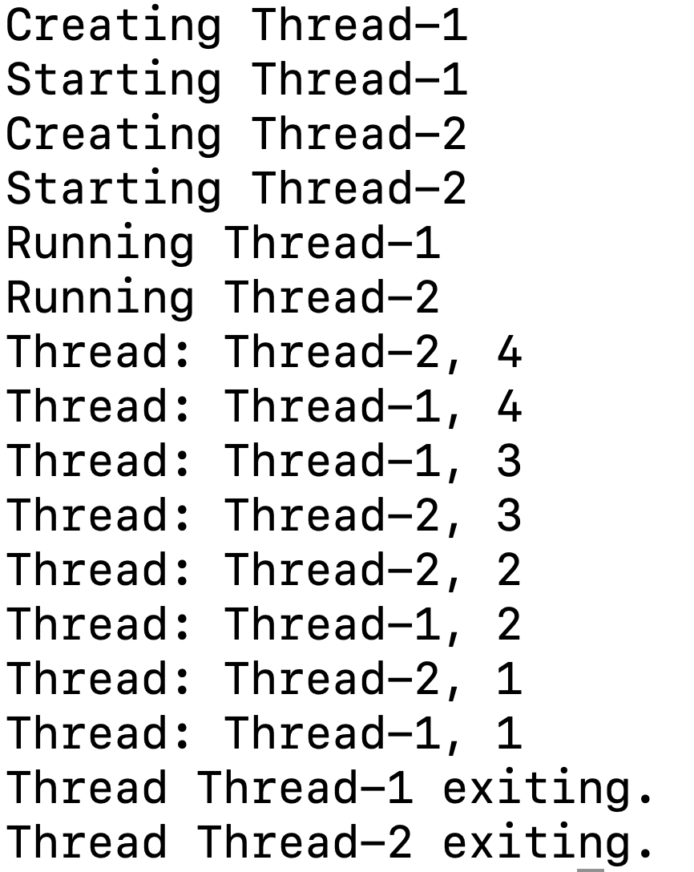

Slide 25
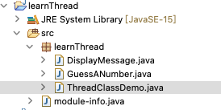

Slide 26
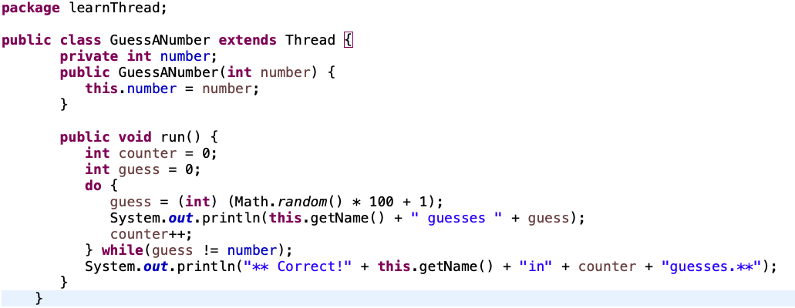

Slide 27
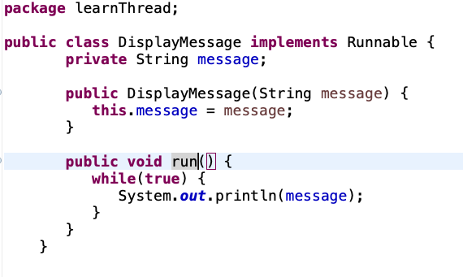

Slide 28
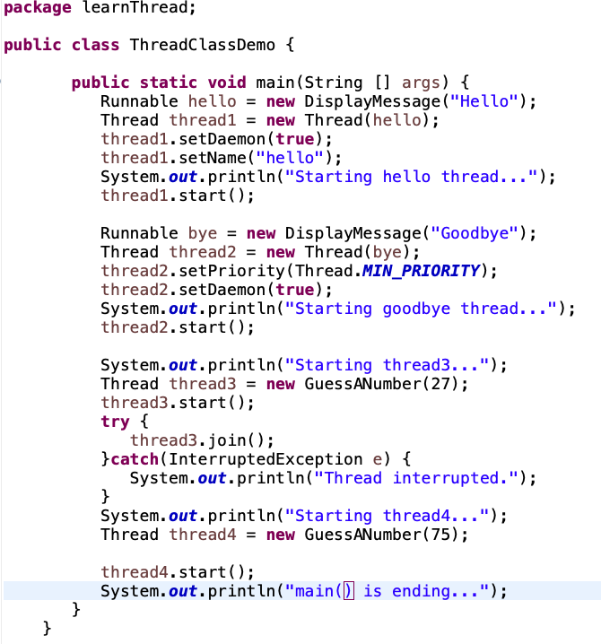

Slide 29
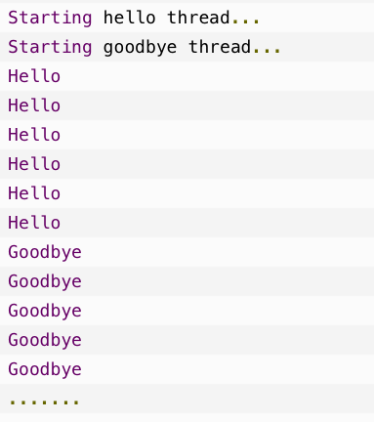

Slide 30
Practice

Slide 31
Task-1
- the parent class (Electronics), describe the attributes of the class (such as weight, price, power consumption and manufacturer), and corresponding management methods, such as output device information, etc.;
-Design and implement a group of subclasses: for example, Computer (add memory and CPU model attributes), mobile Phone (add system (Android/IOS/Windows), storage space attributes).
-Define methods for getting and setting attributes for each subclass, as well as administrative methods, such as output device information, and so on.
Task-3
-The simulation of personal medicine system, through medicine card number and name to complete the identification, the medicine card will automatically get credit from company every month, and you can also withdraw credit form medicine card.
Task-4
-Creating multiple threads to run a function(e.g., print)
Notes:
类的继承与方法覆写
设计一个车类(Vehicles)，其属性包含汽车商标(brand)、颜色(color)；其方法包含构造方法（要求初始化其成员属性）、获取/设置成员属性方法（getX和setX）、当前速度(currentSpeed，随机数生成，0-100之间)、车辆信息(showInfo，输出其属性信息)。
设计小轿车类(Car)，该类继承于Vehicles，并增加座位数量属性(seats)，覆写当前速度方法(currentSpeed，范围在0-180之间)，覆写车辆信息方法(showInfo，输出小轿车的信息），请注意小轿车类的构造方法并初始化其成员属性(请使用 super)。
要求：UML 类图设计、源代码编写、演示、截图运行结果。

