Slide 1

Home
Sidebar for navigation to other steps
Home
1
Upload Dataset
Upload Dataset
Select
Target + Features
Storyboarding key:
Choose + Run Model
1
= step (numbered in sequential order)
= next display if step was not performed/performed incorrectly
= next display if step was performed correctly
= explanation box
View Results
asdf

Slide 2

Upload Dataset
Home
Upload Dataset
Upload a file (CSV):
1
Select
Target + Features
Drag and drop file here
Browse files
Choose + Run Model
Please upload a dataset first
Warns user if dataset not uploaded, otherwise if dataset is uploaded user can move to next step.
View Results
2
Select Target + Features

Slide 3
Select Target + Features
Home
Select 1 target variable:
User must only select 1 column from dropdown in dataset as target variable
1
>
Choose an option
Upload Dataset
Please choose a target variable first.
Select
Target + Features
2
Identify the positive outcome:
>
User must only select 1 column value from dropdown as positive outcome in classifier.
Choose + Run Model
Choose an option
Please choose a positive outcome first.
View Results
Select 1+ features:
3
>
User must select 1 or more columns from dropdown in dataset as features. The target variable column from previous step will be omitted from dropdown options.
Choose an option
Please choose 1+ features first.
4
Choose + Run Model

Slide 4
Select Target + Features
Home
Upload Dataset
1
Missing dataset. Please go back and complete 'Upload Dataset'.
Select
Target + Features
Choose + Run Model
Warns user if they skipped ahead and did not upload a dataset yet. User must go to previous step and upload dataset.
View Results

Slide 5

Choose + Run Model
Home
Choose 1+ classification models:
1
Logistic Regression
User must select 1 or more classification models (maximum of 3 classification models).
Upload Dataset
Random Forest
Support Vector Machine
Select
Target + Features
Please select 1+ classification models.
Choose + Run Model
2
Adjust Slider for Test % in Train Test Split:
User can specify train-test split from 1-99%. 20% is selected as default value. A value will always be between 1-99%, therefore no wrong step
1
20
99
View Results
Type a random state (a positive integer):
3
0
Value must be between [0, 9007199254740991]
4
Run Model(s)
User presses button to fit and run AutoML model(s).
5
View Results
User presses button after running models to view model performance results.

Slide 6
Choose + Run Model
Home
1
Missing target variable. Please go back and complete 'Select Target + Features’.
OR
Missing positive outcome. Please go back and complete 'Select Target + Features’.
OR
Missing features. Please go back and complete 'Select Target + Features'.
Upload Dataset
Select
Target + Features
Choose + Run Model
View Results
Warns user if they skipped ahead. User must go to previous step and complete ‘Select Target + Features’.

Slide 7
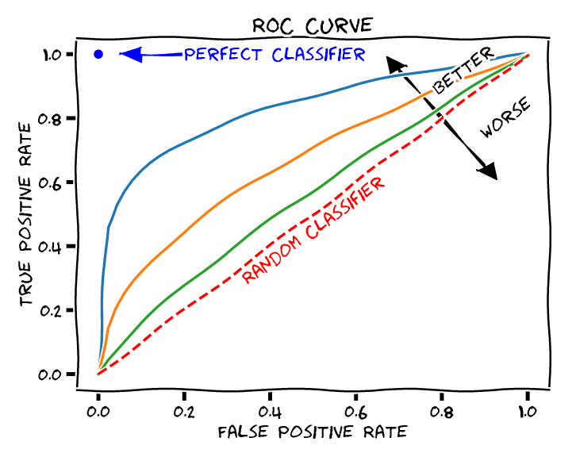
View Results
Home
Displays ROC curve as a graphical visualization of the results to the user. If multiple models were chosen, multiple ROC curves (one for each model) would be plotted here.
Upload Dataset
Select
Target + Features
Choose + Run Model
Performance Metrics:
1
Select between train/test metrics:
User can toggle between Train and Test performance results.
View Results
☑ Train ☐ Test
 | Logistic Regression | Random Forest | Support Vector Machine
Accuracy | X.XX | X.XX | X.XX
Precision | X.XX | X.XX | X.XX
AUC-ROC | X.XX | X.XX | X.XX
Table displays performance metrics to user up to 2 decimal places for clear viewing
2
User can restart the process by pressing the home button.
Home

Slide 8
View Results
Home
Upload Dataset
1
Missing results. Please go back and complete 'Choose + Run Model'.
Select
Target + Features
Choose + Run Model
Warns user if they skipped ahead and did not get the models’ results yet. User must complete the previous ‘Choose + Run Model’ step.
View Results

