Slide 1
SaaS, PaaS and IaaS

Slide 2
Software as a Service
Software as a service (SaaS) is a software licensing and delivery model in which software is licensed on a subscription basis and is centrally hosted.
It is sometimes referred to as "on-demand software".
SaaS has become a common delivery model for many business applications, including office and messaging software, payroll processing software, DBMS software, etc.

Slide 3
Platform as a Service
Platform as a service (PaaS) is a category of cloud computing services that provides a platform allowing customers to develop, run, and manage applications without the complexity of building and maintaining the infrastructure typically associated with developing and launching an app.
PaaS can be delivered in two ways:
Public cloud service: the consumer controls software deployment with minimal configuration options.
Private cloud service: inside the firewall, or as software deployed on a public infrastructure as a service.

Slide 4
Infrastructure as a Service
Infrastructure as a Service (IaaS) is a form of cloud computing that provides virtualized computing resources over the Internet.
In an IaaS model, a third-party provider hosts hardware, software, servers, storage and other infrastructure components on behalf of its users.
IaaS platforms offer highly scalable resources that can be adjusted on-demand.

Slide 5
Cloud components
Logical and physical components

Slide 6
What are logical components?
So-called system software, such as the operating system, which basically allow the rest of the programs to work properly, also facilitating interaction between the physical components and the rest of the applications, and providing an interface with the user.
Logical components include, among many others, computer applications, such as the word processor, which allow the user to perform all tasks related to text editing.

Slide 7
What are the physical components?
These components typically consist of a front end platform (fat client, thin client, mobile device), back end platforms (servers, storage), a cloud based delivery, and a network (Internet, Intranet, Intercloud).
Combined, these components make up cloud computing architecture.

Slide 8
Oracle Cloud

Slide 9
Software as a Service Oracle Cloud
Oracle Cloud SaaS applications deliver the speed and innovation of the best cloud software in a complete, secure, connected suite.
Integrated with modern best practice processes and the social, mobile and analytical capabilities they include, Oracle Cloud applications help you deliver the experiences your customers expect, the talent they need to succeed, and the performance the market demands.

Slide 10
Platform as a Service Oracle Cloud
The Oracle Cloud PaaS provides a shared and elastically scalable platform for consolidation of existing applications and new application development and deployment.
The Oracle Cloud PaaS provides some benefits:
Engineered systems deliver unparalleled speed and the highest consolidation efficiency.
Oracle PaaS includes capabilities for cloud application development and deployment, cloud management, cloud security, and cloud integration.
Etc.

Slide 11
Infrastructure as a Service Oracle Cloud
Oracle Infrastructure as a Service now includes a high-performance architecture that avoids overprovisioning and provides industry-leading compute and network price and performance.
With parallel capabilities to your own corporate data center, you can rely on the Oracle Cloud for all enterprise workloads.
No other public cloud provider has engineered as extensive a solution to meet enterprise needs.

Slide 12
Logical components in Oracle Cloud
Oracle Cloud has a lot of logical components, one of this are the logical database structures, this include:
Tablespaces
Schema objects
Data blocks
Extents
Segments

Slide 13
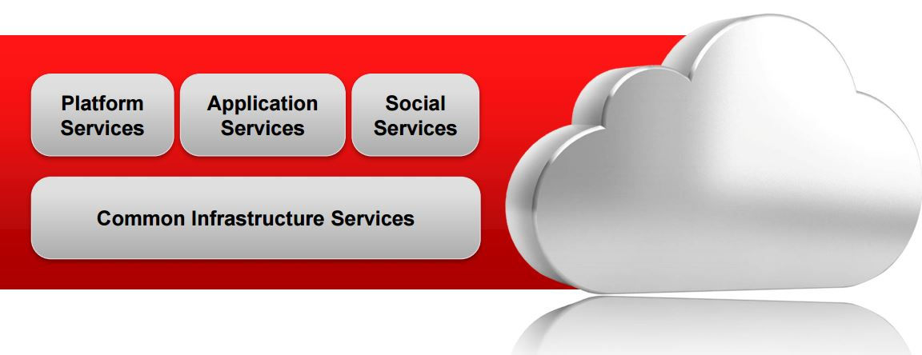
Architecture in Oracle Cloud

Slide 14
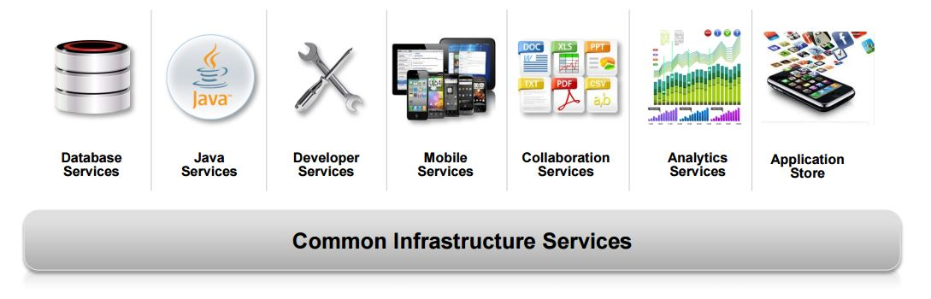
Architecture in Oracle Cloud

Slide 15
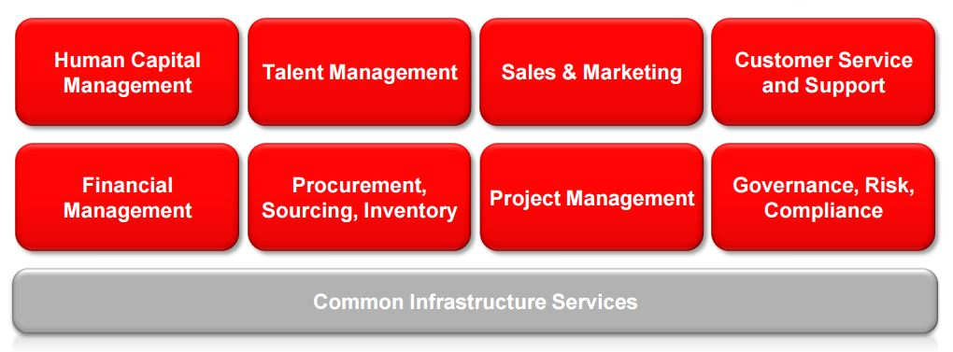
Architecture in Oracle Cloud

Slide 16
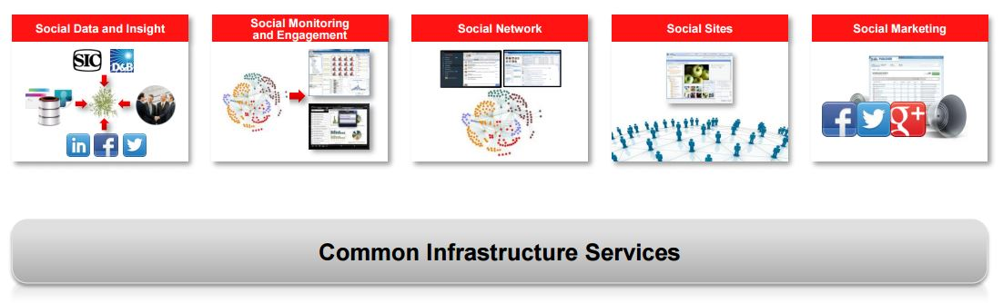
Architecture in Oracle Cloud

Slide 17
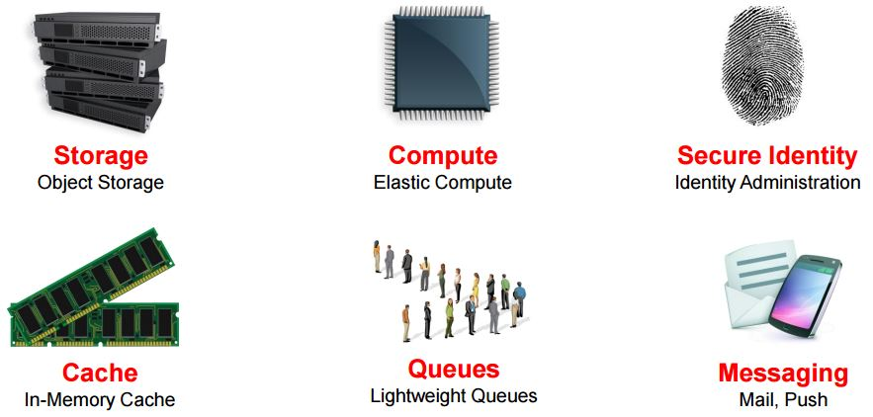
Architecture in Oracle Cloud

Slide 18
Business model in Oracle Cloud
David Vellante Co-founder & co-CEO SiliconANGLE Media, says “The cloud is really a business model, Oracle is now starting to recognize it as revenue. They’re running now at almost $2 billion a year in cloud revenue”.

Slide 19
Service level agreement for Oracle Cloud
Service level agreements (SLA) are technical specifications that determine how the system must perform under certain conditions.
Oracle Cloud has SLA for some requirements like:
Defining Performance Requirements
Defining Availability Requirements
Defining Scalability Requirements
Defining Security Requirements
Defining Latent Capacity Requirements
Defining Serviceability Requirements

Slide 20
Microsoft Azure

Slide 21
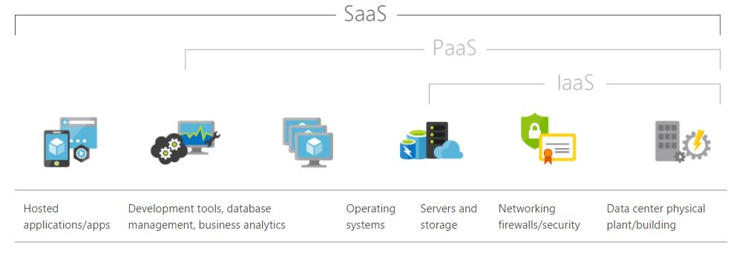
Software as a Service Microsoft Azure

Slide 22
Software as a Service Microsoft Azure
SaaS provides a complete software solution that you purchase on a pay-as-you-go basis from a cloud service provider.
You rent the use of an app for your organization, and your users connect to it over the Internet, usually with a web browser.
All of the underlying infrastructure, middleware, app software, and app data are located in the service provider’s data center.

Slide 23
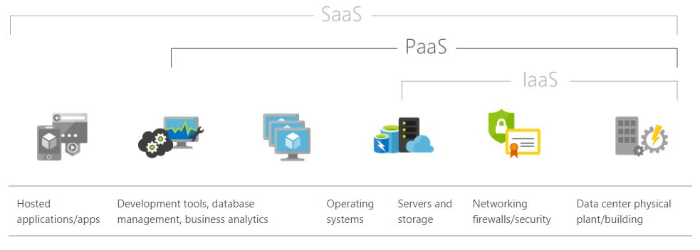
Platform as a Service Microsoft Azure

Slide 24
Platform as a Service Microsoft Azure
PaaS is a complete development and deployment environment in the cloud, with resources that enable you to deliver everything from simple cloud-based apps to sophisticated, cloud-enabled enterprise applications.
You purchase the resources you need from a cloud service provider on a pay-as-you-go basis and access them over a secure Internet connection.

Slide 25
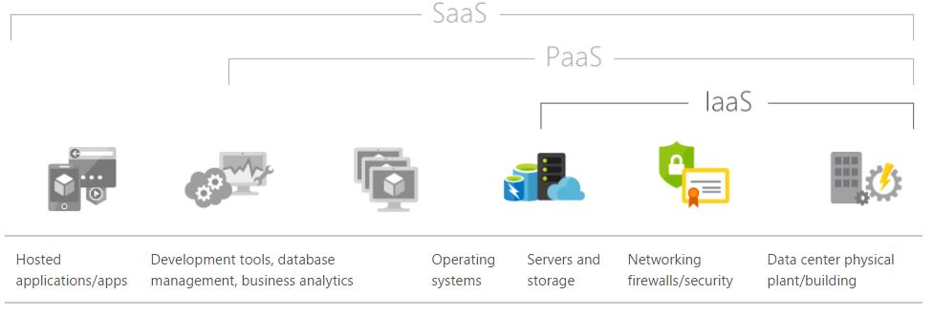
Infrastructure as a Service Microsoft Azure

Slide 26
Infrastructure as a Service Microsoft Azure
IaaS is an instant computing infrastructure, provisioned and managed over the Internet. Quickly scale up and down with demand, and pay only for what you use.
Each resource is offered as a separate service component, and you only need to rent a particular one for as long as you need it.

Slide 27
Logical Components in Microsoft Azure
The logical components of Microsoft Azure are the same that Oracle Cloud, since there are a standard components.

Slide 28
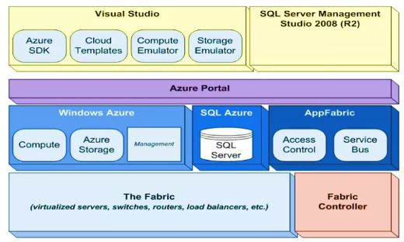
Architecture in Microsoft Azure

Slide 29
Architecture in Microsoft Azure
The architecture of Microsoft Azure is the next:
Fabric: the physical components, like servers, routers,, switches, etc.
Fabric controller: is the software that allows the physical components could work.
Windows Azure: is the SO of the cloud.
SQL Azure: is the databases system of the cloud.
AppFabric: is the component that has the Access Control, Service Bus and Caching Server.
Azure Portal: Web portal that allows the administration of all the resources offered by the Azure platform.
Tools: Development environments for the implementation of cloud solutions such as Visual Studio or SQL Server Management Studio.

Slide 30
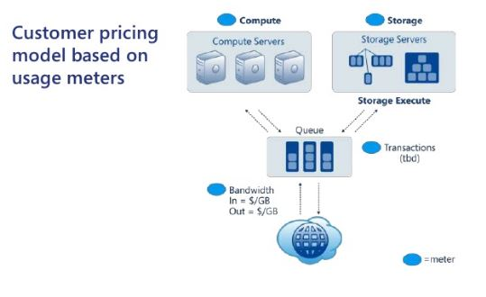
Business model in Microsoft Azure

Slide 31
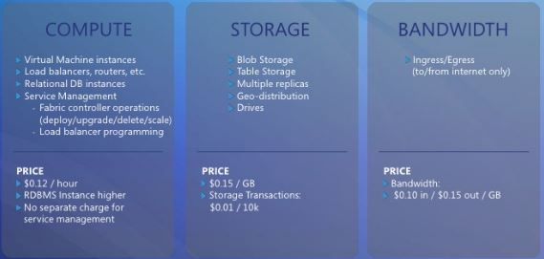
Business model in Microsoft Azure

Slide 32
Service level agreement in Microsoft azure
The Service Level Agreement (SLA) describes Microsoft’s commitments for uptime and connectivity.
Microsoft Azure has a list of SLA for all the individual Azure services, like:
Compute.
Networking.
Storage.
Web + Mobile.
Databases.
Etc.

Slide 33
high availability configuration for installation on premises

Slide 34
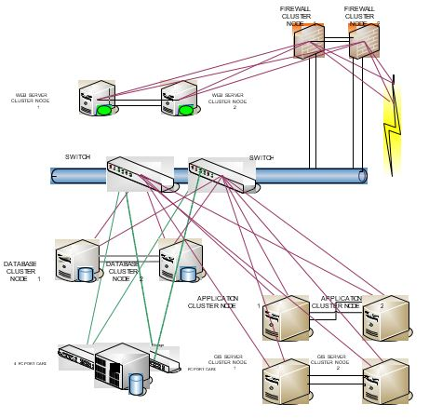

Slide 35
Assume h/w costs
"web server cluster node" =1k euros (mini size) "application cluster node" =2K euros (mid size) "data base cluster node" and "GIS cluster node" =5k euros (large size) Assume firewall cluster node cost 5k euros and 12 TB of useful RAID 6 storage costing 8k euros.

Slide 36
Bibliography
https://azure.microsoft.com
http://es.slideshare.net/rramabad/azure-overview-business-model-overview
http://blogs.itpro.es/eduardocloud/2014/05/16/cuales-son-los-componentes-de-la-plataforma-azure/
http://www.oracle.com/
https://www.wikipedia.org/

