Slide 1
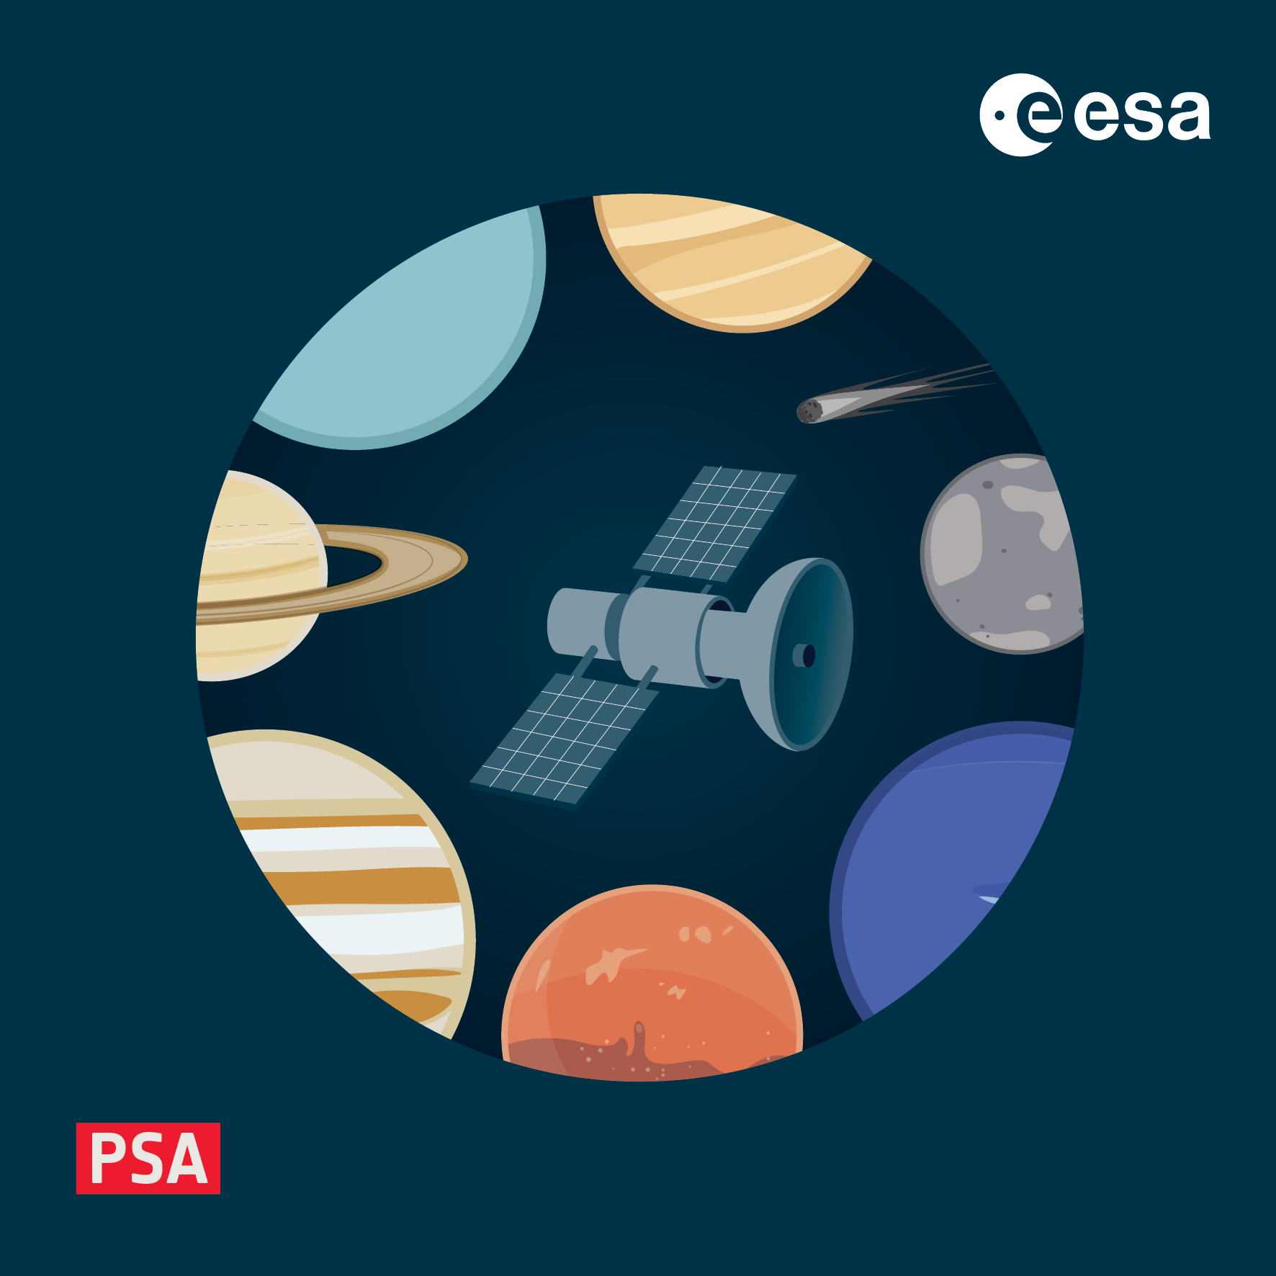
How to build a PDS4 archive
4-8 November 2024, ESAC, Spain

Slide 2
How to approach building a PDS4 archive
Before even thinking about the details of the products, usually a high-level plan is needed:
what types of products will be generated?
at each processing level
how will they be split?
per observation? per day?
how will this split be managed?
simply from telemetry? from details of instrument commanding (e.g. observation log)
how many products will be generated?
are some of these calibration observations/products?
if so, they should go in a calibration collection
no calibration inputs should be "hidden" in a pipeline

Slide 3
Example of a high-level instrument archive
Primary data, processing level | Description
Raw
Partially processed
Calibrated
Derived
Ancillary data, type | Description
Calibration
Geometry
Browse
Miscellaneous

Slide 4
Example of a high-level instrument archive
Raw data description:
The MERTIS raw products consist of packet of Digital Units from the Spectrometer/Bolometer (TIS) and Radiometer (TIR) channels. Data are acquired on a spectral basis for TIR and on hyper-spectral image basis for TIS (push-broom imaging mode). Data packets contain all the relative acquisition ancillary data. All raw spectra are a vector of values (spectral channels), where the values correspond to data numbers (DNs).
Supplementary data associated with these products include the radiometric and spectral calibration coefficients derived during the on-ground calibration in the form of calibration matrices.
The MERTIS raw science products consist of a collection of Spectrometer/Bolometer (TIS) and Radiometer (TIR) “push-broom” measurements in data numbers (DN). The science data are split per sensor (TIR or TIS) and per [mode, binning, windowing] acquisition parameters. Each are produced as PDS4-compliant FITS (Flexible Image Transport System) files. A TIS product is a 3D cube (time x spectral x spatial) with an associated metadata table hosting timing and instrument relevant information. A TIR product consists in 3 tables, one per channel A/B of the TIR, and one hosting the metadata. The science data are complemented by subsets of data extracted from the housekeeping data (default and extended) around the times of science acquisition.

Slide 5
Example of a high-level instrument archive
Calibrated data description:
Derived data description:
Raw spectra DNs are converted to radiance values by applying calibration algorithms based on calibration parameters derived from on-ground instrument calibration measurements and in-flight calibration, and noise optimisation strategies developed in laboratory. The formats of the calibrated data are similar to that of the raw data, but include additional content such as the wavelengths and geometric quantities (viewing angles and coordinates per pixel).
Different types of calibrated products are produced:
Radiometrically and geometrically corrected data by applying on-ground
Calibration data
Geometrically registered products, using MPO attitude data.
Surface temperatures, thermal inertia and emissivity maps are the first-order derived products. From these first order derived products, MERTIS shall identify the following mineral phases and their correlation to surface features: Christiansen features and Reststrahlen bands of proposed surface minerals, Differentiation of end-member of plagioclase group, Pyroxenes, Elemental sulphur, Representation of complex mineral spectra (e.g. sulphates).
Spatial coverage and resolution will depend on altitude and orbit. The delivered derived products will include interpolated maps of key wavelengths, temperatures, thermal inertia and emissivity.

Slide 6
Product split, number, size etc.
At the next level of detail it is useful to think about how the raw products will be generated from a TM stream
for a monitoring instrument (always on) - split per day?
for an imaging instrument – split per exposure?
Is the split sane with respect to size and numbers of products generated?
Calibrated products often mirror raw products 1:1, but not always. For example some may be:
dropped due to not meeting quality constraints
split according to other inputs
If data are being generated operationally, there may be additional constraints
can partial products be generated from incomplete telemetry?
if telemetry is requested/sent per e.g. day can the pipeline avoid artificial splits at midnight?

Slide 7
Define each product type
At this point a table of each product type can be made, listing the key properties of each one
each product is likely to need its own PDS4 template to be fleshed out in a pipeline
Logical identifier | Description | Data structure | Product type | Processing level | Collection | Path
instr_raw_hk_yyyymmd | Housekeeping data TM(25) | Table_Binary 2 tables | Observational | Raw | data_raw | <mission_phase>/<yyyymm>
instr_cal_sc_<detector>_<mode>_yyyymmdd_<obs #> | Science data from each detector in binary arrays | Array_3D_Spectrum | Observational | Calibrated | data_calibrated | <mission_phase>/<detector>/<yyyymm>
instr_calib_gnd_calibration_coefs | Calibration coefficients derived on ground | Table Delimited | Ancillary | Derived | calibration_files
instr_geom_<detector>_<mode>_yyyymmdd_<obs #> | Per-pixel geometry | Array_3D | Ancillary | Derived | geometry | <mission_phase>/<detector>/<yyyymm>

Slide 8
Create a minimal product (template)
With this table it is possible to write a template for each product type
initially without any discipline or instrument-specific meta-data
But WITH links to the PSA dictionary to ensure it meets ingestion criteria
Most pipelines use some kind of templating mechanism to populate these templates and make real products
template engines like Jinja, XML packages (e.g. xml/lxml in python), simple “search and replace” of embedded tags
For test purposes, it is really helpful to have a fully populated example for each template
which can be fully validated and opened with PDS4 tools
for this a corresponding data product is of course needed
Your friendly neighbourhood archive scientist can provide templates where needed
This kind of “minimal product” is a milestone. Products at this point:
can be ingested into the PSA
can be opened with standard tools and used
However, they are probably not scientifically usable because they are missing all the domain and discipline-specific meta-data

Slide 9
Collect relevant meta-data
Meta-data come from a variety of sources for a variety of reasons
housekeeping values may be time-correlated to observations and included as meta-data
e.g. sensor temperature
meta-data can also be used to search/filter data product
e.g. instrument mode/channel/filter
some meta-data can be inserted by the pipeline for quality control
e.g. flagging a data product with very high noise levels
Making a table of these is the first step
then we can figure out whether these already appear in existing dictionaries
if not, then we can
request to the discipline dictionary stewards to expand their dictionary, or
add to mission or instrument dictionary
After the dictionaries have been created
template headers can be updated with the new dictionaries
the new classes and attributes can be used in product labels

Slide 10
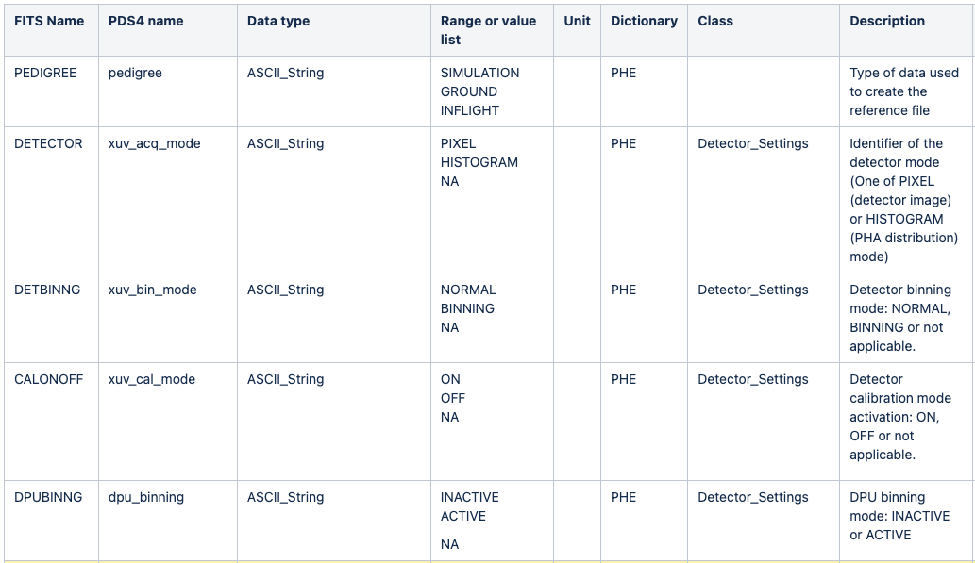
Collected meta-data
An example of a few attributes in one class in an instrument dictionary

Slide 11
Building a validate template/product
This is the topic of the next talk, but in brief you have several ways to build your template
start from the schema
many tools can build templates from schema, with options to include optional elements or not
start from an example from another mission/instrument, or (in most cases),
start from an example provided by your archive scientist.

Slide 12
What else needs to go into the archive?
Don’t forget about the document collection!
at minimum a Data User Guide is needed (see later)
Other documents may be useful for users to understand the instrument and its data, for example:
Instrument user manual
Calibration reports
TM/TC description
Pipeline user manual
As well as in-flight data, it is sometimes necessary, or at least useful, to archive laboratory calibration data

Slide 13
Putting it all together
As well as individual products, a complete PDS4 bundle has a few other objects that tie everything together
Product_Bundle
This product describes the bundle and its child collections, as well as referencing any bundle-level “readme” type files. There is only one Product_Bundle per bundle (in PSA, per instrument).
Product_Collection
This product describes the collection and its contents, including an inventory (CSV file) of all of the products it contains (by LIDVID).
For missions providing data to PSA operationally, the inventory will be updated with every ingestion or deletion to reflect the new contents.
For missions providing data in bundles, this file must be present and correct
validate will check this against archive contents.
Remember that products can only appear in one bundle and collection
But may be referenced as secondary members of any other collection
By reference only, in the collection inventory

Slide 14
Putting it all together
Each PDS4 product contains a Reference_List class which can be used to refer to other products
inside the current bundle, or outside of it – even outside of the archive.
These references are very important in connecting all the pieces together, for example to link:
Higher level data to lower level inputs (data products, calibration products, etc.)
Data products to corresponding browse products
Data products to corresponding geometry products
Data products to documents
etc. etc.
Versioning also needs to be considered
When will a major version be incremented? For a significant re-calibration?
How and where is this documented?
Remember that old products (once public) are generally not removed from the archive
since they may have been used

Slide 15
Summary
Follow this checklist/process:
Describe your products at high level, for each processing level
Define each product type (for each collection)
Collect meta-data needs and see if they fit into core and discipline dictionaries
Create local dictionaries if necessary
Prepare templates for each product type, and make sure they validate
Write your pipeline to process telemetry and lower level products and flesh out templates
At the end of the process, don’t forget to budget for changes needed after review

