Slide 1
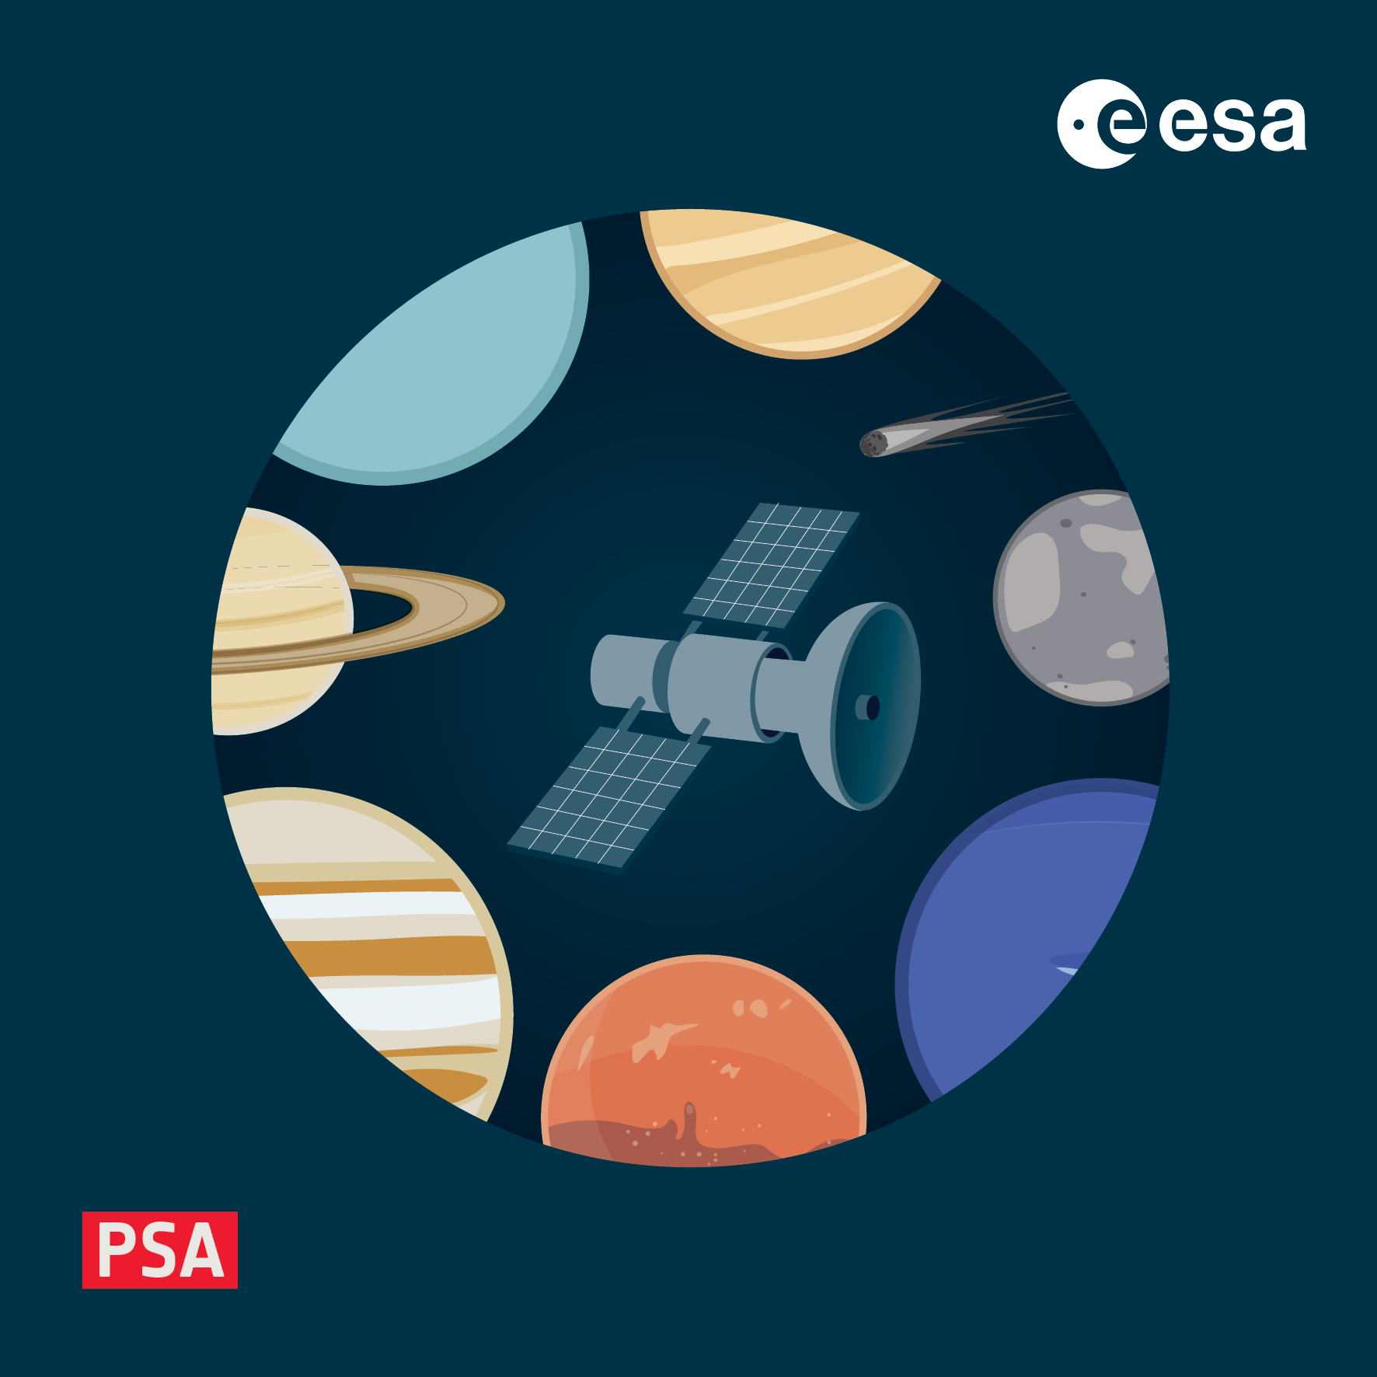
Hands-on setup
4-8 November 2024, ESAC, Spain

Slide 2
Introduction to the tools
Hopefully most of you have taken a look at https://www.cosmos.esa.int/web/pds4-workshop/tools
Tools we will be using:
An XML-aware text editor or IDE
for example, VSCode or its open-source equivalent VSCodium
plus the RedHat XML extension
the most full-featured editor, which does Schemtron as well as schema validation, is oXygen XML editor
this is a commercial product, but a trial license key can be requested
Validate
the PDS-provided validation tool used to check data and meta-data conformity
this requires java >= 11
LDDTool
the PDS-provided tool to build local data dictionaries, needed for some hands-on activities
this requires java >= 11
PDS4 Viewer
a tool to open/display any valid PDS4 data product
users who are familiar with python and tools such as conda may prefer to install PDS4 Tools, the python library on which PDS4 viewer is based
PDS4 Tools is available in the conda-forge community repository

Slide 3
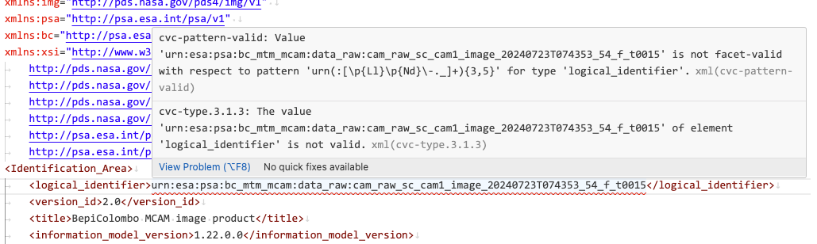
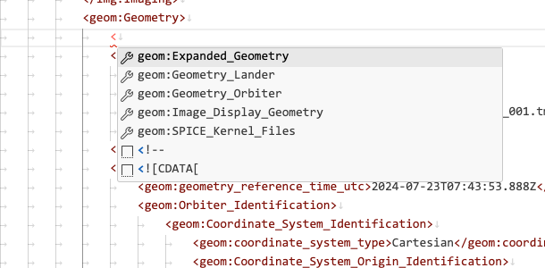
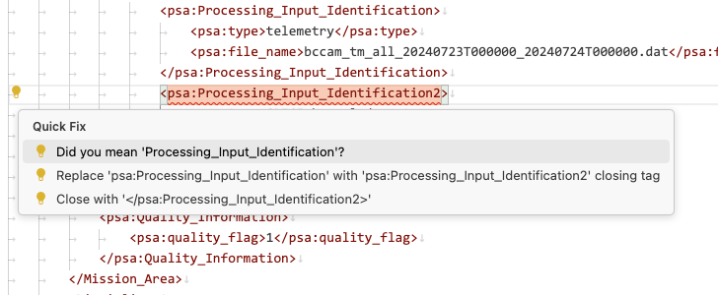
XML-aware text editor or IDE
Any decent editor or IDE probably supports XML. Key things to look for:
syntax highlighting
schema validation
insertion of elements from schema
XML formatting
etc.

Slide 4
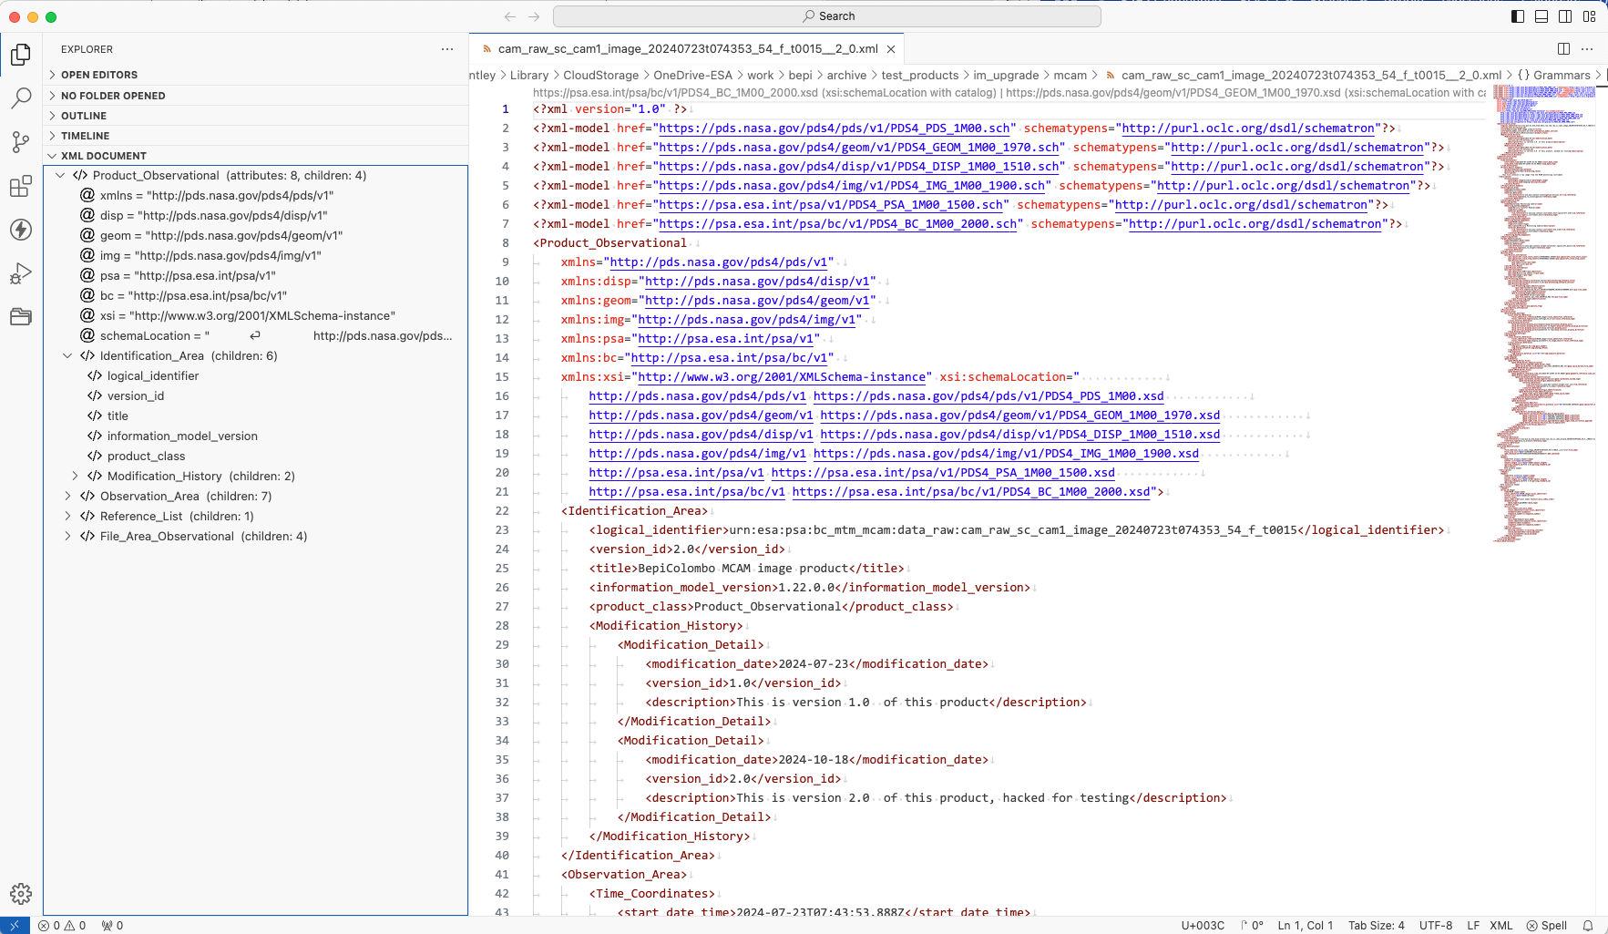
XML-aware text editor or IDE

Slide 5
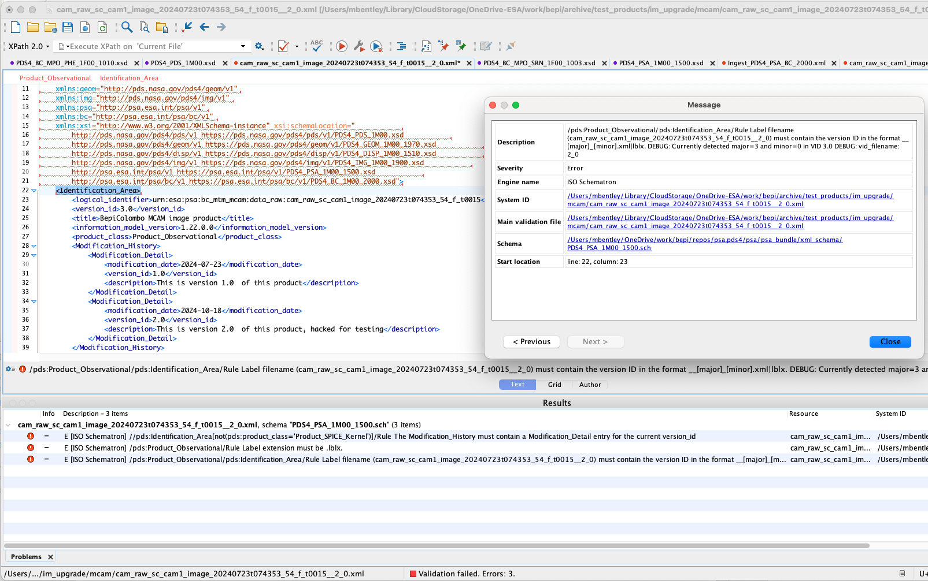
XML-aware text editor or IDE
Finding an IDE/editor that does schema AND Schematron validation is more difficult

Slide 6
validate
https://nasa-pds.github.io/validate/
requires 64-bit java >= 11
see https://openjdk.org/install/ or use your OS package manager to install
test with e.g. $ java –version
note that we will use “$” to represent your prompt, but it may look different!
Once you have java installed and validate unpacked and in your path, try to run, e.g.
$ validate -version
gov.nasa.pds:validate
Version 3.5.2
Release Date: 2024-06-12 18:07:46
Copyright 2019, by the California Institute of Technology ("Caltech").
All rights reserved.

Slide 7
validate
validate requires access to the schema (.xsd) and Schematron (.sch) declared in the label to run
it will try to go online and find these at their respective URLs
PDS dictionaries should always be found
PSA (PSA, mission, instrument) dictionaries under development may not be online yet
in this case a catalogue file can be used
this allows XML-aware tools to look locally for content at a given URL prefix
Examples in this workshop have been curated to only use online dictionaries
but when you build your own, you will either need to use a catalogue
or include the local path to the dictionary in the label
validate also has a built-in list of context products known to PDS to validate against
not all PSA context products are registered with PDS
so validate allows a local set of context products to be referenced by --add-context-products

Slide 8
LDDTool
The dependencies and install for LDDTool are very similar to validate
https://nasa-pds.github.io/pds4-information-model/model-lddtool/index.html
Note that LDDTool can build dictionaries against a range of supported PDS core (information model) versions
% lddtool -v
LDDTool Version: 15.2.0-SNAPSHOT
Built with IM Version: 1.23.0.0
Build Date: 2024-10-07 18:28:58
Configured IM Versions: [1N00, 1M00, 1L00, 1K00, 1J00, 1I00, 1H00, 1G00, 1F00, 1E00, 1D00, 1C00, 1B10, 1B00]
>> INFO DMDoc Version: 15.2.0-SNAPSHOT
>> INFO IM Version Id: 1.23.0.0
>> INFO IM Namespace Id: pds
>> INFO IM Label Version Id: 1.0
>> INFO Date: Tue Oct 22 12:22:24 CEST 2024
>> INFO PARENT_DIR: /Users/mbentley/OneDrive/software/pds/lddtool-15.2.0-SNAPSHOT/Data/
-- IMTool Execution Summary --
0 warning(s)
0 error(s)
0 fatal error(s)

Slide 9

PDS4 viewers
There are several tools that will read PDS4 (meta-)data, including:
Topcat: https://www.star.bris.ac.uk/~mbt/topcat/
works with tables (Table_Delimited, Table_Binary)
handles large (multi-GB) files well
PDS4-IDL: https://github.com/Small-Bodies-Node/PDS4-IDL
pdr: https://pdr.readthedocs.io/en/latest/
works with PDS3 and PDS4 data
PDS4 Tools: https://pdssbn.astro.umd.edu/tools/pds4_tools_docs/
python library, works with all data types, includes a basic viewer
PDS4 Viewer: https://sbnwiki.asteroiddata.org/PDS4_Viewer.html
a standalone build of PDS4 Tools which launches the viewer
It is recommended to have at least one of these installed to view products!

Slide 10
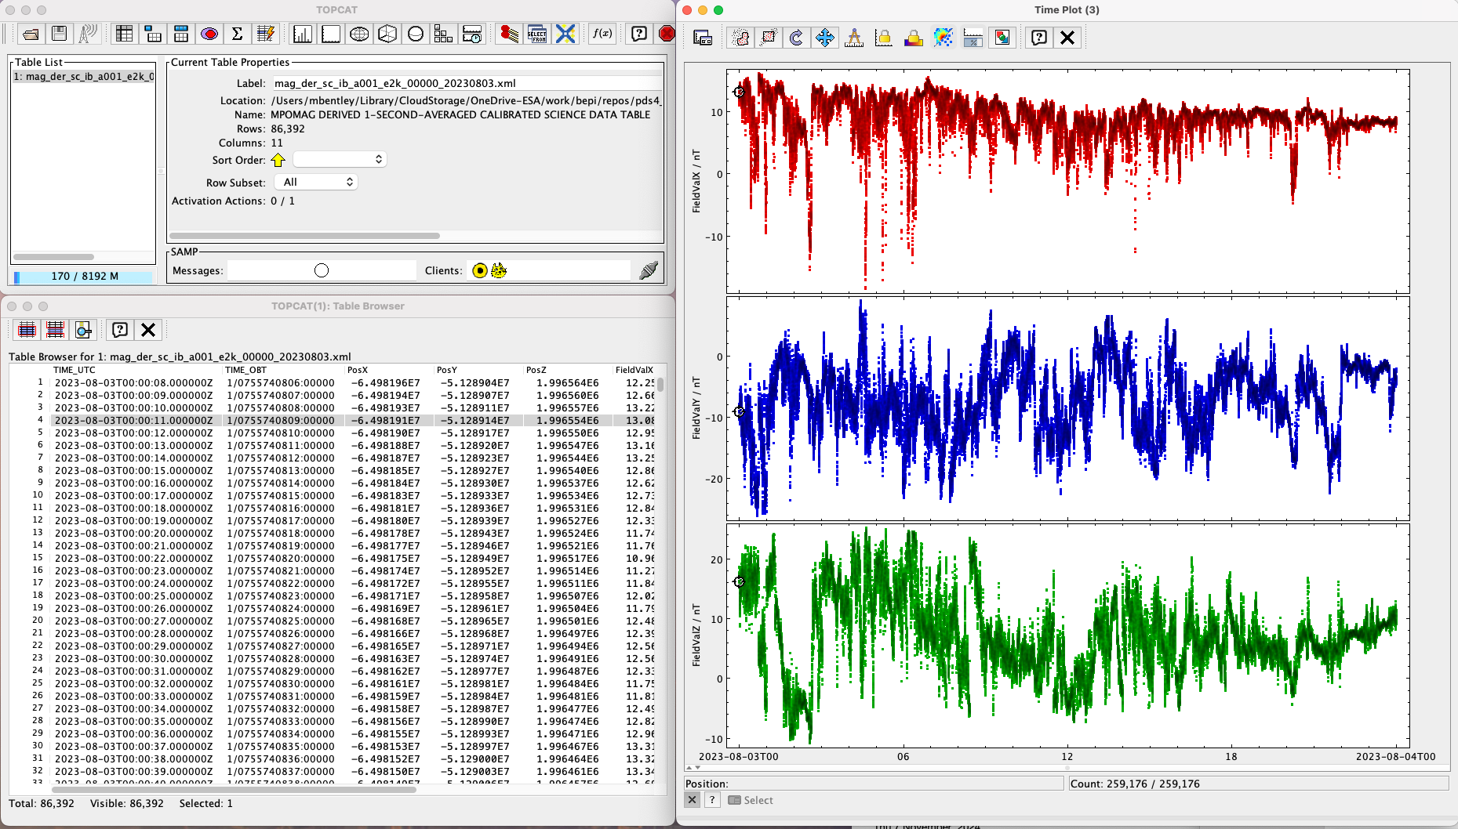
Topcat

Slide 11
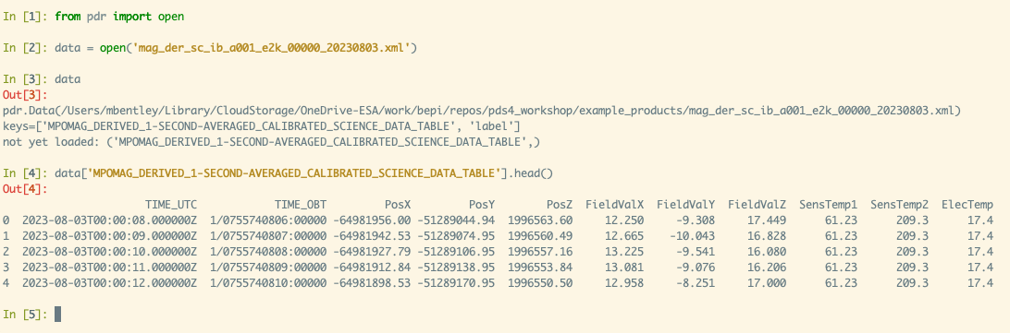
pdr
https://pdr.readthedocs.io/en/stable/
installable via conda (conda-forge channel) and pip

Slide 12
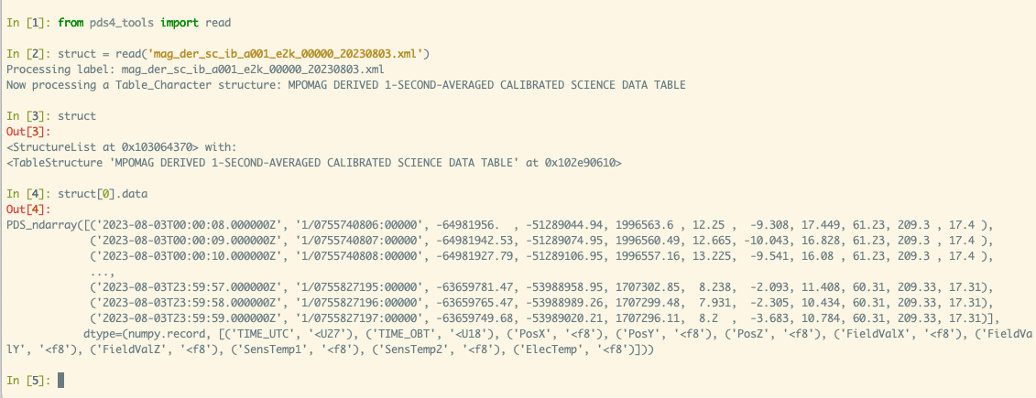
PDS4 Tools
Installable on pip and conda-forge
note that it has not yet been updated for NumPy 2.0

Slide 13
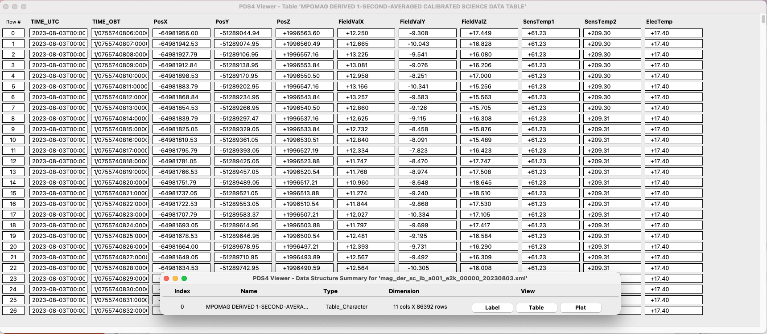
PDS4 Viewer
Works well for a quick sanity check on values in any data file (tables, arrays etc.)
but is not designed for analysis – use the underlying PDS4 Tools for that (or pdr etc.)

Slide 14
Go forth and install…
For this workshop you should install:
A text editor or IDE to work with XML
Validate
LDDTool
one tool of your choice for working with data
We have time now to try to debug any issues
One general note – things should work cross platform, but you may hit issues…
we will do what we can to help!

