Slide 1
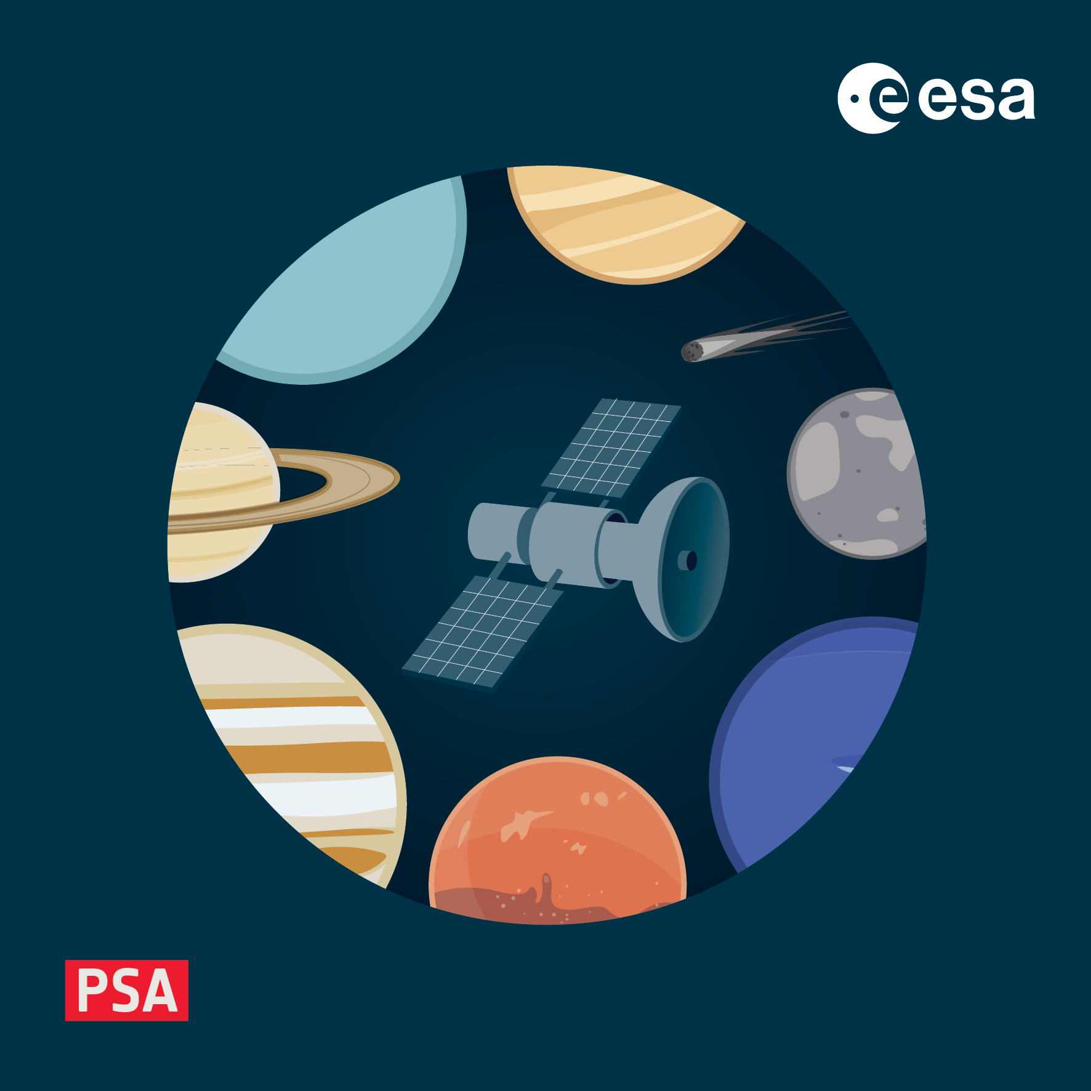
Hands-on - validation
4-8 November 2024, ESAC, Spain

Slide 2
What do we mean by validation?
There are several components to PDS4 validation
are the indvidual labels compliant?
i.e. do all schema and schematron checks pass
are the data files correctly described by the label?
data ranges, types, byte offsets and lengths can be checked
do referential integrity checks pass?
basically, are links to products in the same bundle correct
The above are done by the PDS validate tool that you should all have running now
reference checks are not done by validate in operational archiving, but by the PSA itself (1/month)
What validate cannot do is, of course:
check that values are read from data are correct and meaningful
e.g. if you write an image to disk row-major and read it column-major all validation checks will pass, but if you open the image, it will clearly be wrong!

Slide 3
validate – first run
If java and validate are installed correctly just try:
$ validate
And you should see
Type 'validate -h' for usage
There are a bunch of options to explore. Amongst the important ones:
--add-context-products <dir/files>
specifies a json file or directory of additional context products
-D,--skip-content-validation
only check labels, skip checks on the data file – useful early on in product development
--disable-context-mismatch-warnings
suppress warnings about names in labels not matching those in the corresponding context
-R,--rule <validation rule name>
which rule to apply – check a product, collection, or bundle
-e,--label-extension <xml|lblx>
if you are using the new lblx label extension, tell validate here

Slide 4
Validate – report types
Note that validate can export validation reports in different formats, to files and on screen
s,--report-style <full|json|xml>
text report example: https://nasa-pds.github.io/validate/operate/reports/index-full.html
json report example: https://nasa-pds.github.io/validate/operate/reports/index-json.html
XML report example: https://nasa-pds.github.io/validate/operate/reports/index-xml.html
The structured (XML, json) reports can be useful in a pipeline context
since you can filter out certain warnings, or treat some warnings as errors (more on this later)
validate produces a variety of errors and warnings
we will cover some of them here
more can be found at https://nasa-pds.github.io/validate/operate/errors.html
but some can be a bit cryptic, or the cause may not be at the specified location
if in doubt, ask for help

Slide 5
Hands-on with validate
Data for this exercise can be found in:
https://s2e2.cosmos.esa.int/bitbucket/projects/PSAAS/repos/pds4_workshop/
feel free to clone the entire repo and have all the samples and examples to hand
or grab a zip of the entire repo here
First let’s see what a clean validation run looks like:
$ validate cam_raw_sc_cam3_image_20241018t001002_61_f__t0004.xml
PDS Validate Tool Report
Configuration:
Version 3.5.2
Date 2024-10-22T15:21:16Z
Parameters:
Targets [file:/Users/mbentley/Library/CloudStorage/OneDrive-ESA/work/bepi/repos/pds4_workshop/validation/cam_raw_sc_cam3_image_20241018t001002_61_f__t0004.xml]
Severity Level WARNING
Recurse Directories true
File Filters Used [*.xml, *.XML]
Data Content Validation on
Product Level Validation on
Max Errors 100000
Registered Contexts File /Users/mbentley/OneDrive/software/pds/validate-3.5.2/resources/registered_context_products.json

Slide 6
Hands-on with validate
Product Level Validation Results
FAIL: file:/Users/mbentley/cam_raw_sc_cam3_image_20241018t001002_61_f__t0004.xml
ERROR [error.label.context_ref_not_found] line 43: 'Context product not found: urn:esa:psa:context:investigation:mission.bc
ERROR [error.label.context_ref_not_found] line 53: 'Context product not found: urn:esa:psa:context:instrument_host:spacecraft.mtm
ERROR [error.label.context_ref_not_found] line 62: 'Context product not found: urn:esa:psa:context:instrument:mtm.mcam
WARNING [warning.label.context_ref_mismatch] line 71: Context reference name mismatch. Value: 'SPACECRAFT_DECK' Expected one of: '[SPACECRAFT DECK]'
1 product validation(s) completed
Summary:
1 product(s)
3 error(s)
1 warning(s)
Product Validation Summary:
0 product(s) passed
1 product(s) failed
0 product(s) skipped
1 product(s) total
Referential Integrity Check Summary:
0 check(s) passed
0 check(s) failed
0 check(s) skipped
0 check(s) total
Message Types:
3 error.label.context_ref_not_found
1 warning.label.context_ref_mismatch
End of Report
Completed execution in 12979 ms

Slide 7
Hands-on with validate
Wait, that didn’t look good – what were those errors?
these come from PSA context products not registered with PDS
We need to include this in our config – get the local_context_products_json
from the previously cloned repository
Now you can run with the addition of
--add-context-products <path to local context>local_context_products_json
You should no longer get any errors
you may see a warning e.g.
this means that the name attribute used to refer to the target in the PDS4 label is different than the one in the linked context product and can usually be ignored
you can suppress this by including the option --disable-context-mismatch-warnings
WARNING [warning.label.context_ref_mismatch] line 71: Context reference name mismatch.
Value: 'SPACECRAFT_DECK' Expected one of: '[SPACECRAFT DECK]'
2 product validation(s) completed

Slide 8
Validate – exercise 1
Location: pds4_workshop/validation/exercise_1
Command:
exercise_1 $ validate exercise_1.xml --add-context-product \ ../local_context_products.json
Note that the backslashes here are just *nix line continuation characters -
This product has one simple validation error
the error should point out the line and column of the error, but these are not always 100% reliable
Open the product in a text editor, fix it, and run validation again
Bonus points: if you already have a PDS4 viewer up and running, open the product and check that it makes sense!

Slide 9
Validate – exercise 2
Location: pds4_workshop/validation/exercise_2
Command:
exercise_2 $ validate exercise_2.xml --add-context-products \ ../local_context_products.json
This product includes no PSA or mission dictionaries, but does make reference to Bepi to pass validation
Using an XML-aware editor and the validate tool, try to make this PDS4-compliant
hint: there are bugs in both the data and the label

Slide 10
Validate – exercise 3
This exercise uses a more typical PSA product
referencing PSA, mission, instrument and discipline dictionaries
As before, validate the product and try to fix any errors that you see
Location: pds4_workshop/validation/exercise_3
Command:
exercise_3 $ validate --add-context-products ../local_context_products.json \ –t mag_der_sc_ib_a001_e2k_00000_20230803.xml
note that this time we use the –t flag to specify the target file or directory

Slide 11
Validate – exercise 4
This exercise validates a (very small) bundle
instead of passing a target file to validate, we pass a target directory
We also specify that validate should use the validation rule pds4.bundle
this means check not only products but the integrity of the bundle
e.g. do collection inventories match the products
e.g. do internal references to products in this bundle resolve
Not only errors, but warnings can be important here!
Location: pds4_workshop/validation/exercise_4
Command:
exercise_4 $ validate em16_tgo_nmd --add-context-products \ ../local_context_products.json --rule pds4.bundle

Slide 12
Validate – exercise 4
em16_tgo_nmd
├── bundle_em16_tgo_nmd.xml
├── browse_calibrated
│ ├── Science_Phase
│ │ └── Orbit_Range_27200_27299
│ │ └── Orbit_27236
│ │ ├── nmd_cal_sc_browse_20231231T221819-20231231T232113-d-uvis.png
│ │ └── nmd_cal_sc_browse_20231231T221819-20231231T232113-d-uvis.xml
│ ├── collection_browse_calibrated.csv
│ └── collection_browse_calibrated.xml
├── data_calibrated
│ ├── Science_Phase
│ │ └── Orbit_Range_27200_27299
│ │ └── Orbit_27236
│ │ ├── nmd_cal_sc_uvis_20231231T221819-20231231T232113-d.tab
│ │ └── nmd_cal_sc_uvis_20231231T221819-20231231T232113-d.xml
│ ├── collection_data_calibrated.csv
│ └── collection_data_calibrated.xml
├── data_partially_processed
│ ├── Science_Phase
│ │ └── Orbit_Range_27200_27299
│ │ └── Orbit_27236
│ │ ├── nmd_par_sc_uvis_20231231T221841-20231231T232105-28-27236-1__4_0.tab
│ │ └── nmd_par_sc_uvis_20231231T221841-20231231T232105-28-27236-1__4_0.xml
│ ├── collection_data_partially_processed.csv
│ └── collection_data_partially_processed.xml
├── data_raw
│ ├── Science_Phase
│ │ └── Orbit_Range_27200_27299
│ │ └── Orbit_27236
│ │ ├── nmd_raw_sc_uvis_20231231T221841-20231231T232105-28-27236-1__4_0.tab
│ │ └── nmd_raw_sc_uvis_20231231T221841-20231231T232105-28-27236-1__4_0.xml
│ ├── collection_data_raw.csv
│ └── collection_data_raw.xml
└── document
├── EAICD
│ ├── NOMAD_EAICD_Issue1_Rev13.pdf
│ ├── NOMAD_EAICD_Issue1_Rev13.xml
│ ├── NOMAD_EAICD_Issue1_Rev14.pdf
│ ├── NOMAD_EAICD_Issue1_Rev14.xml
│ ├── NOMAD_EAICD_Issue2_Rev1.pdf
│ ├── NOMAD_EAICD_Issue2_Rev1.xml
│ ├── NOMAD_EAICD_Issue2_Rev2.pdf
│ └── NOMAD_EAICD_Issue2_Rev2.xml
├── EAICD_Reference_Documents
│ ├── RD04_Neefs_et_al_NOMAD_SO_LNO_Channels_Technical.pdf
│ ├── RD04_Neefs_et_al_NOMAD_SO_LNO_Channels_Technical.xml
│ ├── RD05_Patel_et_al_NOMAD_UVIS_Channel_Technical.pdf
│ ├── RD05_Patel_et_al_NOMAD_UVIS_Channel_Technical.xml
│ ├── RD07_Vandaele_et_al_UVIS_Performance.pdf
│ ├── RD07_Vandaele_et_al_UVIS_Performance.xml
│ ├── RD08_Thomas_et_al_SO_LNO_Performance.pdf
│ ├── RD08_Thomas_et_al_SO_LNO_Performance.xml
│ ├── RD09_NOMAD_User_Manual.pdf
│ ├── RD09_NOMAD_User_Manual.xml
│ ├── RD10_Data_Operations_Handbook.pdf
│ ├── RD10_Data_Operations_Handbook.xml
│ ├── RD11_Liuzzi_et_al_SO_LNO_Calibration.pdf
│ ├── RD11_Liuzzi_et_al_SO_LNO_Calibration.xml
│ ├── RD12_Trompet_et_al_SOIR_Transmittance_Calibration.pdf
│ └── RD12_Trompet_et_al_SOIR_Transmittance_Calibration.xml
├── collection_document.csv
└── collection_document.xml

Slide 13
Validate – exercise 5
This exercise once again focuses on a single product.
Use all the tools at your disposal to figure out what is wrong…
Location: pds4_workshop/validation/exercise_5

