Slide 1
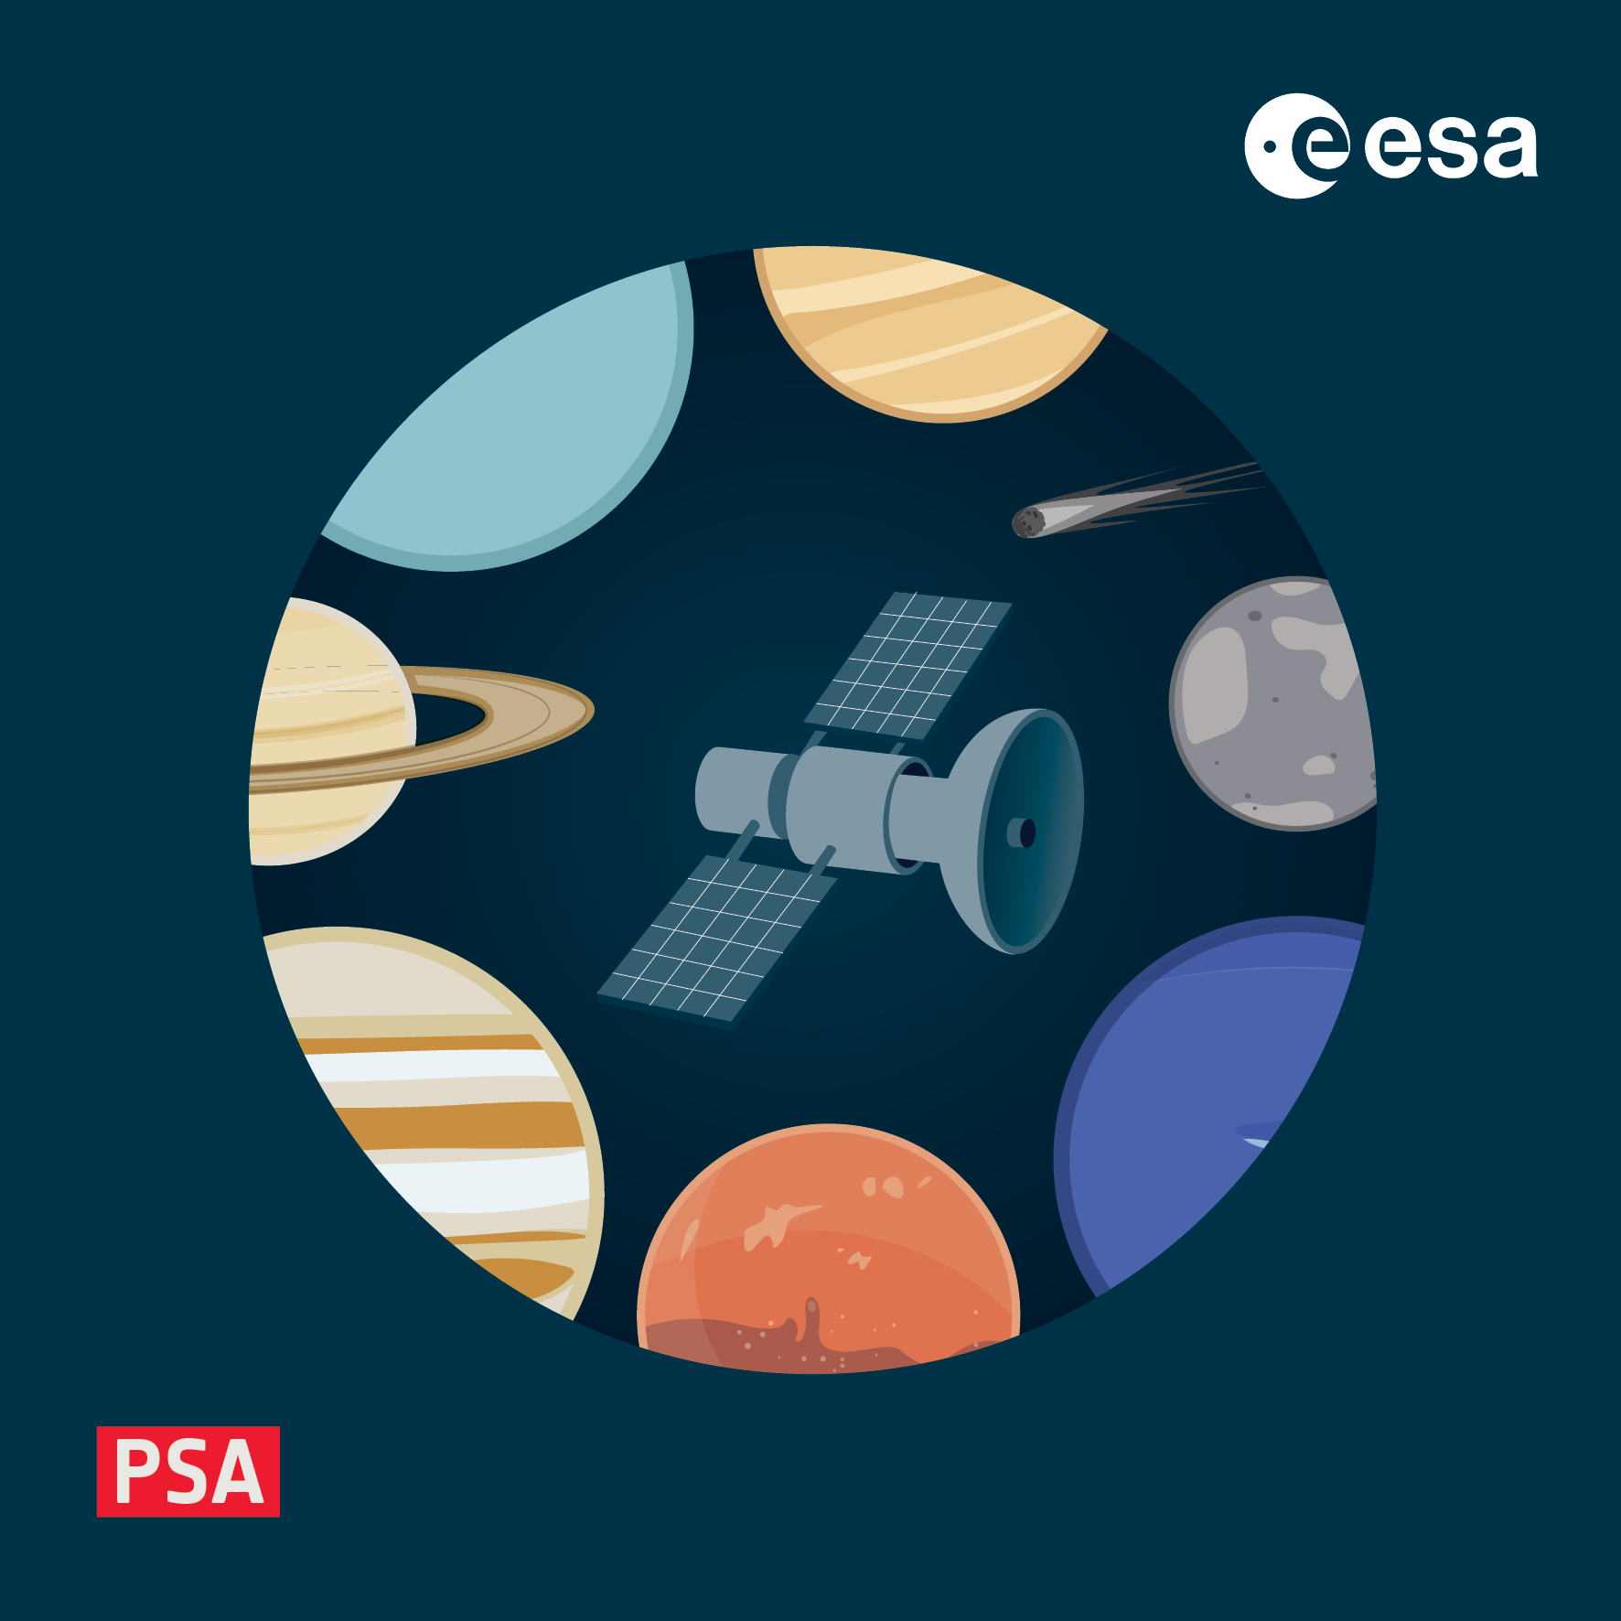
Hands-on: creating PDS4 products
4-8 November 2024, ESAC, Spain

Slide 2
Aims of the exercise
In this exercise you will try to create a Product_Observational PDS4 product
based on sample data in the workshop repo, or your own data
A template label is provided with the basic framework in place
pds4_workshop/2_creating_products/template_label.xml
concentrate on the basics, not Mission_Area or Discipline_Area
for this exercise only use PDS core, no PSA or other dictionaries
links to context products already available at NASA, no need to use local context json
You should:
Write the File_Area_Observational part to describe the data
Validate the product
Open the product in a viewer
Celebrate!

Slide 3
Sample products
The following sample data products are available in pds4_workshop/creating_products/
a_binary_image.img
2D array, 1024 x 1024 pixels, no headers, 16-bit unsigned LSB integers
a_delimited_table.csv
includes a header, which gives some hints on the content
fixed_width_ascii.tab
no header, data types can be inferred from contents
fits_image.fits
contains a primary HDU with meta-data only and 2 image HDUs – label one image array
fits_binary.fits
sample contains both image and tables – label one of the binary tables
Note that some are harder tha others ;-) Experience in FITS files (and some basic tools like fitsinfo, or astropy) will be needed for the last two

Slide 4
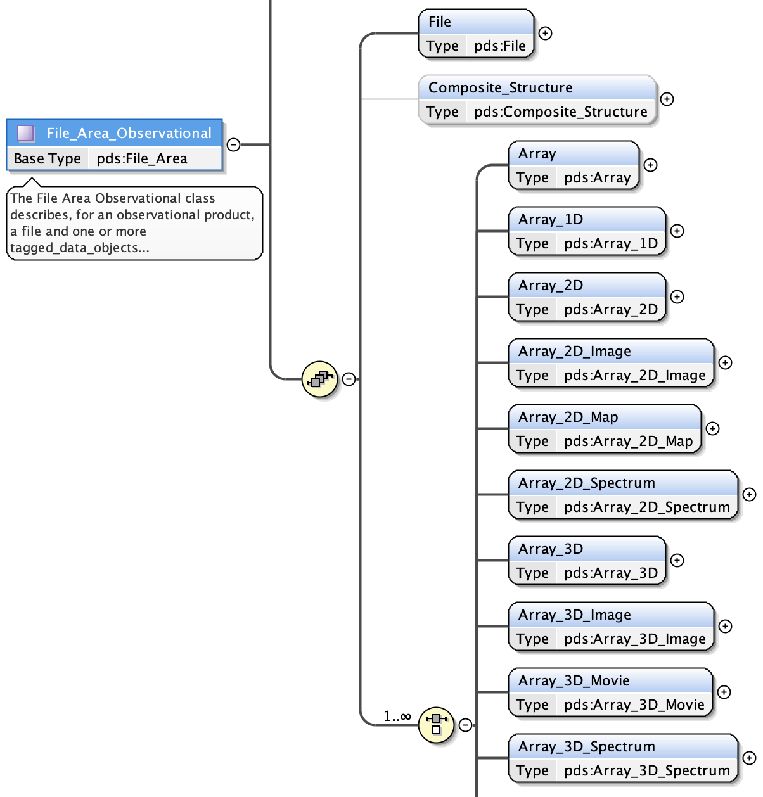
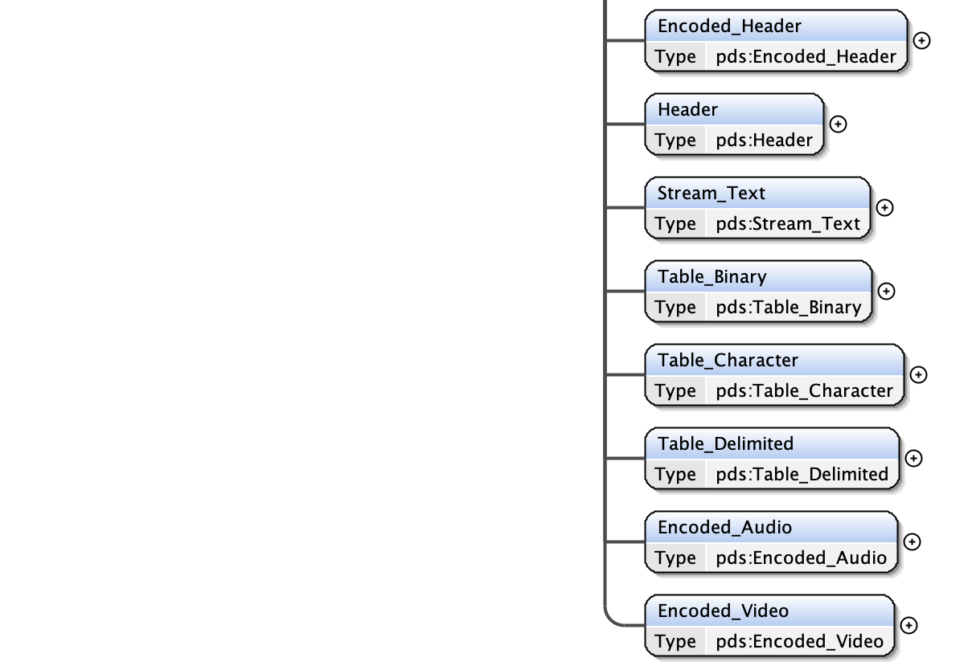
How to build the file description
Find the appropriate PDS4 data structure for the data
Array[_nD][_Image/Map/Spectrum/Movie]
Table_Binary
Table_Delimited
Table_Character
Encoded_Audio
Encoded_Video
Look at the mandatory fields and structure of each
from the schema diagram or information model website
Start to write the basic XML template for File_Area_Observational
XML-aware editors will help suggest elements
Some tools like oXygen will produce templates
with mandatory + optional elements

Slide 5
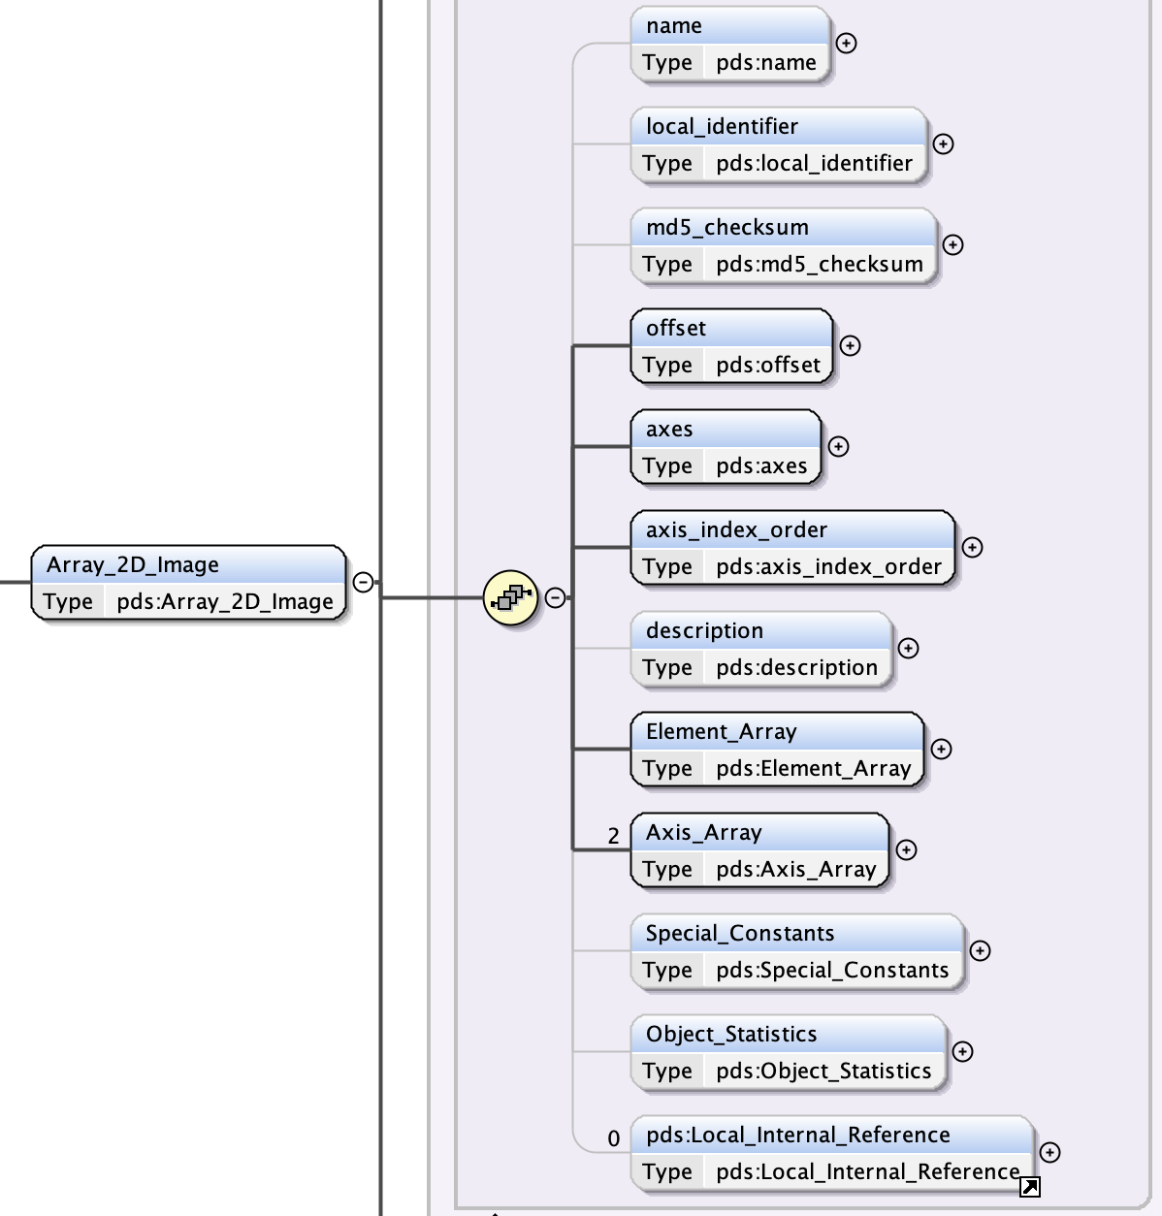
How to build the file description
Look at the schema to find what should be contained
e.g. for a 2D image array see the schema here:
Recall that bold=mandatory and order must be respected
some optional fields according to the schema are actually needed
and Schematron errors will reflect this
but start with the mandatory fields and hack/validate/hack
For all data types offset is the byte offset to the data
e.g. to a zVariable in a CDF
e.g. to an HDR in a FITS file
e.g. after any header in a CSV file
Array axes and table fields must have a data type
not all data types can be used with all data structures
e.g. ASCII tables need ASCII data types…

Slide 6
Resources to help you
Documentation
PDS4 official documentation: https://pds.nasa.gov/datastandards/documents/
PDS4 common data dictionary search: https://pds.nasa.gov/datastandards/documents/dd/common/current/
File_Area_Observational: https://pds.nasa.gov/datastandards/documents/dd/common/current/#ch03s58.html#N179749276
Other PDS4 products in the PSA or elsewhere
Tools
XML-aware editors or IDEs can flag schema (and sometimes Schematron) errors
validate will flag error and run data checks that can flag issues with e.g. byte offsets, data types
PDS4 libraries and tools to open the data will catch some obvious errors
arrays indices wrong, field length/position mismatch etc.

