Slide 1
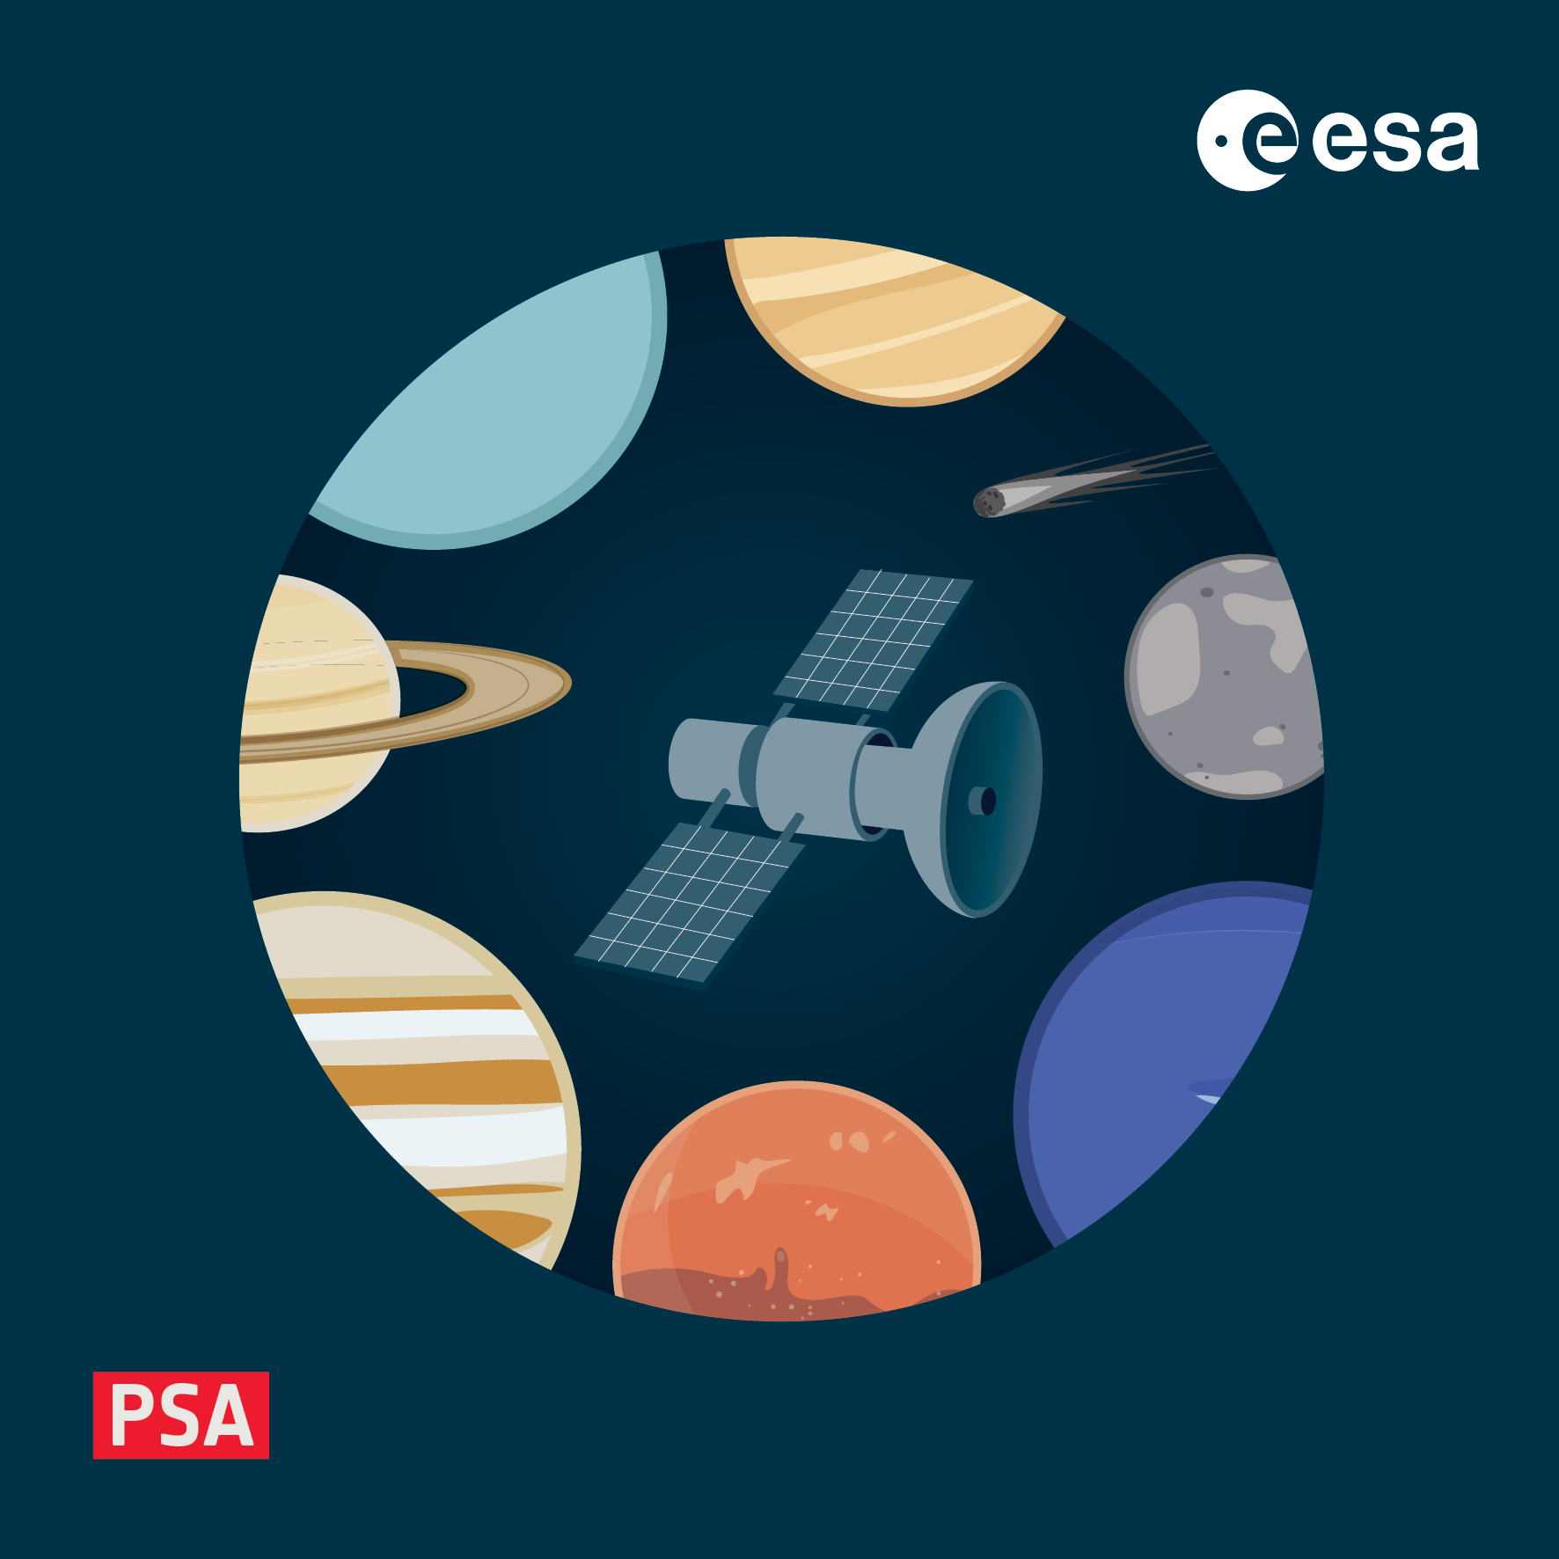
Creating a Dictionary
4-8 November 2024, ESAC, Spain

Slide 2
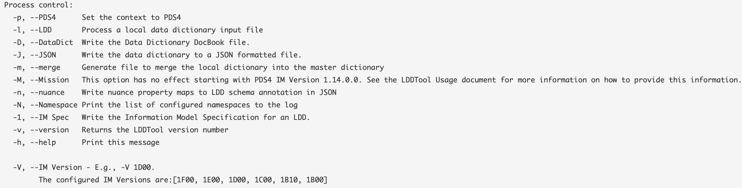
LDD_Tool
Should now by installed from https://nasa-pds.github.io/pds4-information-model/model-lddtool/index.html
You will have a skeleton ingest file, which will already create a dictionary
To run (on a mac)
lddtool -lpdJV 1L00 Path/lddingest_workshop_skeleton_1.0.xml
-d is an additional configuration for the PSA to generate our namespaces correctly

