Slide 1
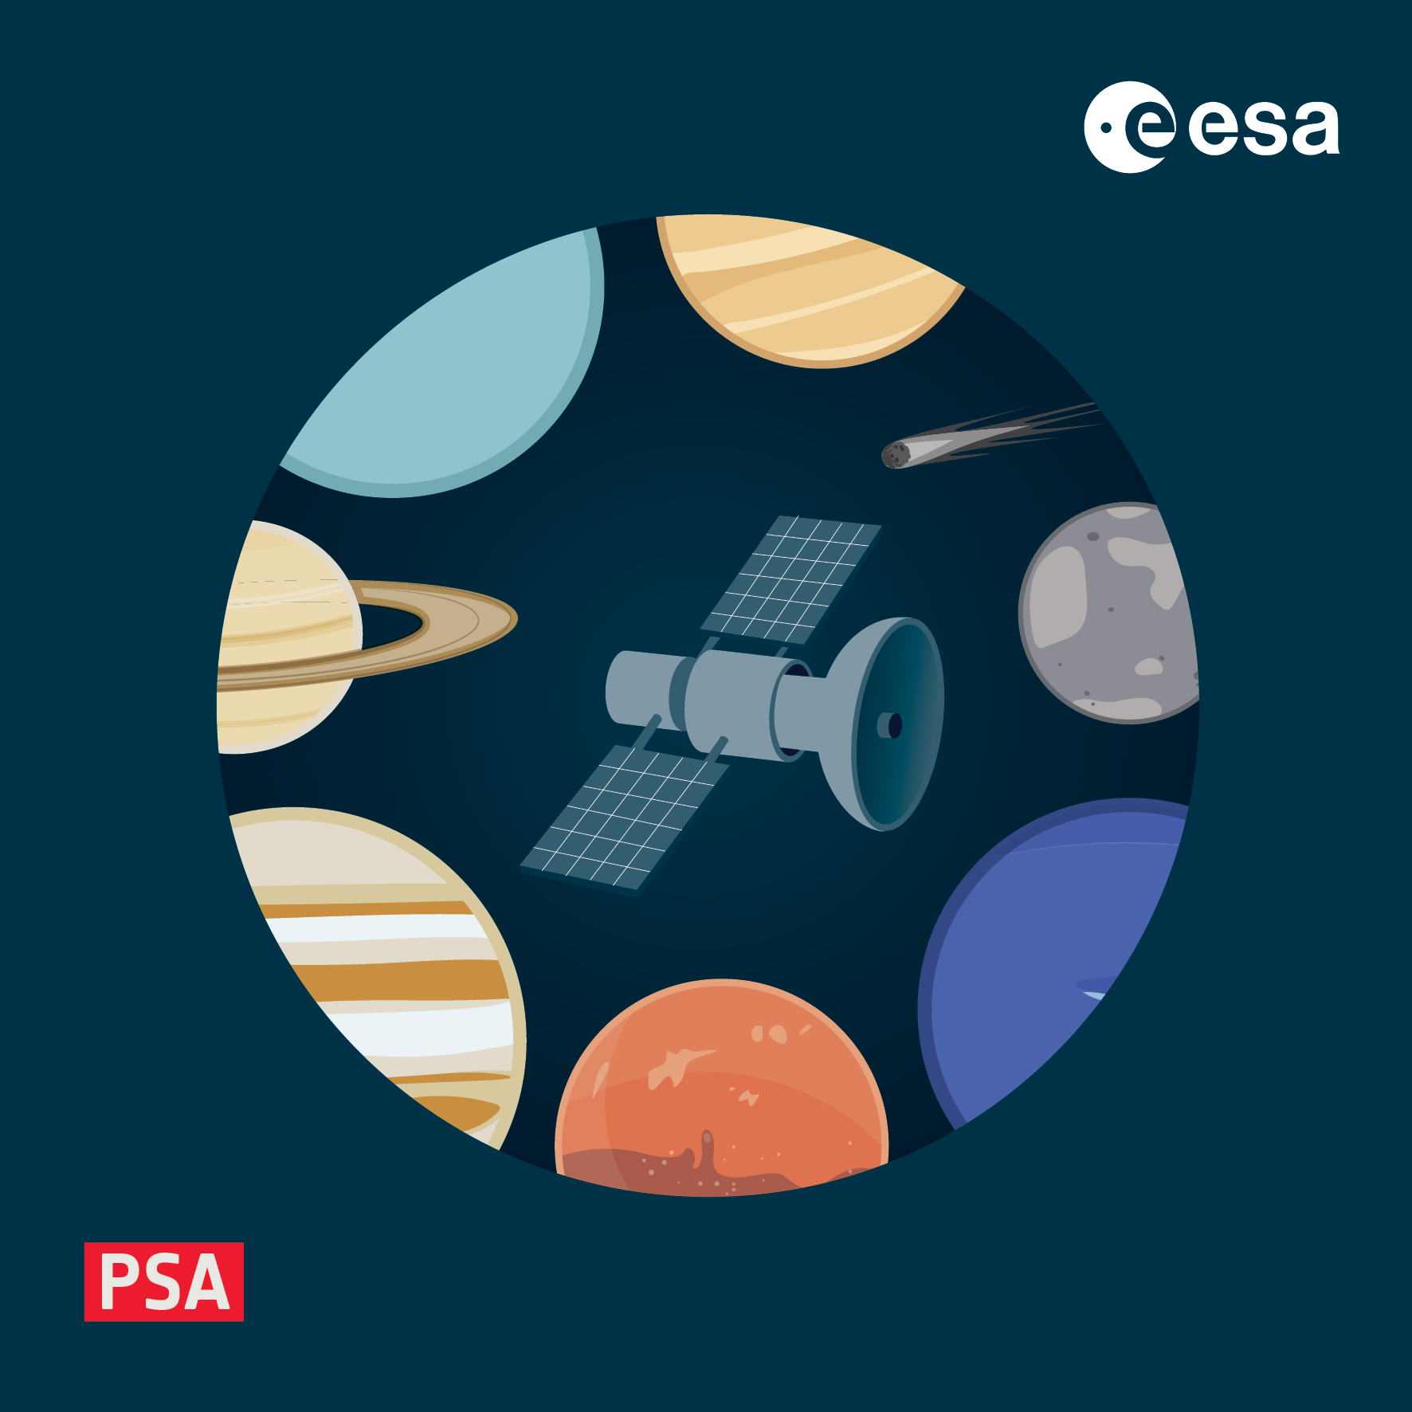
Putting it all together
4-8 November 2024, ESAC, Spain

Slide 2
Aims of the exercise
In the last exercises we learned how to:
use validate and other tools to check data quality
write the File_Area_Observational section of the label to describes the data files
use LDDTool to create a custom dictionary
The aim of this exercise is to combine these by:
referencing the custom dictionary in your own data products
i.e. updating the schema, schematron and namespaces at the top of your label
adding the custom meta-data to your product
in the Mission_Area
validate and open the product

Slide 3
Recall – adding/updating dictionaries
Adding/updating a dictionary requires 3 changes at the start of each product label
Add the xml-model reference pointing to the Schematron (.sch) file
Define the namespace with an xmlns statement
Add the schemaLocation mapping the namespace to the Schema (.xsd) file location
For example the lines in green below show changes made to add the PSA dictionary to a product
<?xml version="1.0" encoding="UTF-8"?>
<?xml-model href="https://pds.nasa.gov/pds4/pds/v1/PDS4_PDS_1M00.sch" schematypens="http://purl.oclc.org/dsdl/schematron"?>
<?xml-model href="https://pds.nasa.gov/pds4/geom/v1/PDS4_GEOM_1M00_1970.sch" schematypens="http://purl.oclc.org/dsdl/schematron"?>
<?xml-model href="https://psa.esa.int/psa/v1/PDS4_PSA_1M00_1500.sch" schematypens="http://purl.oclc.org/dsdl/schematron"?>
<?xml-model href="https://psa.esa.int/psa/bc/v1/PDS4_BC_1M00_2000.sch" schematypens="http://purl.oclc.org/dsdl/schematron"?>
<Product_Observational xmlns="http://pds.nasa.gov/pds4/pds/v1"
xmlns:geom="http://pds.nasa.gov/pds4/geom/v1"
xmlns:psa="http://psa.esa.int/psa/v1"
xmlns:xsi="http://www.w3.org/2001/XMLSchema-instance"
xsi:schemaLocation="
http://pds.nasa.gov/pds4/pds/v1 https://pds.nasa.gov/pds4/pds/v1/PDS4_PDS_1M00.xsd
http://pds.nasa.gov/pds4/geom/v1 https://pds.nasa.gov/pds4/geom/v1/PDS4_GEOM_1M00_1970.xsd
http://psa.esa.int/psa/v1 https://psa.esa.int/psa/v1/PDS4_PSA_1M00_1500.xsd http://psa.esa.int/psa/bc/v1 https://psa.esa.int/psa/bc/v1/PDS4_BC_1M00_2000.xsd">

Slide 4
Recall – adding meta-data
The solution to the “build a dictionary” exercise is available as a dictionary here:
https://psa.esa.int/psa/emrsp/rm/rls/v1/PDS4_EMRSP_RM_RLS_1L00_1000.xsd
https://psa.esa.int/psa/emrsp/rm/rls/v1/PDS4_EMRSP_RM_RLS_1L00_1000.sch
Namespace: http://psa.esa.int/psa/emrsp/rm/rls/v1
Namespace prefix: emrsp_rm_rls
With the above informatinon you should be able to update the header of your label
check that it still validates!
Next try to insert one or more attributes from the two classes in this dictionary
see the schema diagram on the next slide, or check the schema

Slide 5
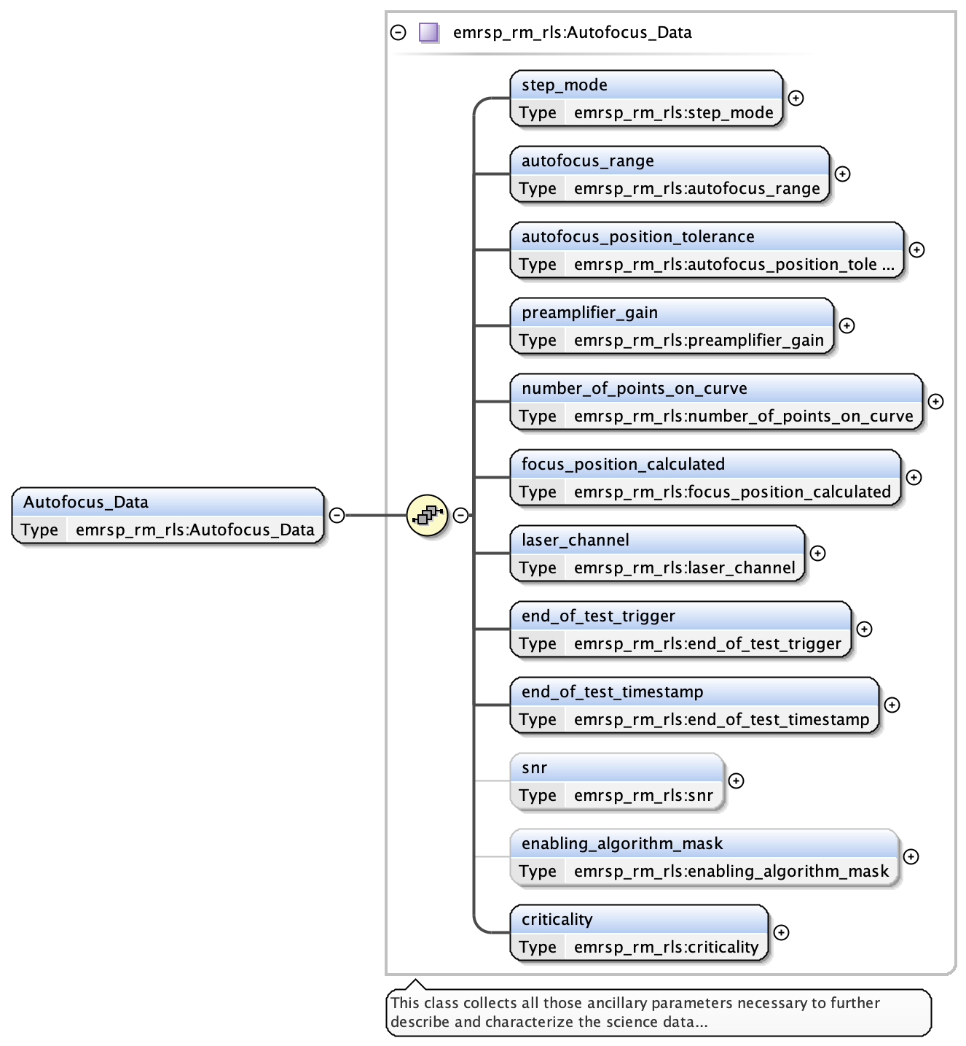
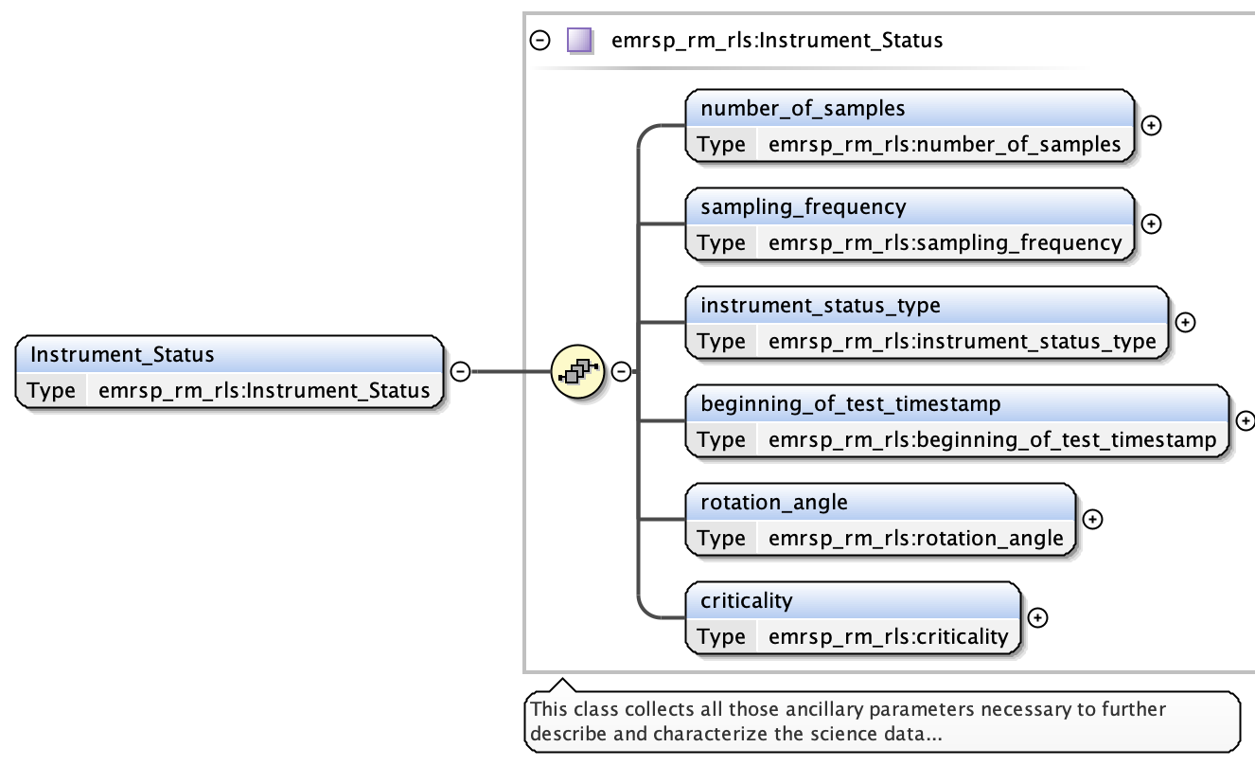
Recall – adding meta-data
Custom (mission or instrument) data go in the Mission_Area
this can come from multiple dictionaries - there is no constraint on how you order the dictionaries

Slide 6
Recall - validation
Don’t forget to include necessary options when calling validate
--add-context-products to point to the local_context_products.json file
--label-extension can be lblx or xml (default) depending on the file you have chosen
That’s it – the aim is then to:
Add the schematron, schema and namespace for the new dictionary to your label
Insert some, or all, of the meta-data in the dictionary into the Mission_Area
Validate your product

