Slide 1
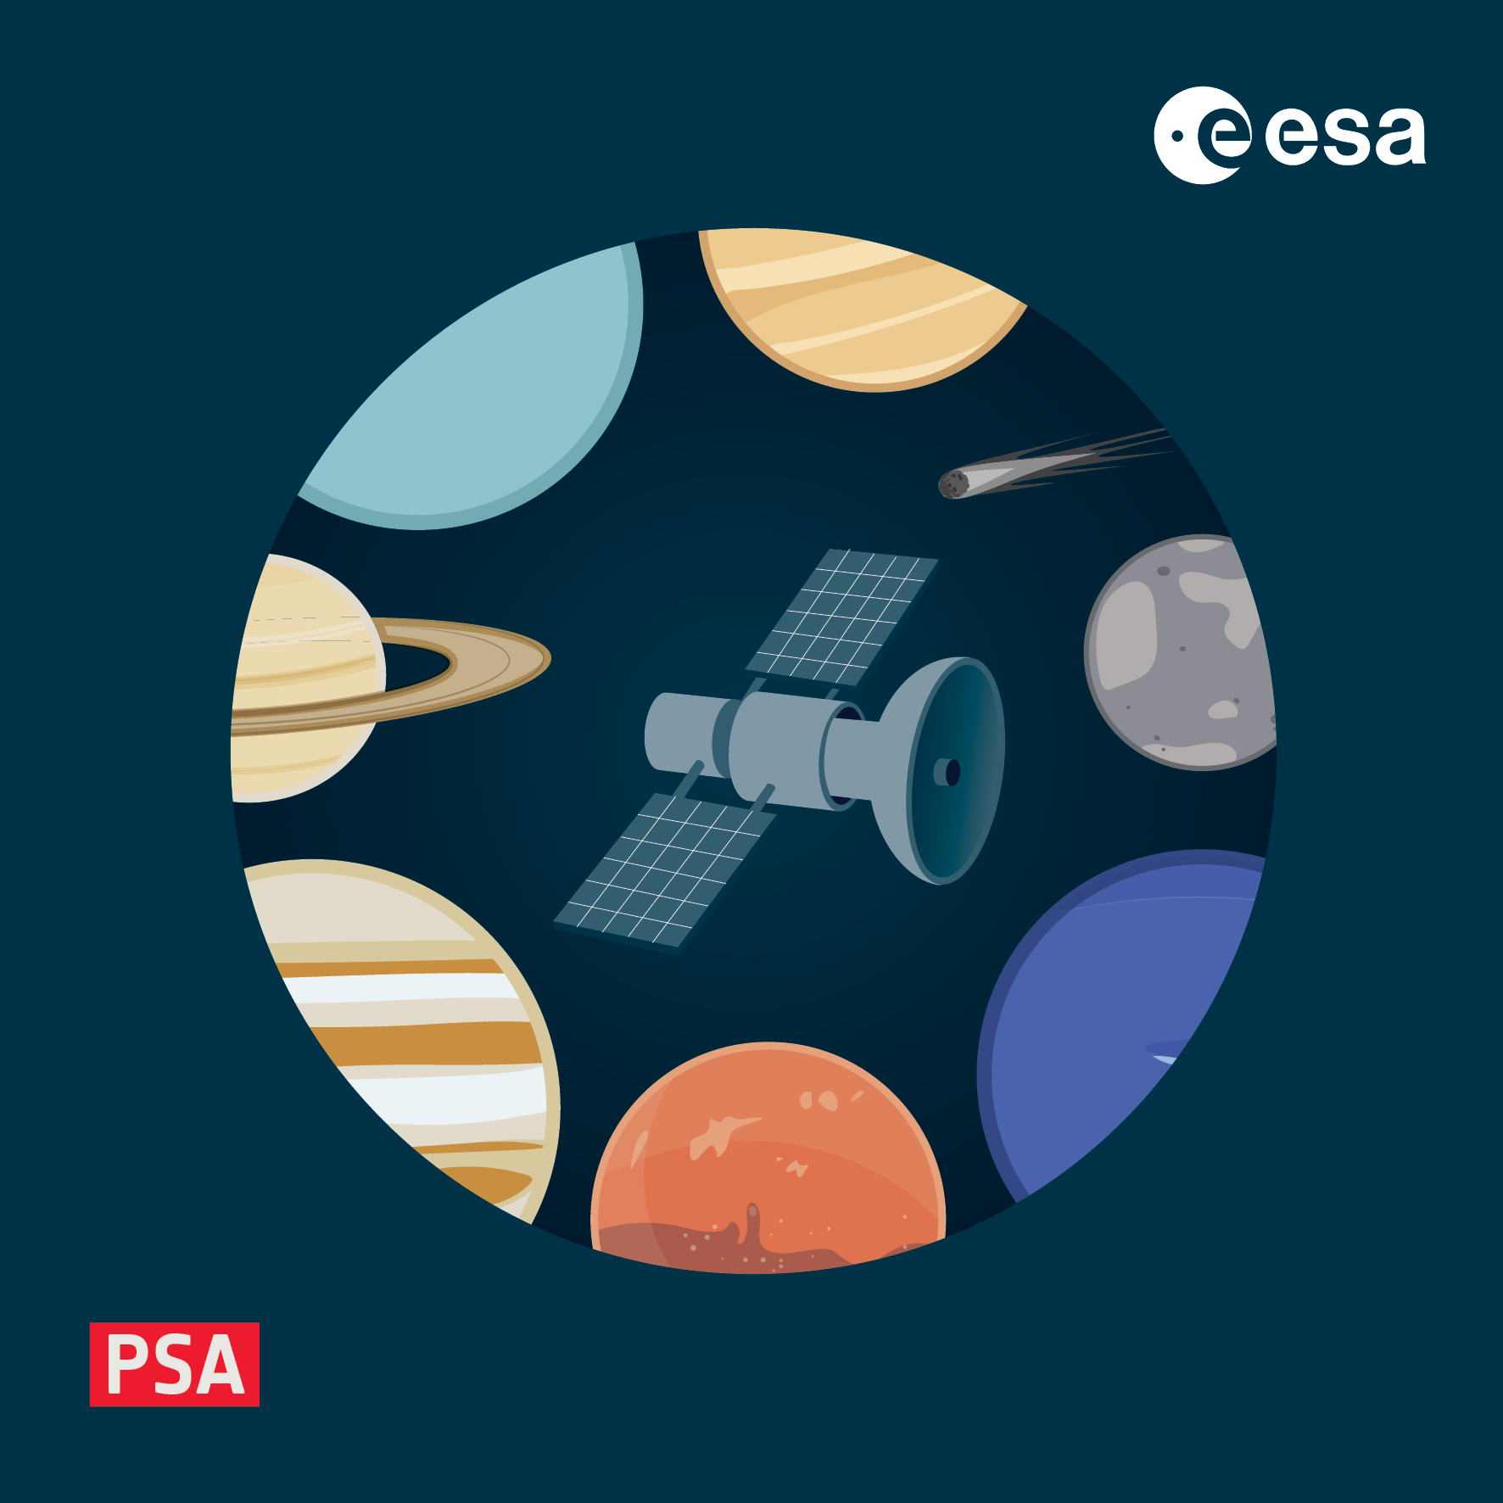
The PSA Challenge
4-8 November 2024, ESAC, Spain

Slide 2
How Easy/Difficult Is the PSA to Find/Use
As a warm up for the workshop we would like to get some feedback on the PSA
We want to do this at the start because we want to gauge impressions from people who may or may not have a lot of experience using the PSA
So we set a few tasks for you to do…

Slide 3
How Easy/Difficult Is the PSA to Find/Use
Find one or more images taken from the surface of Saturn's moon Titan
How many observations of Deimos are in the archive?
How far from the surface of comet 67P was the Rosetta spacecraft when the final OSIRIS images were taken at the end of mission?
Locate the TGO CaSSIS footprints at the Oxia Planum landing site on Mars for the Rosalind Franklyn Rover (18N 24W)
How many TGO CaSSIS, calibrated data, red filter, stereo, framelets are there on August 22nd 2022? (note due to known bug search in basic filter menu)

