Slide 1

How data get to the PSA
4-8 November 2024, ESAC, Spain

Slide 2
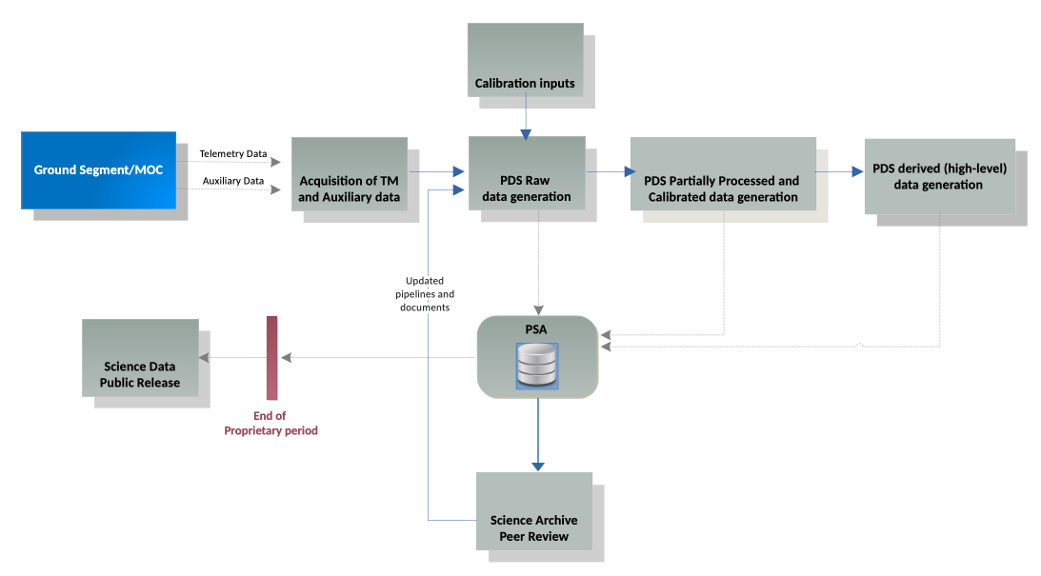
How data get to the archive
This step is done by PI teams
or @ESA, depending on mission
MEX – classical dataset deliveries from PI teams
deliveries every few months, validated at ESA
TGO/BepiColombo/JUICE – “operational archives”
pipelines run after each groundstation pass
raw @ ESAC, cal @ ESAC or PI
products ingested privately into PSA
improved pipelines/calibrations integrated
made available after review on rolling release

Slide 3
Data delivery options
PSA offers several ways in which data can be delivered to the PSA
which one is relevant depends on the mission profile and SOC setup
Options include:
full bundle delivery
a complete bundle containing fully validated collections of products
typical for a short mission, or when data are curated externally to ESA
incremental bundle delivery
a bundle delivery containing only new or updated products
operational delivery of batches of products
typically by executing pipelines regularly and sending products to PSA
these will be kept private by default, or tagged with a release date later in the mission
PSA handles maintenance of collection inventories etc.
used by missions where ESA/mission SOC includes data generation reponsibilities

Slide 4
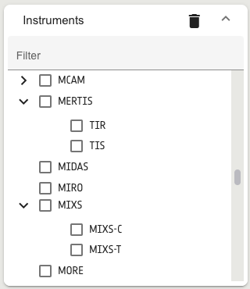
PSA setup
Before the PSA can ingest data from a new mission or instrument, there is some setup needed
In particular we need to:
have the key context products, describing:
the instrument(s)
the instrument host (spacecraft)
the investigation (mission)
identify sub-instruments/channels/detectors needed
these are shown as children of the instrument
and allow granular selection
know the bundle names
These are typically the first things your archive scientist will ask for
so that we can start testing ingestion etc.

Slide 5
Full bundle delivery
Some missions, in particular short ones, may delivery complete bundles
All products, types, processing levels etc.
Fully referentially correct
collection inventories describe all products
internal links resolve correctly
Context products describing mission, spacecraft, instrument etc. should be provided separately
since they are not part of the instrument bundle, but the PSA’s “context bundle”
This option has not been exercised yet in PSA
additional work may be needed on our side for large bundles
Deliveries should be in a compressed file containing a manifest, checksum list etc. described later

Slide 6
Incremental bundle delivery
An intermediate option between full bundle delivery and individual products is bundle increments
Used when pipelines are not run by the SOC, but externally to ESA, but missions are long/data is large
Each delivery should contain:
new or updated products for the bundle in question
complete collection inventories
products already ingested and those in the current delivery
manifest, checksum etc.

Slide 7
Product delivery
When there is a need or desire to have products in the archive in near-real time products can be delivered
for example, if a pipeline is run after every ground-station pass
this is used in some missions to power ”quick look” functions
This is typically called “operational archiving” and is used by missions where SOC runs pipelines
although it can work with pipelines run at PI teams, e.g. using GFTS for transfer and notification
In this case, referential integrity cannot be checked at validation time
but PSA ingests all cross-references into a database and checks them once per month
Products can be delivered in a flat structure
the archive physical structure is defined by the manifest

Slide 8
Combos
In some case combinations of these approaches may be used
at different processing levels
for different instrument hosts etc.
This will usually be agreed in top-level documentation
e.g. the archiving plan or data processing agreements

Slide 9
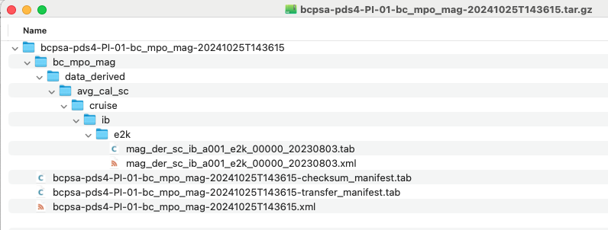
Delivery package format
The delivery package is a file (options: zip, tar, tar.gz) containing the following items:
a folder with the set of files to be ingested in the PSA
either mapping the structure of a bundle or in a flat structure)
the folder name should be the bundle name.
a Submission Information Product (SIP) including:
a transfer manifest (File_Area_Transfer_Manifest)
each record contains a LID or LIDVID and the corresponding path to the product
a check-sum manifest (File_Area_Checksum_Manifest)
each record contains the checksum for a given file

Slide 10
PDS4 Packager
For teams with a SOC at ESAC we provide the “PDS4 Packager”
https://planetary.esac.esa.int/pds4-packager/
This is a tool that:
wraps and runs the NASA/PDS validate tool
comes pre-configured with all necessary dictionaries and catalogue files to use them
performs additional checks not possible with dictionaries alone
e.g. checks that the mission phase name/ID are correct for the given product start time
creates a delivery package to either the SOC or PSA
classifying products and building the manifest to give the correct physical structure
JUICE teams will get hands on at next SWT/DHAWG

Slide 11
Final words
All products sent to the PSA must pass validation
please make sure that your products are valid before sending to us
for bundle delivery make sure that all referential checks are performed
When pipelines are integrated at the SOC
ensure that they have been fully tested before delivery

