Slide 1

PDS4 labels – an introduction
4-8 November 2024, ESAC, Spain

Slide 2
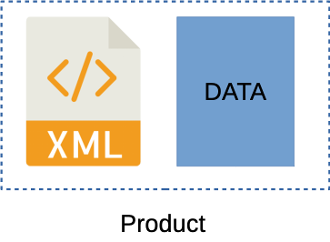
PDS4 labels – the basics
In PDS4, meta-data are stored in “labels” describing the corresponding data, document etc.
PDS4 labels are written in XML
eXtensible Markup Language
highly structured, many available tools
validation is possible using standard, open tools
uses paired tags to bracket values, like HTML e.g.
<file>a_useful_file.txt</file>
Structure and content enforced by rules
in the PDS core Information Model
and in discipline, mission and instrument “dictionaries”
implemented as schema and Schematron
Many labels have the extension .xml but in recent versions of PDS4 a unique .lblx extension is used
to allow .xml files to be archived without conflict
in this workshop you will see both

Slide 3
XML basics
XML is highly structured and case sensitive
the order of elements often matters!
The label can be written and validated against dictionaries using standard tools
Formatting does not matter in XML… to a computer, but please use indentation etc. to make it readable
where validation rules allow (e.g. descriptions) inputs can span multiple lines without problem
<Identification_Area><logical_identifier>urn:esa:psa:bc_mtm_mcam:data_raw:cam_raw_sc_cam3_image_20241014</logical_identifier><version_id>1.0</version_id><title>BepiColombo MCAM image product</title><information_model_version>1.15.0.0</information_model_version><product_class>Product_Observational</product_class><Modification_History><Modification_Detail><modification_date>2024-10-16</modification_date><version_id>1.0</version_id><description>This is version 1.0 of this product</description></Modification_Detail></Modification_History></Identification_Area>
<Identification_Area>
<logical_identifier>urn:esa:psa:bc_mtm_mcam:data_raw:cam_raw_sc_cam3_image_20241014</logical_identifier>
<version_id>1.0</version_id>
<title>BepiColombo MCAM image product</title>
<information_model_version>1.15.0.0</information_model_version>
<product_class>Product_Observational</product_class>
<Modification_History>
<Modification_Detail>
<modification_date>2024-10-16</modification_date>
<version_id>1.0</version_id>
<description>This is version 1.0 of this product</description>
</Modification_Detail>
</Modification_History>
</Identification_Area>

Slide 4
XML basics
Every node tag must be closed
or empty, if allowed, e.g.
<name></name>
<name/>
Elements are arranged in a tree
<name> has two children
<first_name> has one parent
End tags must be inside the same element as start
Every XML element has one parent
with one exception – the root element
this contains all other elements
Some elements are mandatory, others are optional
On the right is a complete and valid XML document
<?xml version="1.0"?>
<catalog>
<book id="bk101">
<author>Gambardella, Matthew</author>
<title>XML Developer's Guide</title>
<genre>Computer</genre>
<price>44.95</price>
<publish_date>2000-10-01</publish_date>
</book>
</catalog>

Slide 5
XML attribute
<?xml version="1.0"?>
<catalog>
<book id="bk101">
<author>Gambardella, Matthew</author>
<title>XML Developer's Guide</title>
<genre>Computer</genre>
<price>44.95</price>
<publish_date>2000-10-01</publish_date>
</book>
</catalog>
XML elements can have attributes
name-value pairs inside start tag
values are enclosed quotes
and separated by an equals sign
In the example book has an attribute “id”
with value bk101
Attributes are rarely used in PDS4
typically to declare units associated to an element, e.g.
<exposure_duration unit="ms">10</exposure_duration>
<file_size unit="byte">2108160</file_size>

Slide 6
Comments and processing instructions
<?xml version="1.0"?>
<catalog>
<book id="bk101">
<author>Gambardella, Matthew</author>
<title>XML Developer's Guide</title>
<!-- this is the old value
<genre>Computers</genre>
-->
<genre>Computer</genre>
<price>44.95</price>
<publish_date>2000-10-01</publish_date>
</book>
</catalog>
Comments are bracketed by <!-- and -->
e .g. <!-- this is a comment -->
multi-line (block) comments are no problem
BUT nested comments are not allowed
indeed -- must not appear inside a comment
Processing instructions appear outside root element
are bracketed by <? and ?>
<?xml-model…?>
pass information to applications using the document
more on this later…

Slide 7

Schema and schematron
A document that follows the previously discussed rules is “well formed”
if not, any XML parser will probably stop and return an error
note that well-formed XML does not mean valid PDS4!
PDS4 uses schema (.xsd) & Schematron (.sch) to further validate
A coherent set of xsd and sch are called a dictionary and this:
defines the content of PDS4 labels
applies rules to further constrain content
Note that a “technically valid” PDS4 product may still not be
scientifically correct (values may all be wrong)
usable (e.g. a 1000 2D tables instead of a cube)
Dictionary
XSD
SCH
PDS4 label
Check XML syntax
Validate Schema
Apply rules
Valid product

Slide 8
Namespaces
Namespaces are used a lot in XML/PDS4 and refer to dictionaries in PDS-speak
to distinguish elements with the same name
but with different domains/uses (different dictionaries)
to allow related elements to be grouped
In PDS4 namespaces are used to identify content coming from different dictionaries
the core PDS dictionary
discipline dictionaries (e.g. geometry, imaging, spectroscopy)
mission and instrument dictionaries
Example namespaces:
http://pds.nasa.gov/pds4/pds/v1
http://psa.esa.int/psa/v1
a URI does not have to be a real URL, but sometimes it is!

Slide 9
Namespaces
To make labels shorter, namespaces can be assigned a namespace prefix
each prefix is mapped to a URI (the full namespace)
e.g. xmlns:prefix=”URI”
example:
xmlns:psa=http://psa.esa.int/psa/v1
Namespaces are used in the root element of your label in two ways:
define the namespace prefix
give the location of the corresponding schema for this namespace
Now you can use elements from the corresponding schema in your label!
<Product_Observational
xmlns="http://pds.nasa.gov/pds4/pds/v1"
xmlns:disp="http://pds.nasa.gov/pds4/disp/v1" xmlns:xsi="http://www.w3.org/2001/XMLSchema-instance"
xsi:schemaLocation=”
http://pds.nasa.gov/pds4/pds/v1 https://pds.nasa.gov/pds4/pds/v1/PDS4_PDS_1F00.xsd
http://pds.nasa.gov/pds4/disp/v1 https://pds.nasa.gov/pds4/disp/v1/PDS4_DISP_1F00_1500.xsd
">

Slide 10
Namespaces
Once the namespace and prefix are defined, these can be used to reference those schema
reference is by prefix:element
for example:
<psa:Sub-Instrument> <psa:identifier>CAM3</psa:identifier> <psa:name>Monitoring Camera 3</psa:name> <psa:type>Imager</psa:type> </psa:Sub-Instrument>
A default namespace can be given – in the case of PDS4 labels this is usually the PDS namespace
elements coming from the default namespace can be used without prefix
e.g. xmlns="http://pds.nasa.gov/pds4/pds/v1"
this allows <Identification_Area> instead of <pds:Identification_Area>

Slide 11
XML vs PDS4 terminology
<Array_2D_Image>
<name>MCAM image</name>
<local_identifier>MCAM_image</local_identifier>
<offset unit="byte">8640</offset>
<axes>2</axes>
<axis_index_order>Last Index Fastest</axis_index_order>
<Element_Array>
<data_type>SignedMSB2</data_type>
</Element_Array>
<Axis_Array>
<axis_name>Line</axis_name>
<local_identifier>line</local_identifier>
<elements>1024</elements>
<sequence_number>1</sequence_number>
</Axis_Array>
<Axis_Array>
<axis_name>Sample</axis_name>
<local_identifier>sample</local_identifier>
<elements>1024</elements>
<sequence_number>2</sequence_number>
</Axis_Array>
<Special_Constants>
<missing_constant>-1</missing_constant>
<valid_maximum>1023</valid_maximum>
<valid_minimum>0</valid_minimum>
</Special_Constants>
</Array_2D_Image>
PDS4 adopts some different terms from XML standard
In PDS4
classes = elements with children
names are capitalised
e.g. Array_2D_Image
attributes = child elements
names are lower case
Whereas in XML attributes refer to meta-data about a given element
e.g. <offset unit="byte">8640</offset>
unit=”byte” is an XML attribute
In PDS4 classes never have XML attributes
only PDS4 attributes have XML attributes ;-)

Slide 12
What’s in a label?
A label is an XML file with a defined set of dictionaries declared
the XML prolog declares the Schematron files used in this label
the root tag declares namespaces and Schema
Labels come in different types, one for each class of PDS4 product
Product_Observational, Product_Ancillary, Product_Browse etc.
The root tag also tells us the product type
mostly we will concentrate on Product_Observational
since this describes data, and is the most complex and complete
Everything else follows from the XML schema in use
plus rules applied by Schematron checks
Now let’s walk through the parts of a label…
the diagram on the left shows the structure of Product_Observational
XML prolog
Product Observational
Identification Area
Observation Area
Mission Area
Discipline Area
Reference List
File Area

Slide 13
An observational product
<?xml version="1.0" encoding="UTF-8"?>
<?xml-model ...?>
<Product_Observational ...>
<Identification_Area>
...
</Identification_Area>
<Observation_Area>
...
</Observation_Area>
<File_Area_Observational>
<File>
<file_name>file.txt</file_name>
</File>
<Table_Binary>
<Record_Binary>
<Field_Binary>
...
</Field_Binary>
</Record_Binary>
</Table_Binary>
</File_Area_Observational>
</Product_Observational>
XML prolog
Root (product type or class)
Identification_Area
uniquely identifies the product
Observation_Area
most meta-data are here
File_Area_Observational
describes how to open the bits and bytes and describes all data types, arrays, tables, etc.
XML prolog
Product Observational
Identification Area
Observation Area
Mission Area
Discipline Area
Reference List
File Area

Slide 14
Processing instructions
Before we even get to the opening tag, we have some XML processing instructions
The form of the xml-model references is always the same
you just have to make sure that all Schematron are listed
Recall that a dictionary = schema (.xsd) + Schemaron (.sch) and versions must match
validation tools will check these and warn if not!
e.g. if you use PDS4_GEOM_1F00_1910.sch + PDS4_GEOM_1F00_1950.xsd
References to Schematron files should generally always be https
Validation tools will reach out to find .xsd and .sch but they are not always online
catalog files and SOC tools can help here to resolve to local copies
XML prolog
Product Observational
Identification Area
Observation Area
Mission Area
Discipline Area
<?xml version="1.0" ?>
<?xml-model href="https://pds.nasa.gov/pds4/pds/v1/PDS4_PDS_1F00.sch" schematypens="http://purl.oclc.org/dsdl/schematron"?>
<?xml-model href="https://pds.nasa.gov/pds4/geom/v1/PDS4_GEOM_1F00_1910.sch" schematypens="http://purl.oclc.org/dsdl/schematron"?>
<?xml-model href="https://pds.nasa.gov/pds4/disp/v1/PDS4_DISP_1F00_1500.sch" schematypens="http://purl.oclc.org/dsdl/schematron"?>
<?xml-model href="https://pds.nasa.gov/pds4/img/v1/PDS4_IMG_1F00_1810.sch" schematypens="http://purl.oclc.org/dsdl/schematron"?>
<?xml-model href="https://psa.esa.int/psa/v1/PDS4_PSA_1F00_1300.sch" schematypens="http://purl.oclc.org/dsdl/schematron"?>
<?xml-model href="https://psa.esa.int/psa/bc/v1/PDS4_BC_1F00_1100.sch" schematypens="http://purl.oclc.org/dsdl/schematron"?>
Reference List
File Area

Slide 15
The root tag
The root tag defines the PDS4 product type
and defines all the schema and namespaces used
Note that paths to schema (.xsd) and Schematron (.sch) should be https references
but that namespace URIs never are
Watch out for mis-matched quotes
XML prolog
Product Observational
Identification Area
Observation Area
<Product_Observational
xmlns="http://pds.nasa.gov/pds4/pds/v1"
xmlns:disp="http://pds.nasa.gov/pds4/disp/v1" xmlns:geom="http://pds.nasa.gov/pds4/geom/v1"
xmlns:img="http://pds.nasa.gov/pds4/img/v1" xmlns:psa="http://psa.esa.int/psa/v1"
xmlns:bc="http://psa.esa.int/psa/bc/v1" xmlns:xsi="http://www.w3.org/2001/XMLSchema-instance"
xsi:schemaLocation="
http://pds.nasa.gov/pds4/pds/v1 https://pds.nasa.gov/pds4/pds/v1/PDS4_PDS_1F00.xsd
http://pds.nasa.gov/pds4/geom/v1 https://pds.nasa.gov/pds4/geom/v1/PDS4_GEOM_1F00_1910.xsd
http://pds.nasa.gov/pds4/disp/v1 https://pds.nasa.gov/pds4/disp/v1/PDS4_DISP_1F00_1500.xsd
http://pds.nasa.gov/pds4/img/v1 https://pds.nasa.gov/pds4/img/v1/PDS4_IMG_1F00_1810.xsd
http://psa.esa.int/psa/v1 https://psa.esa.int/psa/v1/PDS4_PSA_1F00_1300.xsd
http://psa.esa.int/psa/bc/v1 https://psa.esa.int/psa/bc/v1/PDS4_BC_1F00_1100.xsd">
Mission Area
Discipline Area
Reference List
File Area

Slide 16
The identification area
All PDS4 products start with an Identification_Area, providing the unique identifier:
logical identifier (LID)
version identifier (VID)
As well as a modification history recording when each version was generated
XML prolog
Product Observational
Identification Area
<Identification_Area>
<logical_identifier>
urn:esa:psa:bc_mtm_mcam:data_raw:cam_raw_sc_cam3_image_20241014t001002_61_f__t0004</logical_identifier>
<version_id>1.0</version_id>
<title>BepiColombo MCAM camera 3 image product 2024-10-14T00:10:02.745Z</title>
<information_model_version>1.15.0.0</information_model_version>
<product_class>Product_Observational</product_class>
<Modification_History>
<Modification_Detail>
<modification_date>2024-10-16</modification_date>
<version_id>1.0</version_id>
<description>Version 1.0 generated with MCAM tm2raw 1.3.2</description>
</Modification_Detail>
</Modification_History>
</Identification_Area>
Observation Area
Mission Area
Discipline Area
Reference List
File Area

Slide 17
Logical identifiers
Let’s break down the LID in that last example:
urn:esa:psa:bc_mtm_mcam:data_raw:cam_raw_sc_cam3_image_20241014t001002_61_f__t0004
Basic product LIDs have 6 sections separated by colons
urn:esa:psa = identifies the PSA
bc_mtm_mcam = the name of the bundle
one per instrument in PSA
follows convention <mission>[_<host>]_<instrument>
data_raw = the name of the collection
PSA conventions give the name, or at least its prefix
cam_raw_sc_cam3_image_20241014t001002_61_f__t0004
product ID – PSA conventions dictate the form
LIDs have max length of 255 characters and must be lower case
XML prolog
Product Observational
Identification Area
Observation Area
Mission Area
Discipline Area
Reference List
File Area

Slide 18
Version numbering
Product version numbers in PDS4 have the form major.minor (M.n)
the major number (M) is initialized to 1 for archive products
PSA uses 0 for test products and ingestions of data pre review/release
when the major number (M) is incremented, minor number (n) is reset to 0
neither M nor n should be prepended with zeros; each increments as integer
thus 1.1 and 1.10 are different versions, and 1.01 is invalid
To refer to a fully unique product including its version we use a LIDVID
formed by LID::VID
LIDs and LIDVIDs are used throughout the PDS4 system to connect products
e.g. to link a calibrated product to its raw source products
XML prolog
Product Observational
Identification Area
Observation Area
Mission Area
Discipline Area
Reference List
File Area

Slide 19
Observation area
Describes details of the observation(s) in a data product
start/stop time of observation
processing level (raw, calibrated, etc.)
observing instrument, spacecraft, mission
target(s) of observation
discipline-specific meta-data (e.g. image filters, spectral binning)
mission and instrument-specific meta-data
The Observation_Area contains the majority of the meta-data
except those needed to read the bits and bytes of a data file
It includes the Mission_Area and Discipline_Area
these are containers for content from outside the core dictionary
Discipline_Area: any discipline dictionary can be used
Mission_Area: mission/instrument specific dictionaries can be used
XML prolog
Product Observational
Identification Area
Observation Area
Mission Area
Discipline Area
Reference List
File Area

Slide 20
Reference List
The Reference_List class is critical to a coherent PDS4 archive
references objects inside the archive, and out (e.g. a journal publication)
example usage includes
link data product ↔ browse product
link a calibrated product → its source raw products + calibration files
XML prolog
Product Observational
Identification Area
<Reference_List>
<Internal_Reference>
<lid_reference>urn:esa:psa:em16_tgo_acs:document:exm-ac-icd-iki-00001_acs_eaicd</lid_reference>
<reference_type>data_to_document</reference_type>
</Internal_Reference>
<Internal_Reference>
<lid_reference>urn:esa:psa:em16_tgo_acs:browse_calibrated:acs_cal_sc_browse_mir_20220407t023127-20220407t024208-19495-1-1</lid_reference>
<reference_type>data_to_browse</reference_type>
</Internal_Reference>
<Internal_Reference>
<lid_reference>urn:esa:psa:em16_tgo_acs:geometry:acs_geo_mir_20220407t023127-20220407t024208-19495-1-1</lid_reference>
<reference_type>data_to_geometry</reference_type>
</Internal_Reference>
<Source_Product_Internal>
<lidvid_reference>urn:esa:psa:em16_tgo_acs:data_raw:acs_raw_sc_mir_20220407t023127-20220407t024208-19495-1-1::1.0</lidvid_reference>
<reference_type>data_to_raw_source_product</reference_type>
</Source_Product_Internal>
</Reference_List>
Observation Area
Mission Area
Discipline Area
Reference List
File Area

Slide 21
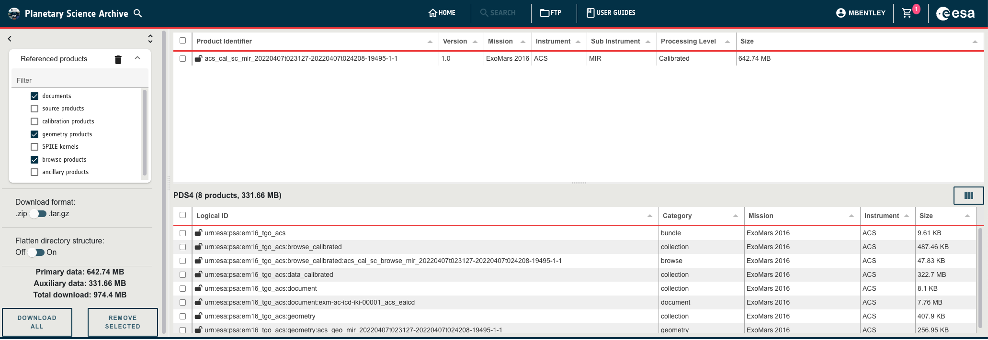
Reference List
PSA uses these links to correctly serve ancillary data to the user
as of next week, when version 7.3.0 is released the UI will serve these data as below
Note that links to SPICE kernels are meant for archived kernels
typically, the versioned meta-kernel
for missions archiving operationally we use another mechanism to link to operational kernels
XML prolog
Product Observational
Identification Area
Observation Area
Mission Area
Discipline Area
Reference List
File Area

Slide 22
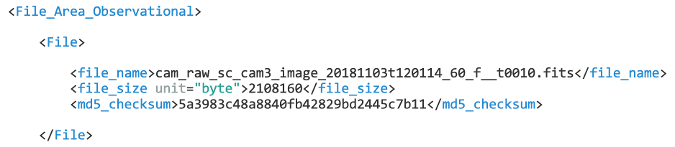
File Area Observational
This is the class that tells software how to read the bits and bytes
and is the one most likely to throw validation errors
Note that the schema/Schematron validation checks the label
but the validate tool will check the values against data type and meta-data
so, running validate on samples and pipeline output is critical!
Even when you have a valid PDS4 product, it doesn’t mean the values are correct
so, make sure you read back the data and sanity check
Starts with the filename and optional filesize and MD5 checksums
you don’t have to include these, but if you do, they are checked by validate
XML prolog
Product Observational
Identification Area
Observation Area
Mission Area
Discipline Area
Reference List
File Area

Slide 23
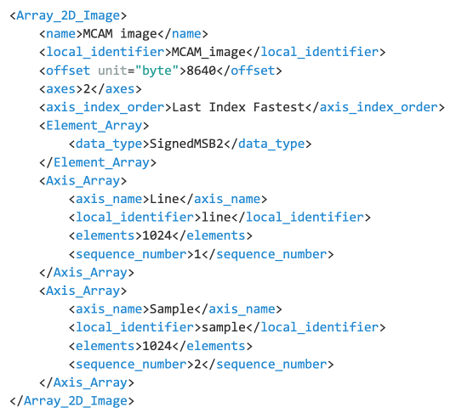
File Area Observational
Then you define data objects
In this example you see:
2D image array
of 1024 x 1024 pixels
stored as 16-bit signed integers
at byte offset 8640
This is actually a FITS file
but the internal format = PDS4 array
Note the local_identifier
this is used to link this array to other meta-data in the Discipline_Area
When labelling arrays, they must be
last index fastest = row major
if written differently, switch the sequence_numbers
XML prolog
Product Observational
Identification Area
Observation Area
Mission Area
Discipline Area
Reference List
File Area

Slide 24
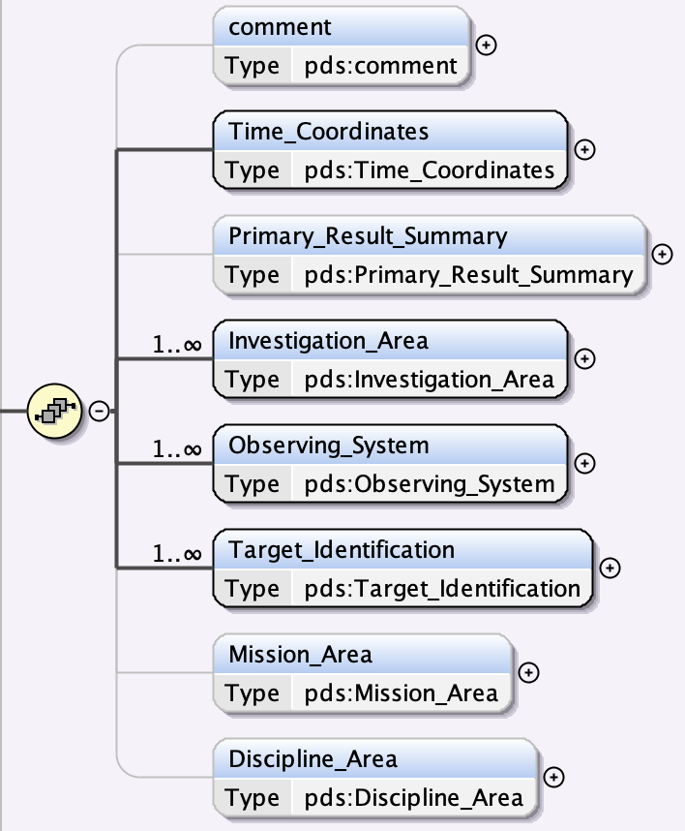
Visualising schema
This will be covered in more detail later, but… how do I know what can/should go in a label?
schema are not so fun to read, but they can be visualised with tools
see e.g. this article https://www.xml.com/articles/2023/03/06/visualising-xml-schemas/
The most comprehensive tool for working with PDS4 labels is oXygen XML editor
it’s not free, but supports schema diagrams, schema and Schematron validation
https://www.oxygenxml.com/xml_editor.html
Throughout this workshop you will see images of schema from oXygen
solid black lines = mandatory
grey lines = optional
numbers indicate cardinality
how many times an attribute or class can be repeated
Alternatives include Visual Studio, Eclipse QXmlEdit and online tools e.g.
http://www.xml-tools.net/schemaviewer.html

Slide 25
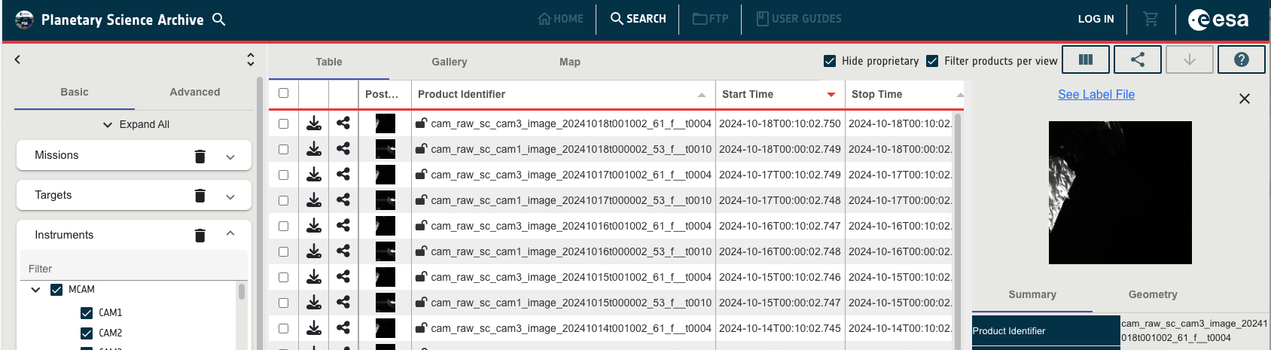
Help!
We will cover the end-to-end process of desiging a label separately, but a few pointers
look for other examples – in PSA you can click “See label file” for any product
https://pds.nasa.gov/datastandards/training/documents/PDS4_Label_Overview.pdf

Slide 26
Backup slides

Slide 27
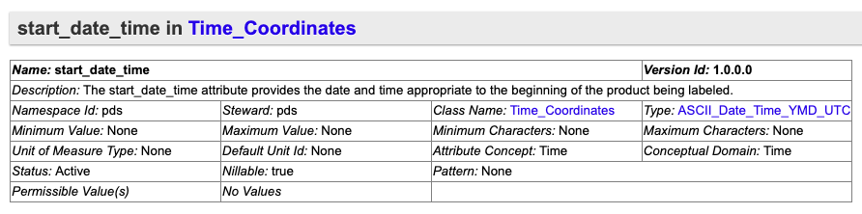
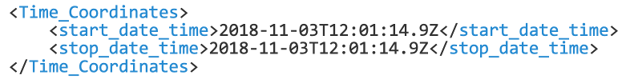
Observation area
Time_Coordinates – what formats can be used?
check the core data dictionary
so here we need ASCII_Date_Time_YMD_UTC
click through will give you the pattern
yyyymmddThhmmss[.sss]Z
XML prolog
Product Observational
Identification Area
Observation Area
Mission Area
Discipline Area
Reference List
File Area

Slide 28
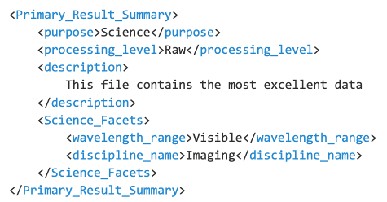
Observation area
Primary_Result_Summary
refers to the observation (not data file)
so typically
Science during science ops
Engineering for checkout, on-ground etc.
Processing level is used to filter data
Wavelength range is enforced by PSA dictionary
for search/filter – but if not relevant, use:
<wavelength_range nilReason="inapplicable" xsi:nil="true"/>
XML prolog
Product Observational
Identification Area
Observation Area
Mission Area
Discipline Area
Reference List
File Area

Slide 29
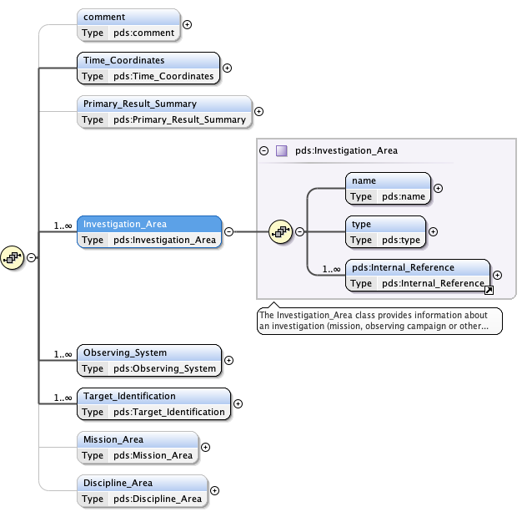
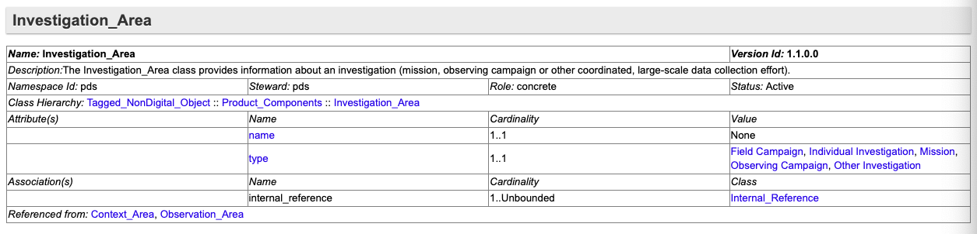
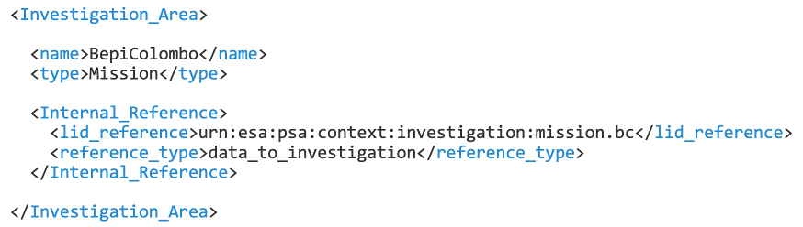
Observation area
Investigation_Area
links to the investigation (~mission)
specifically to a context product in the PSA context bundle
Note the use here of Internal_Reference to link PDS4 products
reference_type is critical – here it has to be data_to_investigation
This part of the label is mostly boilerplate and an example will be provided
XML prolog
Product Observational
Identification Area
Observation Area
Mission Area
Discipline Area
Reference List
File Area

Slide 30
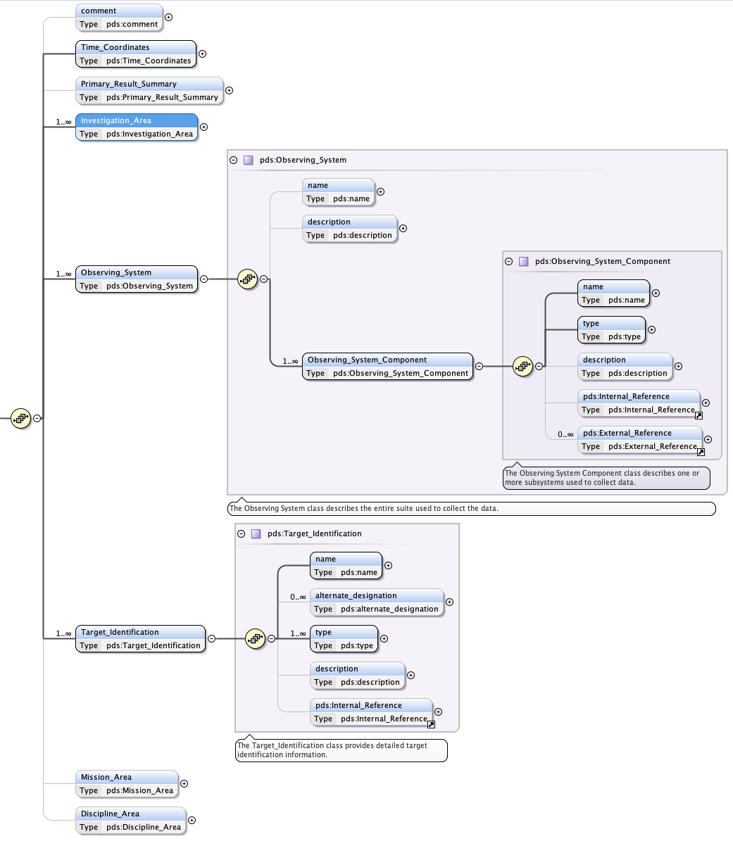
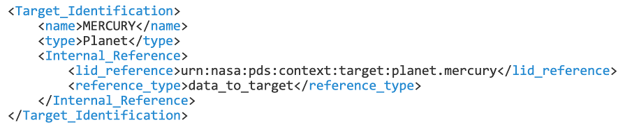
Observation area
Observing_System
another static part of your templates – yay!
links to descriptions of the
instrument
instrument host (spacecraft, lander etc
Target_Identification
In the schema, name and type are mandatory
but in PSA we rely on use of a link to a context product
Target contexts can be created as needed but first check if one exists:
at PDS: https://pds.nasa.gov/data/pds4/context-pds4/target/
in PSA: https://psaftp.esac.esa.int/#/context/target/
XML prolog
Product Observational
Identification Area
Observation Area
Mission Area
Discipline Area
Reference List
File Area

Slide 31
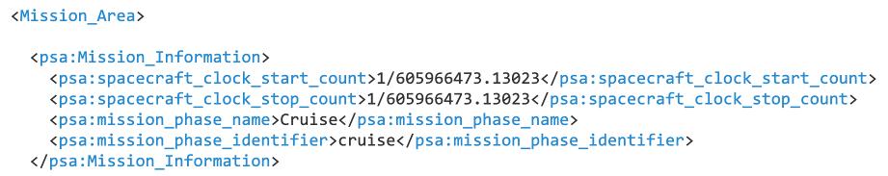
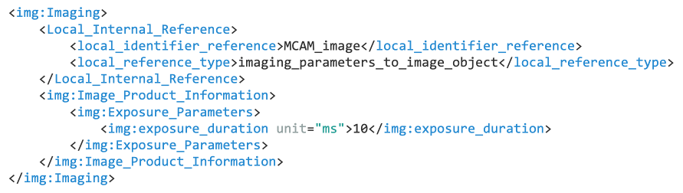
Mission and discipline areas
The Mission_Area and Discipline_Area are containers for content from outside the core dictionary
Discipline_Area: any discipline dictionary can be used here
see https://pds.nasa.gov/datastandards/dictionaries and later presentations
Mission_Area: any mission or instrument specific dictionaries can be used here
e.g. PSA dictionary
XML prolog
Product Observational
Identification Area
Observation Area
Mission Area
Discipline Area
Reference List
File Area

Slide 32
XML prolog
Product Observational
Identification Area
Observation Area
Mission Area
Discipline Area
Reference List
File Area

