Slide 1

External formats compatible with PDS4
4-8 November 2024, ESAC, Spain

Slide 2
Compatibility of external data formats
External data formats are sometimes used to archive instruments data in PSA, provided they follow PDS4 rules.
General requirements need to be met:
Unfragmented (all data for a variable must be contiguous in the file);
Uncompressed (file and variable);
Need to be able to retrieve location of data in file (offsets);
Data type needs to match a PDS4 one;
Metadata needs to simultaneously meet multiple metadata standards (external standard + PDS4);
Key metadata need to be mapped to PDS4 attributes;
Typical external formats are*: CDF, FITS, VICAR, GeoTIFF, …
IMPORTANT
When using any of these external encoding data standards, it is strongly recommended to design data products that are PDS4-compliant and meet all PSA archiving requirements to avoid any reformatting or conversion of data only for archiving purposes.
This will guarantee that the same data formats used and exchanged by the science team during the mission will be archived and preserved.

Slide 3
CDF in Planetary Sciences
CDF = Common Data Format;
Widely used in the Heliophysics domain;
Time series data;
Some agencies and/or instrument teams in planetary sciences have adopted CDF
existing infrastructure;
broad software support for the format.
Implies ISTP (International Solar-Terrestrial Physics) metadata compliancy.
For planetary science missions it is required to have the data archived with the Planetary Data System (PDS)
This allows PDS4 aware tools to access and manipulate data stored in a CDF file without the need for a CDF reader;
Adopting a set of best practices for constructing a CDF will enable archiving of the data with PDS.

Slide 4
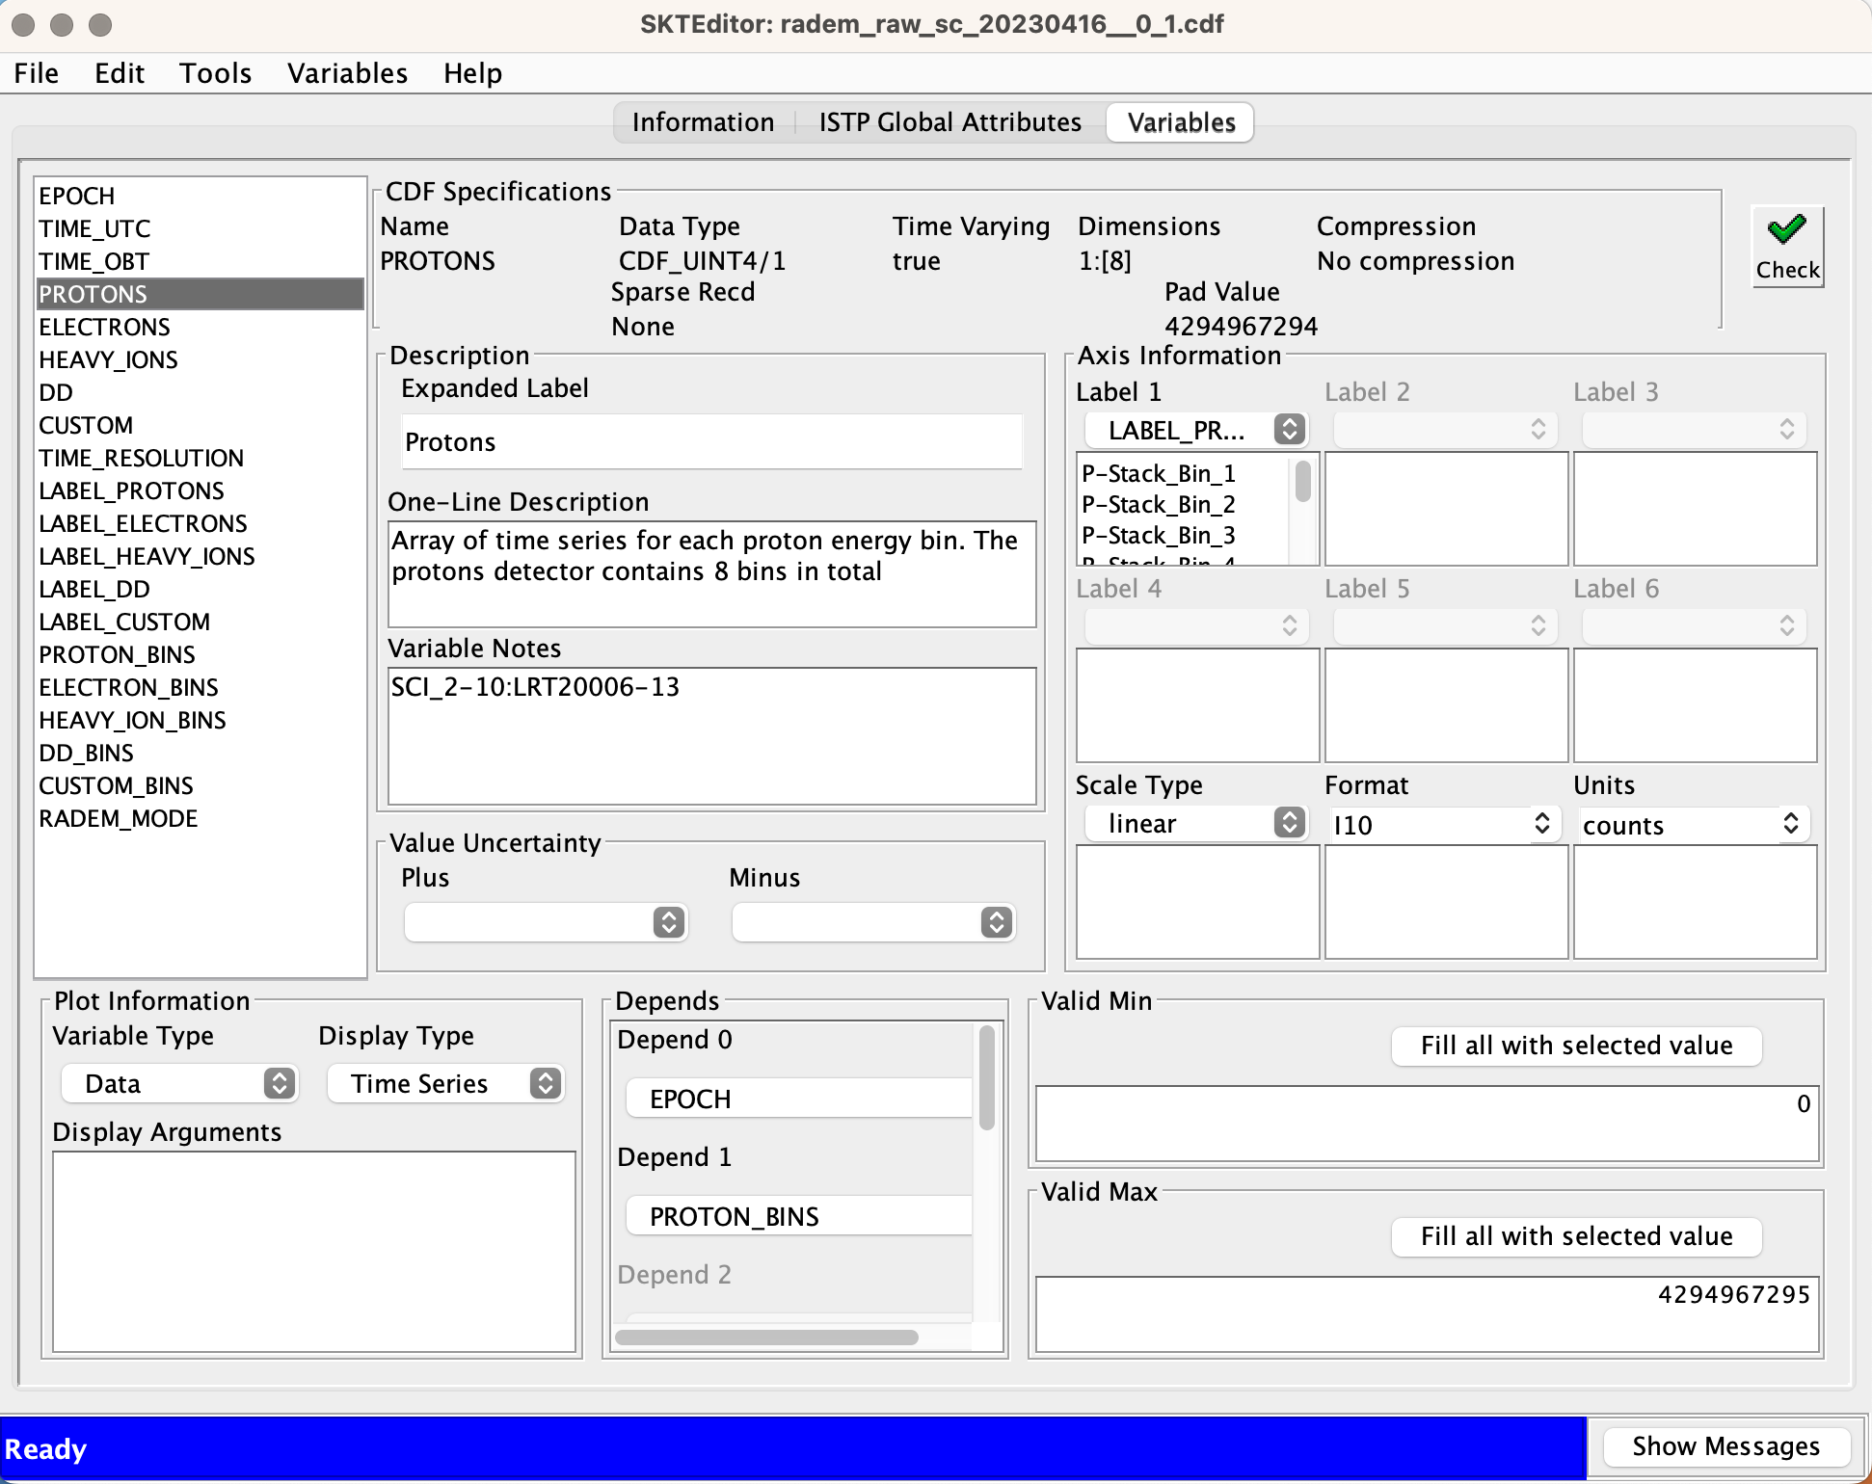
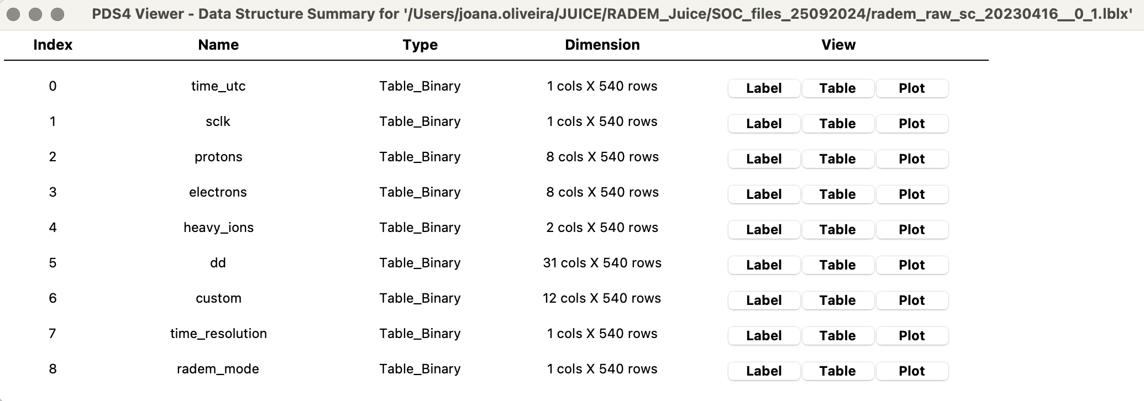
CDF in Planetary Sciences

Slide 5
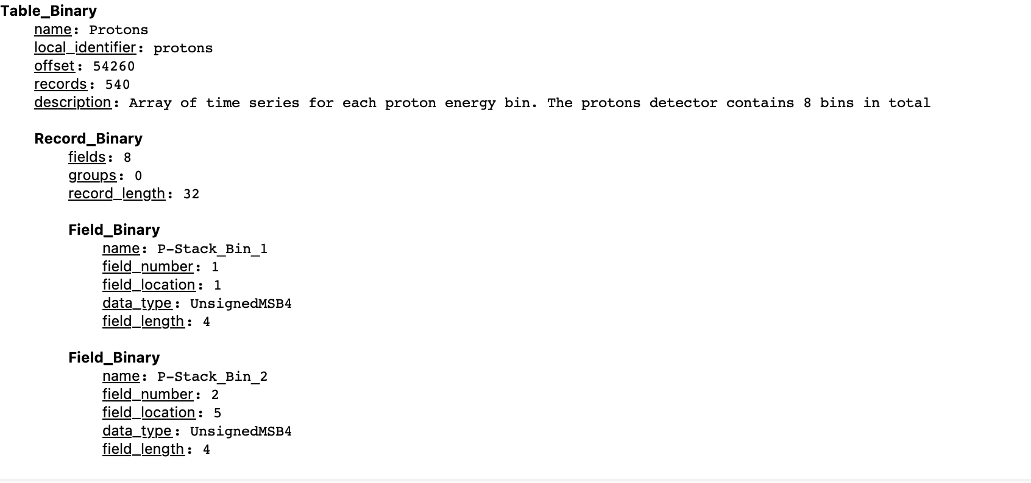
CDF in Planetary Sciences

Slide 6
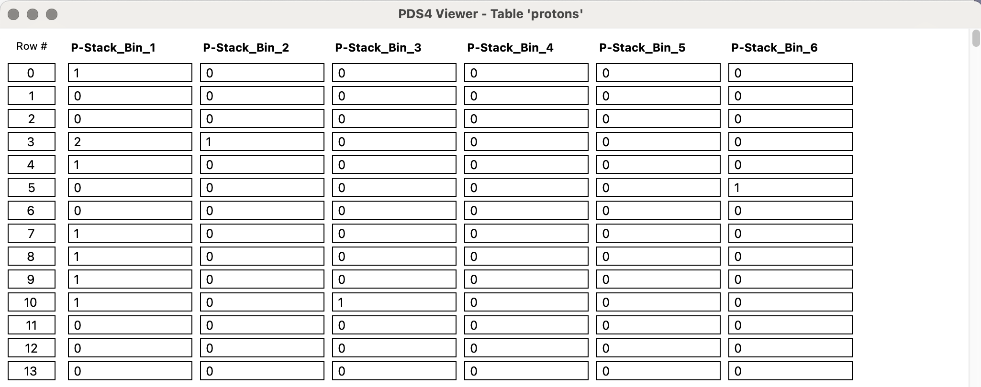
CDF in Planetary Sciences

Slide 7
CDF in Planetary Sciences

Slide 8
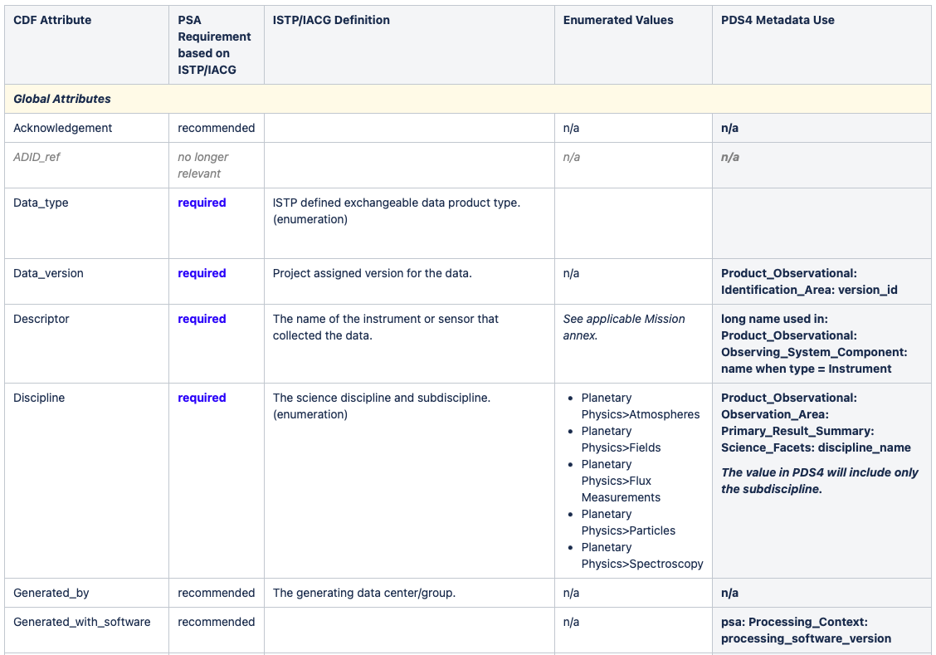
Specificities of archivable CDF files
Global attributes + variable attributes + variables = make the data correctly and independently usable by someone not connected with the instrument team.
Global attributes - Used to provide information about the data set as an entity
Required
Optional
Variable attributes – linked with each individual variable and provide additional information about each variable
Required
Optional

Slide 9
Specificities of archivable CDF files
To ensure data in a CDF file will be in an archivable form:
Create CDF compliant with version 3.4 or later.
Use single file CDF.
No compression (file or variable).
No fragmented variables (all data for a variable must be contiguous in the file).
No sparse variables (data for all dimensions in a variable are written).
No virtual (calculated) variables.
Variables are stored in row majority order.
Use only "zVariables" (also recommended by the CDF standard).
To aid in the generation of PDS metadata it is advisable to include
ISTP/IACG compliant metadata.

Slide 10
Relevant CDF tools
Tools to verify ISTP/IACG compliance
SKTEditor – verify that the CDFs comply with standards and tools
CDFConvert – convert internal structure of existing CDF files.
http://cdaweb.sci.gsfc.nasa.gov/pub/software/cdf/dist (complete CDF library, including various tools like cdfconvert)
Tools to verify CDF-A compliance
cdfcheck: Scan a CDF file and determine if the CDF files meets requirements specified for CDF tools, ISTP/CDF and PDS archiving. http://release.igpp.ucla.edu/pds/cdf/
Tools to create PDS4 labels for CDF files
PPI has created an application (igpp.docgen) which defines an environment that can process Apache Velocity templates into PDS4 labels. http://release.igpp.ucla.edu/igpp/docgen /
Data providers can create tools to generate PDS4 labels from CDF files.
Mark’s code to retrieve offsets: https://github.com/msbentley/pds4_utils (cdf_utils module)
Tools to read CDF data
CDF reader in Python: https://github.com/MAVENSDC/cdflib, module to read/write CDF files without needing to install the CDF NASA library.

Slide 11
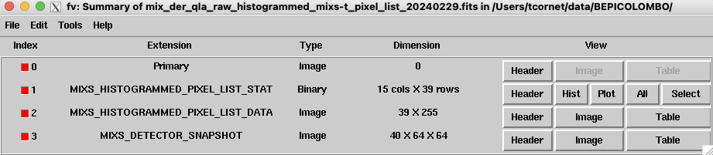
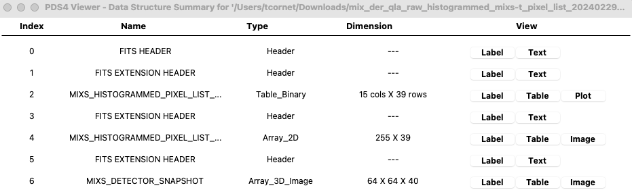
FITS in Planetary Sciences
FITS = Flexible Image Transport System (FITS Standard)
Widely used in astronomy domain; becomes popular in planetary science for imagers and spectral imagers.
Multiple data types can be stored in the same FITS file in multiple (Header +) Data Units HDUs
FITS headers capture the relevant metadata.
Opening a FITS file with a FITS viewer tool
Opening the PDS4 product (using the same FITS file) with PDS4 reader tool

Slide 12
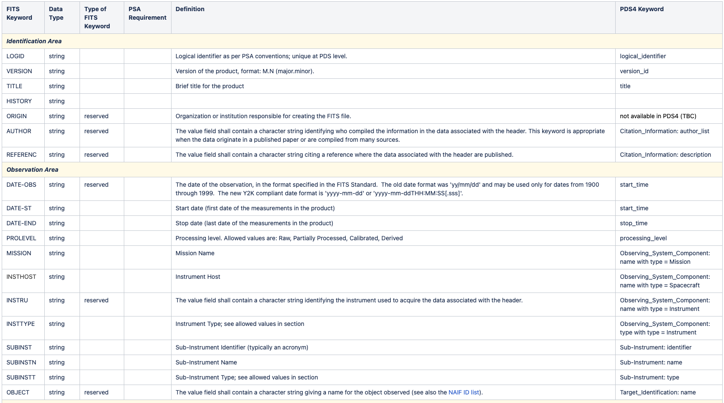
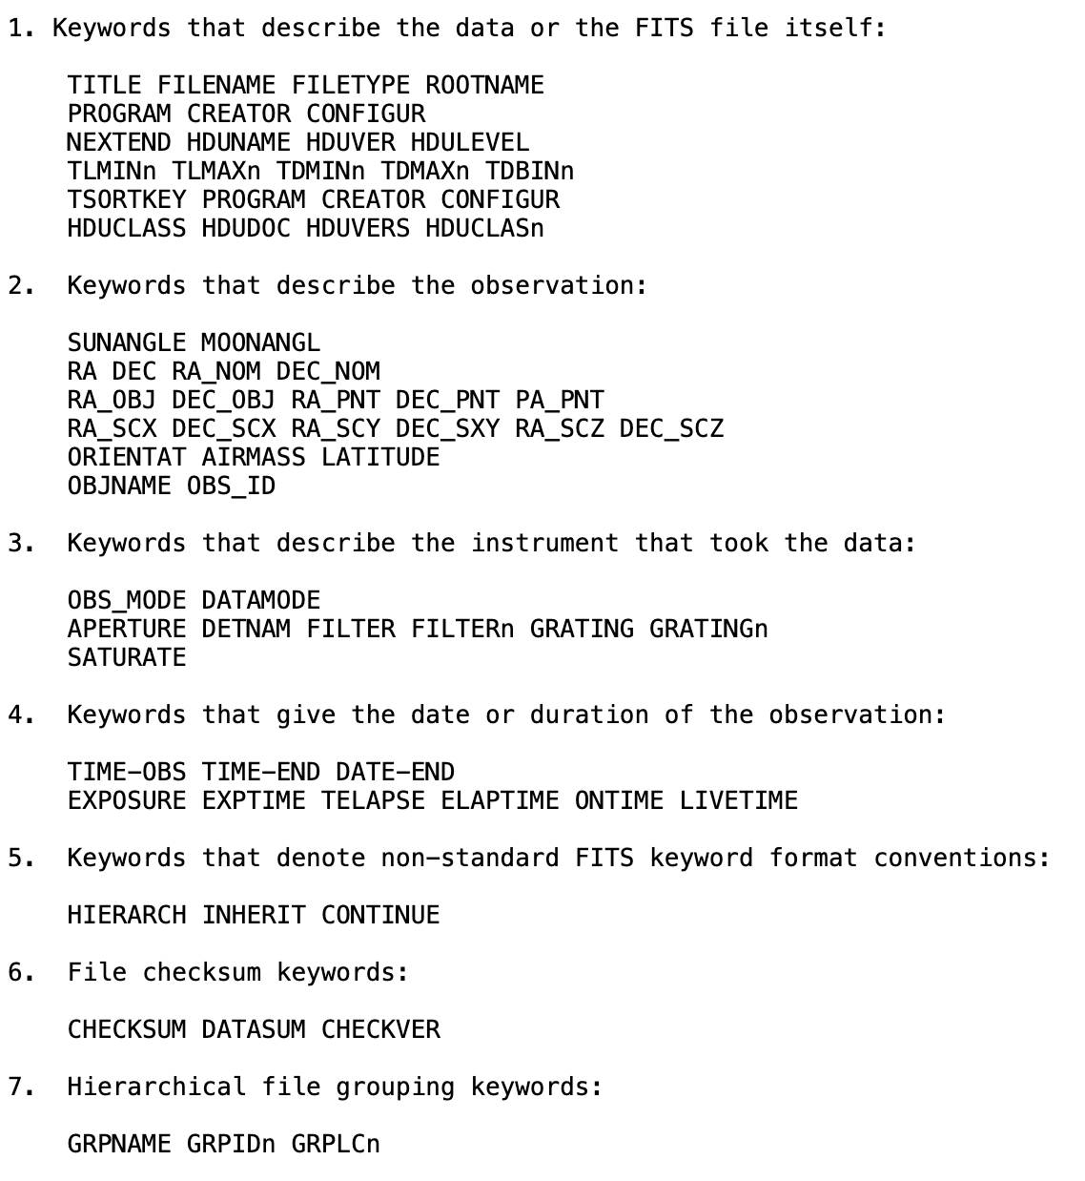
Usage of the FITS headers
Implies simultaneous PDS4 and International Astronomical Union (IAU) metadata compliancy.
Existing FITS keywords are mapped to PDS4 attributes (PSA PDS4 Archiving Guide).
Other keywords can be used to capture further metadata (e.g. FITS keyword dictionaries).

Slide 13
Header Data Unit (HDU) in FITS files
Human readable ASCII headers
Primary Header
Extension Header (= header for each of the subsequent FITS extensions)
Header Data Units
Image HDU for storing N-dimensional arrays (all values must be of the same kind)
BinTable HDU for storing Binary tables
(Table HDU for storing ASCII tables)
FITS HDU type | PDS4 Structure
Image HDU | Array_ND, Array_ND_type
BinTable HDU | Table_Binary
Table HDU | Table_Character* (line endings required)
FITS Header | Header

Slide 14
Specificities of archivable FITS files
Some caveats on the PDS4 compatibility of FITS data formats and data types can be found in the PDS Small Bodies Node (SBN) PDS4 Wiki, as well as guidelines on how to generate PDS4 labels for FITS files.
https://sbnwiki.asteroiddata.org/Notes_for_Labelling_FITS_files.html
FITS files comprise of one or more Header and Data Units (HDUs).
The first (mandatory) HDU is called the Primary HDU and must contain a primary header, and optional data.
Subsequent HDUs are called FITS Extensions and currently include image, ASCII table and binary table data formats, with accompanying headers.
Each HDU in a FITS file must be described in the corresponding PDS4 label.
The PSA recommends the use of a header only primary HDU which should provide metadata for the entire product (file), and one or more FITS extensions (additional HDUs) providing the actual data and corresponding metadata.

Slide 15
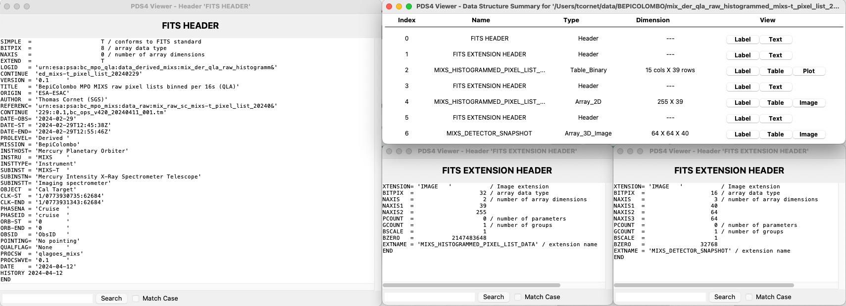
Specificities of archivable FITS files
The PSA recommends the use of a header only primary HDU which should provide metadata for the entire product (file), and one or more FITS extensions (additional HDUs) providing the actual data and corresponding metadata.

Slide 16
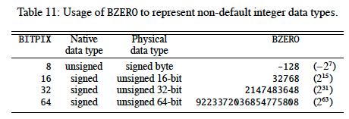
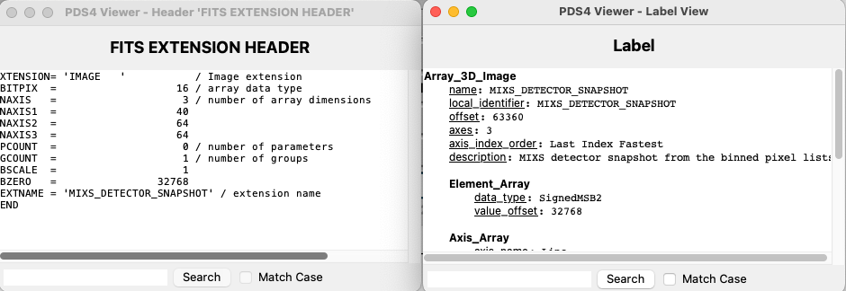
Specificities of archivable FITS files
A few more caveats
Not all integer types are supported but integers can be offset and scaled (BZERO/TZERO keyword = value_offset attribute; BSCALE/TSCAL = scaling_factor attribute)
The axis ordering for Image HDU (= PDS4 arrays) is opposite between FITS and PDS4.
Padding of FITS tables (to match FITS 2880 bytes blocks)

Slide 17
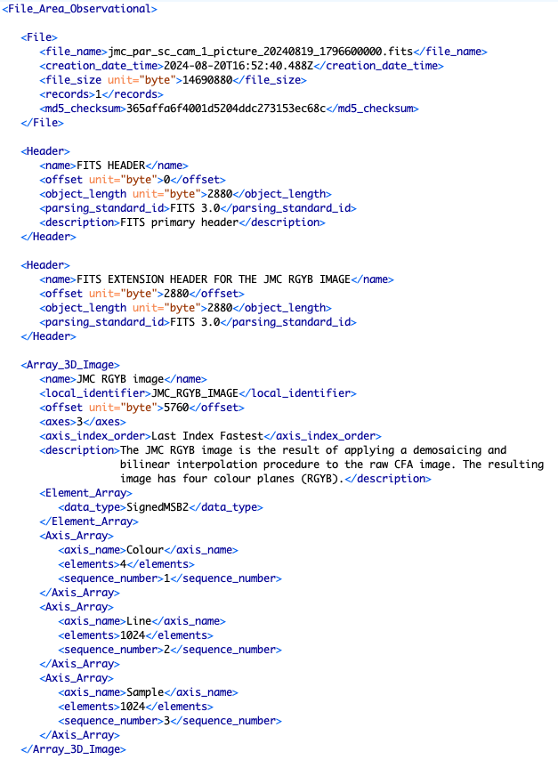
Example of PDS4 labeled FITS file
FITS file identification (name, size, etc)
FITS primary header (describes product metadata)
FITS extension header (describes array metadata)
Array data definition (offset, data type, axis order, dimensions, description)

Slide 18
Relevant FITS tools
External libraries:
FITS data is already supported by GDAL via the external library CFITSIO (see the GDAL documentation).
Astropy is a python library that allows to create and manipulate FITS files (https://docs.astropy.org/en/stable/io/fits/index.html)
List of FITS I/O libraries (many programming languages): https://fits.gsfc.nasa.gov/fits_libraries.html
File Editor:
FV: Interactive FITS file editor and viewer. FV can be used with the DS9 image display.
FITS Verication Tool:
fitsverify - A FITS File Format-Verification Tool. A web version of this tool can be found at: https://fits.gsfc.nasa.gov/fits_verify.html

Slide 19
GeoFITS in Planetary Sciences
GeoFITS is an attempt to add geospatial meta-data to FITS data products
as such, to archive in PDS4 all existing FITS guidelines and constraints are valid
To use GeoFITS data are reprojected into one of a set of projections
which are then identified using FITS “World Coordinate System” (WCS) keywords
PSA has not yet archived GeoFITS, but no issues are expected
More information: Marmo et al. (2018)

Slide 20
GeoTIFF in PDS4
GeoTIFF takes the TIFF image format and adds geospatial meta-data
it and COG (Cloud Optimised GeoTIFF) are commonly used in Earth sciences
PDS4 products using Array_2D* and Array_3D* can be used with GeoTIFF under these conditions:
no compression
no tiling
appropriate data type matching a PDS4 data type
Header parsing_standard_id is TIFF 6.0
As ever when archiving external formats the usual constraints apply:
all scientifically useful meta-data must be replicated in the PDS4 label
pipelines using GeoTIFF must be able to locate the offset to each data object
Additional guidelines are available at: https://pds-imaging.jpl.nasa.gov/help/PDSandGIS_GeoTiff_v8.pdf
GDAL includes support for producing PDS4 labels for GeoTIFF images
Example: https://astrogeology.usgs.gov/search/map/enceladus-cassini-global-dem-200m-schenk

