Slide 1
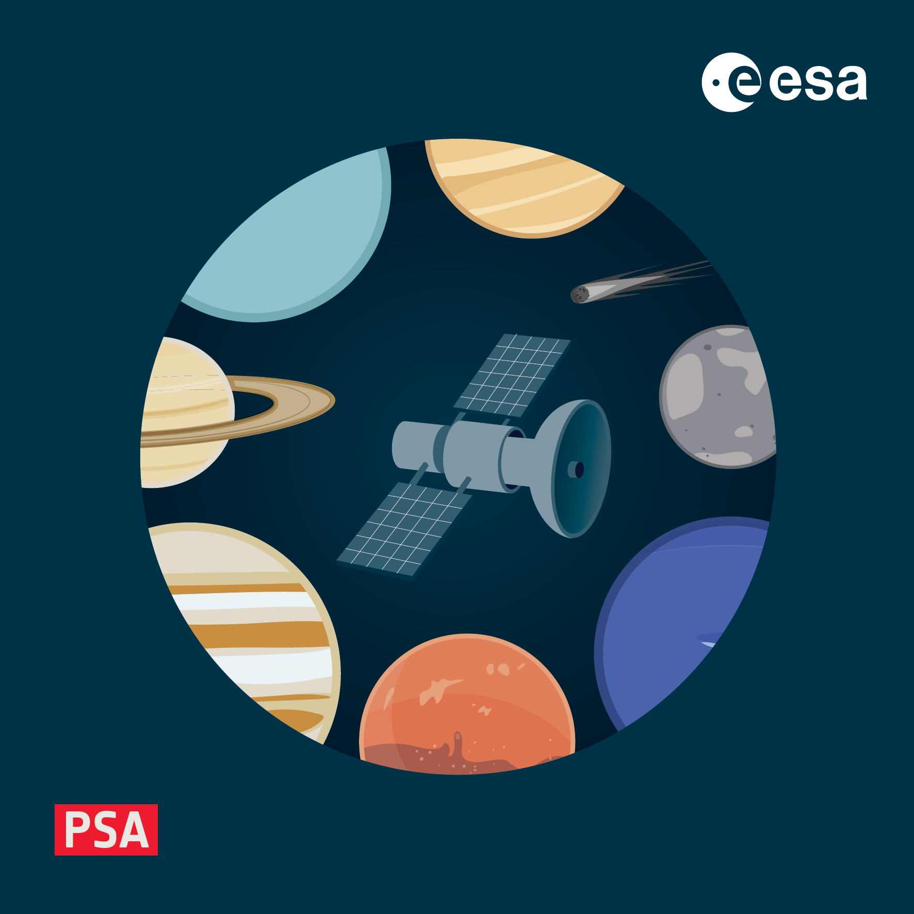
Archive Documentation
4-8 November 2024, ESAC, Spain

Slide 2

Why, if data is available?
From a point of view of a random user (who has a scientific background but is not fully familiar with the instrument or the archived data), having general context is welcome to:
learn how the instrument operates;
know how data is organized;
get to know all the caveats of the instrument/operations;
learn how to calibrate the raw data;
etc...
Typically the documents are linked from other (data) products (e.g., Reference_List).

Slide 3
What documentation is required?
Data User Guide (formely EAICD);
Calibration reports/documents;
Other documentation deemed necessary by the instrument team/Archive Scientist to understand the instrument, calibration and/or data.
Performance reports;
Key instrument or calibration published papers (with journal’s permission);
Pipeline description;
…
Mandatory
Recommended

Slide 4
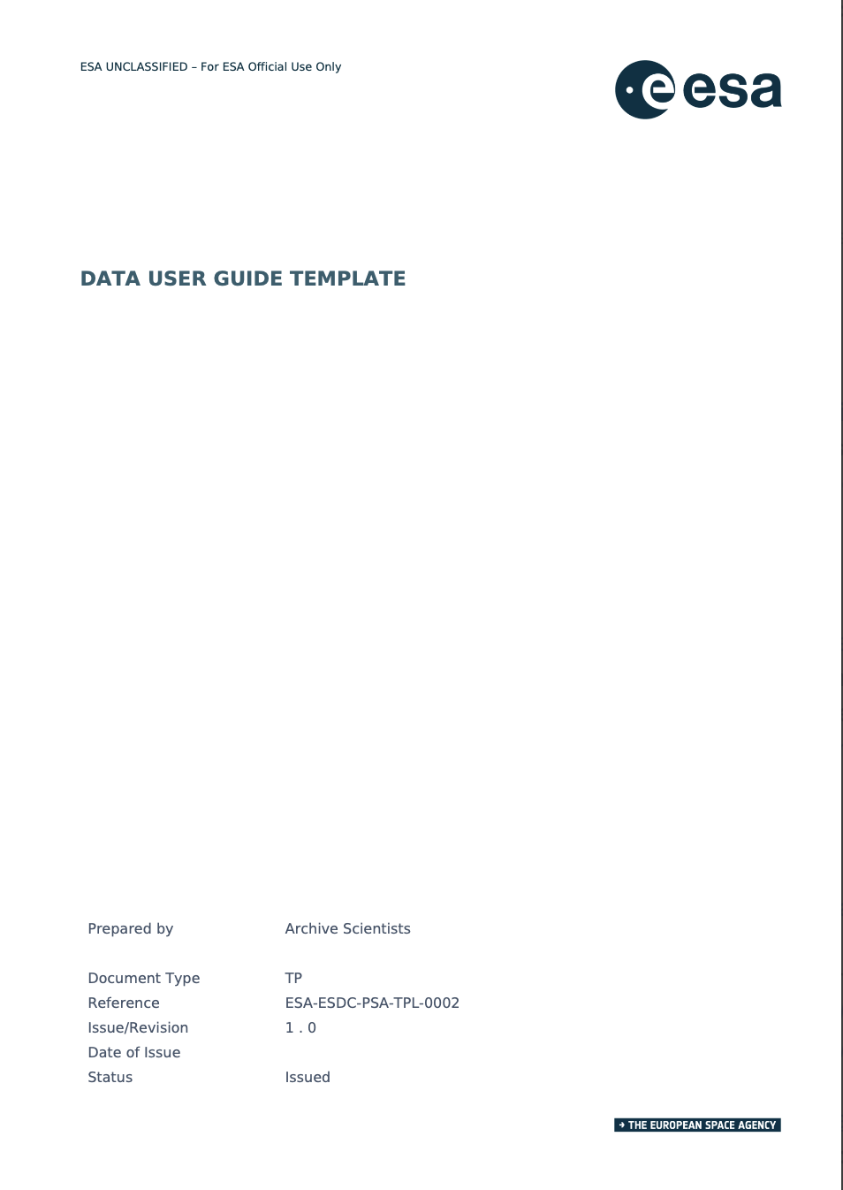
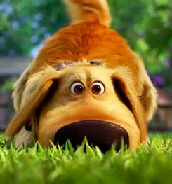
Data User Guide (previously EAICD)
DUG template is available at PSA Bitbucket: https://s2e2.cosmos.esa.int/bitbucket/projects/PSAAS/repos/psa.pds4/browse/psa/templates
For JUICE mission: https://s2e2.cosmos.esa.int/confluence/display/SPL/Data+Handling+and+Archiving
In general it contains:
Detailed information how the instrument works and acquires the data;
How data is calibrated;
How data is organized;
How to work with the data;
Caveats in the data;
…

Slide 5
Data User Guide (previously EAICD)
1. Introduction
1.1 Related documentation | Documentation that can also be found in the instrument or mission archive
1.2 Citation and license information | How the data should be cited in the literature, list of DOIs
1.3 Data availability | Additional repositories?
2. Instrument Description
2.1 Science objectives
2.2 Instrument design | Including sensor locations, orientation, frames of reference, field-of-views, etc…
2.3 Instrument performance | Changes in the instrument performance should be reported, together with its impact on data quality.
2.4 Instrument operations
2.4.1 Planning strategy | How were observations planned? Were there different strategies used for different mission phases?
2.4.2 Operating modes | Does the instrument generate different data in different modes?
2.5 Data handling | Overall processing and versioning strategy.

Slide 6
Data User Guide (previously EAICD)
3. Calibration | One of the most important sections of this document! All information that a random user needs to perform the calibration (e.g., from raw to cal) without contacting the instrument team.
Calibration strategy
On-ground calibration | If it was performed, the results should be described here.
In-flight calibration | If used, then describe it here. Is this performed per observation or periodically?
4. Data Description | Overview how to use the data (description of each different types of data product, filename conventions, metadata possible values, caveats of data use, …). NOTE: description should NOT be a repetition of the PDS4 label.
5. Science user guide
How to approach the dataset | Which are the most important products for different science cases?
Working with the data | Recommendations for software to be used, or data analysis techniques…
Key data and meta-data
Known issues and caveats
Example analysis | e.g., Reproducing an analysis from a published paper.

Slide 7
Calibration reports/documents
There is no "one size fits all" rule!
These documents contain calibration aspects that are extremely detailed, and will be referenced in the Data User Guide/EAICD.
E.g., in the case of lab measurements, detector characterisation, beamline tests, etc... it's often difficult to get these as data into the archive.
Ideally, reports that came out of these campaigns are archived together with the derived calibration files.

Slide 8
Documents are products!
Bear in mind that a document needs its own label!
And like any product, it also needs to be validated (Validator checks for PDF/A compliance).
PDF/A
.lblx

Slide 9
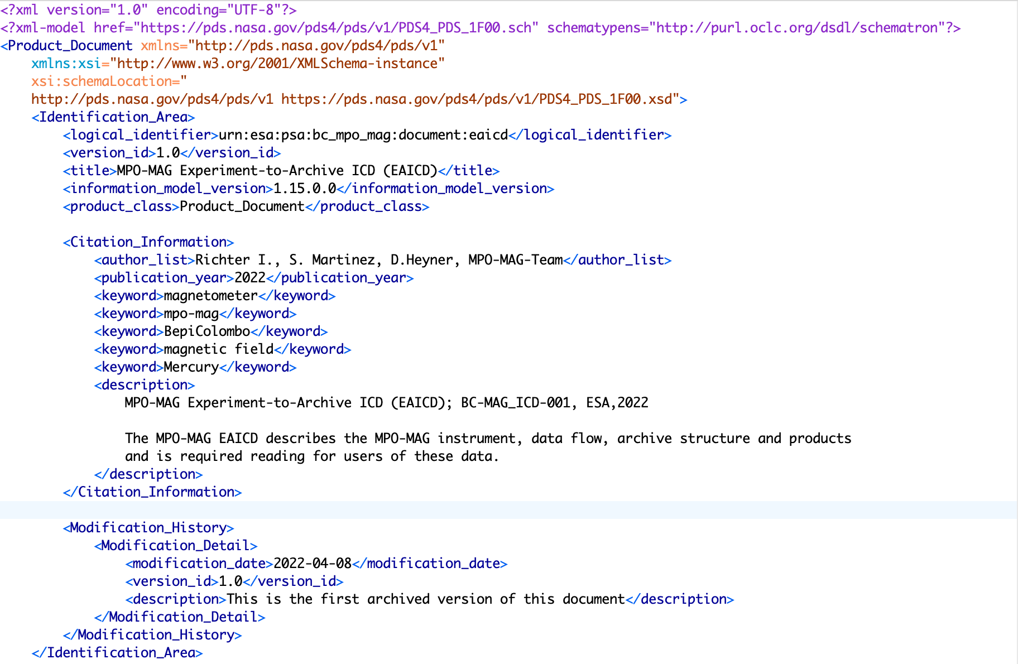
Documents are products!
.lblx

Slide 10
Documents are products!
.lblx

Slide 11
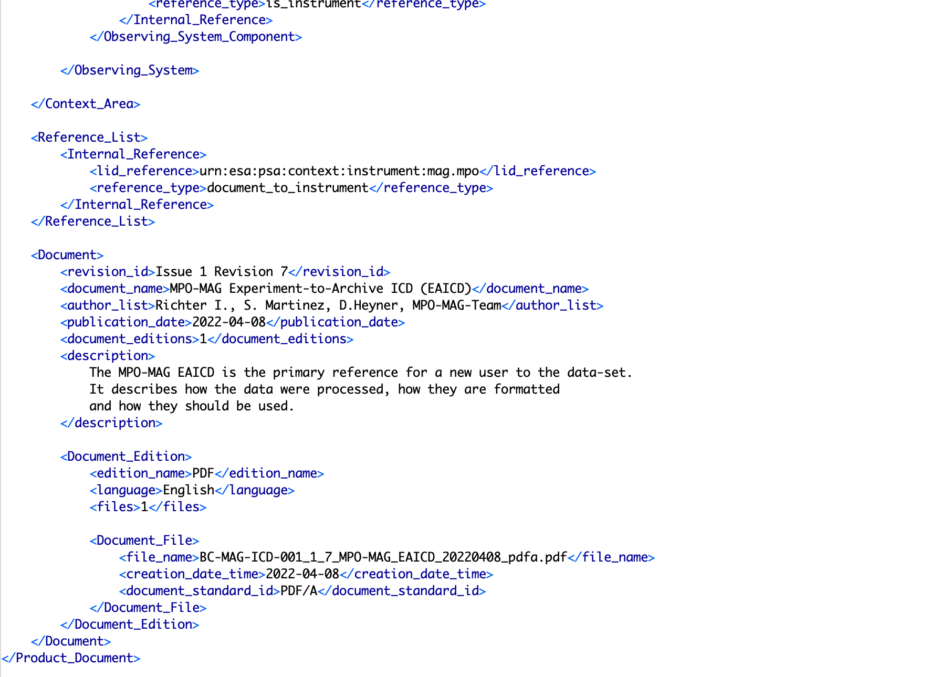
Documents are products!
.lblx

Slide 12
Documents are products!
.lblx

Slide 13
Documents are products!
PDF/A – long-term preservation
PDF/A differs from PDF by prohibiting features unsuitable for long-term archiving, such as font linking (as opposed to font embedding) and encryption.
Best practices for authoring documents for PDF/A generation, as well as how to create, convert, and validate PDF/A documents prior to submission to the PDS or PSA: https://pds.nasa.gov/datastandards/documents/PDFA_Guidelines.pdf
Open Source fonts when possible

