Slide 1
pygame
DSD

Slide 2
BATTLE TANK
SHOOTING GAME

Slide 3
TEAM NAME:
s cube
TEAM NUMBER:
26

Slide 4
Team members
sanjay.j
samuvel.s
sai BGM hemamalini

Slide 5
`
ACADAMIC MENTOR:
Mr.RAJASEKARAN

Slide 6
INDUSTRY MENTOR: MR
INDUSTRY MENTOR: Mrs.Subhashini.U

Slide 7
ABSTRACT
BATTLE TANKER
This project is based on battle tank in war.It is a python game with graphics and user interaction.It is a basically battle game and it has two player controlled by keyboard actions .It has shooting function tankers have bombing functionality manyobjective of each player by shooting other tank.And make them every cause one life for user but the life are limited

Slide 8
In battle tank the toughness of the will be increased Once the certain score is reached then the player will move to next stage.
Once the player lost he will reappear for three time because in this game you have three life. In this game we can improve our speed because tanker will be moving speeder than you .This game is easily playable .It is an 2d game .

Slide 9
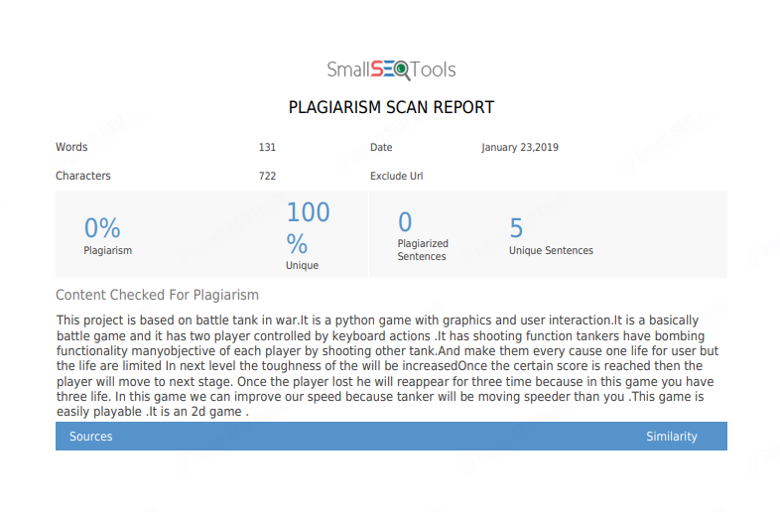

Slide 10
MODULES
Module is divided into two roles they are.
Single role
Double role

Slide 11
SINGLE ROLE
In single role there will be only one player.
The single player will attack the opponent differentiated than the other tanker.
In single role the player will be in green color.
In single role there will be only two levels.

Slide 12
DOUBLE ROLE
In double role there will are multi players
The first player will be in yellow color
And the second player will be green color
In double role each player will have two level
Each player have three life

Slide 13
MODEL ARCHITECTURE
START THE GAME
ONE VS ONE BATTLE
TWO PLAYERS
SHOOTING GAME
END THE GAME

Slide 14
REQUIREMENT THONNY LANGUAGE PYTHON
REQUIREMENT: THONNY LANGUAGE: PYTHON

Slide 15
Statement:
we developed the simple tanker battle game using python programming
:

Slide 16
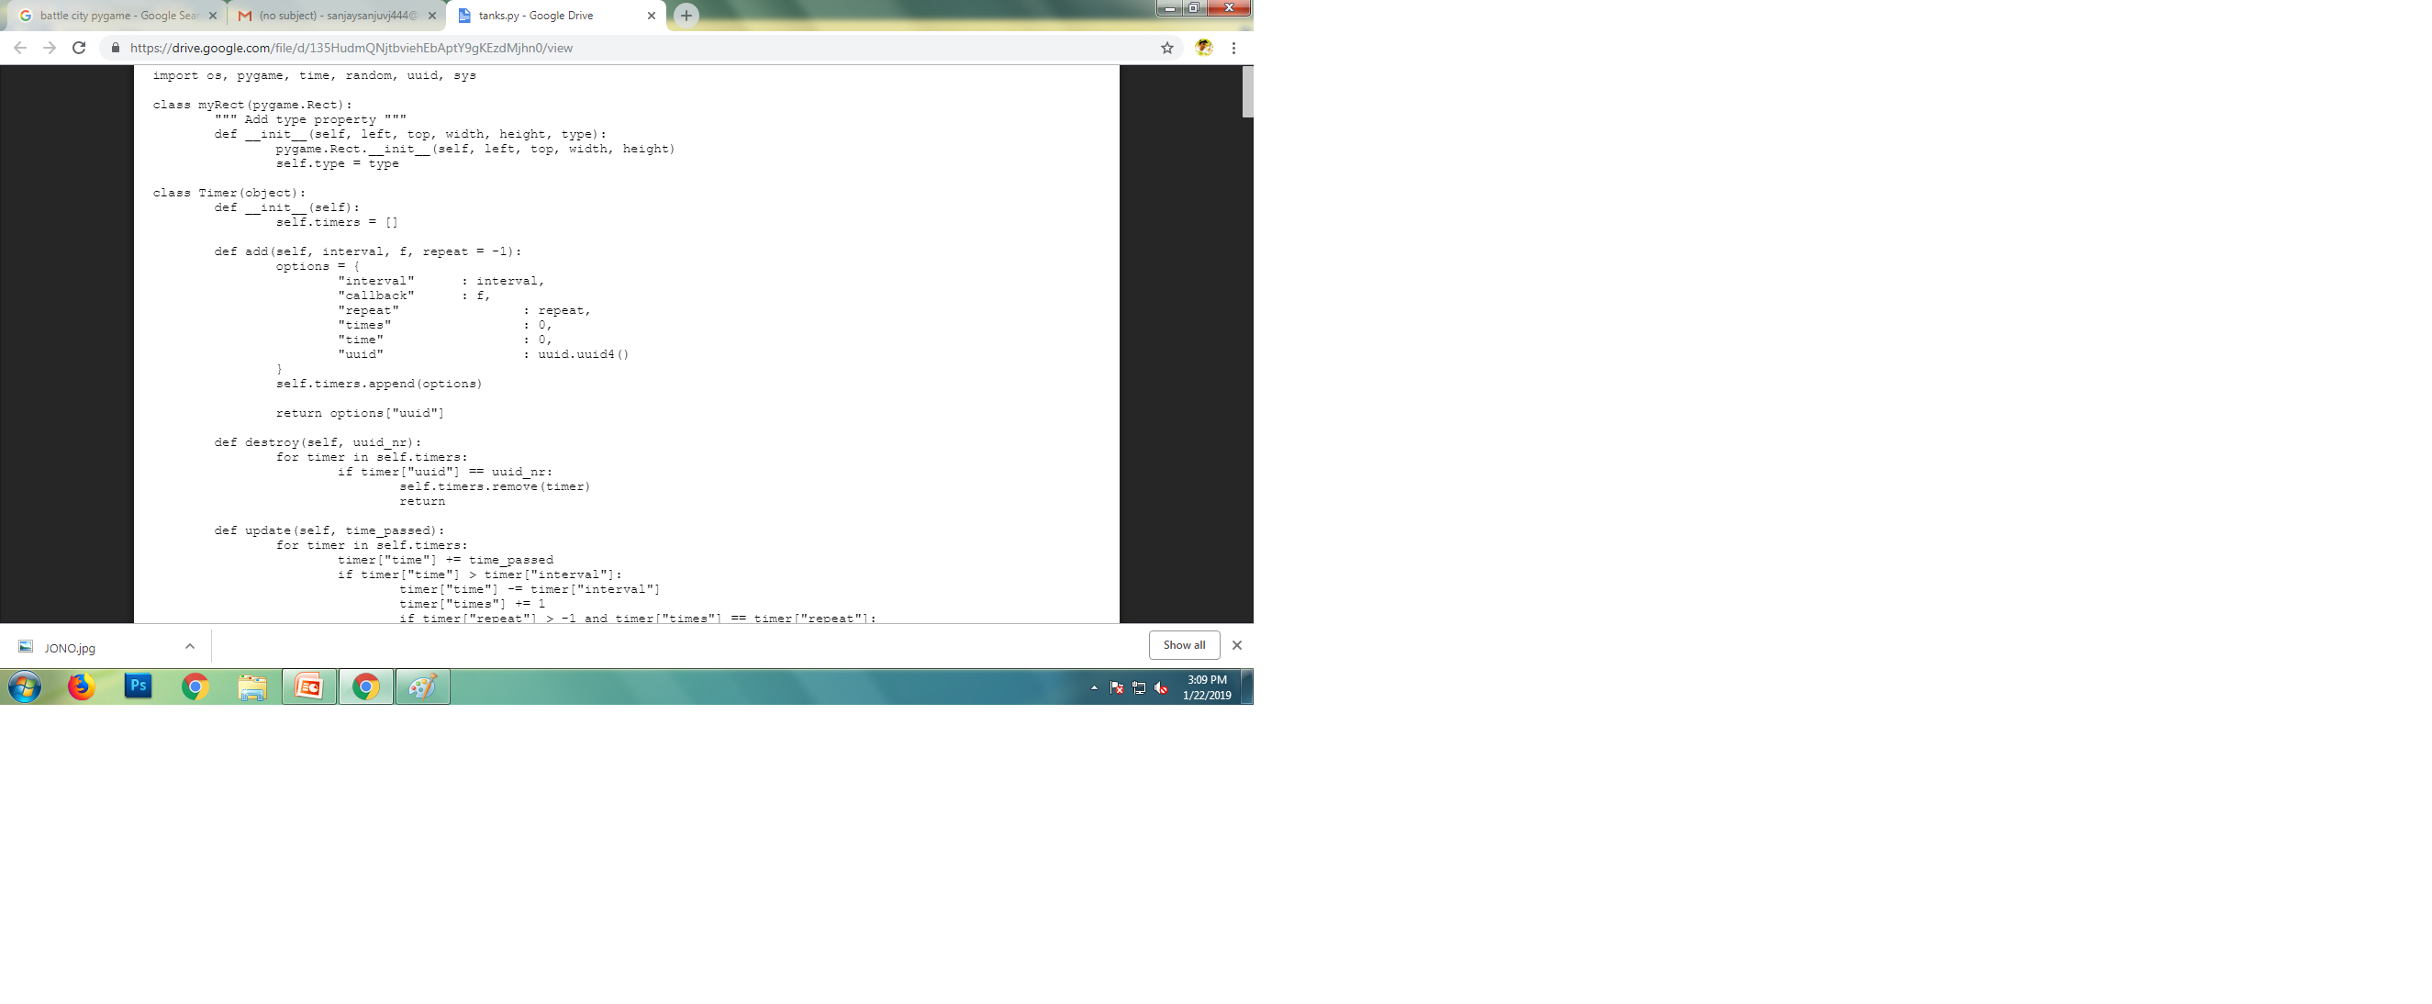

Slide 17
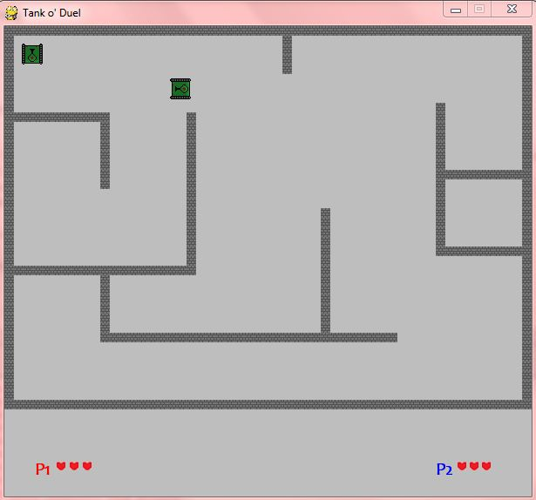

Slide 18
FEATURES:
FEATURES:
interactive game
single player
multiplayer

Slide 19

THANK YOU

