Slide 1
Mbed: From a local connectivity to the cloud
Industrial Placement Presentation:
30/01/2012
Samuel Mokrani

Slide 2
Outline
Mbed
Internet of Things
WebSocket: new HTML5 feature
Connecting sensors to the cloud
USB Device Stack
USB Overview
Stack architecture
USB HID class
USB Audio

Slide 3
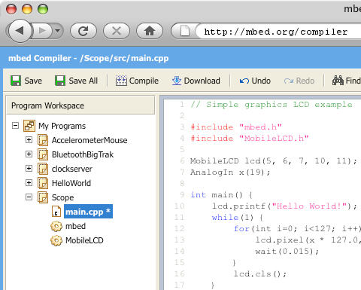
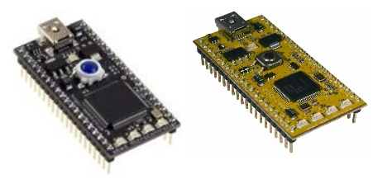

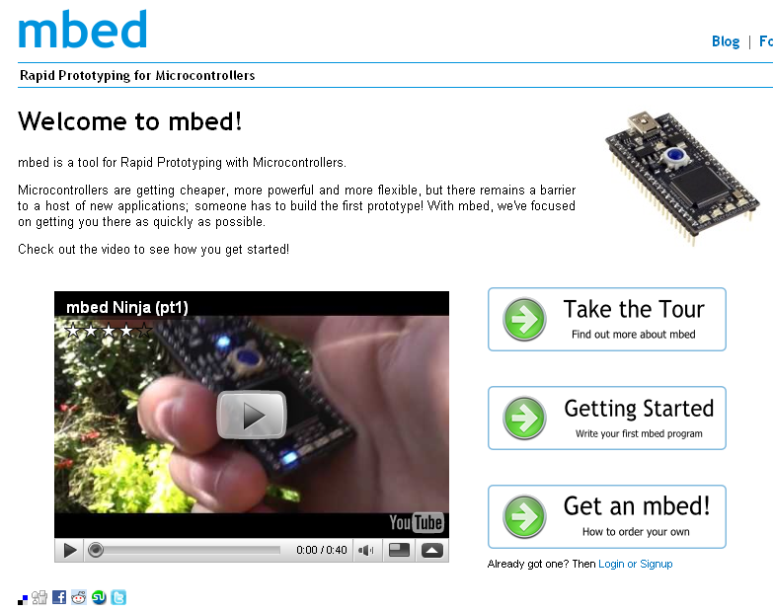
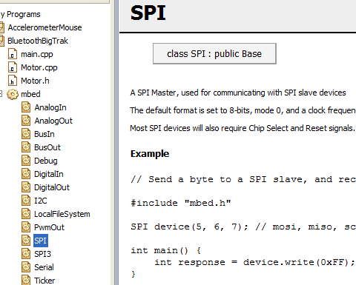
Mbed
What is Mbed ?
Cortex-M3 and Cortex-M0
boards
Online Compiler
Rapid Prototyping
for Microcontrollers
Dedicated Developer Web Platform
High-level Peripheral APIs

Slide 4
Internet Of Things

Slide 5
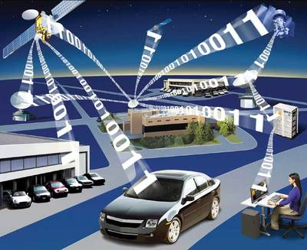
Internet of Things (IOT)
Physical objects addressable via the Internet
More and more devices connected to the Internet:
15 billion by 2015 according a prediction from Cisco
Connecting microcontrollers to the Internet is the first step of the IOT:
Smart buildings
Medical devices

Slide 6

IOT: WebSockets
New HTML5 feature (RFC 6455) providing:
Full-duplex communication over a single TCP socket
Overhead reduction
Less traffic
Standard and secure connections (ws:// and wss:// URL)
Why a such new feature ?
Replace all existing polling techniques (AJAX)
Need a two-way communication without multiple HTTP connections

Slide 7
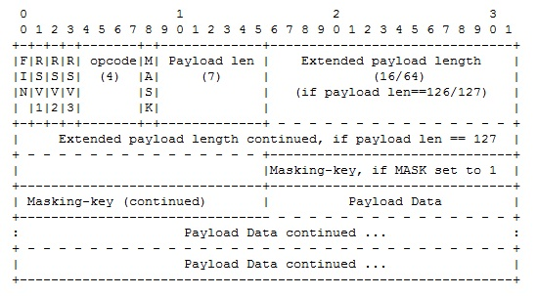
IOT: WebSockets
Handshake:
GET /ws HTTP/1.1
Host: example.org
Connection: Upgrade
Sec-WebSocket-Key: dGhlIHNhbXBsZSBub25jZQ==
Upgrade: WebSocket
Origin: http://example.org
Sec-WebSocket-Version: 13
HTTP/1.1 101 Switching Protocols
Upgrade: websocket
Connection: Upgrade
Sec-WebSocket-Accept: s3pPLMBiTxaQ9kYGzzhZRbK+xOo=
Response from the server
HTTP request from a client to upgrade
from HTTP to WebSocket
Data framing:

Slide 8
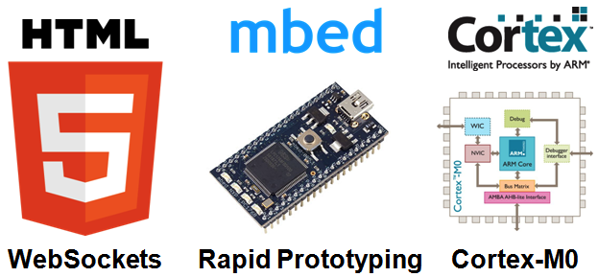
Connecting sensors to the cloud

Slide 9
IOT: connecting sensors to the cloud
Architecture:
WebSocket Server
(Python)
Mbed board +
Sensor
(C++)
Desktop browser
(Javascript)
Mobile browser
(Javascript)
Browsers receive sensor data
Mbed boards send sensor data to the server
The server broadcasts each messages received
Browsers can then read sensor data

Slide 10
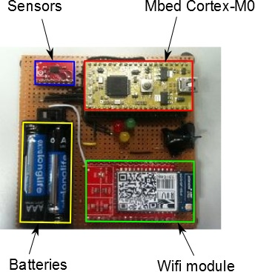
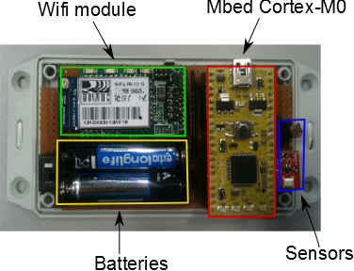
IOT: connecting sensors to the cloud
Mbed boards:
Connecting the boards to the Internet:
Wifi module from Roving Networks
Full TCP/IP stack integrated
Communication over serial port
A WebSocket library on top of the TCP/IP
stack

Slide 11
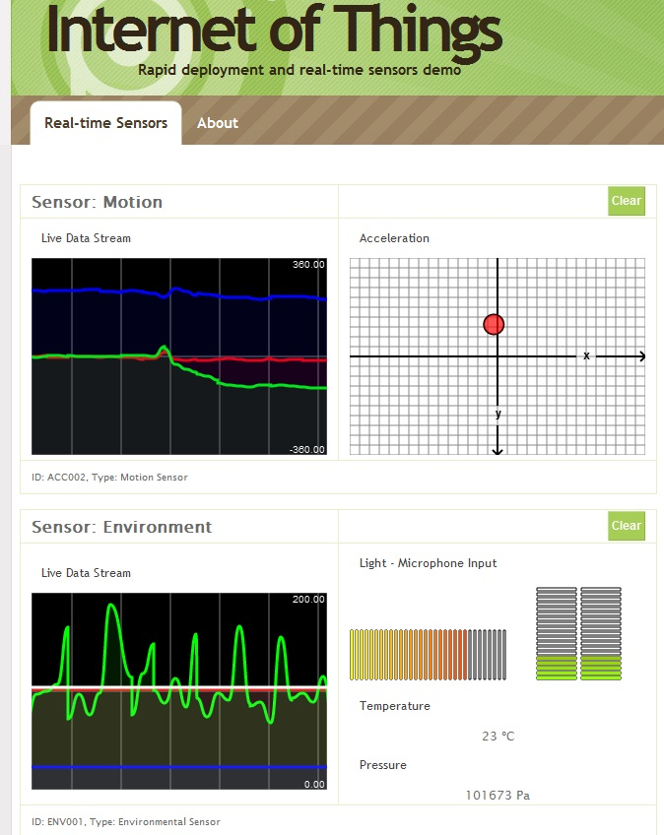
IOT: connecting sensors to the cloud
Browsers:
Architecture:
Open a WebSocket communication with the server
Listen WebSocket messages
Update real-time graphs

Slide 12
IOT: connecting sensors to the cloud
WebSocket server:
Based on Tornado webserver
ws://sockets.mbed.org/ws/<channel>/<mode>
A client is connected over a “channel”
Over a same channel, messages can be exchanged according the “connection mode”:
Write-Only (wo)
Read-Only (ro)
Read-Write (rw)

Slide 13

IOT: connecting sensors to the cloud
Dashboard

Slide 14
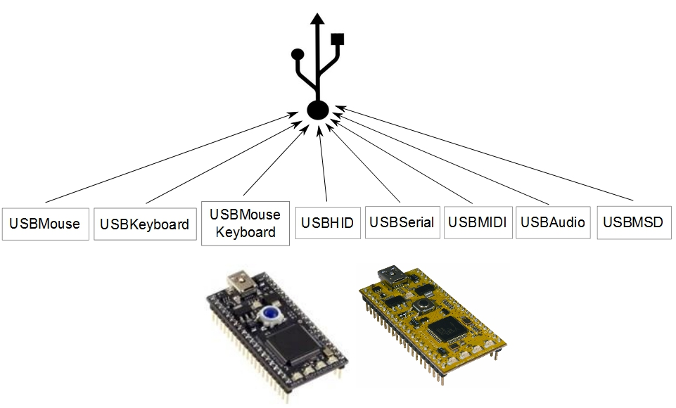
Universal Serial Bus: Device

Slide 15
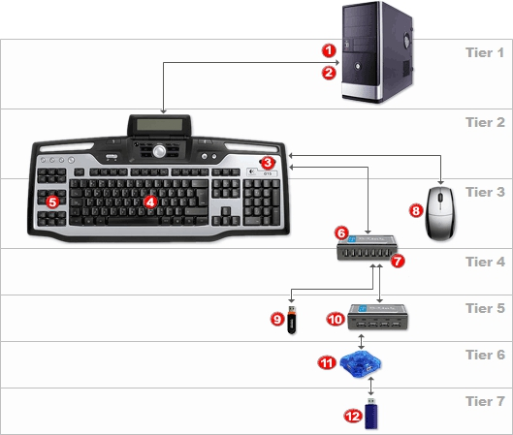
USB Device: Overview
Speed:
USB 1.0 | Low-speed Full-speed | 1.5 Mbit/s 12 Mbit/s
USB 2.0 | High Speed | 480 Mbit/s
USB 3.0 | Super Speed | 5 Gbit/s
Topology:
One host
Several devices
Tiered star architecture

Slide 16
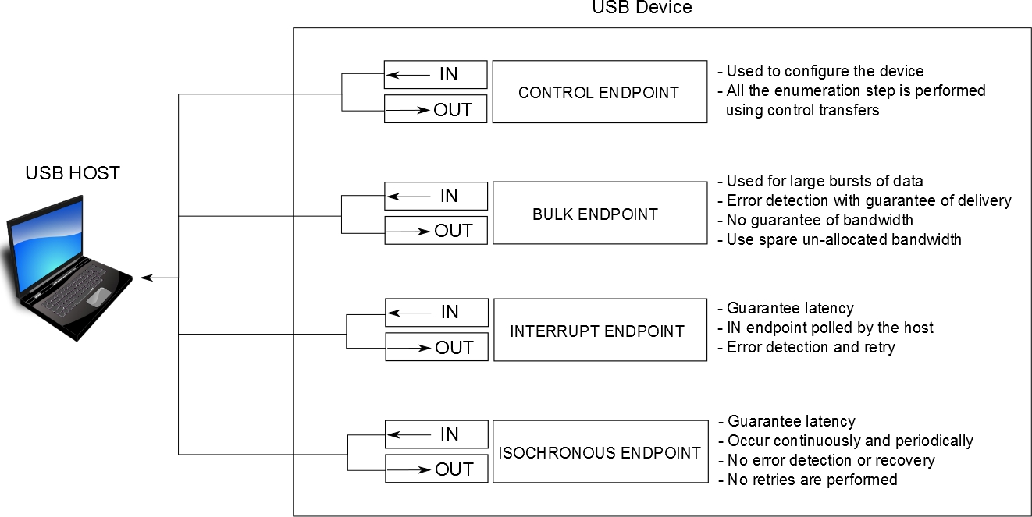
USB Device: Overview
Transfers:
Between “endpoints”
Different types according to different requirements

Slide 17
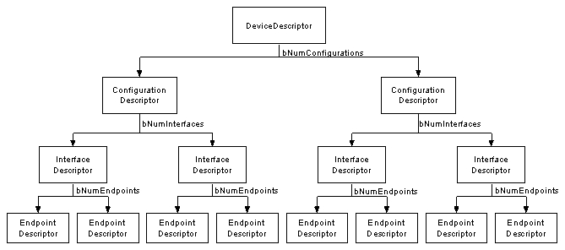
USB Device: Overview
Enumeration:
The host sets a unique address to the device
The host learns about the device capabilities to load an
appropriate driver
Device capabilities are contained in descriptors

Slide 18
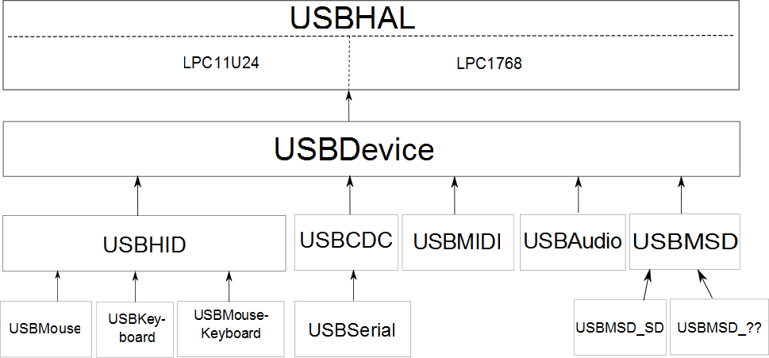
USB Device: stack architecture
Hardware abstraction
USB IRQ handler
Target abstraction
Enumeration step

Slide 19
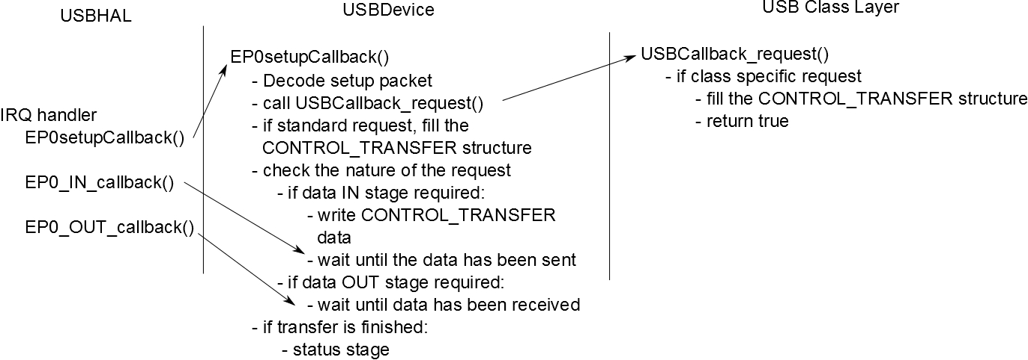
USB Device: USBDevice
USBDevice class:
No difference between the two targets
Enumeration step for “standard” descriptors:

Slide 20
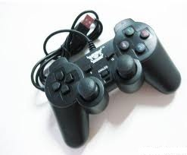
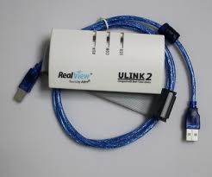
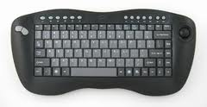
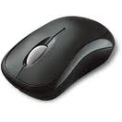
USB Device: USB HID
Human Interface device (HID):
Examples: mouse, keyboard, joystick
Can be a solution to exchange raw data with a computer
HID driver is built-in in all operating systems
Class requirements:
Interrupt IN, OUT endpoint to send and receive data
Data are exchanged in data structure called “reports”
A report descriptor defines format and size of a report

Slide 21
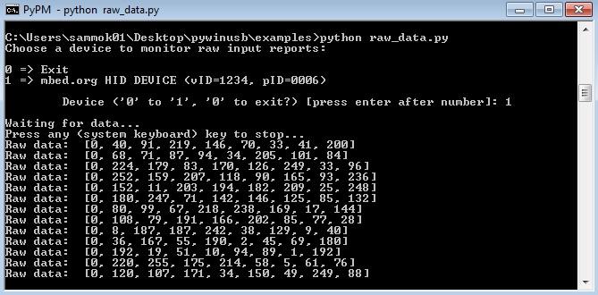
USB Device: Generic USB HID device
Report descriptor:
8 bits data exchanged in packets
Lengths for input and output packets defined
Photo mbed hid

Slide 22
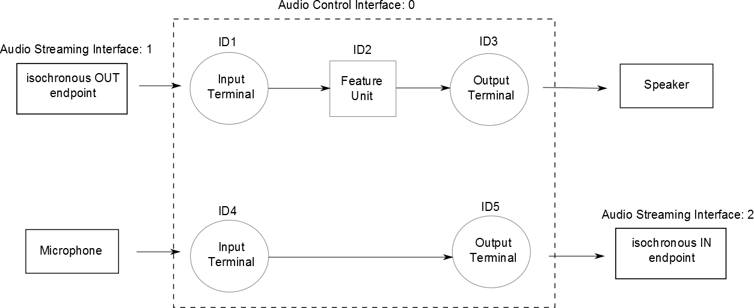
USB Device: USB Audio
Enable the mbed to:
Send and receive audio packets to or from a computer
PCM 16 bits signed packets
Class requirements:
Isochronous IN endpoint to send audio packets
Isochronous OUT endpoint to receive audio packets

Slide 23
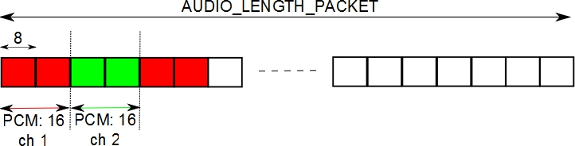
USB Device: USB Audio
Timing requirement:
Use of the Start of Frame event generated each millisecond
Example: reception of a 48kHz stereo stream
Each sample is 16 bits (2 bytes) long: 48 * 2 bytes received for one channel each millisecond
For 2 channels, 48 * 2 * 2 bytes will be received each millisecond
AUDIO LENGTH PACKET = (FREQ / 500) * nb channel

Slide 24
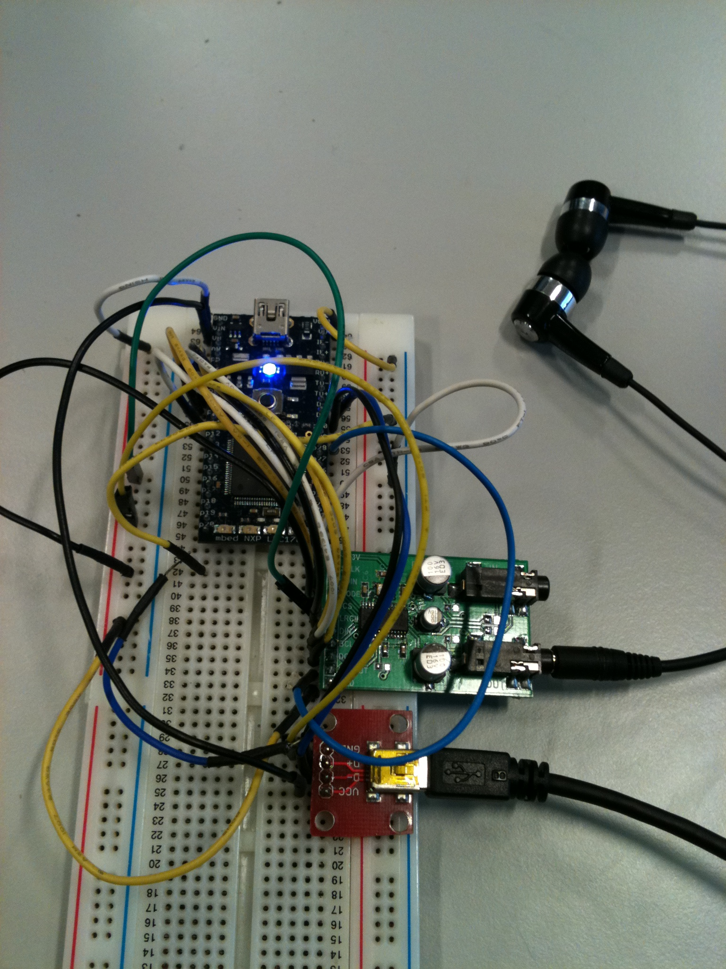
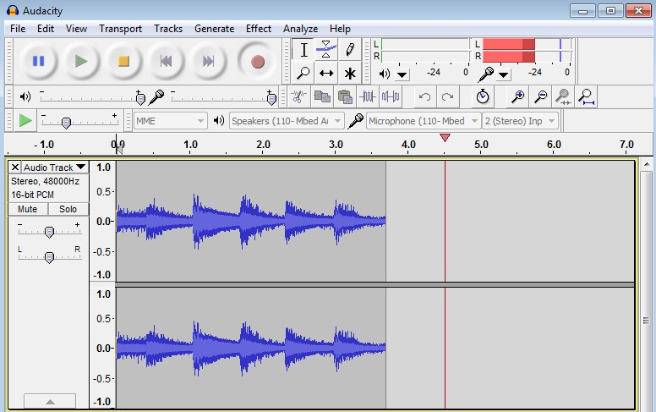
USB Device: USB Audio
Implementation:
If a user wants to read an audio packet:
Try to read the OUT isochronous endpoint on a SOF event
If a user wants to send an audio packet:
Write it on the IN isochronous endpoint on a SOF event

Slide 25
Conclusion
Internet Of Things:
Introduction of a new HTML5 feature on embedded systems
Connection of sensors to the cloud:
First prototypes
Basis for some potential IOT applications
Mbed as a USB device:
HID: generic HID, mouse, keyboard
Virtual serial port
Mass Storage Device
Audio
MIDI

Slide 26
Thanks! Questions ?

