Slide 1
Embedded systems: From the cloud to a global connectivity
Industrial Placement Presentation:
30/01/2012
Samuel Mokrani

Slide 2
Outline
Mbed
Internet of Things
WebSockets
Connecting sensors to the cloud
Remote Procedure Call (RPC) over WebSocket
USB Device Stack
USB Overview
Stack architecture
USB HID class
USB Audio

Slide 3
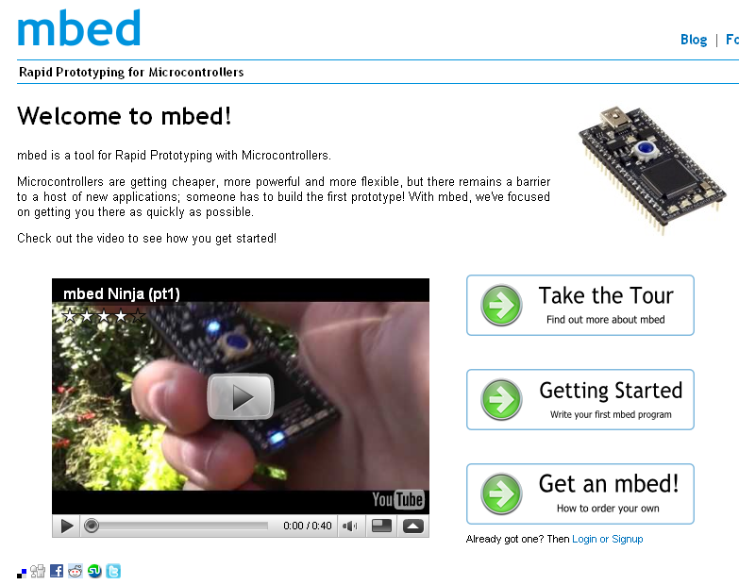
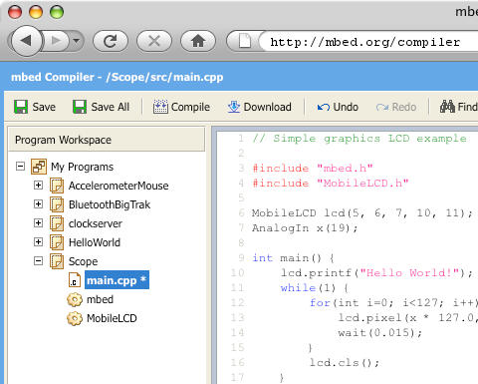

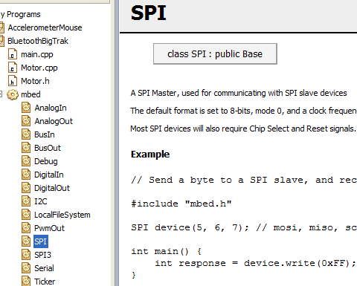
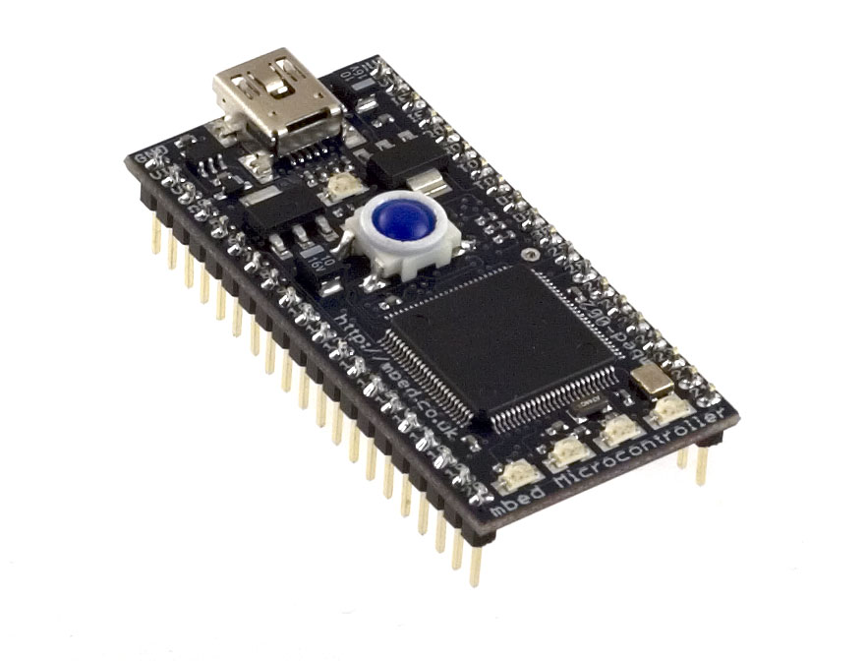
Mbed
What is Mbed ?
Dedicated Developer Web Platform
Lightweight Online Compiler
Rapid Prototyping
for Microcontrollers
High-level Peripheral APIs
Cortex-M3 MCU in a Prototyping Form-Factor

Slide 4
Internet Of Things

Slide 5
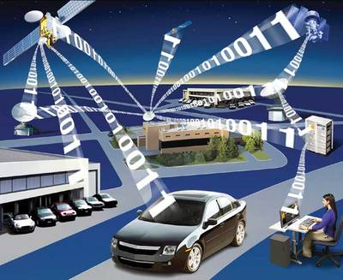
Internet of Things (IOT)
Physical objects addressable via the Internet
More and more devices connected to the Internet:
15 billion by 2015 according a prediction from Cisco
Connecting microcontrollers to the Internet is the first step of the IOT:
Smart buildings
Medical devices

Slide 6

IOT: WebSockets
New HTML5 feature (RFC 6455) providing:
Full-duplex communication over a single TCP socket
Overhead reduction
Less traffic
Standard and secure connections (ws:// and wss:// URL)
Why a such new feature ?
Replace all existing polling techniques (AJAX)
Need a two-way communication without multiple HTTP connections

Slide 7
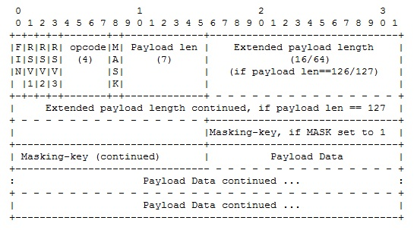
IOT: WebSockets
Handshake:
GET /ws HTTP/1.1
Host: example.org
Connection: Upgrade
Sec-WebSocket-Key: dGhlIHNhbXBsZSBub25jZQ==
Upgrade: WebSocket
Origin: http://example.org
Sec-WebSocket-Version: 13
HTTP/1.1 101 Switching Protocols
Upgrade: websocket
Connection: Upgrade
Sec-WebSocket-Accept: s3pPLMBiTxaQ9kYGzzhZRbK+xOo=
Response from the server
HTTP request from a client to upgrade
from HTTP to WebSocket
Data framing:

Slide 8
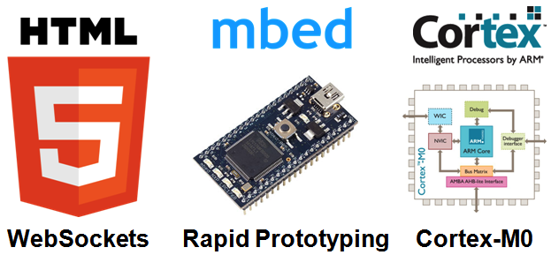
Connecting sensors to the cloud

Slide 9
IOT: connecting sensors to the cloud
Architecture:
WebSocket Server
(Python)
Mbed board +
Sensor
(C++)
Desktop browser
(Javascript)
Mobile browser
(Javascript)
Browsers will receive sensor data
Mbed board send in streaming to the server sensor data
The server will broadcast each messages received
Browsers can then read the values

Slide 10
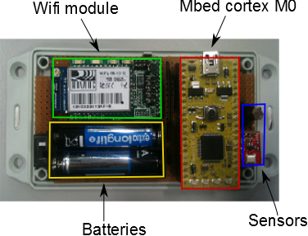
IOT: connecting sensors to the cloud
Mbed boards:
Connecting the boards to the Internet:
Wifi module from Roving Networks
Full TCP/IP stack integrated
Communication over serial port
A WebSocket library on top of the TCP/IP
stack

Slide 11
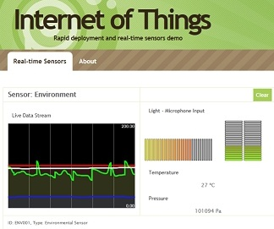
IOT: connecting sensors to the cloud
Browsers:
Architecture:
Open a WebSocket communication with the server
Listen WebSocket messages
Update the real-time graph

Slide 12
IOT: connecting sensors to the cloud
WebSocket server:
Based on Tornado webserver
ws://sockets.mbed.org/ws/<channel>/<mode>
A client is connected over a “channel” and a “connection mode”
Over a same channel, messages can be exchanged according the connection mode:
Write-Only (wo)
Read-Only (ro)
Read-Write (rw)

Slide 13

IOT: connecting sensors to the cloud
Dashboard

Slide 14
RPC over WebSockets

Slide 15
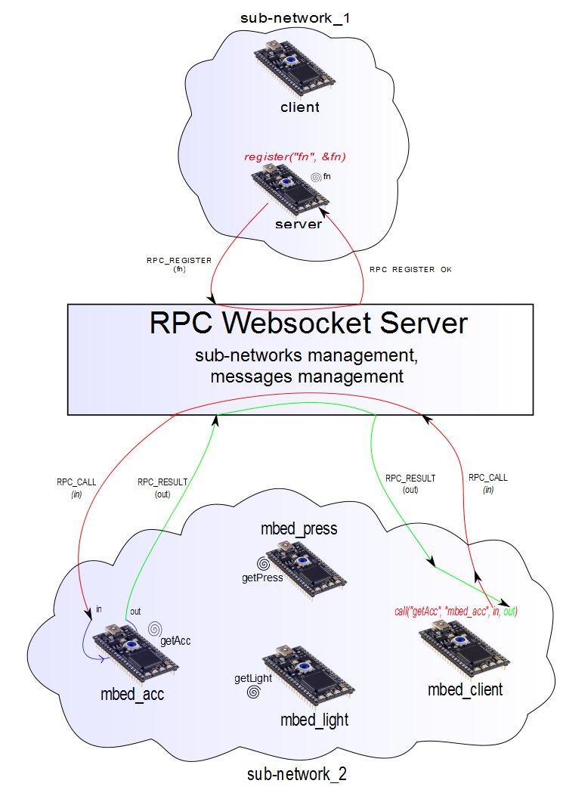
IOT: RPC over WebSockets
Architecture:
Mbed(s) connected to a WebSocket server
Sub-networks organization
On each sub-network, an mbed must have a unique id
JSON messages between clients and server

Slide 16
IOT: RPC over WebSockets
Messages exchanged:
CALL
RESULT
REGISTER
INFO_METHODS
ERROR
Messages examples:
{“from”: “mbed1”, “to”: “gateway”, “msg”:”REGISTER”, “fn”: “echo”, “id”: 10}
{“from”: “gateway”, “to”: “mbed1”, “msg”:”REGISTER_OK”, “id”: 10}
Register method transaction
{“from”: “mbed2”, “to”: “mbed1”, “msg”:”CALL”, “fn”: “echo”, “params”: “Hello!”, “id”: 13}
{“from”: “mbed1”, “to”: “mbed2”, “msg”:”RESULT”, “res”: “Hello!”, “id”: 13}
Distant method call transaction

Slide 17
IOT: RPC over WebSockets
WebSocket server:
Based on Tornado webserver (Python)
ws://sockets.mbed.org/rpc/<sub-network>/<mbed_id>
Manage all sub-networks
Manage messages exchanged

Slide 18
IOT: RPC over WebSockets
Mbed boards requirements:
Wifi module or Ethernet connection
RPC library
void echo(MbedJSONValue& in, MbedJSONValue& out)
{
out = in.get<string>();
}
int main()
{
WebSocket ws(“ws://sockets.mbed.org/rpc/net/mbed1”);
MbedJSONRpc rpc(&ws);
connectWifi();
connectWebSocket();
rpc.registerMethod(“echo”, &echo);
rpc.work();
}
int main(void)
{
WebSocket ws(“ws://sockets.mbed.org/rpc/net/mbed2”);
MbedJSONRpc rpc(&ws);
MbedJSONValue in = “Hello!”;
MbedJSONValue out;
connectWifi();
connectWebSocket();
rpc.call(“echo”, “mbed1”, in, out);
printf(“result: %s”, out.get<string>());
}

Slide 19
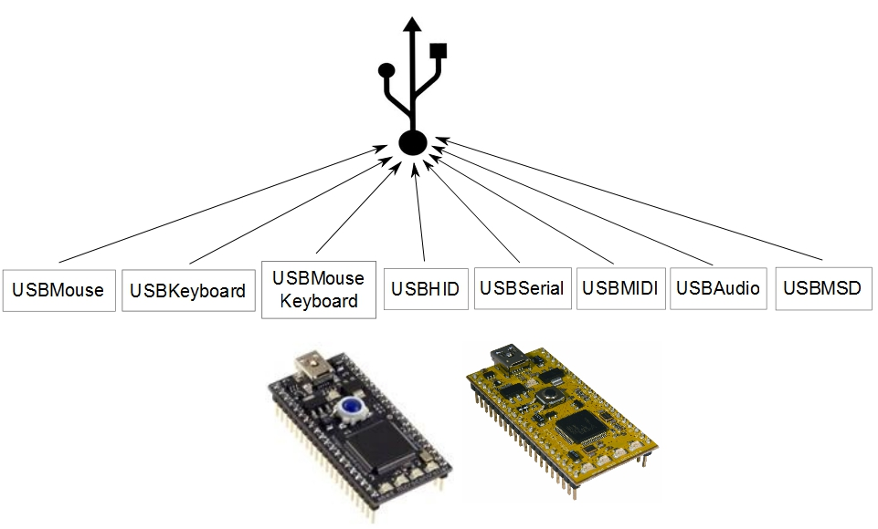
Universal Serial Bus: Device

Slide 20
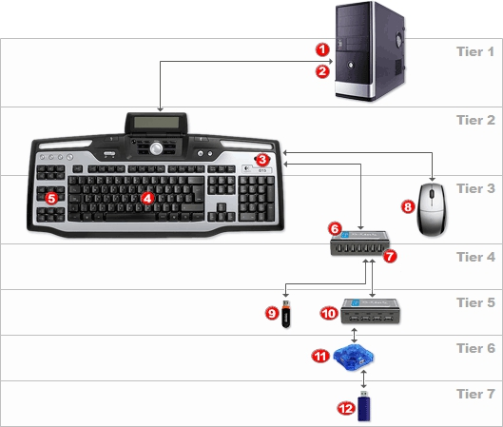
USB Device: Overview
Speed:
USB 1.0 | Low-speed Full-speed | 1.5 Mbit/s 12 Mbit/s
USB 2.0 | High Speed | 480 Mbit/s
USB 3.0 | Super Speed | 5 Gbit/s
Topology:
One host
Several devices
Tiered star architecture

Slide 21
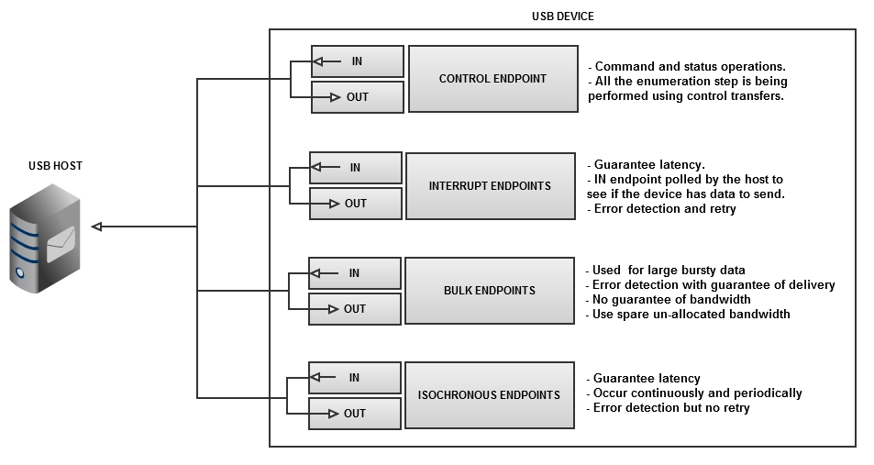
USB Device: Overview
Transfers:
Between “endpoints”
Different types according to different requirements

Slide 22
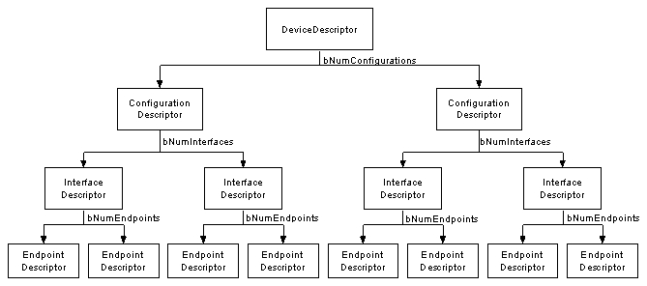
USB Device: Overview
Enumeration:
The host sets a unique address to the device
The host learns about the device capabilities
Device capabilities are contained in descriptors

Slide 23
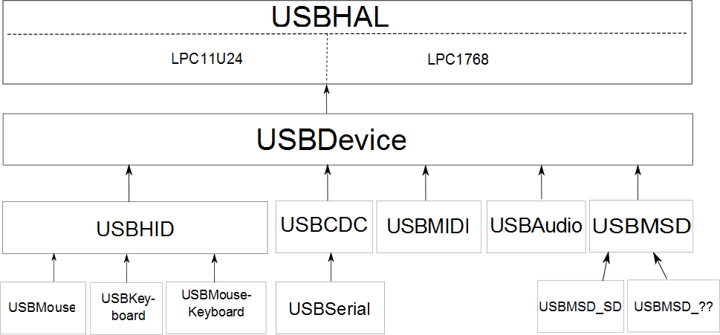
USB Device: stack architecture

Slide 24
USB Device: USBHAL
USBHAL class:
USB Hardware Abstraction layer for the LPC11U24 and the LPC1768
Implemented in two different .cpp files with a unique .h
A macro is defined by the compiler according to the target
Low level methods:
Write an Endpoint
Read an Endpoint
IRQ handler which calls virtual functions:
EPx_OUT_callback(): data received
Epx_IN_callback(): data sent
SOF(int frameNumber): Start Of Frame event (each ms)

Slide 25
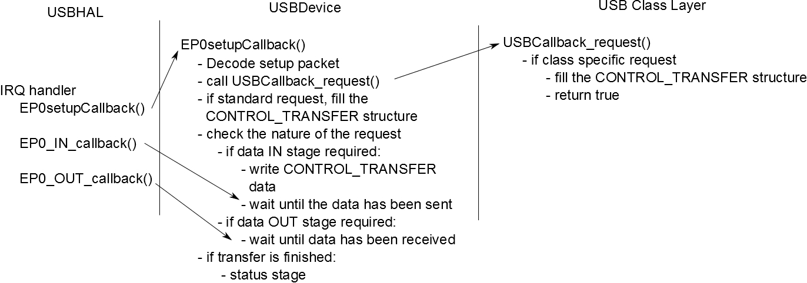
USB Device: USBDevice
USBDevice class:
No difference between the two targets
Enumeration step for “standard” descriptors:

Slide 26
USB Device: USB HID
Human Interface device (HID):
primarily defined for devices that are used by humans
Examples: mouse, keyboard, joystick
Can be a solution to exchange raw data with a computer
A HID driver is built-in in all operating systems
Class requirements:
Interrupt IN endpoint to send data
Interrupt OUT endpoint to receive data
Data are exchanged in data structure called “reports”
A report descriptor defines format and size of a report

Slide 27
USB Device: Generic USB HID device
uint8_t * USBHID::reportDesc() {
static uint8_t reportDescriptor[] = {
0x06, LSB(0xFFAB), MSB(0xFFAB),
0x0A, LSB(0x0200), MSB(0x0200),
0xA1, 0x01, // Collection 0x01
// data are sent in packets containing input length bytes
0x75, 0x08, // report size = 8 bits
0x15, 0x00, // logical minimum = 0
0x26, 0xFF, 0x00, // logical maximum = 255
0x95, input_length, // report count
0x09, 0x01, // usage
0x81, 0x02, // Input (array)
// data are sent in packets containing input length bytes
0x95, output_length, // report count
0x09, 0x02, // usage
0x91, 0x02, // Output (array)
0xC0 // end collection
};
reportLength = sizeof(reportDescriptor);
return reportDescriptor;
}
Once a report defined:
Data can be exchanged between computer and device by writing and reading the two interrupts endpoints

Slide 28
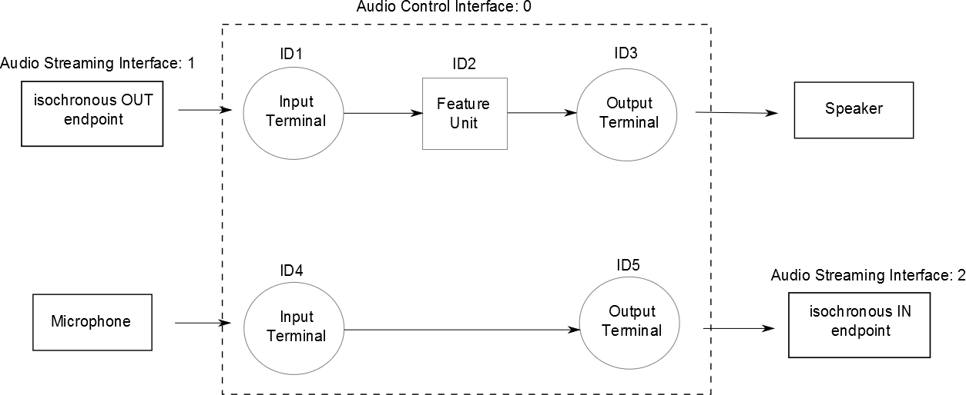
USB Device: USB Audio
Enable the mbed to:
Send and receive audio packets to or from a computer
Class requirements:
Isochronous IN endpoint to send audio packets
Isochronous OUT endpoint to receive audio packets
Format of data exchanged: PCM 16 bits signed

Slide 29
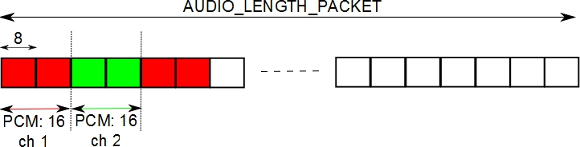
USB Device: USB Audio
Timing requirement:
Use of the Start of Frame event generated each millisecond
Example: reception of a 48kHz stereo stream
Each sample is 16 bits (2 bytes) long: 48 * 2 bytes received for one channel each millisecond
For 2 channels, 48 * 2 * 2 bytes will be received each millisecond
AUDIO LENGTH PACKET = (FREQ / 500) * nb channel

Slide 30
USB Device: USB Audio
Implementation:
If a user wants to read an audio packet:
Try to read the OUT isochronous endpoint on a SOF event
If a user wants to send an audio packet:
Write it on the IN isochronous endpoint on a SOF event
TODO: put photo of I2S and microphone on mbed

Slide 31
Conclusion
Internet Of Things:
Introduction of a new HTML5 feature on embedded systems
Connection of sensors to the cloud:
First prototypes
Basis for some potential IOT applications
Mbed as a USB device:
HID: generic HID, mouse, keyboard
Virtual serial port
Mass Storage Device
Audio
MIDI

Slide 32
Thanks! Questions ?

