Slide 1
Scrum class 1

Slide 2
Outline
1. What is Scrum
2. Scrum Theory
3. The Scrum team

Slide 3
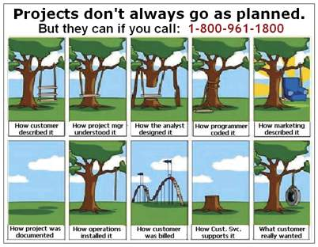
What is Scrum

Slide 4
What is Scrum
As the definition comes…
A framework within which people can address complex adaptive problems, while productively and creatively delivering products of the highest possible value.

Slide 5
What is Scrum
Scrum is:
Lightweight.
Simple to understand.
Difficult to master.
The Scrum framework consists of Scrum Teams and their associated roles, events, artifacts and rules.

Slide 6






What is Scrum
Who is using Scrum?
…And more.

Slide 7
Scrum Theory
Scrum is founded on empirical process control theory.
Empiricism -> knowledge comes from experience and making decisions on what is known.
Three pillars: Transparency, inspection and adaption.

Slide 8
Scrum Theory
Transparency: Significant aspects of the process must be visible to those responsible for the outcome.
A common language referring to the process must be shared.
Those performing the work and those accepting the work product must share a common definition of “done”.

Slide 9
Scrum Theory
Inspection: Scrum users must frequently inspects artifacts and progress toward a Sprint Goal to detect undesirable variances.
Artifacts … Product backlog, sprint backlog etc.

Slide 10
Scrum Theory
Adaption: If an inspector determines that one or more aspects of a process deviate outside acceptable limits, the material being processed must be adjusted.
For inspection and adaption Scrum prescribes four formal events: Sprint planning, Daily Scrum, Sprint Review, Sprint Retrospective.

Slide 11
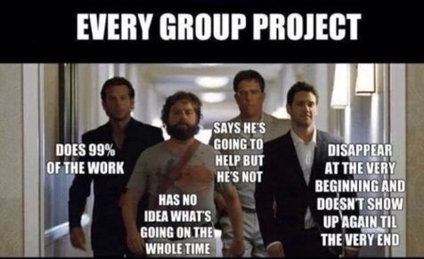
The Scrum Team

Slide 12
The Scrum Team
Scrum Master
Development Team
Product Owner

Slide 13
The Scrum Team
Self-organizing and cross-functional.
Self-organizing teams choose how best to accomplish their work and cross-functional teams have all the competencies needed to accomplish the works without depending on others not part of th team.

Slide 14
The Scrum Team – Product Owner
The product owner is the sole person responsible for managing the Product Backlog. Product Backlog management includes:
Clearly expressing the Product Backlog items.
Ordering the items in the product backlog to best achieve goals and missions.
Optimizing the value of the work the Development Team performs.
Ensuring the Product Backlog is visible, transparent and clear to all.
Ensuring the Development Team understands items in the Product Backlog to the level needed

Slide 15
The Scrum Team – Development Team
It consists of professionals who do the work of delivering a potentially releseable increment of “Done” product at the end of each Sprint:
Scrum recognizes not titles other than Developer, regardless of the working being performed.
Scrum recognizes no sub-teams in the development team.
Accountability belongs to the Development Team as a whole.

Slide 16
The Scrum Team – Scrum Master
The scrum master is responsible for ensuring Scrum is understood and enacted.
The scrum master is a servant leader for the Scrum team and supports both the product owner as well as the development team in many ways, as well as the entire organization.

Slide 17
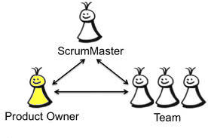
The Scrum Team

Slide 18
References
K. Schwaber, J. Sutherland, “The Scrum Guide, the definitive Guide to Scrum: The Rules of the Game”, July 2013.
P. Hundermark, “Do better Scrum”, ver. 3, agile42 – The Agile Coaching Company.
K. Nader, K. Rad, F. Turley, “The Scrum Master Training Manual”, ver 1.2, Management Plaza.

Slide 19


