Slide 1
Scrum class 2

Slide 2
Outline
1. Scrum events

Slide 3
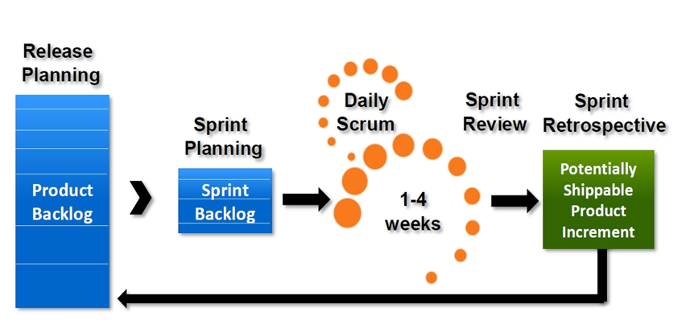
Scrum events

Slide 4
Scrum events
In order to create regularity and minimize the need for meetings not defined in the Scrum.
Time-boxed.
Each event is a formal opportunity to inspect and adapt something.

Slide 5
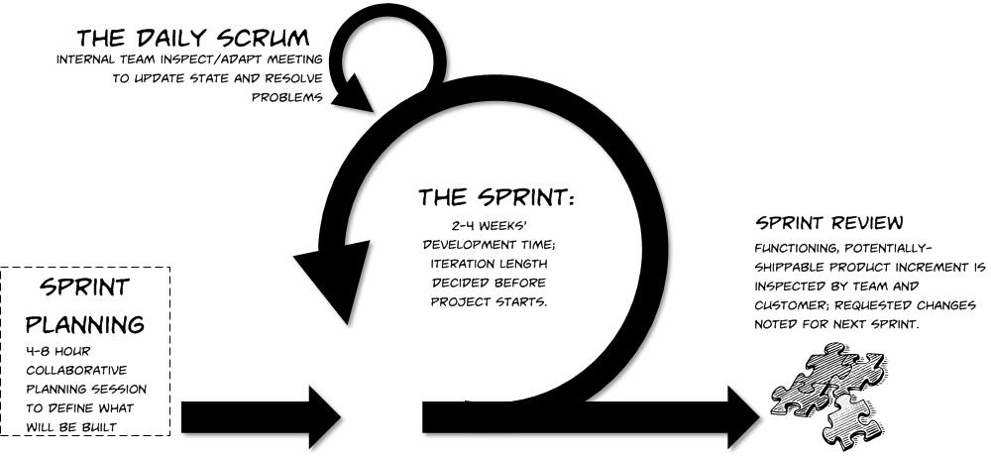
Scrum events - Sprint

Slide 6
Scrum events - Sprint
2 – 4 weeks long.
A new sprint starts immediately after the conclusion of the previous Sprint.
It consists of sprint planning, daily scrums, the development work, the Sprint review and the Sprint retrospective.
During the Sprint:
No changes are made to endanger the Sprint goal.
Quality goals do not decrease.
Scope may be clarified and re-negotiated between PO and DT.

Slide 7

Scrum events – Cancelling a Sprint
Only the product owner has the authority to cancel the Sprint.
Cancellation rarely makes sense.
All incomplete product backlog items are re-estimated and put back on the product backlog.
Releasable part of the work is usually accepted.

Slide 8
Scrum events – Sprint planning
The work performed during the sprint is planned at the Spring Planning.
Time-boxed to a maximum of eight hours for a one-month Sprint.
What can be done this Sprint?
Given the product backlog, the latest product increment, projected capacity of the Development team and past performance of the Development team… The development Team choose what it can accomplish over the upcoming sprint.
Then, the sprint goal is defined to provide guidance to the Development Team on why it is building the increment.

Slide 9
Scrum events – Sprint planning
How will the chosen work get done?
The Development Team decides how it will build this functionality into a “Done” product increment during the Sprint.
By the end of the Sprint Planning the Development Team should be able to explain to the Product Owner and Scrum Master how it intends to work as a self-organizing team.

Slide 10

Scrum events – Sprint goal (little parenthesis…)
The sprint goal is an objective set for the Sprint that can be met through the implementation of Product Backlog.
It provides guidance to the Development Team on why it is building the Increment.

Slide 11

Scrum events – Daily Scrum
15-minute time-boxed event for the Development team to synchronize activities and create a plan for the next 24 hours.
3 questions:
What did I do yesterday?
What I am doing today?
Do I see any impediment on the path
Towards the sprint goal?

Slide 12
Scrum events – Daily Scrum
The Scrum Master ensures that the Development Team has the meeting but the Development team itself is responsible for it.

Slide 13
Scrum events – Daily Scrum
Benefits of a Daily Scrum:
Daily Scrums improve communications.
Eliminate other meetings.
Idenfity impediments.
Promote quick decision-making.
Improve the DT’s level of knowledge.

Slide 14

Scrum events – Sprint review
It is held at the end of the Sprint to inspect the increment and adapt the Product backlog if needed.
This is a four-hour time-boxed meeting for one-month Sprints.
The result is a revised PB that defines the
Probable PB items for the next Sprint.

Slide 15
Scrum events – Sprint review
Scrum Team and key stakeholders invited by the PO.
PO explains what items have been “Done” and what have not been done.
The TD discuss what went well, the problems ecountered and how they were solved.
The TD demos the work that it has “done”
Etc.

Slide 16
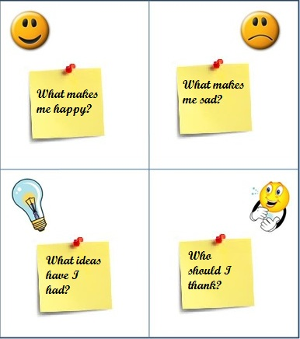
Scrum events – Sprint retrospective

Slide 17
Scrum events – Sprint retrospective
An opportunity for the Scrum Team to inspect itself and create a plan for improvement to be enacted during the next Sprint.
A three-hour time-boxed meeting for one-month sprints.

Slide 18
Scrum events – Sprint retrospective
The purpose of the Sprint Retrospective is to:
Inspect how the last Sprint went with regards to people, relationships, process, and tools.
Identify and order the major items that went well and potential improvements.
Create a plan for implementing improvements.
The Sprint retrospective provides a formal opportunity to focus on inspection and adaption.

Slide 19
References
K. Schwaber, J. Sutherland, “The Scrum Guide, the definitive Guide to Scrum: The Rules of the Game”, July 2013.
P. Hundermark, “Do better Scrum”, ver. 3, agile42 – The Agile Coaching Company.
K. Nader, K. Rad, F. Turley, “The Scrum Master Training Manual”, ver 1.2, Management Plaza.

Slide 20


