Slide 1
Data Science Cryptocurrency Price Prediction
Syed Abdullah Muzaffar 18K-0169 CS-H
Instructor: M. Nouman Durrani

Slide 2
Introduction
Cryptocurrencies, or virtual/digital currencies, are a digital means of exchange that uses cryptography for security.
There are several different cryptocurrencies that are being traded on the market today. Each cryptocurrency has a purpose behind it.
Some cryptocurrencies are viable currency replacements (Bitcoin, Ethereum)
Some are digital representations of fiat currency (Tether) called stablecoins
Others act as tokens to be used on different platforms.
Multiple cryptocurrencies may be present on a single network (e.g. BTC and BCH)

Slide 3
The Data Science Process
Frame the problem
Collect the raw data needed for your problem
Process the data for analysis
Explore the data
Perform in-depth analysis
Communicate results of the analysis
Notes:
https://www.kdnuggets.com/2016/03/data-science-process.html

Slide 4
The Problem
Project Motivation
Cryptocurrency is an interesting investment opportunity, as it will eventually replace physical fiat currencies.
There is a potential for high return on investment, but at a cost of high risk.
As an investor in cryptocurrency (beginning since November 2020) it is also in my personal interest to make profitable investments.
Strategic Goal
Our goal is to predict the trends in cryptocurrencies and estimate their prices, to minimize the risk of investing in crypto currencies and make smart investments.

Slide 5
The Data
Cryptocurrency Historical Prices
https://www.kaggle.com/sudalairajkumar/cryptocurrencypricehistory
Content
The dataset has one csv file for each currency.
Price history is available on a daily basis from April 28, 2013.
This dataset has the historical price information of some of the top crypto currencies by market capitalization.
Date : date of observation
Open : Opening price on the given day
High : Highest price on the given day
Low : Lowest price on the given day
Close : Closing price on the given day
Volume : Volume of transactions on the given day
Market Cap : Market capitalization in USD

Slide 6
The Data
The variables present in the dataset include:
● Serial number
● Name (Name of coin)
● Symbol (Symbol of coin)
● Date (Date)
● High (High value on the date)
● Low (Low value on the date)
● Open (Open value on the date)
● Close (Close value on the date)
● Volume (Volume of transactions in USD)
● Marketcap (Marketcap of coin)

Slide 7
The Data
Target variable: Closing price of cryptocurrency from the point of the latest timestamp in the data upto a few months in the future .
Index variable: Timestamp/Date
Other variables: Open, Mean can also be substituted to predict the outcome.
In models that incorporate exogenous variables, all the relevant secondary variables such as Open, High, Low can be used

Slide 8
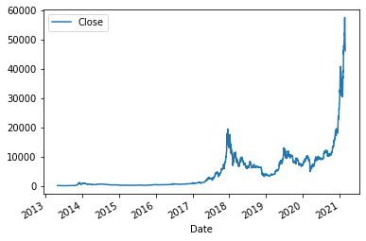
Exploration
Time Series Analysis

Slide 9
Exploration
Models:
ARIMA (Autoregressive integrated moving average)
SARIMAX (Seasonal Auto-Regressive Integrated Moving Average with eXogenous factors)
FBProphet
XgBoost

Slide 10
Analysis
Performance Measurement
The accuracy of the predictions will be measured using the root mean square error where the aim is to get the lowest error value possible.
The expected level of accuracy is 70%-80%, even though, due to the highly volatile nature of cryptocurrency, the results may vary.
Limitations
Since the cryptocurrency trends are extremely volatile, the predictions made using this project should not be used as financial advice.
The predictions made in this project cannot be extended to large time frames and are only as accurate and up to date as the dataset being utilized.

Slide 11
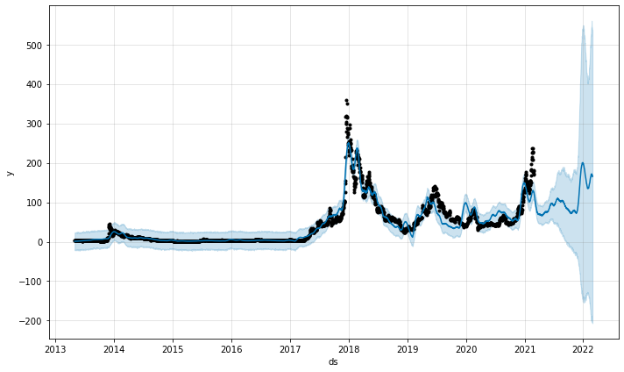
Analysis
fbProphet Prediction with Confidence Intervals
On the Litecoin dataset
X-axis: TimeStamp
Y-axis: Price in USD ($)

Slide 12
Results
Discussion…
Explain the Code

Slide 13
Conclusion
The dataset provided has been utilized to predict the next few months cryptocurrency prices for the different crypto currencies present.
To further improve the model, machine learning and/or deep learning can be applied in conjunction with NLP to keep track of external variables, such as twitter tweets (see Elon Musk and the effect of his public tweets on the crypto market).
For a proof of experiment, the project is perfectly adequate to demonstrate the use of Computer prediction models in the field of cryptocurrency/finance.

Slide 14
References
https://www.kaggle.com/sudalairajkumar/cryptocurrencypricehistory
https://machinelearningmastery.com/
https://facebook.github.io/prophet/
https://xgboost.readthedocs.io/en/latest/

