Slide 1
OS PROJECT HYPERVISORS
Rahim Muhammad Syed 18K-0122
Syed Abdullah Muzaffar 18K-0169
Muhammad Ahmed Khan 18K-1103

Slide 2
OS PROJECT HYPERVISORS
introduction

Slide 3
Introduction
Section: 2E
Members:
Rahim Muhammad Syed 18k-0122
Syed Abdullah Muzaffar 18k-0169
Muhammad Ahmed Khan 18k-1103
Objectives:
To perform a comparison between the two different types of hypervisors (namely, type I and type 2), and report the results/findings.

Slide 4
Requirements
Test Benches, in this case we shall name them:
Testbench Name: | Rahim PC | Sam PC
CPU | i5 8600k | i5 6600k
Cores/Threads | 6/6 | 4/4
SSD? | Yes | Yes
RAM | 16GB DDR4 | 16GB DDR4
An installation of Hyper-V (which requires Windows 10 Pro)
An installation of VMWare (and maybe VirtualBox)
Benchmarking software

Slide 5
OS PROJECT HYPERVISORS
Comparison

Slide 6
Comparison
Hypervisor is a software that allows physical host machines (system) to create and operate multiple virtual machines.
Allocate computer resources
multiple OS host
time consumption testing/debugging purpose
individuality/performance
reduce operational costs …. fewer systems involved
better scalability
bare metal/ Type 1
embedded/Type 2

Slide 7
Comparison
Difference is that Type 2 hypervisor virtual machine requires resources to be allocated and managed by the OS.
type 1 runs directly on hardware hence performance efficient.
Type 1 has advantage over Type 2 in a way it is safe from vulnerabilities and flaws associated with the OS in Type 2.
Question arises that if Type 1 allocate resources itself then why is performance not affected.
Hardware acceleration software is used.

Slide 8
Comparison
USAGE:
Type 1 used in enterprises.
Type 2 used in small servers or a small setup. Probably to test new project ideas.
Type 2 does not need of a separate management console.
Type 2 can also use hardware acceleration if the system supports. Else emulation is used.
KVM hypervisor (more flexible).
Type 1 generates less overhead no underlying OS involves
For Developers environment use Type 2.
If OS needs to be involved for testing purpose use Type 2.

Slide 9
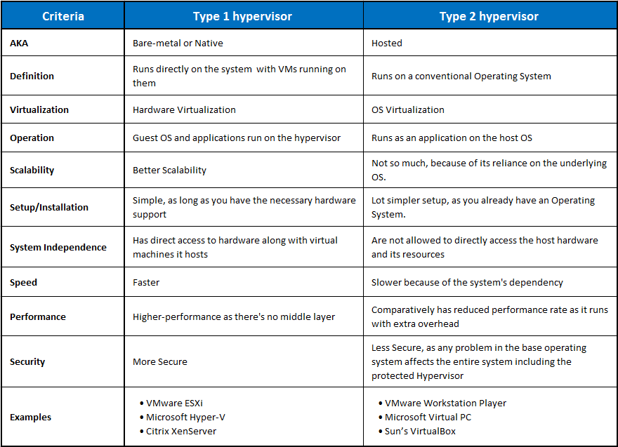
Comparison

Slide 10
OS PROJECT HYPERVISORS
INSTALLATION

Slide 11
Installation
Hyper-V
The following slides will guide you through the Hyper-V installation and configuration process

Slide 12
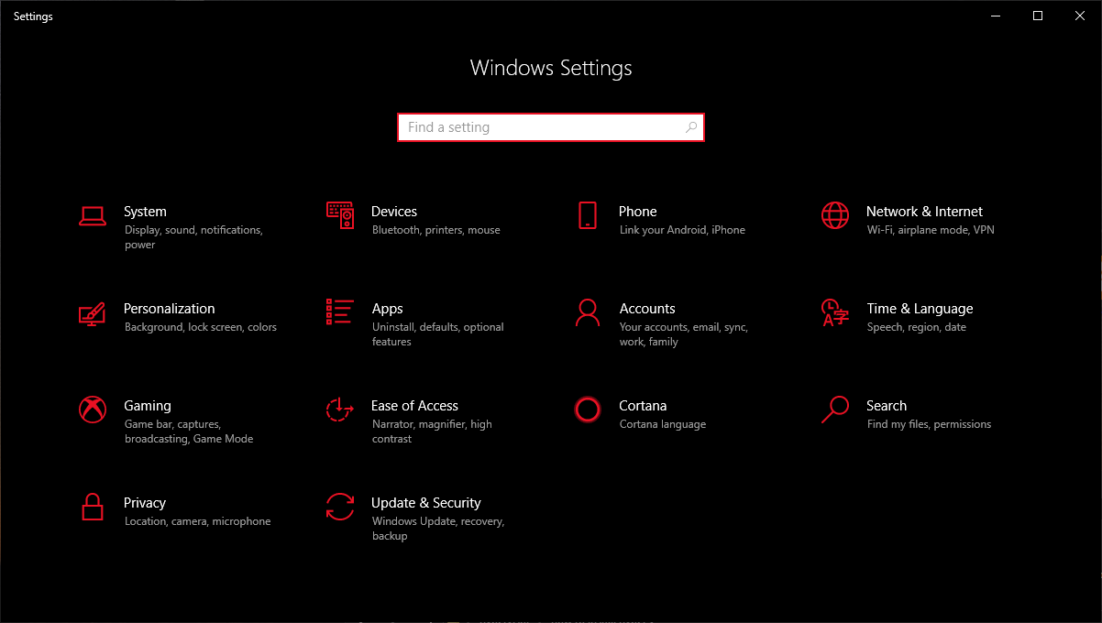
1-Verifying that you have Windows 10 Pro

Slide 13
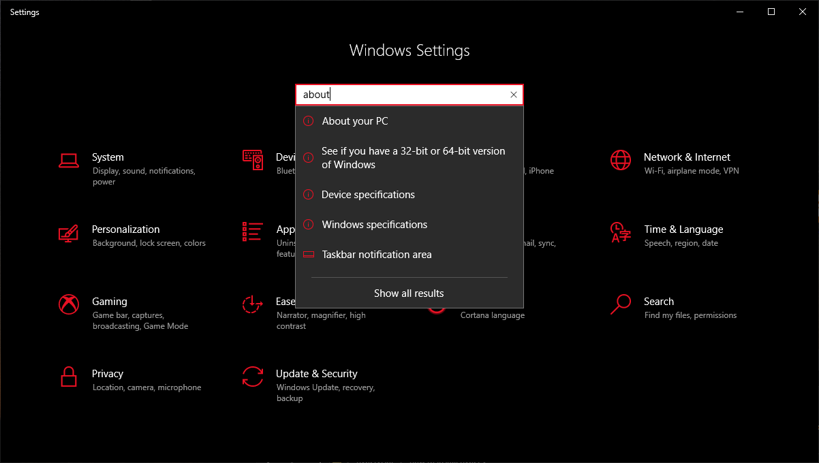
1-Verifying that you have Windows 10 Pro

Slide 14
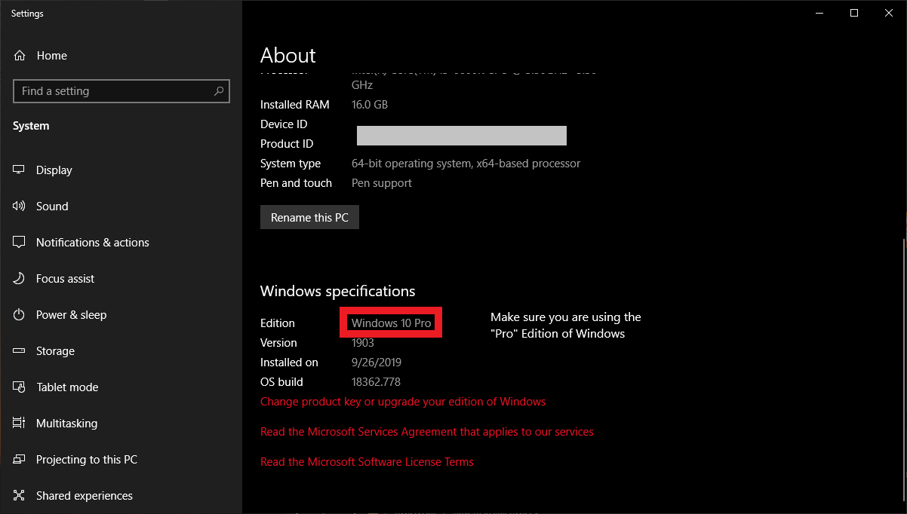
1-Verifying that you have Windows 10 Pro

Slide 15
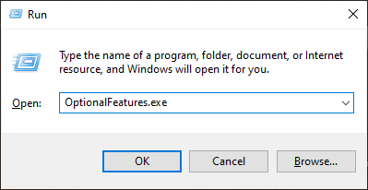
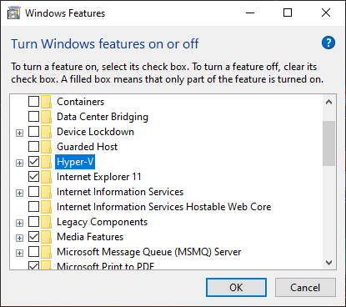
2-Enabling Hyper-V

Slide 16
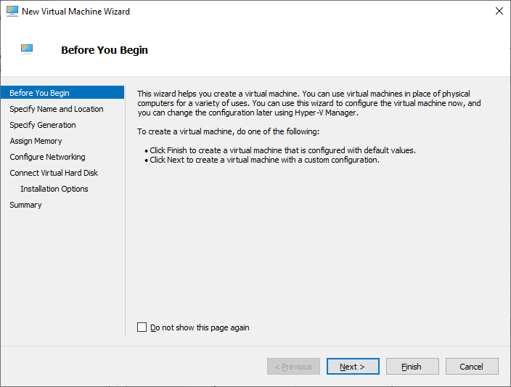
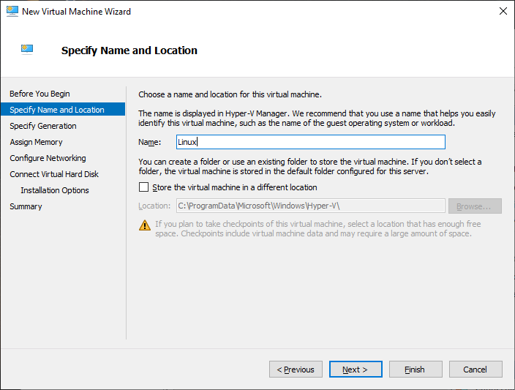
3-Creating New Hyper-V VM

Slide 17
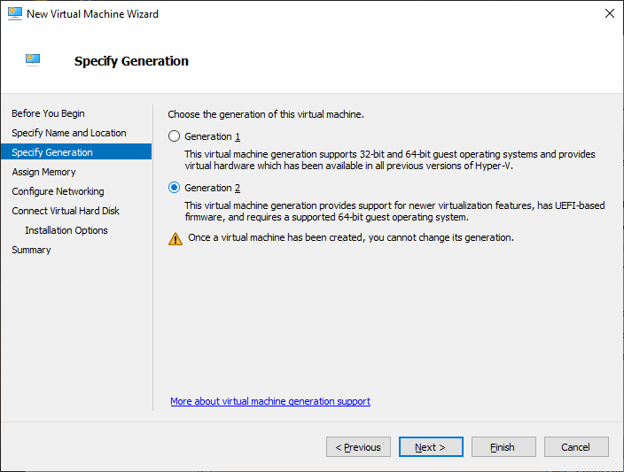
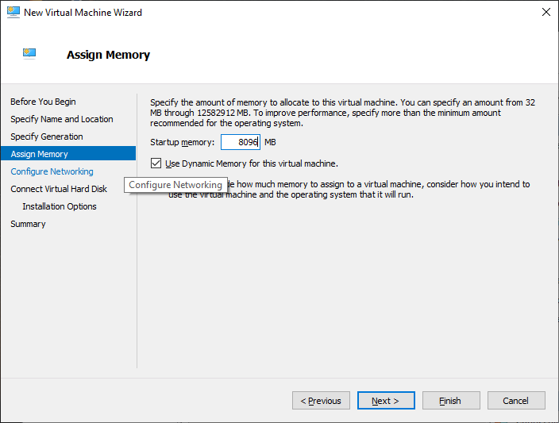
3-Creating New Hyper-V VM

Slide 18
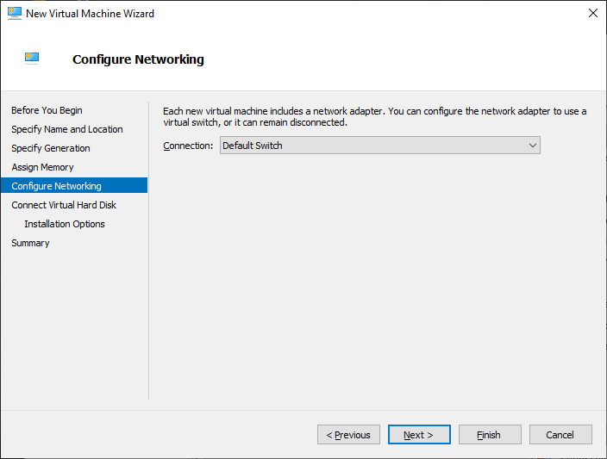
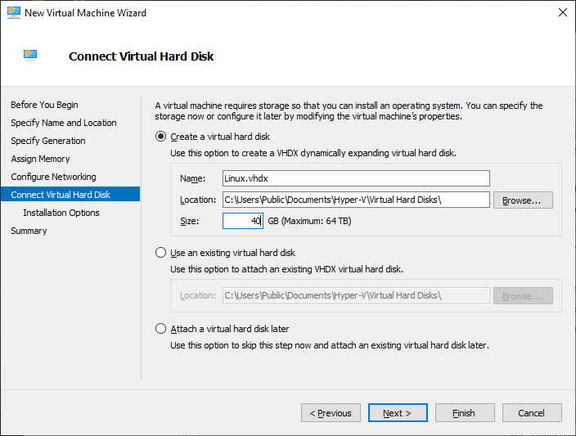
3-Creating New Hyper-V VM

Slide 19
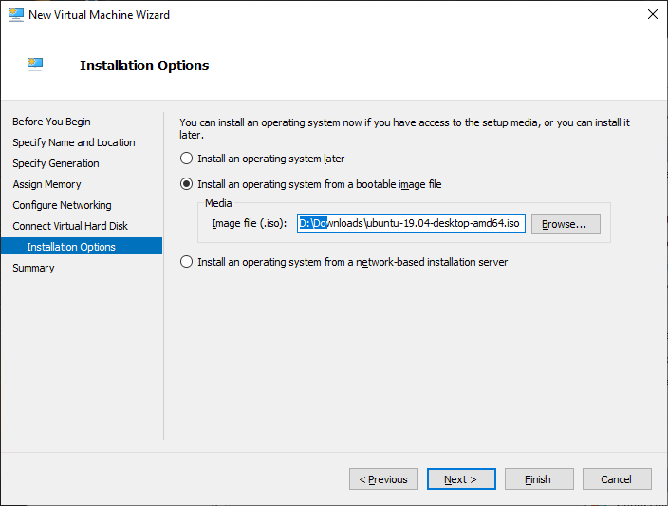
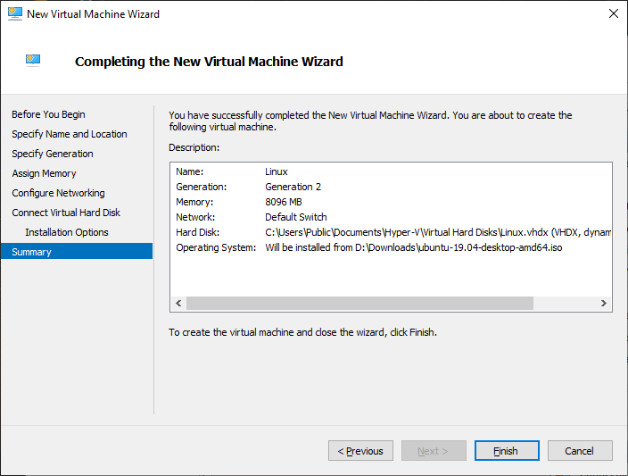
3-Creating New Hyper-V VM

Slide 20
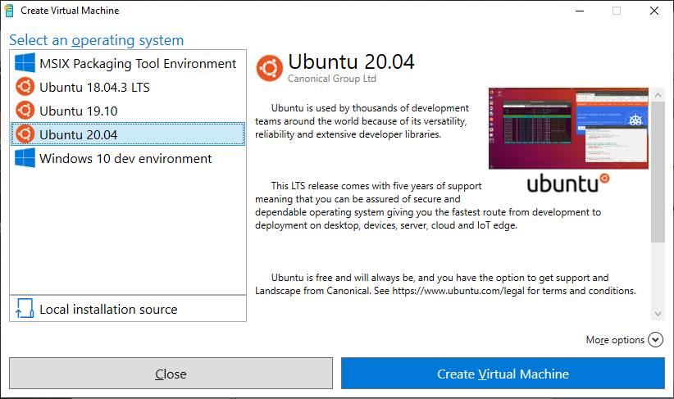
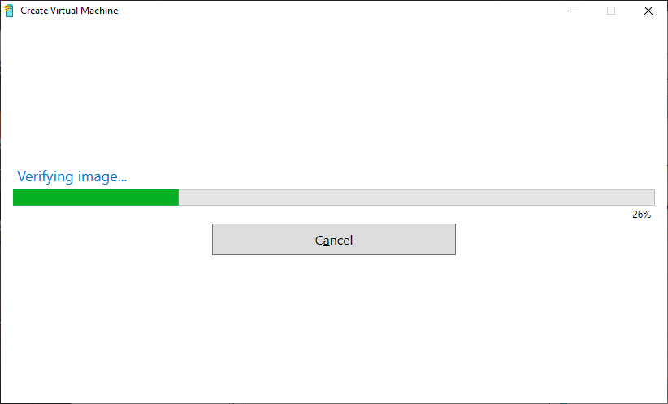
4-Creating a VM using Quick Create

Slide 21
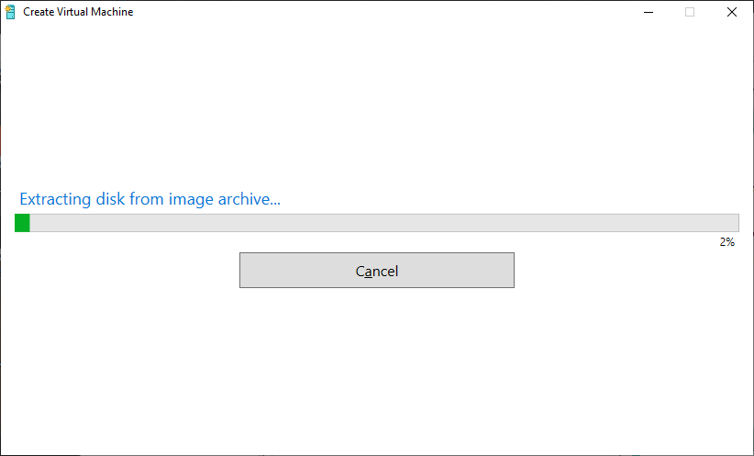
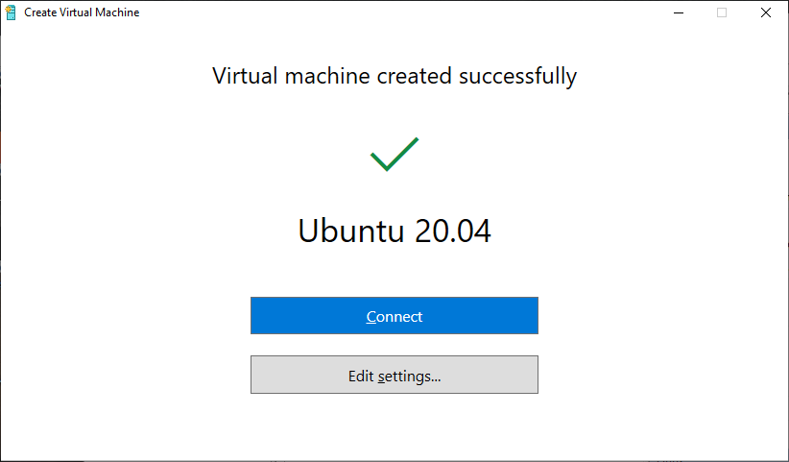
4-Creating a VM using Quick Create

Slide 22
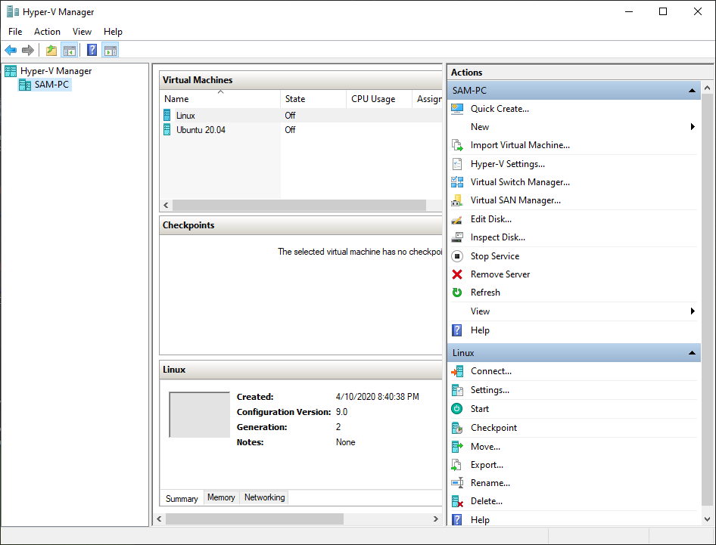
5-Virtual Machine Manager

Slide 23
Installation
VirtualBox
The following slides will guide you through the VirtualBox configuration process

Slide 24
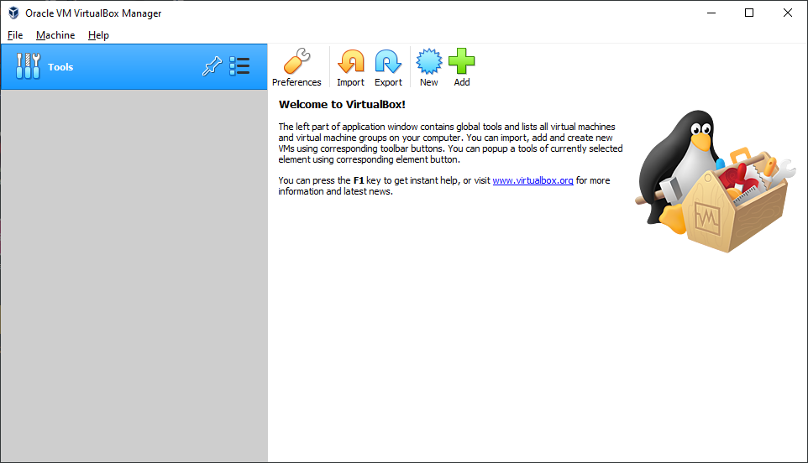
1-Creating a Virtual Machine

Slide 25
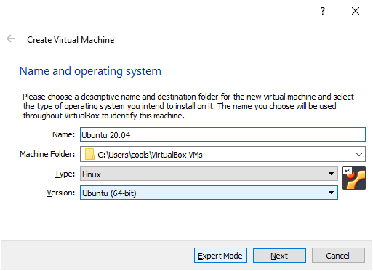
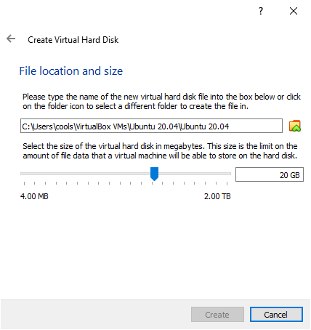
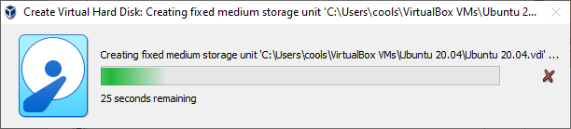
1-Creating a Virtual Machine

Slide 26
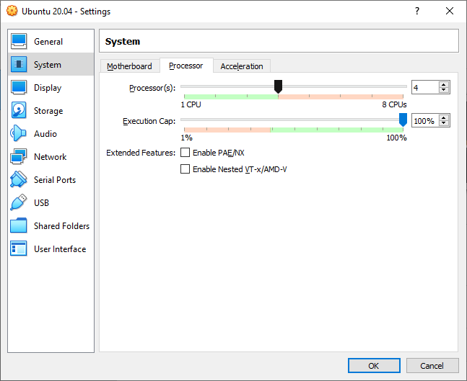
2-Virtual Machine Configuration

Slide 27
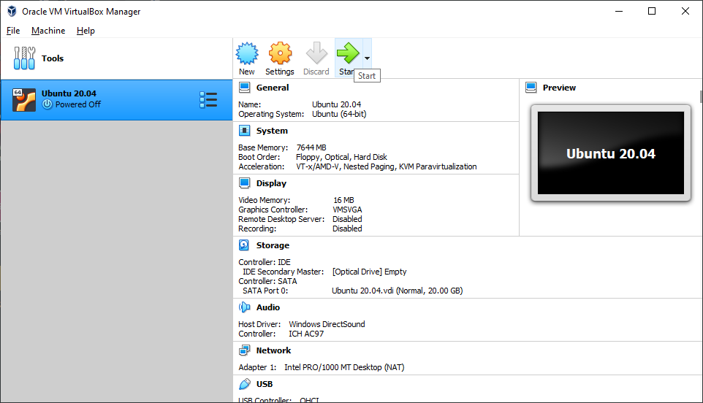
3-Virtual Machine Manager

Slide 28
Installation
VMware
The following slides will guide you through the VMware installation and configuration process

Slide 29
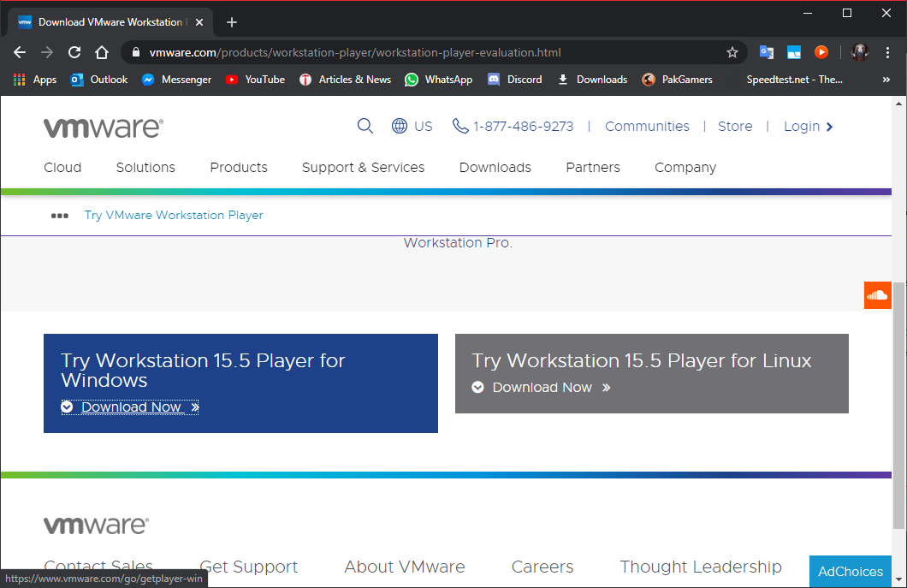
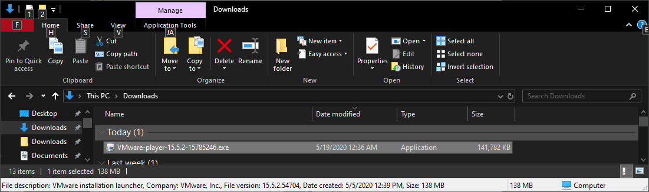
1-Downloading VMware

Slide 30
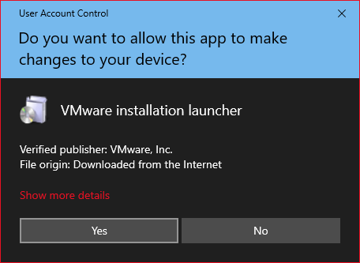
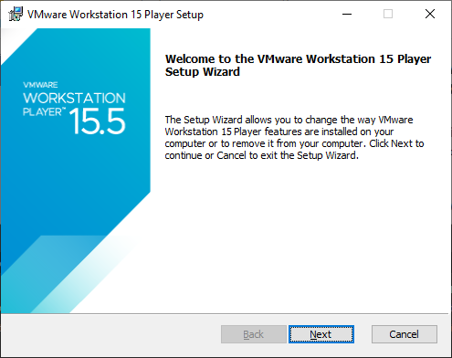
2-Installing VMware

Slide 31
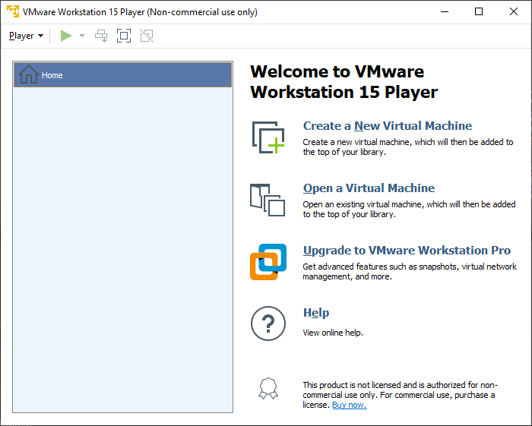
3-VMware Manager

Slide 32
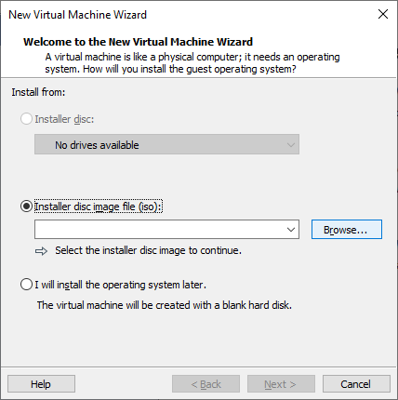
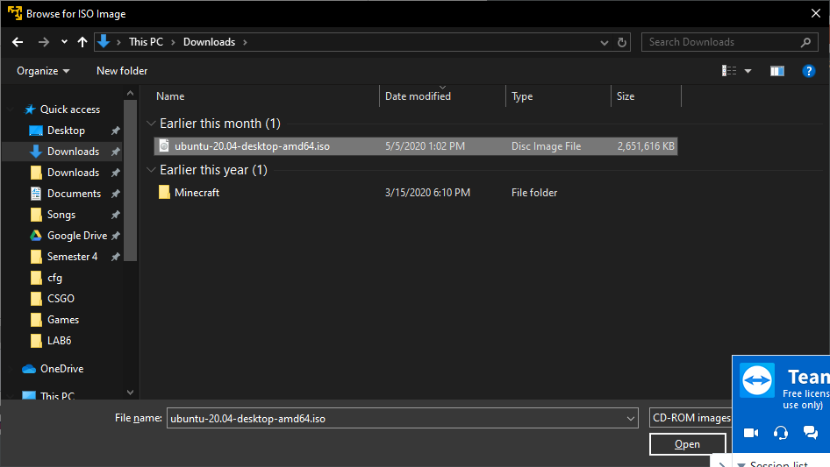
4-Creating a Virtual Machine

Slide 33
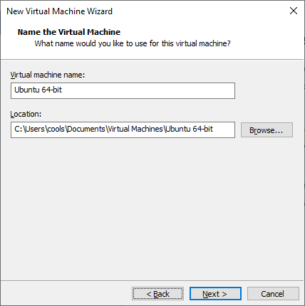
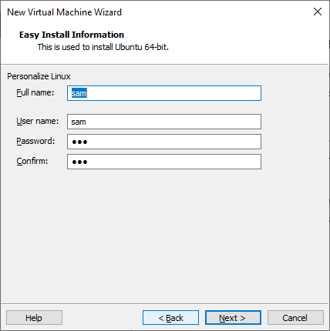
4-Creating a Virtual Machine

Slide 34
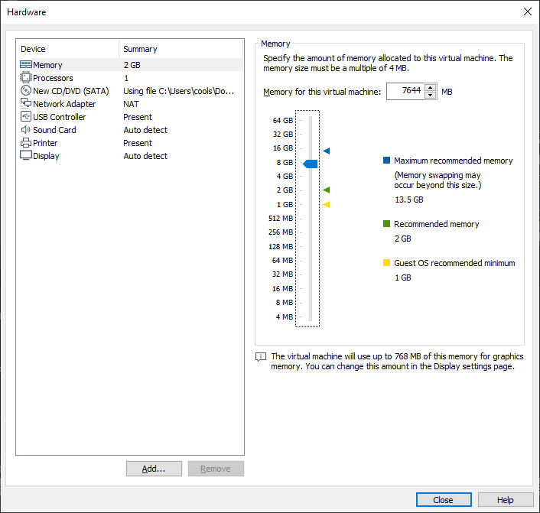
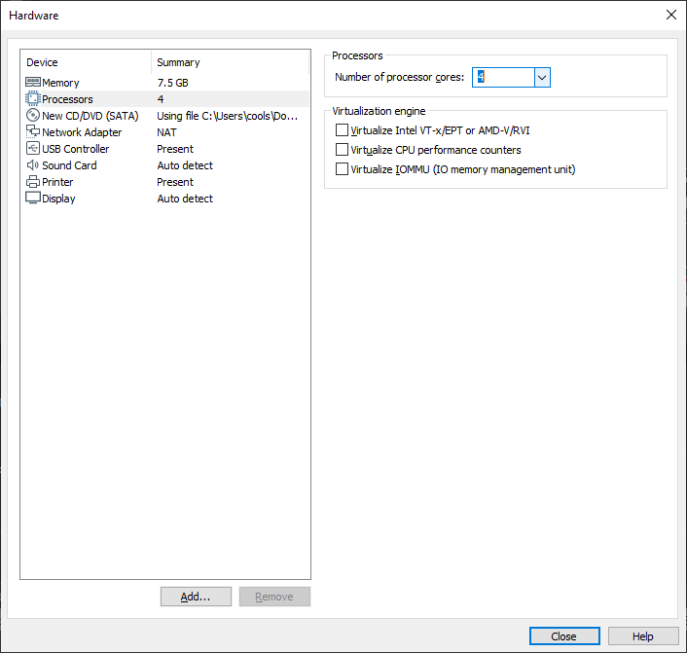
4-Creating a Virtual Machine

Slide 35
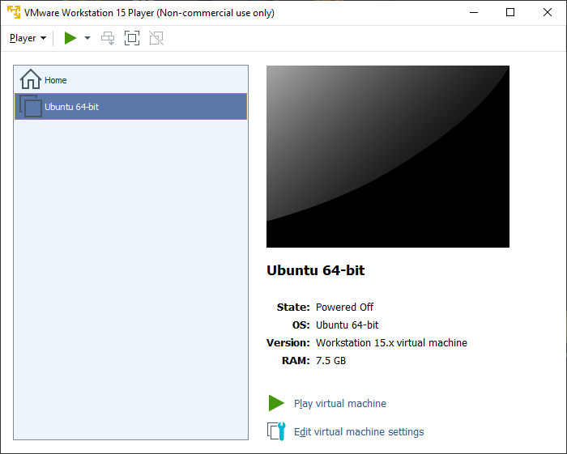
5-Successful VM Installation

Slide 36
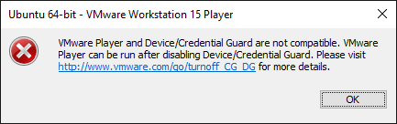
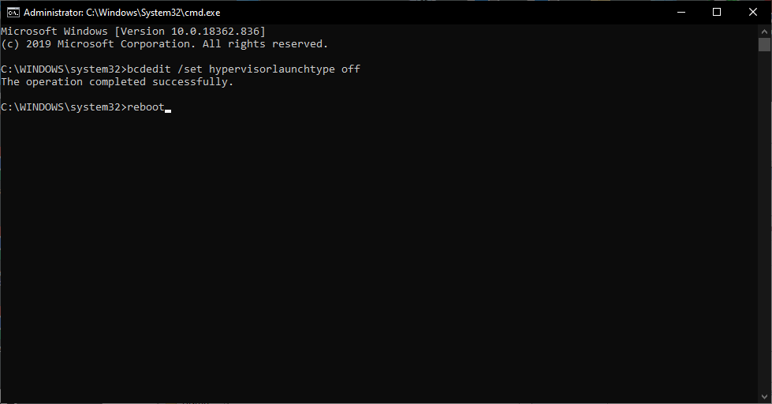
6-Fixing Conflict with Hyper-V

Slide 37
OS PROJECT HYPERVISORS
BENCHMARKS

Slide 38
Tests Performed:
GeekBench
Single Thread
Multi-Threaded
hdparm
Cached
Buffered
Sysbench
CPU
Memory

Slide 40
GeekBench Scores
Type I
HyperV Dynamic Memory
HyperV Static Memory 1
HyperV Static Memory 2
Type II:
VMware 1
VMware 2
VirtualBox 1
VirtualBox 2
Reference Scores (Host):
Windows (Host) 1
Windows (Host) 2
Windows (Host) HyperV enabled

Slide 41
OS PROJECT HYPERVISORS
Closing thoUGHts

Slide 42
Performance
For general purpose/personal use, Type II hypervisors have matured enough that you can use them for almost any purpose(that does not require specialized hardware). However, if disk speed is a factor for you, then Native Hypervisors(Type I) are by far the best in terms of Disk I/O speed, as they do not have to interface with the Host OS I/O Scheduler, and instead get direct access to storage.

Slide 43
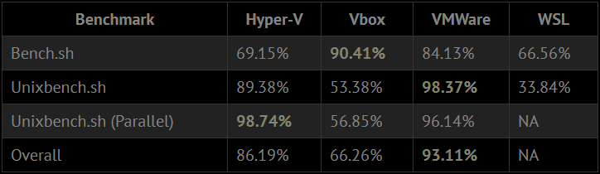
Performance
The above table shows the performance in certain benchmarks, the reference link can be found at the end of the document. The author goes into deep details during his testing of the different hypervisors.

Slide 44
Explanation
The performance deficit of Hyper-V can be attributed to the kernel having to manage both the guest and native OS.
Secondly the performance gap has closed in recent years due to advancements in technology, especially with the introduction of Hardware Assisted Virtualization, called VT-x on the intel platform and AMD-V on the AMD platform, which are a set of instructions related to virtualization. These carry flags that can be checked in Linux using “/proc/cpuinfo”

Slide 45
Caveats
On most Hypervisors, GPU Performance is subpar, as most of the graphics processing occurs on the CPU, which is not ideal for these kinds of computations. This is done via software-based rendering which is marginally slower than hardware-based rendering. An alternative is to use GPU Passthrough, which however, requires an additional GPU and output (so that the main GPU can still display the hypervisor OS).
However, Nvidia Quadro cards do support GPU Passthrough without having an extra card, as this is mostly a driver issue. Some workarounds do exist but are not recommended. Type II Hypervisors also have higher I/O latency and lower bandwidth(especially in the case of VMware disk performance).

Slide 46
Recommendations
For personal use, I would recommend VMware, as it has easy host integration (drag and drop), and quite good performance, sometimes even beating the native Windows Host (due to Linux optimizations). However, for any storage-based tasks, it does fall short. For large scale and commercial use, Native Type I Hypervisors are a much better option, as they have direct access to hardware, which may speed up certain workloads by a large amount.
However, if the majority of your work is done on a certain OS, then a Native install is much better, as hypervisors should only be used for testing/prototyping programs, and not for the majority of tasks (which should ideally be done natively). An exception to this is for security reasons, as a virtualized OS is less risky for the company.

Slide 47
References
https://xioustic.com/2019/06/07/windows-hypervisors-benchmarks/
https://en.wikipedia.org/wiki/Virtualization

Slide 48
THANK YOU

