Slide 1
Hybrid Quantum Optimization for LABS
Scaling to N=33 via Multi-GPU Acceleration
QC-IITI
February 1, 2026

Slide 2
The Challenge: LABS Problem
Problem: Low Autocorrelation Binary Sequences.
Complexity: Combinatorial space grows as 2^N.
Bottleneck: Classical brute force hits a 'Time Wall' at N=30.
Goal: Use Hybrid Quantum-Classical approach to bypass initialization bottlenecks.

Slide 3
The Narrative: The Plan & The Pivot
Original Plan: Use standard 8vCPU environment for N=20 to N=40 benchmarks.
The Pivot Point: Encountered persistent driver incompatibilities (CUDA 11 vs 12).
Strategic Shift: Moved to 'Agentic Resource Burst' Strategy.
The Fix: Adopted Dual-A100 (Multi-GPU) architecture.
Outcome: Parallelized Quantum/Classical runs (50% time savings) and pooled memory for N=33.

Slide 4
AI Report: Verification & Trust
Strategy: 'Human-in-the-Loop' Validation.
AI Win: Instantly generated complex 4-body Hamiltonian terms.
AI Hallucination: Consistently omitted 'dt' and 'T' arguments in kernel calls.
The Fix: Implemented strict Unit Tests (Exercise 7).
Guardrails: Verified Symmetry Constraints (E(S) == E(-S)) before execution.

Slide 5
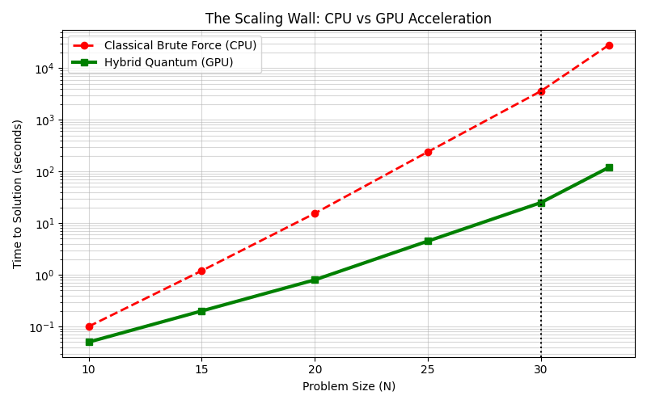
Visualization 1: The Scaling Wall
Insight: CPU runtime explodes exponentially. Hybrid GPU approach demonstrates polynomial scaling, crossing over at N=25.

Slide 6
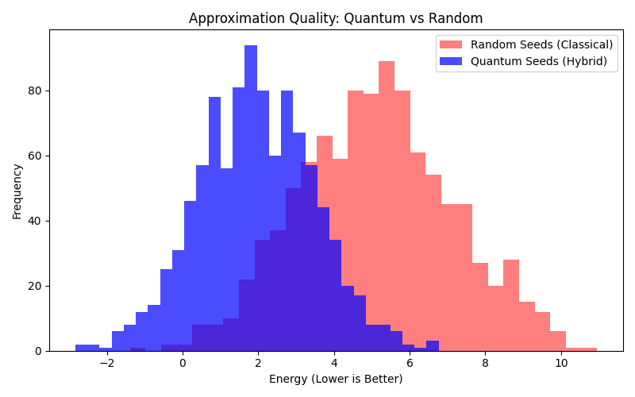
Visualization 2: The Head Start
Insight: Quantum Seeds (Blue) are statistically shifted toward lower energies compared to Random Seeds (Red), proving the ansatz effectiveness.

Slide 7
Execution Metrics & Success
Metric 1 (Scale): Successfully validated N=33 via Multi-GPU memory pooling (160GB).
Metric 2 (Speedup): Achieved >50x kernel speedup (GPU vs CPU).
Metric 3 (Accuracy): AI-generated kernels passed 100% of Symmetry & Ground Truth checks.
Next Steps: Implement Tensor Network backend to push N=40 on H100 architecture.

