Slide 1
British Library Funding Dynamics and Inflation Impact A 25-year overview
Tidy Tuesday / Pydy Tuesday Weekly Data Analysis
Week: 15-07-2025
Exploratory Data Analysis using Python
Dataset Credits:
Andy Jackson (Data Compiling)
David Rosenthal (2017 Blog)
Jon Harmon, DSLC (Curator)
Analysis and Presentation By:
Saumita Haldar

Slide 2
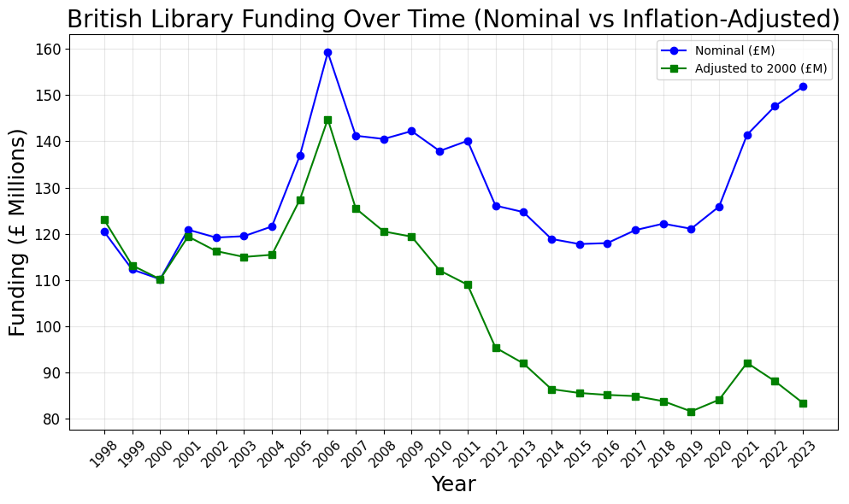
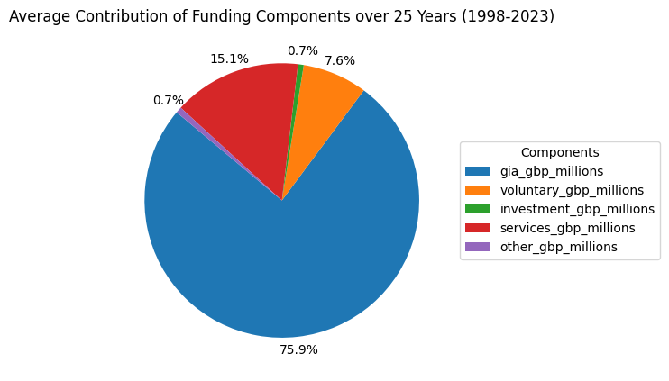
British Library Funding - Over the Years
Funding Range: 110M – 160M
Average Funding: around 130M
Highest Funding in the year 2006
Widening Inflation gap
Highest Contributor: Grant-in-Aid (GIA) (core funding from the UK Government)
Other Significant Contributor: Services (Main part being the document supply service, which started out as the National Lending Library for Science and Technology)

Slide 3
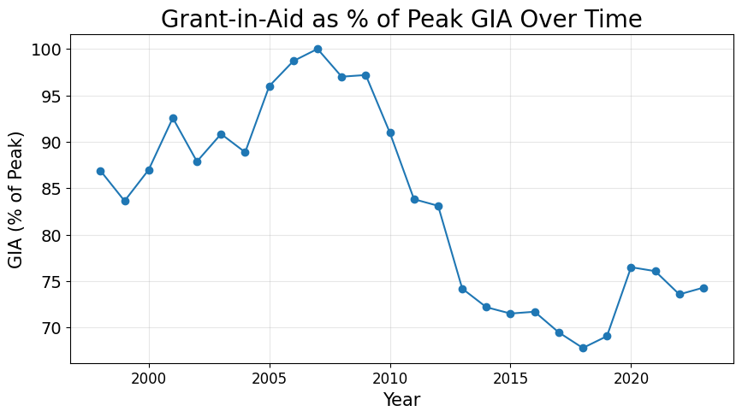
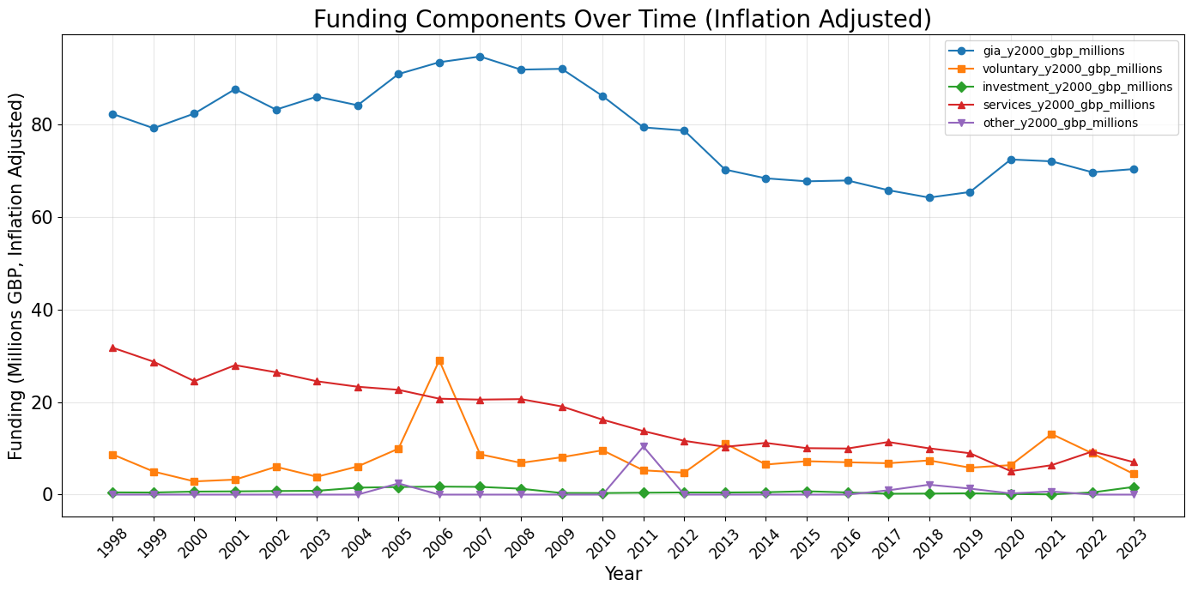
A dig into the funding sources
Grant-in-Aid
the Highest Contributor
What led to the peak in 2006?
Voluntary contributions saw a spike in 2006 which led to the record high total funding of 160M
Peak around 2006-07
Lowest around 2017-19
On a drop between 2010-19
Rise in 2020, fairly stagnant

Slide 4
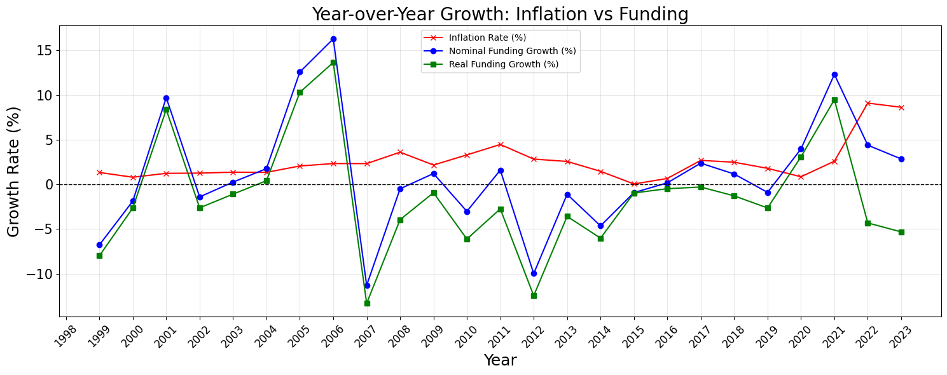
Race and Pace with Inflation
Inflation adjustment figures obtained from the current (2024) Bank of England inflation calculator

Slide 5
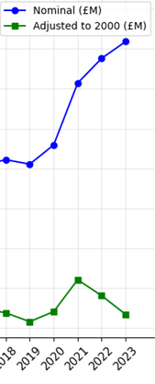
Navigating Price Dynamics – Funding v/s Inflation
2006 Peak Funding
Inflation outpaces increases during 2007 – 2014
Purchasing Power adjusts in 2015-16
Funding ahead of inflation in 2020-21
Inflation record high in 2022 (post-COVID pandemic) leading to a dip again
Nominal funding rebounded post-2020,
but Real value remains under pressure from Inflation
Inflation adjustment figures obtained from the current (2024) Bank of England inflation calculator

