Slide 1

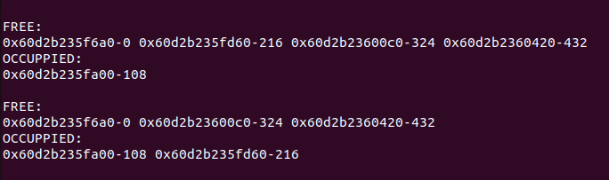
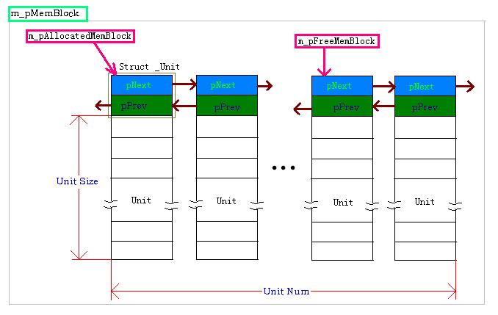
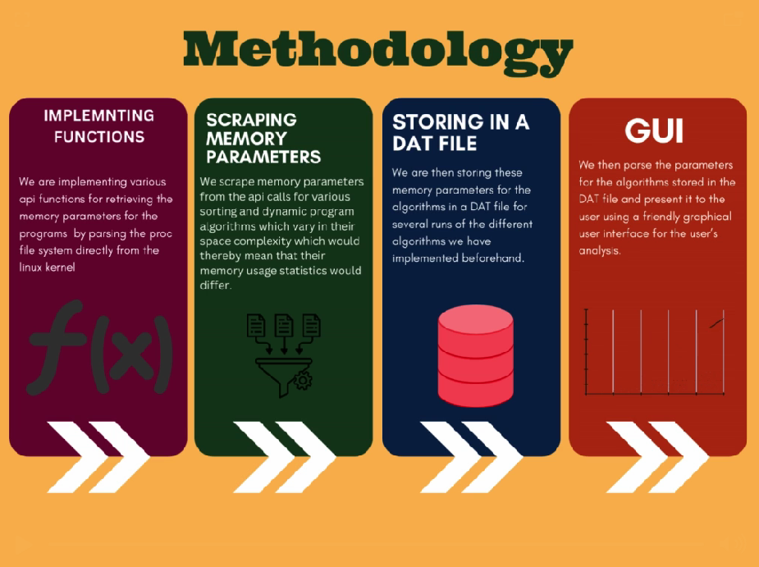
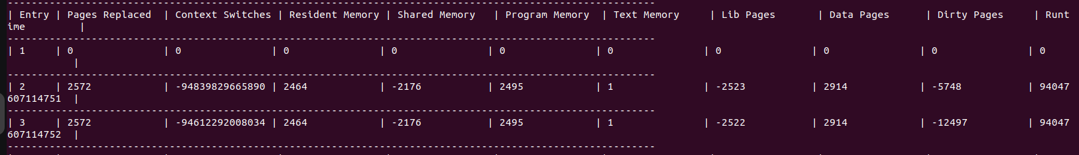
RV College of Engineering
Title:Memory Management API
Go, change the world
Department of Computer Science Engineering
RV College of Engineering, Bangalore – 50059, INDIA
Problem Statement:
The problem entails designing and implementing a memory management API to facilitate users in efficiently utilizing system memory. This API should enable seamless allocation and deallocation of memory while optimizing resource utilization. Additionally, thorough testing using appropriate data structures is essential to validate the functionality and robustness of the API.
Results:
Memory pools were successfully created.
Memory data of a process was successfully scraped and recorded for comparison
Comparison was made between memory pool scheme and regular scheme and the advantages of the memory pool scheme were demonstrated.
Motivation:
To enable users to easily access and store relevant memory management parameters and compare it with future runs to test memory efficiency.
To develop functions to handle create, deletion and manipulation of memory pools to enable access of memory minimizing overhead.
To essentially provide the user of the API with security benefits by controlling memory alloc and de-alloc.
References:
Manish PandeyYoung Woo Kwon: Optimizing Memory Allocation in a Serverless Architecture through Function Scheduling
Ben Kenwright: Fast Efficient Fixed-Size Memory Pool: No Loops and No Overhead
Acknowledgements The authors thanks Principal and HoD, Department of Computer Science Engineering, RVCE for the kind support received for completion of the project.
Guide Information: Raghuveer.N.R, Priyansh Rajiv Dhotar, Rohan J.S, Samvit Sanat Gersappa

