Slide 1
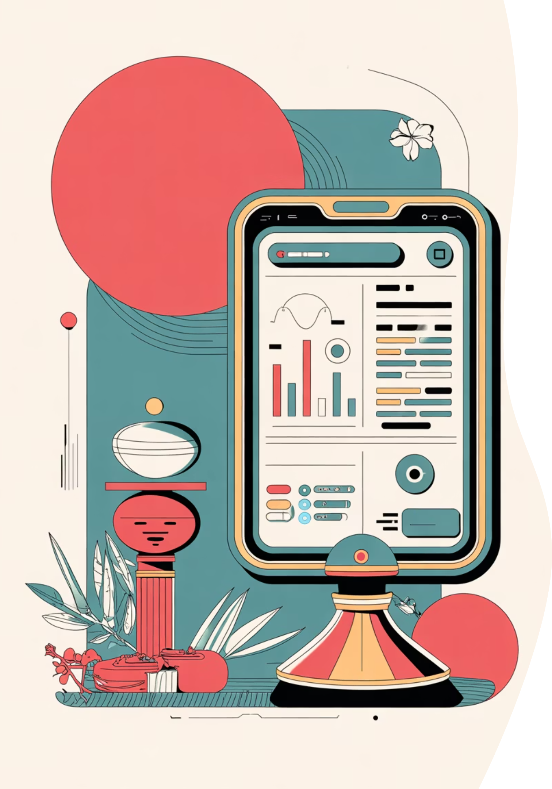

AIyuv — AI-Powered Ayurvedic Diagnostic Tool
Personalized Wellness through AI and Ayurveda
Punuru Shyam Suchit Reddy

Slide 2



Executive Summary
Key Points:
Healthcare today is reactive, while Ayurveda promotes prevention and balance.
Current Ayurvedic diagnosis methods are manual and inconsistent.
AIyuv bridges this gap by making Ayurveda data-driven, scalable, and accurate.

Slide 3




Problem: A Reactive Healthcare System
Modern healthcare focuses on curing disease after it occurs, instead of predicting and preventing it.
Reactive, Not Preventive
Subjective Interpretation
The current system addresses symptoms instead of root causes, making it reactive rather than preventive.
Ayurvedic diagnosis varies from doctor to doctor, often leading to confusion and inconsistent results.
Limited Access to Experts
Low Public Awareness
There's limited access to qualified Ayurvedic experts, especially outside urban areas.
People are often unaware of their Prakruthi and Dosha balance, missing crucial preventive insights.

Slide 4




The Cost of Reactivity: Ravi's Story
Imagine Ravi, a 30-year-old IT professional. He lives a sedentary life, eats irregularly, and often feels fatigued. But he doesn't consult a doctor because he assumes it's "normal."
One year later, Ravi is diagnosed with Type 2 diabetes — a lifestyle disease that could have been prevented with early awareness of his Dosha imbalance (Kapha dominant) and a simple change in diet and activity.
Supporting Insights:
Reactive Help Seeking
Rising Chronic Illnesses
Ayurveda + AI for Prevention
Most people only seek help after symptoms appear.
Chronic illnesses like diabetes, obesity, hypertension, and PCOD are rising due to late detection.
Ayurveda, when combined with AI, can offer preventive insights before illness begins.
"In today's reactive healthcare system, millions like Ravi wait for disease to strike — AIyuv empowers them to act before it happens."

Slide 5
Solution: How AIyuv Solves the Problem
🌿 Solution:
AIyuv makes Ayurvedic diagnosis digital, consistent, and available to everyone — so people can understand their body early, detect imbalances, and take action before falling ill.
How AIyuv Solves the Problem Step-by-Step:
Problem: Ayurvedic diagnosis depends on human interpretation.
Problem: Lack of access to Ayurvedic experts in many areas.
Solution: AIyuv uses a trained AI model for consistent, unbiased, and accurate Prakruthi assessment.
Solution: AIyuv offers digital self-assessment, accessible anytime, anywhere — no expert required.
Problem: People don't know their body type or how to maintain balance.
Problem: Reactive healthcare leads to high costs and chronic issues.
Solution: AIyuv explains your body constitution (Prakruthi) and gives personalized recommendations for diet, sleep, and lifestyle.
Solution: AIyuv promotes preventive healthcare, reducing hospital visits and long-term treatment costs.
🧠 Simple Summary:
"AIyuv transforms healthcare from reactive to preventive — helping people stay balanced and healthy before illness begins."

Slide 6




The AIyuv Product: Data-Driven Personalized Health
AIyuv provides a comprehensive, digital framework for personalized wellness based on your unique constitution.
User Inputs
AI Analysis
Personalized Guidance
User enters traits, symptoms, and lifestyle details; Body traits (Prakruthi); Mind traits (Guna).
AI model maps inputs to dosha, guna, agni, and ama patterns.
Recommends diet, lifestyle, yoga, and mental wellness routines.
Data Processing
Diagnosis
System collects biometric data — heart rate, HRV, Images of Tongue or face etc.
Detects dosha imbalances and predicts probable illness; Generates confidence score.
Uses advanced AI algorithms to analyze complex user inputs, translating subjective data into actionable insights.
Recommends personalized, holistic wellness routines spanning diet, yoga, meditation, and lifestyle changes.
Detects current Dosha imbalances with precision.
Blends Ayurvedic wisdom with rigorous data analytics to promote widespread preventive health awareness.

Slide 7
How AIyuv Adds Value
In Simple Terms:
AIyuv is like your personal health guide that understands you the way an Ayurvedic doctor would — but faster and available anytime on your phone or computer.
You just answer a few simple questions about your daily habits, mood, food, and sleep, and AIyuv's smart system figures out:
What your body type (Prakruthi) is,
Which Doshas (imbalances) are causing issues, and
What you can do to bring your body and mind back into balance.
How It Helps You
How It Helps Healthcare
How It Helps Society
Knows You Better: It tells you what kind of body and mind you have — like whether you're more Vata (energetic), Pitta (intense), or Kapha (calm).
Makes Ayurvedic knowledge available digitally to everyone — not just experts.
Promotes preventive health awareness among youth.
Helps people in rural access wellness advice without traveling.
Builds trust in Ayurveda by using clear, data-backed methods.
Catches Problems Early: Finds signs of imbalance before they turn into health problems.
Brings traditional Ayurveda and modern AI together in one simple system.
Supports India's vision for digital and holistic healthcare.
Gives Practical Tips: Suggests small, doable changes in food, sleep, and lifestyle — based on your body's needs.

Slide 8
Competitive Landscape — Where AIyuv Stands Out
AIyuv competes in the growing space of AI-driven Ayurveda and digital wellness. While other players focus on treatment or traditional products, AIyuv focuses on preventive, personalized, and accessible diagnosis.
Competitor
Tech Approach
Focus Area
Key Limitation
AIyuv's Advantage
Nadi Tarangini
Hardware-based pulse analysis using sensors + AI
Detects Dosha imbalance through pulse data
Needs physical device & expert; not scalable
Fully digital — no device needed; integrates heart rate data from sensors
AyurAI
Symptom-based AI prediction for treatments
Disease identification & medicine recommendation
Focused on treatment, not prevention
Predicts Dosha imbalance early; focuses on preventive health
Ayurythm
Mobile sensors + quizzes for Dosha analysis
Lifestyle & Dosha self-assessment
Limited biometric accuracy; relies on self-input
Combines AI + biometrics + lifestyle data for accuracy
Other Ayurveda Platforms (Jiva, Suddhi, Dabur, Patanjali)
Manual or e-commerce models
Consultations & herbal products
No AI or data-driven diagnosis
AI-powered, personalized, and scalable self-assessment platform
AIyuv's Unique Advantage
🌎 Scalable and accessible for anyone with a smartphone.
💡 Combines AI + Ayurveda + Biometrics — no hardware required.
🔒 Builds a data-driven, consistent Ayurvedic experience.
🌿 Shifts healthcare from reactive to preventive.

Slide 9



How Easy Is It to Replicate AIyuv?
Why It's Actually Hard to Replicate
🧠 a. Unique Data Collection
AIyuv's model depends on verified Ayurvedic datasets (Prakruthi, Dosha, Guna traits, biometric correlations).
These datasets are not easily available publicly.
You'll build this data through collaboration with AYUSH experts, universities, and real assessments — giving you a first-mover dataset advantage.
🤖 b. Algorithm & Knowledge Integration
Your system uniquely combines AI logic (pattern recognition, supervised learning) with Ayurvedic domain logic (dosha rules, guna mapping, symptoms).
Translating ancient textual logic into machine-understandable format takes deep domain work — not just coding.
This hybrid logic model becomes your intellectual property (IP).
🩺 c. Scientific & Cultural Validation
AIyuv will use expert-reviewed frameworks validated by Ayurvedic doctors.
This makes your platform trusted, while copies might lack credibility.
Trust is critical in healthcare — and it cannot be copied easily.

Slide 10
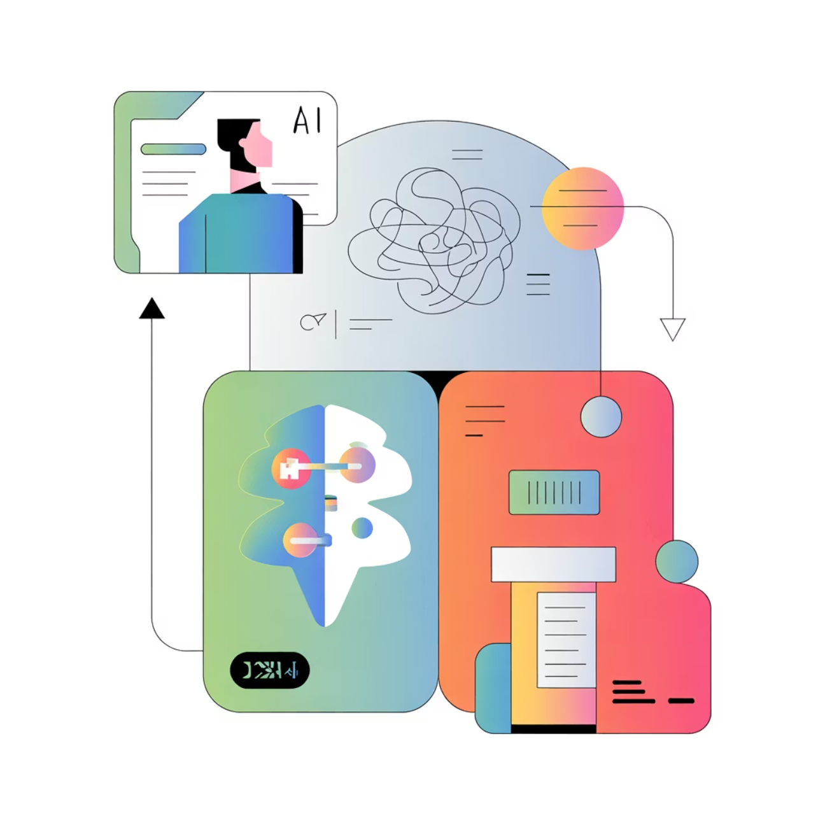
Technology & Intellectual Property Strategy
Our technology ensures both accuracy and defensibility, securing our position as a leader in integrated health-tech.
Core Technological Stack
AI Engine powered by Supervised Learning models trained on extensive, validated Ayurvedic datasets.
Seamless integration layer for processing biometric data streams (e.g., from wearables) to enhance diagnostic accuracy.
Proprietary algorithms that translate Dosha balance assessment into quantifiable data points.
IP and Validation
High Patent potential for our unique diagnostic logic and data pipeline methodology.
Ongoing collaboration with AYUSH research institutions ensures continuous validation and domain authority.

Slide 11








The Team: Interdisciplinary Strength
AIyuv is driven by a blend of technical expertise, academic mentorship, and a clear vision for growth.
Founder
Co-Researcher & Idea Collaborator
Punuru Shyam Suchit Reddy (B.Tech C.S.E)
Korrapati Jaideep (B.Tech C.S.E)
Future Recruitment
Domain Experts
Expanding team to include specialized data scientists, certified Ayurvedic doctors, and UX designers.
Mentorship from people in Ayurveda and AI departments, ensuring clinical relevance and data integrity.

Slide 12
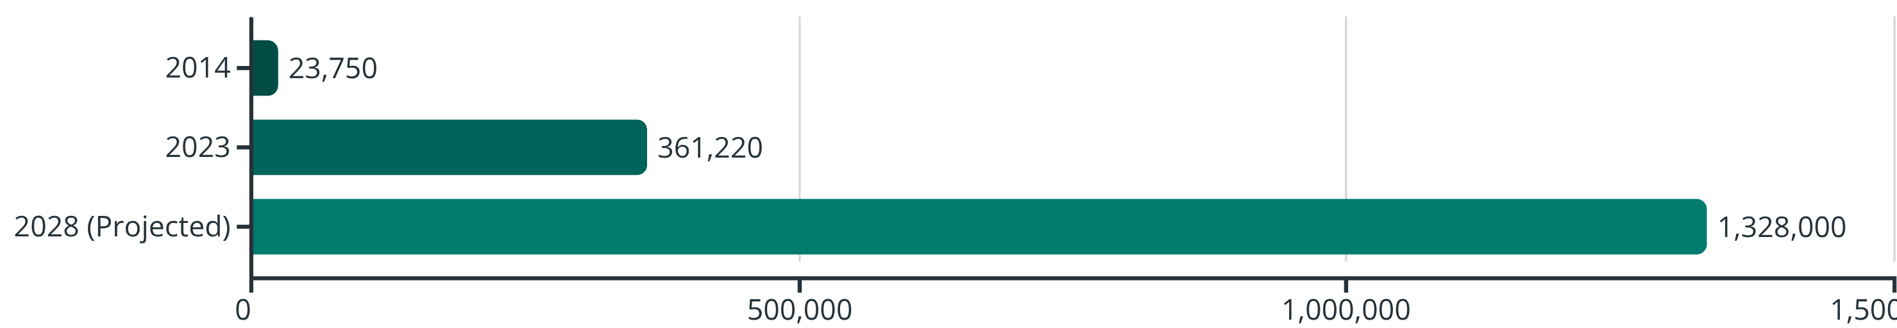
Market Analysis
The Ayurvedic market demonstrates robust growth, driven by increasing consumer awareness and a global shift towards digital and preventive wellness.
The chart shows market growth: • Y-axis (vertical): Years from 2014 to 2028 • X-axis (horizontal): Market value in Crores INR
The global Ayurveda market has seen significant expansion, growing from ₹23,750 crores in 2014 to ₹3,61,220 crores in 2023. While a projection of ₹13,28,000 crores for 2028 indicates market adjustments, the overall trend reflects a substantial and sustained interest in Ayurvedic solutions.
95%
53%
46%
Indians know Ayurveda
Urban Indian usage of Ayurveda
Rural Indian usage of Ayurveda
This widespread awareness, coupled with strong usage rates across both urban and rural populations, confirms a deep-rooted acceptance of Ayurveda in India. Furthermore, there is a rising global trend of digital health and preventive wellness solutions.

Slide 13
Market Analysis (with Target Customer Estimation)
🇮🇳 1. Ayurveda Market Overview (India)
🌿 2. Define Your Ideal Target Audience
📱 3. Narrowing to Digital Health Adopters
Indian Ayurveda market size (2023): ≈ ₹3,61,220 crores
AIyuv focuses on:
India has over 750 million smartphone users.
Digitally literate, health-conscious individuals (urban + semi-urban).
About 15–20% of them use digital health or wellness apps (like Fittr, HealthifyMe, Cure.fit, etc.).
Projected CAGR: ~15% annually (expected to reach ₹5,81,000–6,22,500 crores by 2028).
Age group 20–45 years, who use smartphones and prefer personalized digital solutions.
Awareness: Around 95% of Indians know about Ayurveda.
These are the people most likely to try an AI-powered Ayurveda tool.
Active users: ~45–50% of Indians use some Ayurvedic product or service.
Users interested in preventive health, yoga, diet, and fitness tracking.
So, your direct reachable market = ≈ 15% of digital health app users in India→ roughly 100–120 million potential users.
This means you already have a massive potential base of users who are familiar with Ayurveda.
According to national data, this segment makes up roughly 25–30% of the Indian population.
🎯 4. Target Market Share (Realistic for AIyuv's Early Stage)
In your first 3–5 years, realistically aim to capture 1–2% of that reachable segment. That equals 1–2 million users in India initially — a very strong early-stage goal for an Ayurveda-based AI platform.

Slide 14

Thank You / Vision
"AIyuv — Where technology and tradition heal together."

