Slide 1


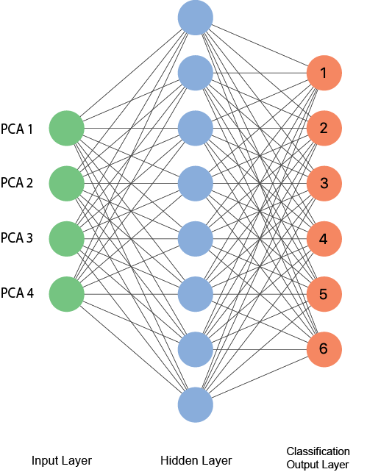
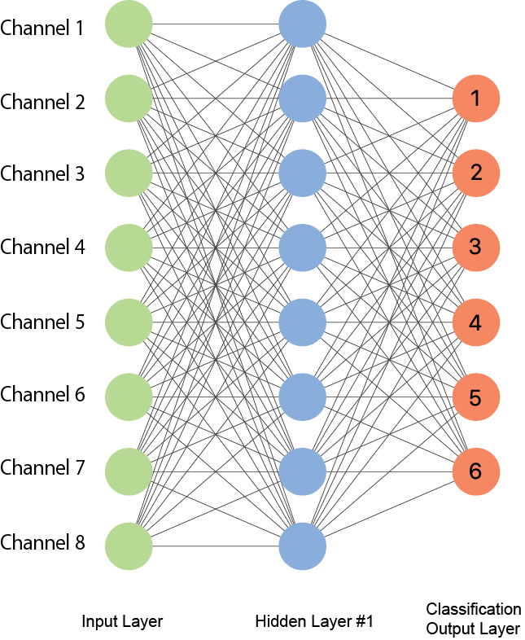
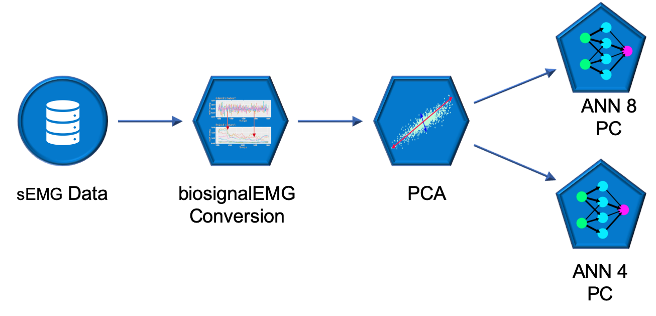
Final project for STA561
Eduardo Coronado, Sebastian Knigge, Sam Voisin, Zheng Yuan
Interpreting nerve impulses with ANN
Objective
Results
sEMG (surface electromyographic signals) data can be used to control exoskeletons and prostheses if it allows movements to be classified accurately enough. Our goal in this project is to design a neural network, which will be learned by data collected from different test subjects in a synthetic test setting to accurately predict the movements of a new test subject.
Data
Table 1. xxx
ANN structure with 4 PC vs. with all 8 channels
Xxxx
xxxx
Methods
Discussion/Conclusion
PCA
We use PCA for dimension reduction, in order to reduce the training time of the neuronal network. The decision of using only 4 of the 8 components is based on two essential findings of the PCA. First, while coponent 4 still explains approximately 12%, component 5 only contributes a little more than 7% of the explained variance (see Screeplot). Second, components 1 through 4 together explain 80% of the variance (see Cumulative Variance Plot).
Xxxx
Xxxx
xxxx
References
Daniel Falbel, e. a. Package ‘keras’.
J.A. Guerrero, J. M.-D. Package ‘biosignalEMG’.
Sergey Lobov, Nadia Krilova, I. K. V. K. and V. A. Makarov (2018). Latent factors limiting the performance of semg-interfaces. Sensors 18(1122).

