Slide 1


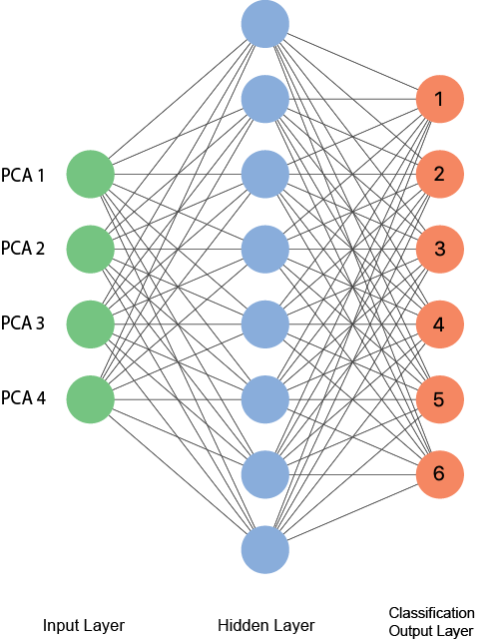
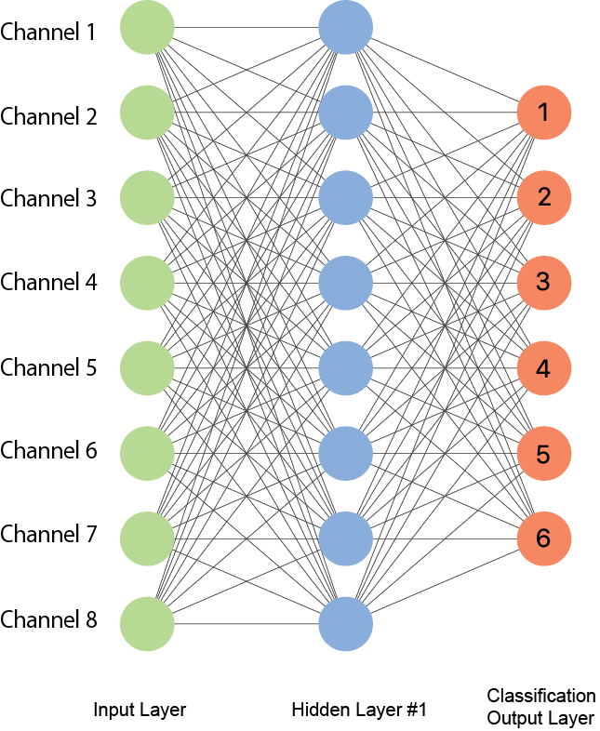
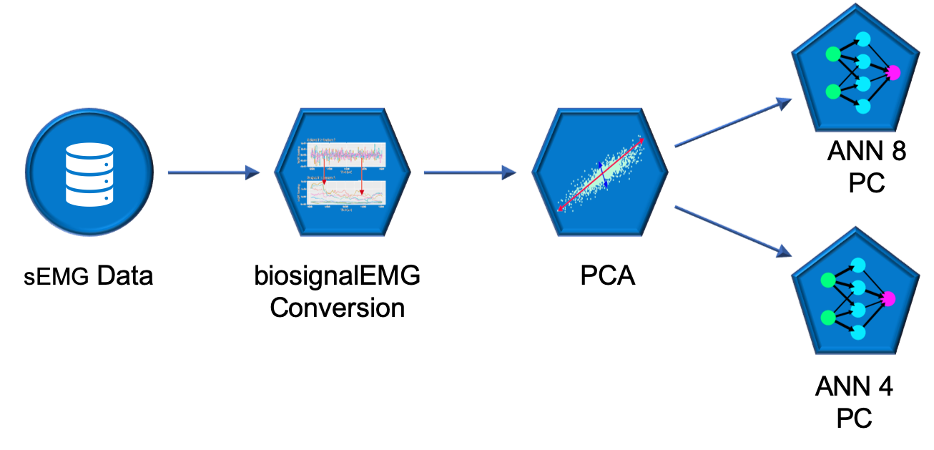
Final project for STA561
Eduardo Coronado, Sebastian Knigge, Sam Voisin, Zheng Yuan
Interpreting nerve impulses with ANN
Objective
ANN structure with 4 PC vs. with all 8 channels
Xxxx
xxxx
Results
sEMG (surface electromyographic signals) data can be used to control exoskeletons and prostheses if it allows movements to be classified accurately enough. Our goal in this project is to design a neural network, which will be learned by data collected from different test subjects in a synthetic test setting to accurately predict the movements of a new test subject.
Data
Table 1. xxx
Methods
PCA
We use PCA for dimension reduction, in order to reduce the training time of the neuronal network
The components 1 to 4 explain 80% of the variance
Discussion/Conclusion
Xxxx
Xxxx
xxxx
References
Daniel Falbel, e. a. Package ‘keras’.
J.A. Guerrero, J. M.-D. Package ‘biosignalEMG’.
Sergey Lobov, Nadia Krilova, I. K. V. K. and V. A. Makarov (2018). Latent factors limiting the performance of semg-interfaces. Sensors 18(1122).

