Slide 1
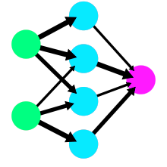

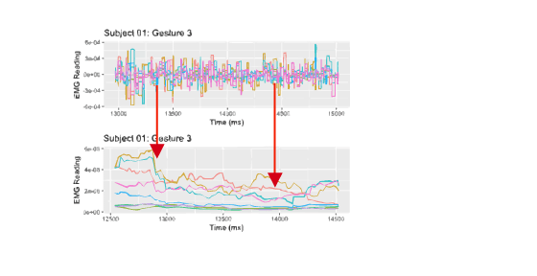
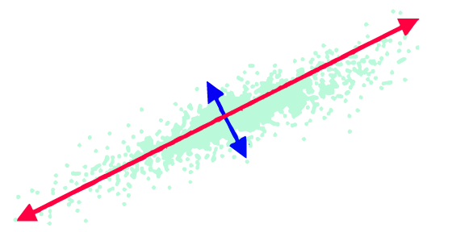
ANN all components
sEMG Data
biosignalEMG
Preprocessing
PCA
ANN 4 PC

