Slide 1
TDA for Gesture Recognition
Sam Voisin

Slide 2
Outline
Background information
Problem Description
Proposed Solution & Pipeline Concept
Previous Work
Data Set & Current Challenges
Software

Slide 3
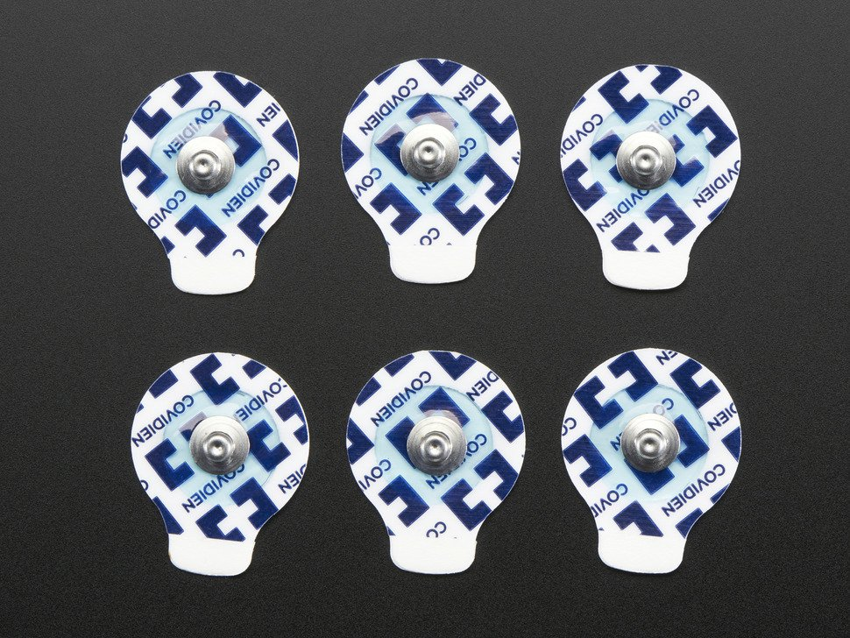
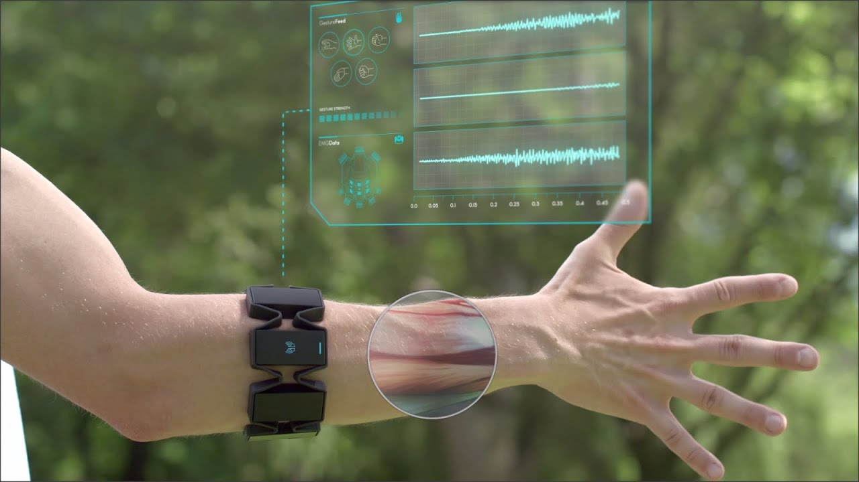
Background & Terminology
Gesture recognition
Electromyograph (EMG)
Surface electromyograph (sEMG)
Photo credit: sEMG paddles – adafruit.com; MYO armband – Focals by North

Slide 4
Problem Description
Dependable gesture recognition & prediction provides intuitive alternatives for a wide range of applications:
Consumer – Prosthetics, Human-computer interface, etc.
Military & industrial – Exoskeleton, remote robotic control, etc.
Modest results despite ample researcher attention:
Imprecise readings dependent on superficial user characteristics
Incongruous data sets leads to small training sets & overfitting
Onboard computing resources limited

Slide 5
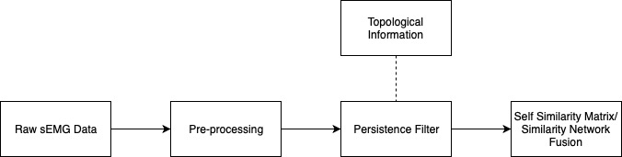
Proposed & Pipeline Concept
A computationally feasible pipeline capable of receiving signal, reducing noise & inferring gesture
Receiving signal – sEMG sensor array
Reducing noise –
Hypothesis: Signal will have similar topological structure across individuals
Noise (tremor, muscle fatigue, bodyfat, …) can be filtered out
Inferring gesture – Many methods; prefer unsupervised

Slide 6
Previous Work
Latent Factors Limiting the Performance of sEMG-Interfaces
Lobov, et al.
A Topologically Informed Chart of Electromyographic Features Space
Phinyomark, et al.
Geometric cross-modal comparison of heterogeneous sensor data
Traile, et al.
Multi-Scale Geometric Summaries for Similarity-Based Sensor Fusion
Traile, Bendich, & Harer
Notes:
Phinyomark - mapper algorithm created a topological network to better understand the EMG feature space:
signal amplitude and power
nonlinear complexity and frequency information
and time-series structure
SSM – encodes distances on a time ordered point cloud > similarity network fusion (SNF) - takes SSMs and outputs a single fused template which is meant to leverage the strengths of indiv SSMs > shattering transform provides geometric features of template
O(N^3) for N x N matrix but can be mitigated via sparse

Slide 7
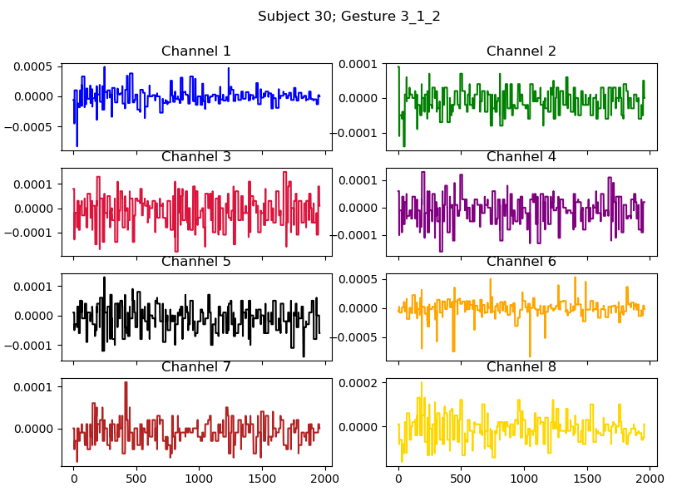
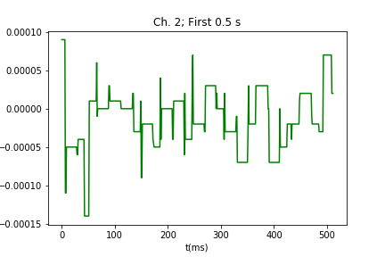
Data Set
36 test subjects
6 distinct gestures
Each performed 4x per subject
8 sensors capture motion

Slide 8
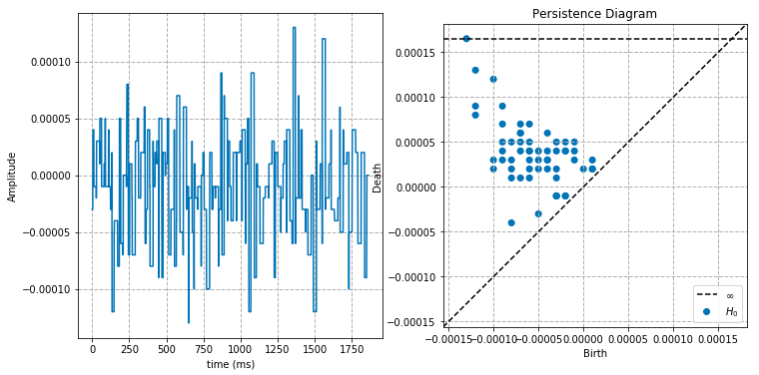
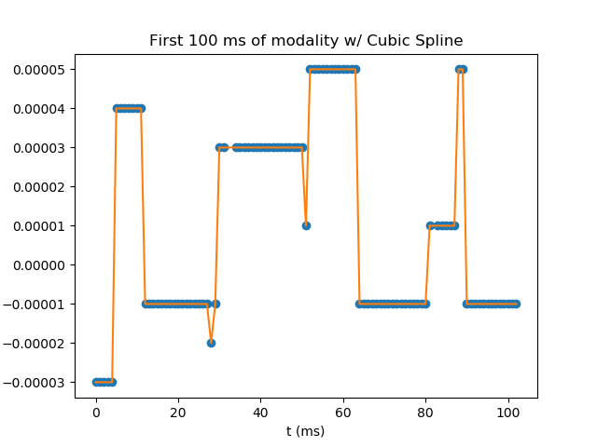
Current Challenges

Slide 9

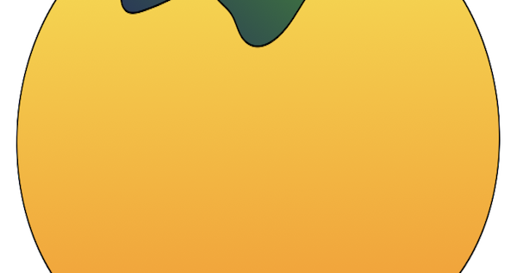
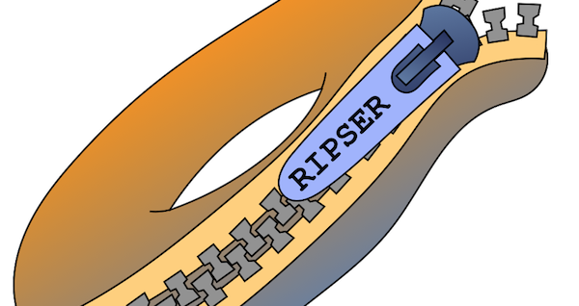
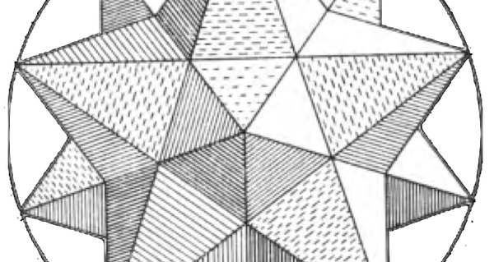
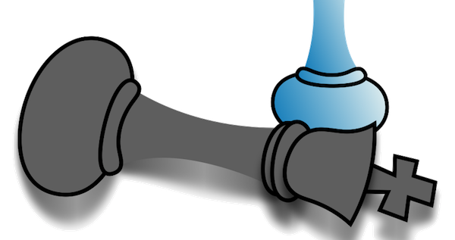

Software

