Slide 1
Identifying Gestures through EMG signals
Sam Voisin

Slide 2
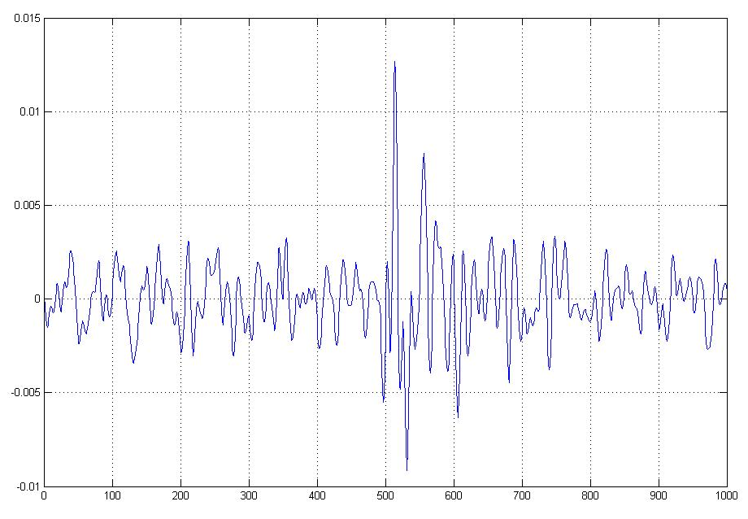
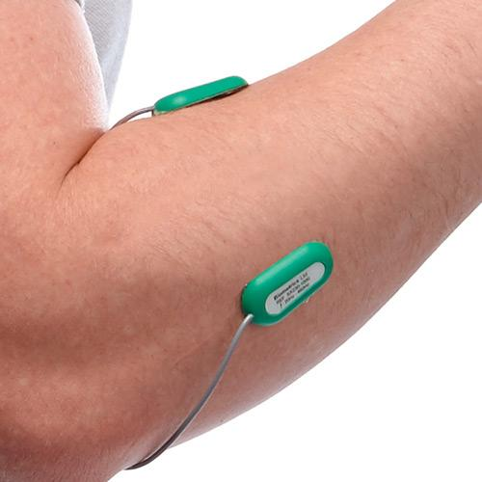
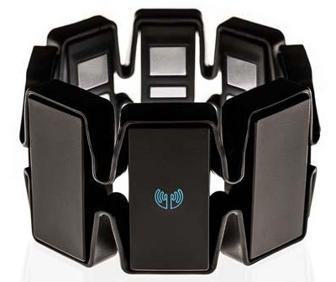
Background

Slide 3
The Problem
Dependable gesture recognition & prediction provides intuitive alternatives for a wide range of applications:
Consumer – Prosthetics, Human-computer interface, etc.
Military & industrial – Exoskeleton, remote robotic control, etc.
Modest results despite ample researcher attention:
Imprecise readings dependent on superficial user characteristics
Incongruous data sets leads to small training sets & overfitting
Onboard computing resources limited

Slide 4
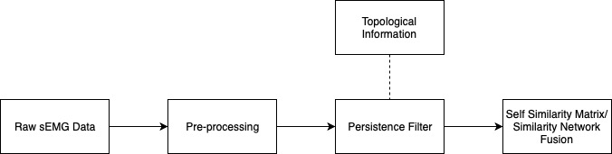
Solution
Computationally feasible data pipeline comprised of two parts:
Filtering component: Remove superficial noise irrelevant to all gesture classes
Classifying component: Classify gesture as early as possible in cycle

Slide 5
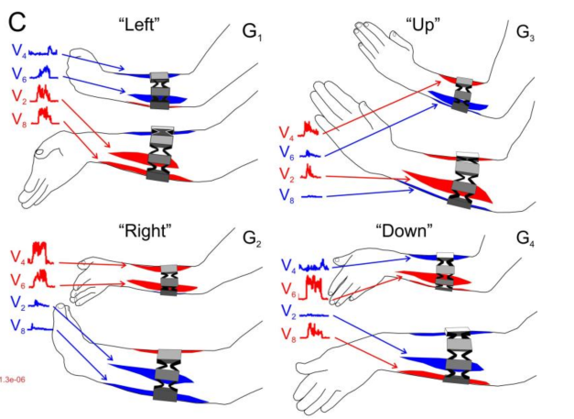
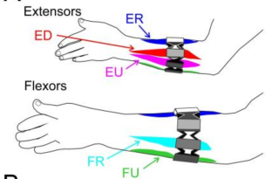
Data
36 Test Subjects
8 Sensors: 5 are placed directly on main muscles
6 Gestures: 4 simple (e.g. “left”) and 2 compound (e.g. “left + up”)
Perform gesture for 3 sec.

Slide 6
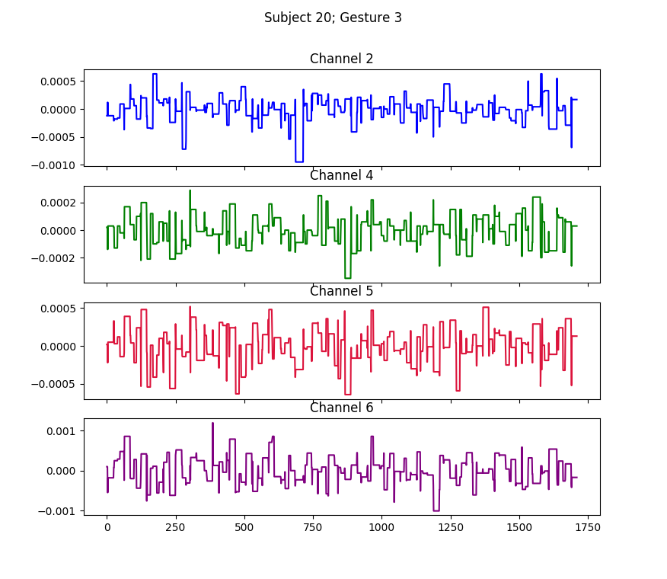
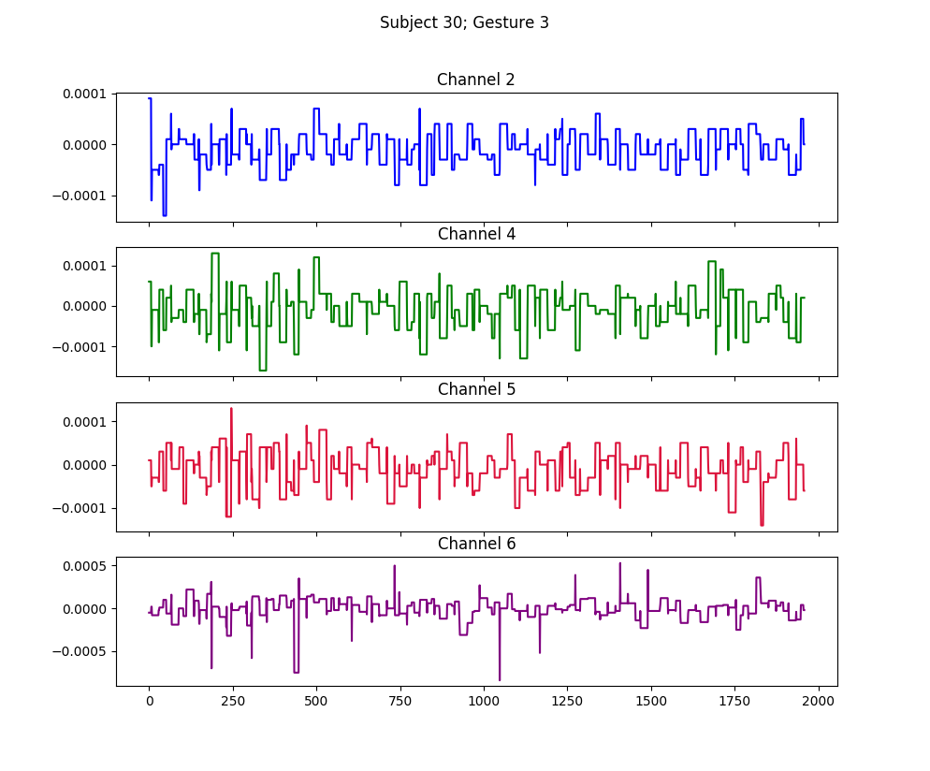
Data
Between subject performance variability

Slide 7
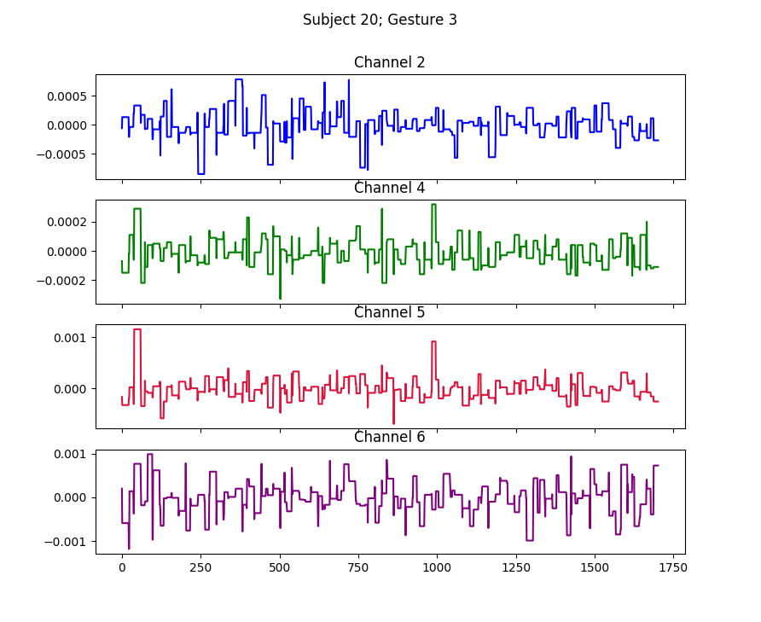
Data
Within subject performance variability

Slide 8
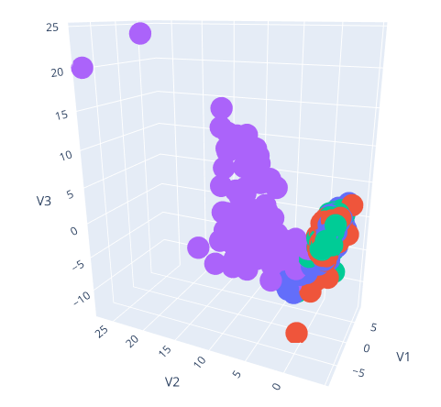
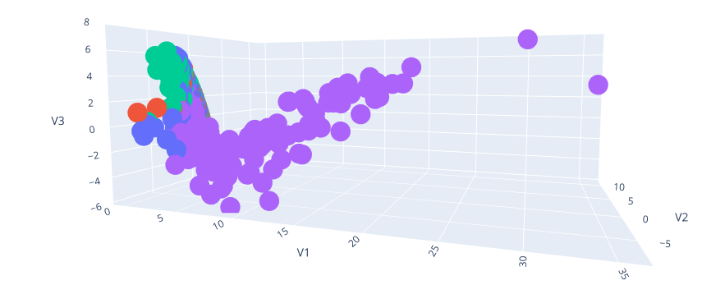
Exploratory Analysis - Dimension Reduction
Principal Components Analysis:
First 3 PCs: 80% of variance
Multidimensional Scaling

Slide 9


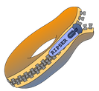
Identifying Important Characteristics
What characteristics are important for classification?
Identifying peaks & valleys will be unique to a gesture
Characteristics common to all gestures may be removed without information loss
Persistent homology may help to answer this question
Vietoris-Rips Complex calculated for 1-D homology group on 5-channel time series
20x20 pixel persistence images generated with 𝛔 = 1e-5

Slide 10
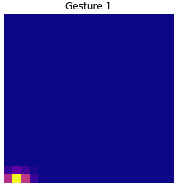
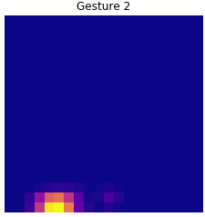
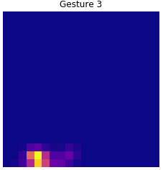
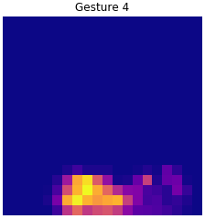
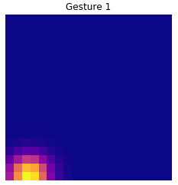
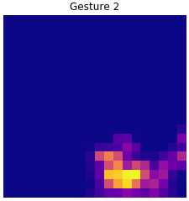
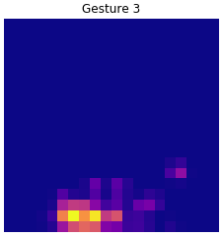
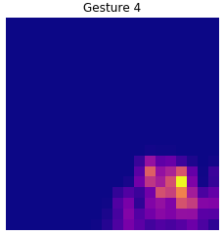
Persistence Images

Slide 11
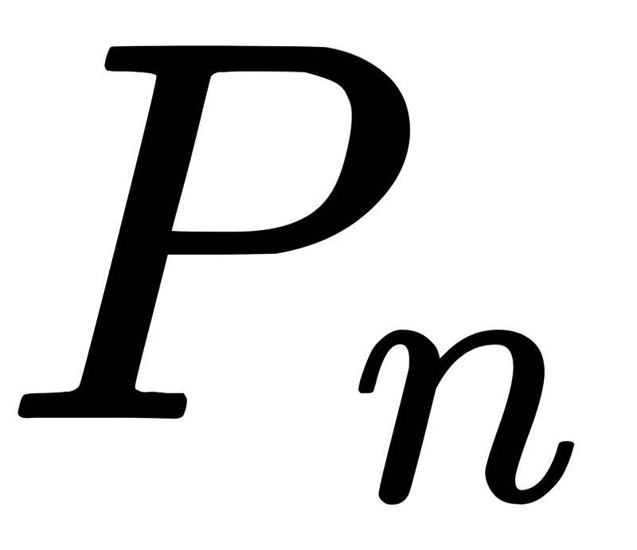
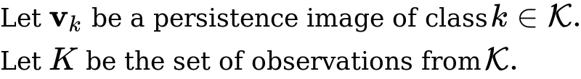
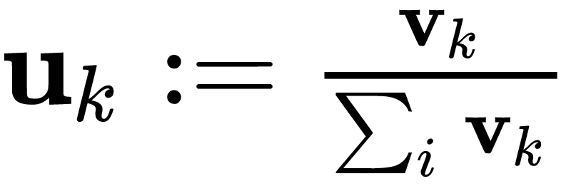
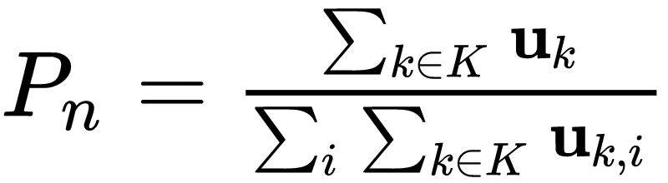

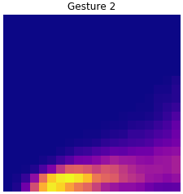
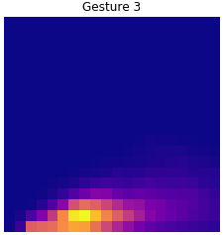
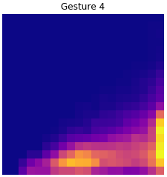
Combining Persistence Images
Want to determine which qualities are shared within a gesture class
Normalized sum of normalized persistence images,

Slide 12
Aside: Using Pn to classify persistence images
These vectors provide a baseline classification rate
In-sample accuracy: 57.1%
Remarkably high for extremely low compute cost
Expect 25% for random assignment
Out-of-sample accuracy is hit & miss - some subjects have more influence than others

Slide 13
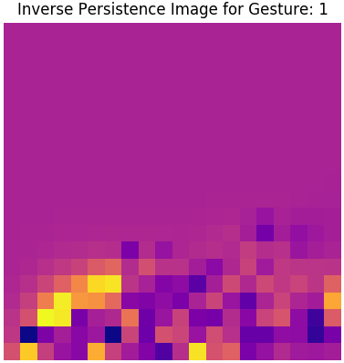
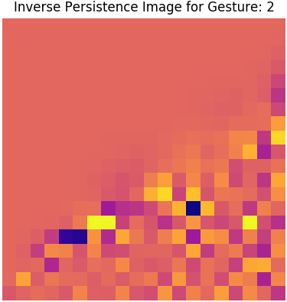
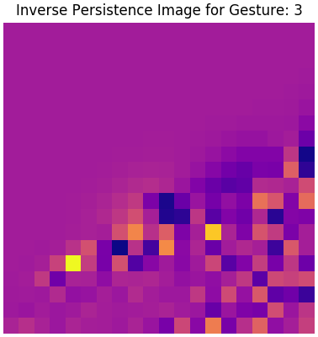
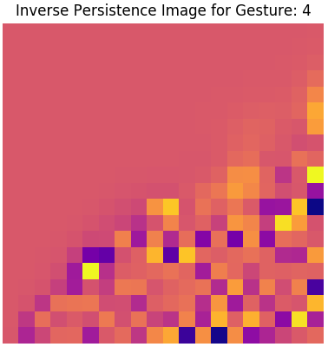
Inverse Images - Logistic Regression
Another method for determining feature importance: Fit logistic regression; extract coefficients and reform as inverse persistence image
In-sample performance: 99.57% accuracy
Out-of-sample performance: 52.59% accuracy

Slide 14
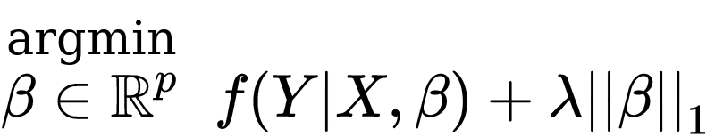
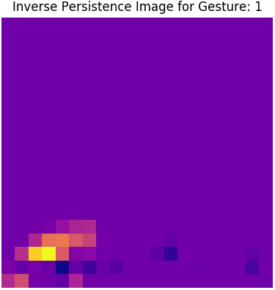
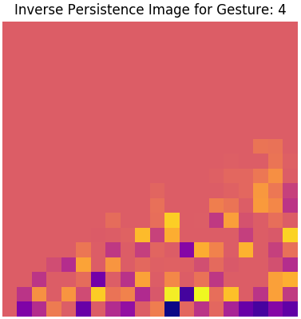
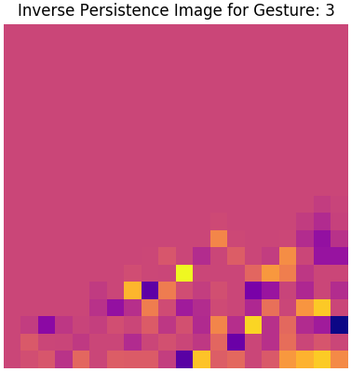
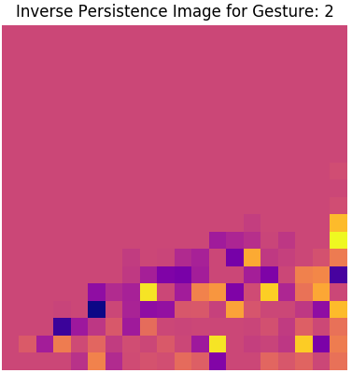
Inverse Images - LASSO
Regularize & sparsify with L1 penalty:
More aggressive filtering
In-sample performance: 81.96% accuracy
Out-of-sample performance: 59.48% accuracy

Slide 15
Inverse Images - Compare

Slide 16
Persistence Filter
Is it possible to construct a filter in this manner?
Important information provided by less persistent 1-cycles.
Cannot remove larger 1-cycles without loss of critical 1-cycles.

Slide 17
SSM - Classifier
What and How?
Generate self-similarity matrix (SSMs) for time-ordered point cloud (TOPC) for each channel (modality)
Derive self-similarity template through similarity network fusion (SNF); Use normalized SSMs to randomly walk over TOPC as a graph.
Use features of fused SSMs to classify gestures.

Slide 18
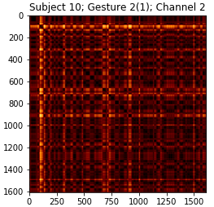
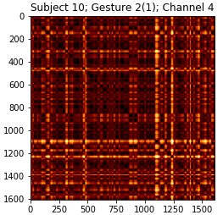
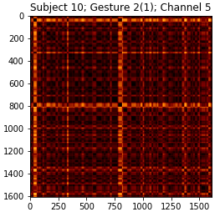
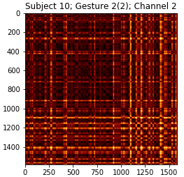



Slide 19
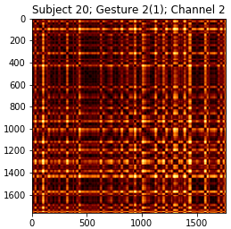
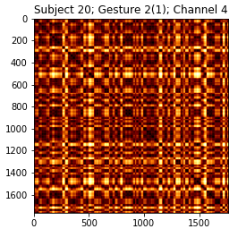
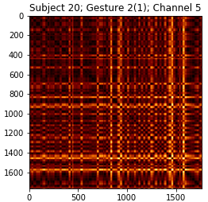

Slide 20
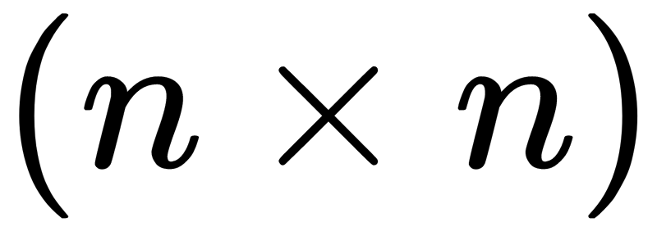
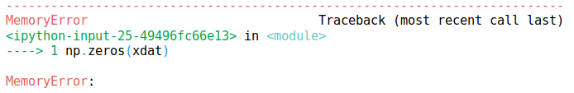
Classifier - Challenges
High one-time compute cost (size & time complexity)
36 x 5 x 4 = 720 SSMs of size
Varying sized TOPCs require dynamic time-warping
Complexity:

Slide 21
Moving Forward
Separate gestures into phases: begin, hold, release
Perform sparse sampling of time series
More work with SW1Pers:
Difficult to obtain topological evidence of cycles due to noise
More work needed to tune sliding window parameters
Computing resources are available for SNF
Duke cluster
Google cloud environments

Slide 22
Sources
Daniel. “Myo Gesture & Motion Control Armband.” Gadgetsin, 21 July 2014, https://gadgetsin.com/myo-gesture-motion-control-armband.htm.
“Surface EMG Sensor.” , Amplifier and Electrodes | Biometrics Ltd, http://www.biometricsltd.com/surface-emg-sensor.htm.
Lobov, Sergey, et al. “Latent Factors Limiting the Performance of SEMG-Interfaces.” Sensors, vol. 18, no. 4, June 2018, p. 1122., doi:10.3390/s18041122.
Phinyomark, Angkoon, et al. “Navigating Features: a Topologically Informed Chart of Electromyographic Features Space.” Journal of The Royal Society Interface, vol. 14, no. 137, June 2017, p. 20170734., doi:10.1098/rsif.2017.0734.
Tralie, Christopher J., et al. “Geometric Cross-Modal Comparison of Heterogeneous Sensor Data.” 2018 IEEE Aerospace Conference, 2018, doi:10.1109/aero.2018.8396789.
Tralie, Christopher J., et al. “Multi-Scale Geometric Summaries for Similarity-Based Sensor Fusion.” 2019 IEEE Aerospace Conference, 2019, doi:10.1109/aero.2019.8741399.
Holt, G.A., et al. “Gesture Recognition Using Skeleton Data with Weighted Dynamic Time Warping.” Proceedings of the International Conference on Computer Vision Theory and Applications, 2013, doi:10.5220/0004217606200625.
Phinyomark Angkoon, Khushaba Rami N., Ibáñez-Marcelo Esther, Patania Alice, Scheme Erik and Petri Giovanni Navigating features: a topologically informed chart of electromyographic features space14J. R. Soc. Interface

