Slide 1
TDA for Gesture Recognition
Sam Voisin

Slide 2
Outline
Background information
Problem Description
Previous Work
Data Set & Current Challenges
Pipeline Concept
Software

Slide 3
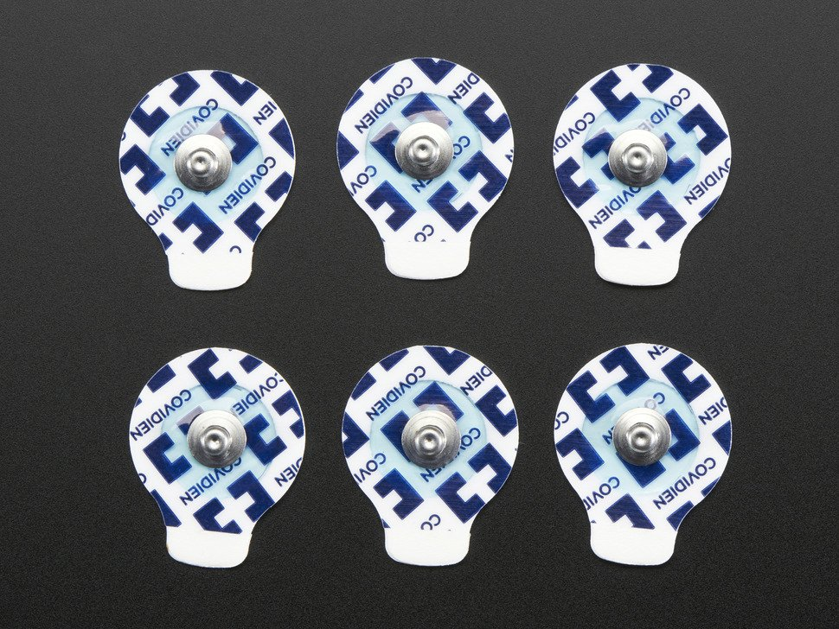
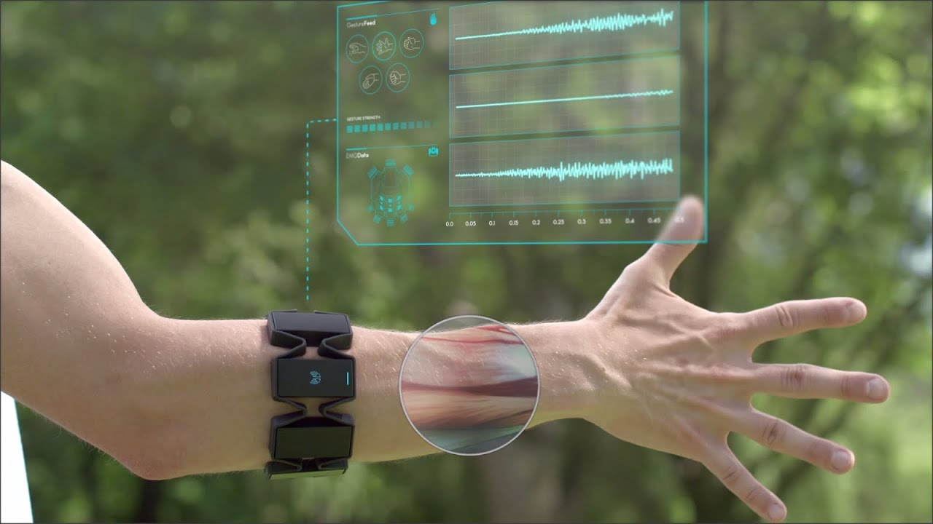
Background & Terminology
Gesture recognition
Electromyograph (EMG)
Surface electromyograph (sEMG)
Photo credit: sEMG paddles – adafruit.com; MYO armband – Focals by North

Slide 4
Problem Description

Slide 5
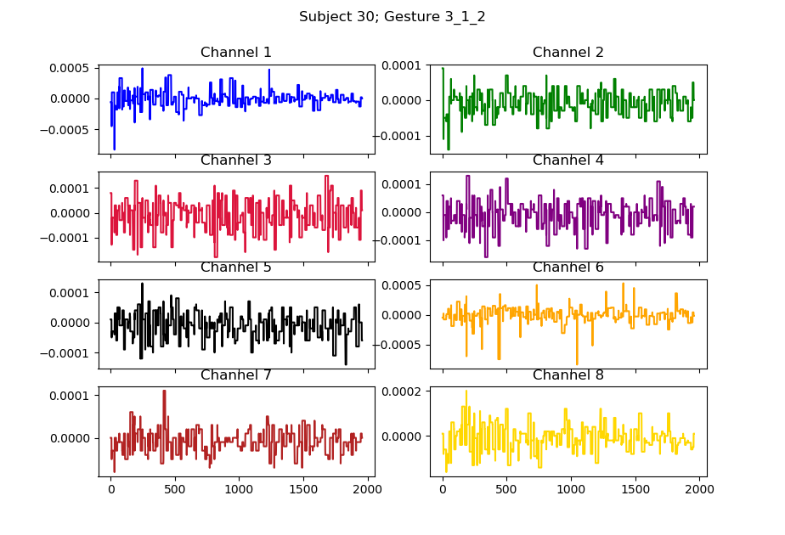
Data Set & Current Challenges
36 test subjects
6 distinct gestures
8 signal channels

Slide 6
Pipeline Concept

Slide 7
Software

