Slide 1
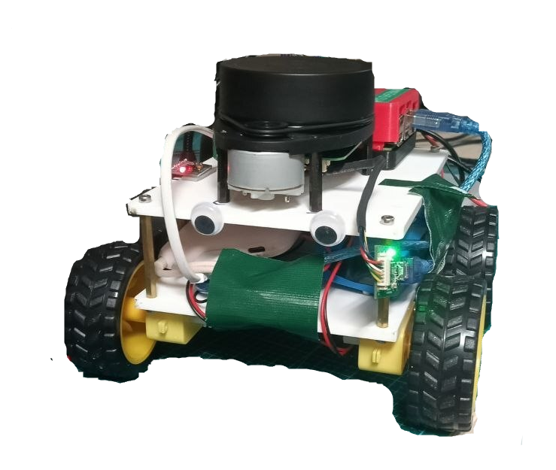
Building An Autonomous Driving Robot…
FROM SCRATCH
MA4890
Sherman Wee
Chloe Tan
Cui Yujie
Notes:
Good morning, everyone. We're Yujie, Chloe and Sherman, and our project is building an autonomous driving robot from scratch, on a student budget.
We started with one question.

Slide 2
Aim
How can we apply what we learnt and build a low-cost autonomous driving robot?
Our resources:
2D Lidar
Raspi
IMU
Wheels & Drivers
Notes:
This course covered the whole autonomous driving stack, from sensing and localisation to planning and control. So we asked: how much of it can we build ourselves, cheaply? We had a 2D lidar, a Raspberry Pi, an IMU, and wheels with motor drivers.
Here's what we built.

Slide 3
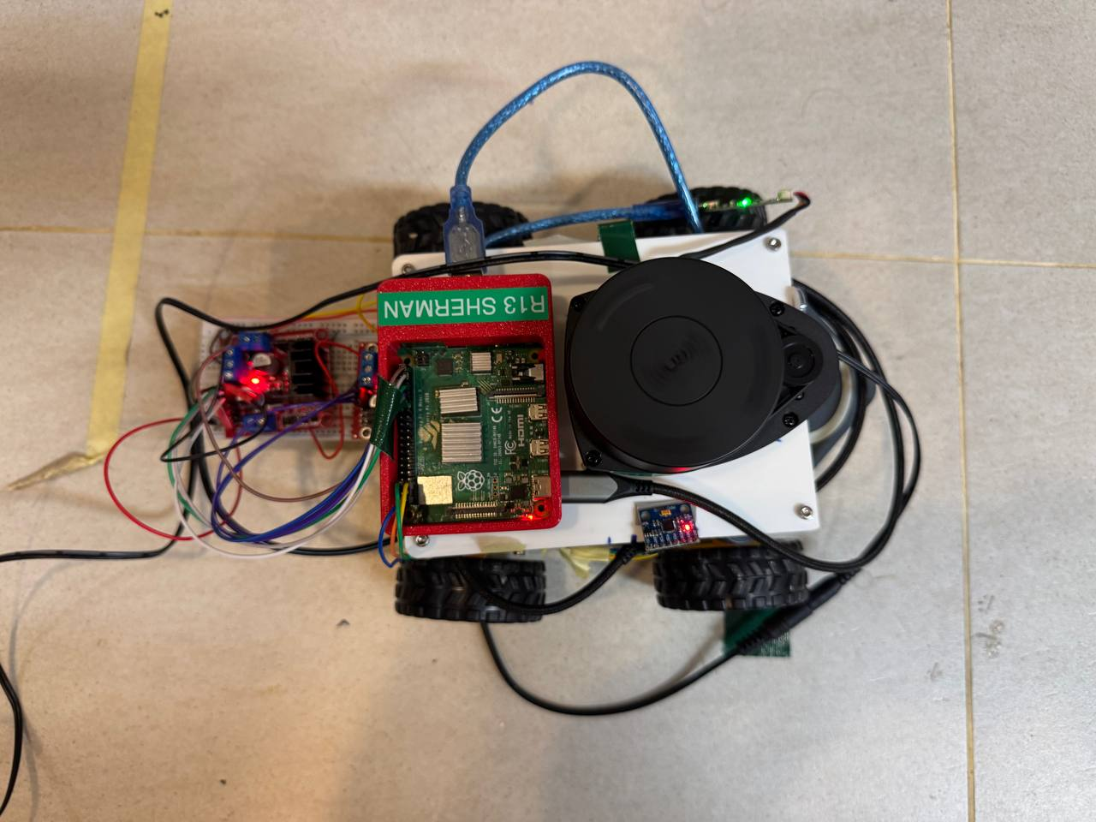
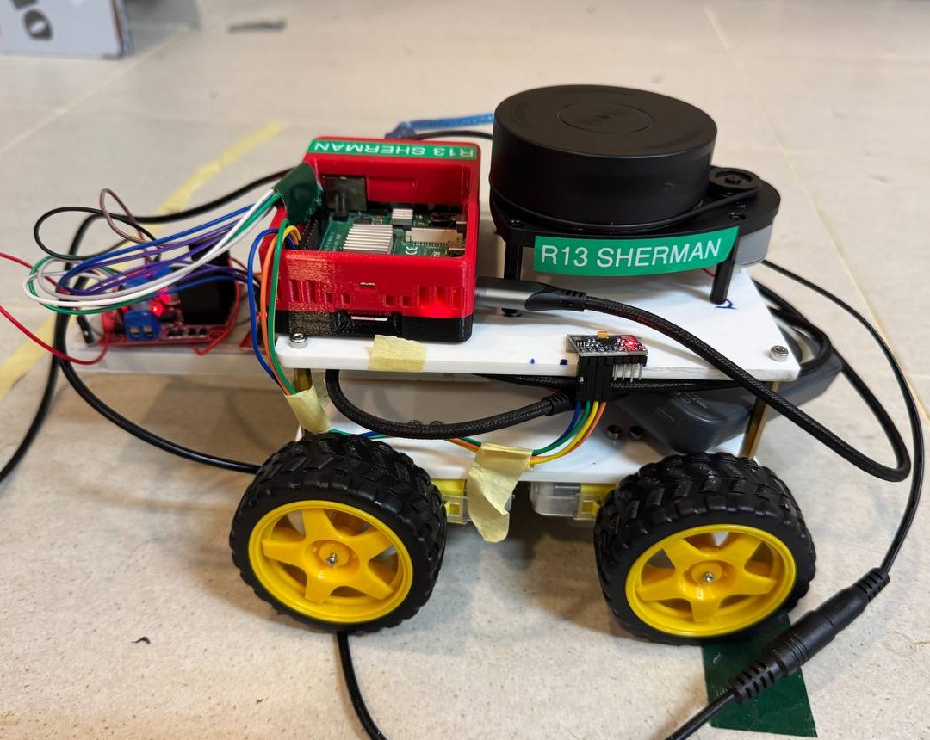
This is the robot we built
Off-the-shelf parts on a four-wheel base, no wheel encoders
Raspberry Pi 4B
RPLidar A1M8
Lidar 12 cm up
L298N driver
MPU6050 IMU
4 DC gear motors
Overview · Yujie
03
Notes:
From the top: the round unit on the right is the RPLidar, which spins and measures distance all around. The Raspberry Pi 4 in the red case runs everything, the small board at the front is the IMU, and the red board at the back is the motor driver. From the side you can see four DC gear motors, two per side.
Everything is off the shelf, and there are no wheel encoders, so the robot can't measure how far its wheels have turned. Keep that in mind, because it shapes most of what follows.
First, let's put this robot next to a real self-driving car.

Slide 4
Background Research

Slide 5
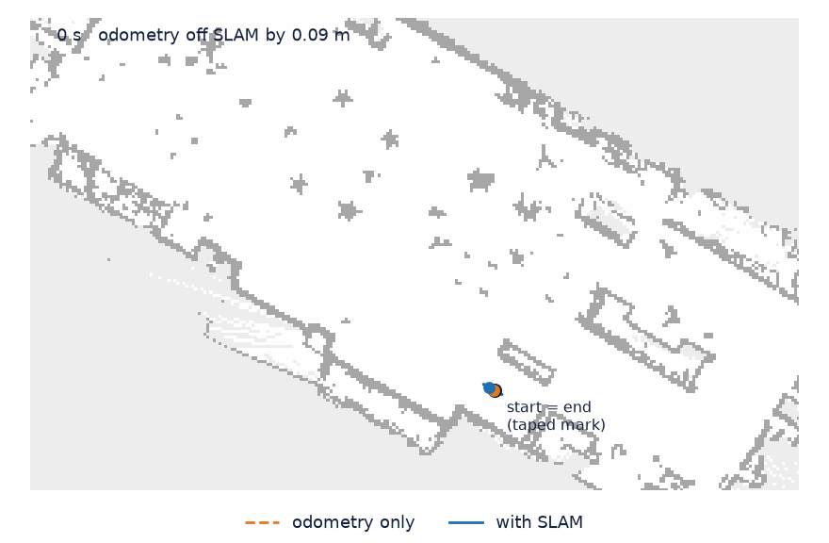
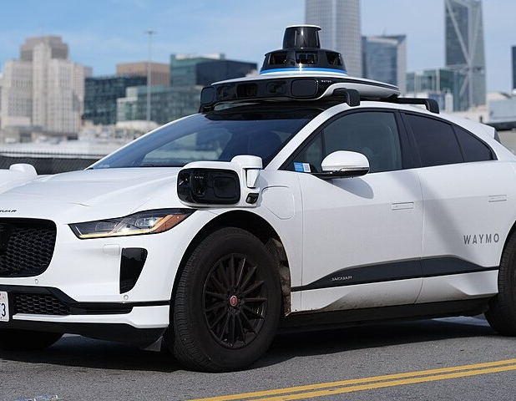
Same loop as a road AV, scaled down to one room
Odometry alone drifts up to 0.46 m over one lap. SLAM holds it.
Waymo robotaxi
29 cameras, lidar and radar all around
Our robot
One 2D lidar, one IMU, a Raspberry Pi 4
Waymo photo: Dllu, CC BY 4.0, Wikimedia Commons
Background · Yujie
05
Notes:
This Waymo robotaxi carries twenty-nine cameras, plus lidar and radar all around. Ours has one 2D lidar, one IMU and a Raspberry Pi. Yet both run the same loop from the course: build a map, locate yourself on it, plan a path, and follow it.
The animation shows why that matters even at our scale. In orange is the robot's own motion estimate over one lap, drifting up to forty-six centimetres. In blue is SLAM, which keeps correcting it. So the method works. The question is what it takes on hardware this cheap.
Most of that effort went into sensing.

Slide 6
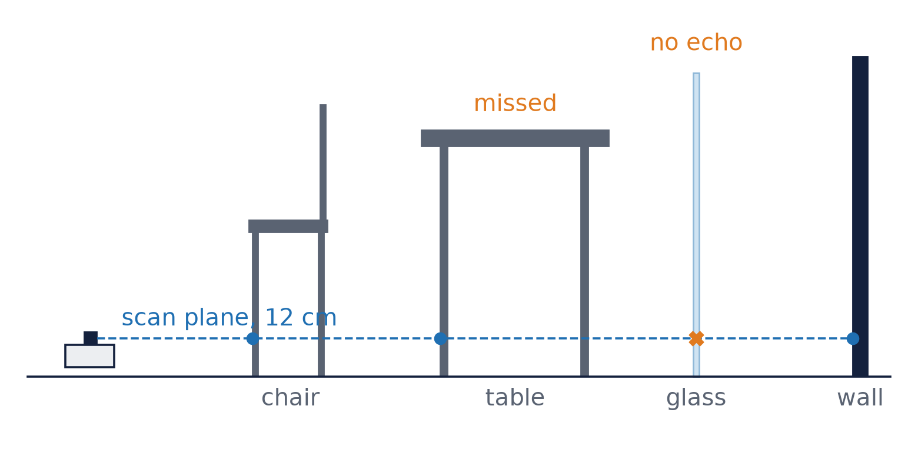
A 7 Hz single-plane lidar replaces the encoders
RPLidar A1M8 · one plane, 12 cm above the floor
Static scene
Anything moving with the robot reads as "not moving"
1
Instant scan
At 7 Hz the robot turns about 8° per sweep
2
Every surface echoes
Glass returns nothing, table tops sit above
3
rf2o · lidar odometry
SLAM Toolbox · graph SLAM
Background · Yujie
06
Notes:
Our lidar scans one flat plane, twelve centimetres off the floor, about seven times a second. With no encoders, it also has to be our odometry. For that we use rf2o, which compares two consecutive scans to work out how the robot moved. SLAM Toolbox then builds the map, and later localises the robot on it.
Three assumptions hide in here, and each comes back later. rf2o assumes nothing in the scene moves. It treats each scan as a snapshot, though at seven hertz the robot can turn eight degrees mid-sweep. And it assumes every surface reflects. As the sketch shows, glass often doesn't, and a table top sits above the plane.
Lidar odometry is weakest on fast turns, which is where the IMU helps.

Slide 7
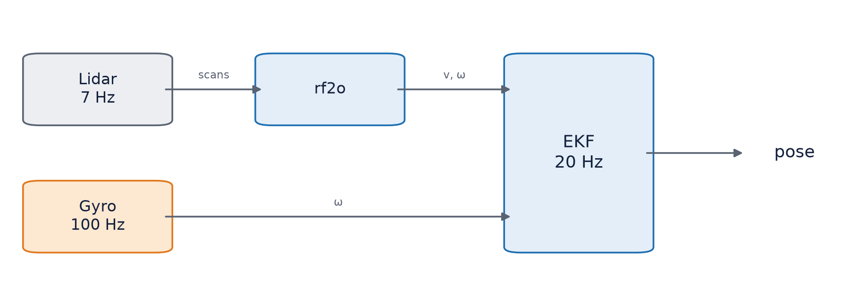



The EKF fuses lidar odometry with the gyro
Velocities, not poses
One bad reading cannot drag the estimate
Fitted noise values
From our own hand tests
One publisher only
Two publishers of odom → base spin the map
Background · Yujie
07
Notes:
We combine the two with an Extended Kalman Filter. As the diagram shows, it takes speed and turning rate from rf2o, turning rate from the gyro, and blends them into one smooth estimate.
The cards show three choices. We fuse speeds, not positions, so one bad reading can't throw it off. Each input is weighted by its noise, which we measured ourselves. And only the filter may publish the robot's position. When two programs did, the map visibly spun.
That's how the robot knows where it is. Moving it was just as tricky.

Slide 8

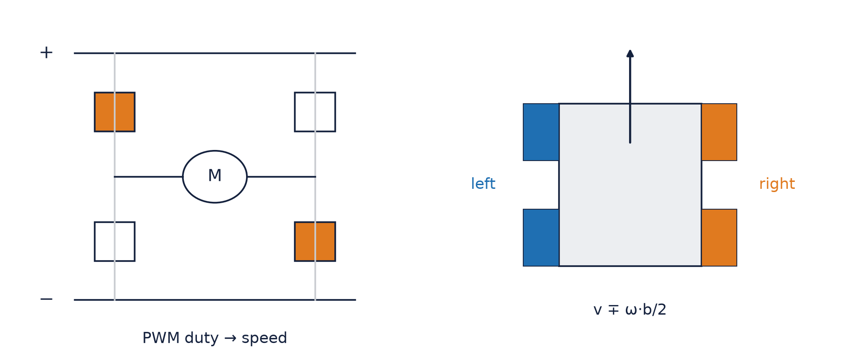


Skid steer, driven open loop, with a stall floor
Open loop
No encoders, no speed feedback
Skid steer
Wheels scrape on turns, so the real track is wider
Stall floor
Below a certain duty, the wheels do not turn
Background · Yujie
08
Notes:
On the left is the motor driver. The speed comes from the duty cycle, the share of time the power is on. On the right, each side's motors share one channel, so the robot steers like a tank.
The cards are the three catches. With no encoders, it's open loop: we send a duty cycle and trust the wheels follow. The wheels skid on turns, so real turning differs from the model. And there's a stall floor: below a certain duty, the wheels don't turn at all.
On top of all this sits the navigation software.

Slide 9
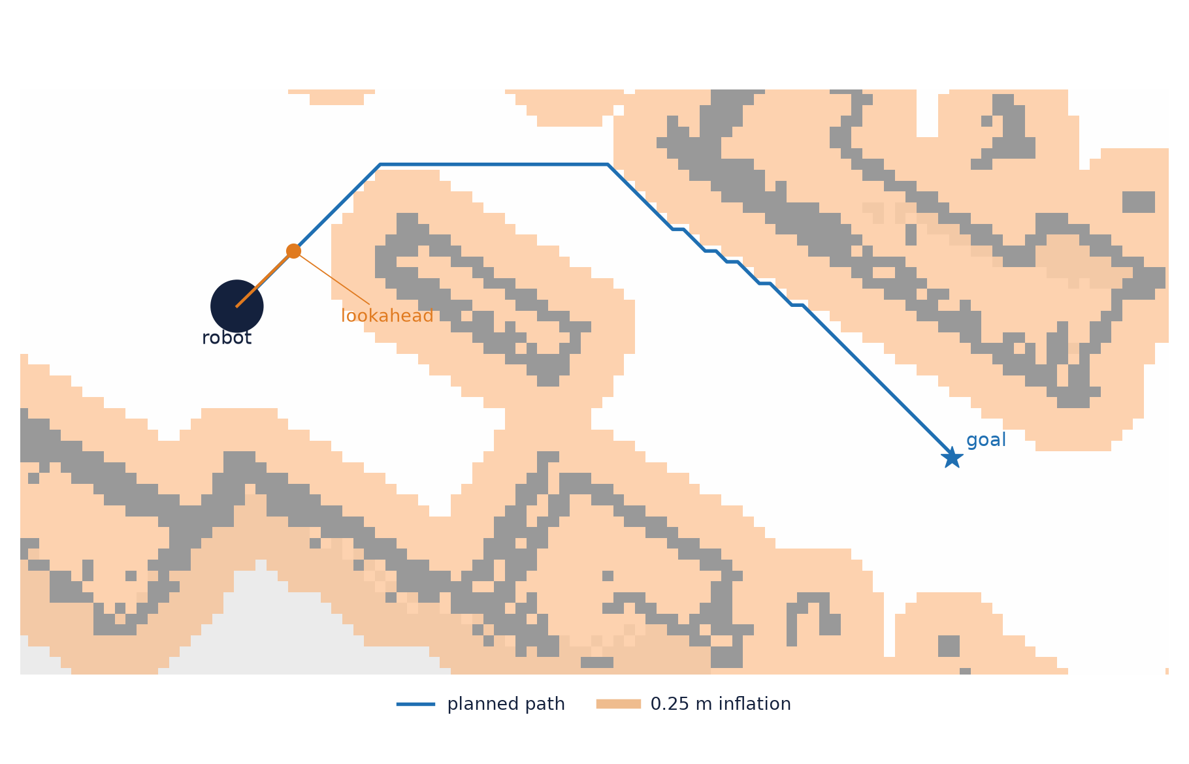
Nav2: Dijkstra planner, Regulated Pure Pursuit
INFLATION
0.25 m
LOOKAHEAD
0.2 to 0.4 m
SPEED CAP
0.15 m/s
SAFETY
collision monitor, lidar stop, watchdog, switch
Background · Yujie
09
Notes:
For navigation we use Nav2, the standard ROS 2 package. It plans with Dijkstra's algorithm on a map where every obstacle is grown by twenty-five centimetres, then follows the path with pure pursuit, steering at a point just ahead. In our example, the orange band is that margin and the orange dot is the point being chased.
We capped speed at fifteen centimetres a second, with three safety layers: Nav2's collision monitor, a lidar stop in our motor program, and a physical switch. Remember that Nav2 slows down near obstacles. That matters later.
How does our setup compare with published work?

Slide 10
Papers used better sensors. We measured live
 | Lidar | Encoders | Results from | They found | We saw
Kudriashov 2026 | Ouster 3D, cut to 2D | No | Desktop replay | Runs repeat to 0.2 m | 3 replays, 3 answers
Merrick 2026 | Hokuyo UTM-30LX | Yes | PR2 dataset | IMU cuts error 60–75 % | Gyro 360.2° vs lidar 352.9°
Ye 2021 | Hokuyo, 40 Hz |  |  | People ruin the map | Person behind: 24 %
Salem 2023 | Low-rate 2D lidars |  |  | Motion skews each scan | About 8° per scan at 1 rad/s
Ours | A1M8, 7 Hz | No | Pi 4, live
OUR TAKE
Published numbers come from good sensors and desktop replays. We measured live.
Full references on the last slide
Background · Yujie
10
Notes:
The closest paper, by Kudriashov and colleagues, uses exactly our software. But they recorded their sensor data and replayed it later on a powerful desktop. When we replayed one of our recordings on the Pi three times, we got three different distances, all short of what the robot really moved, because the Pi can't keep up. So everything we show you today was measured live on the robot.
Merrick and Nandikolla found an IMU cuts odometry error by up to three quarters, which matches our gyro beating the lidar on turns. Ye and colleagues showed people walking through scans corrupt maps, and we hit that too. And Salem and colleagues describe the mid-sweep smearing from earlier.
And against robots you can buy?

Slide 11
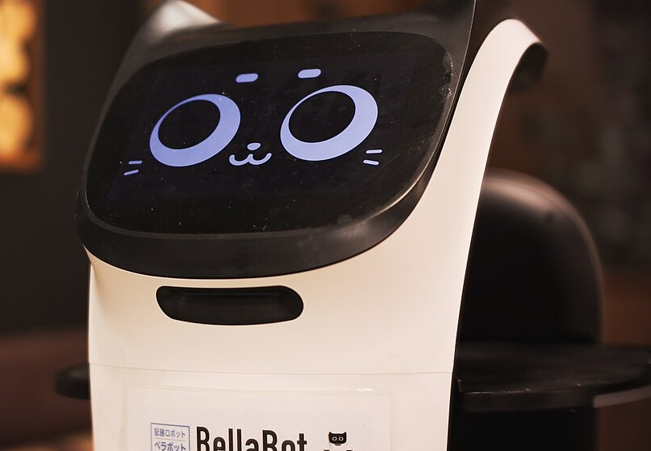
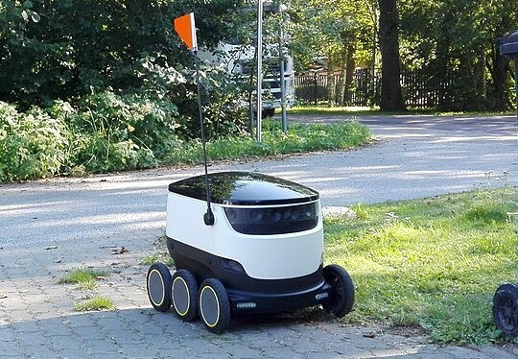
Robots on sale add cameras and drive up to 8x faster
Pudu BellaBot
Lidar + 3 depth cameras
Indoors · up to 1.2 m/s
Starship
Cameras + radar
Sidewalks · up to 6 km/h
Ours
One 2D lidar + IMU
Indoors · capped 0.15 m/s
Photos: MIKI Yoshihito, CC BY 2.0; Ohpuu, CC0 (Wikimedia Commons)
Background · Yujie
11
Notes:
Pudu's BellaBot, a restaurant robot, adds three depth cameras to its lidar and drives up to one point two metres a second. Starship's sidewalk robot uses cameras and radar. Both see far more than our single lidar plane, and BellaBot drives eight times faster. Our main gap is clear: we only see one slice of the room.
I'll hand over to Sherman, who'll show how we built it.

Slide 12
Implementation

Slide 13
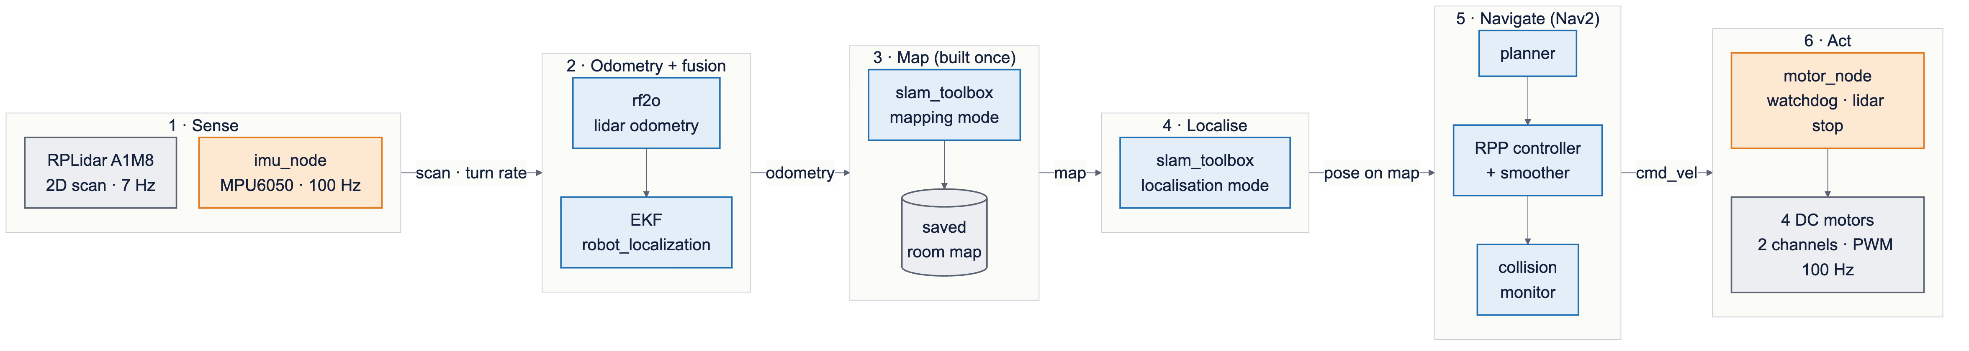
Six blocks, left to right
ROS 2 Jazzy · Foxglove to watch live · rosbag to record every run
Written by us
IMU node · motor node · robot model · launch files
Existing packages
rf2o · EKF · SLAM Toolbox · Nav2
Implementation · Sherman · overview
13
Notes:
Thanks, Yujie. Here's our software as six blocks: sensing, then odometry and the filter, then the map, localisation, Nav2, and finally the motors. It all runs on ROS 2.
The orange panel is what we wrote: the IMU and motor programs, the robot description and the launch files. The blue panel is the existing packages we built on. I'll cover blocks one to five, and Chloe the motors.
Let's start with the sensors.

Slide 14
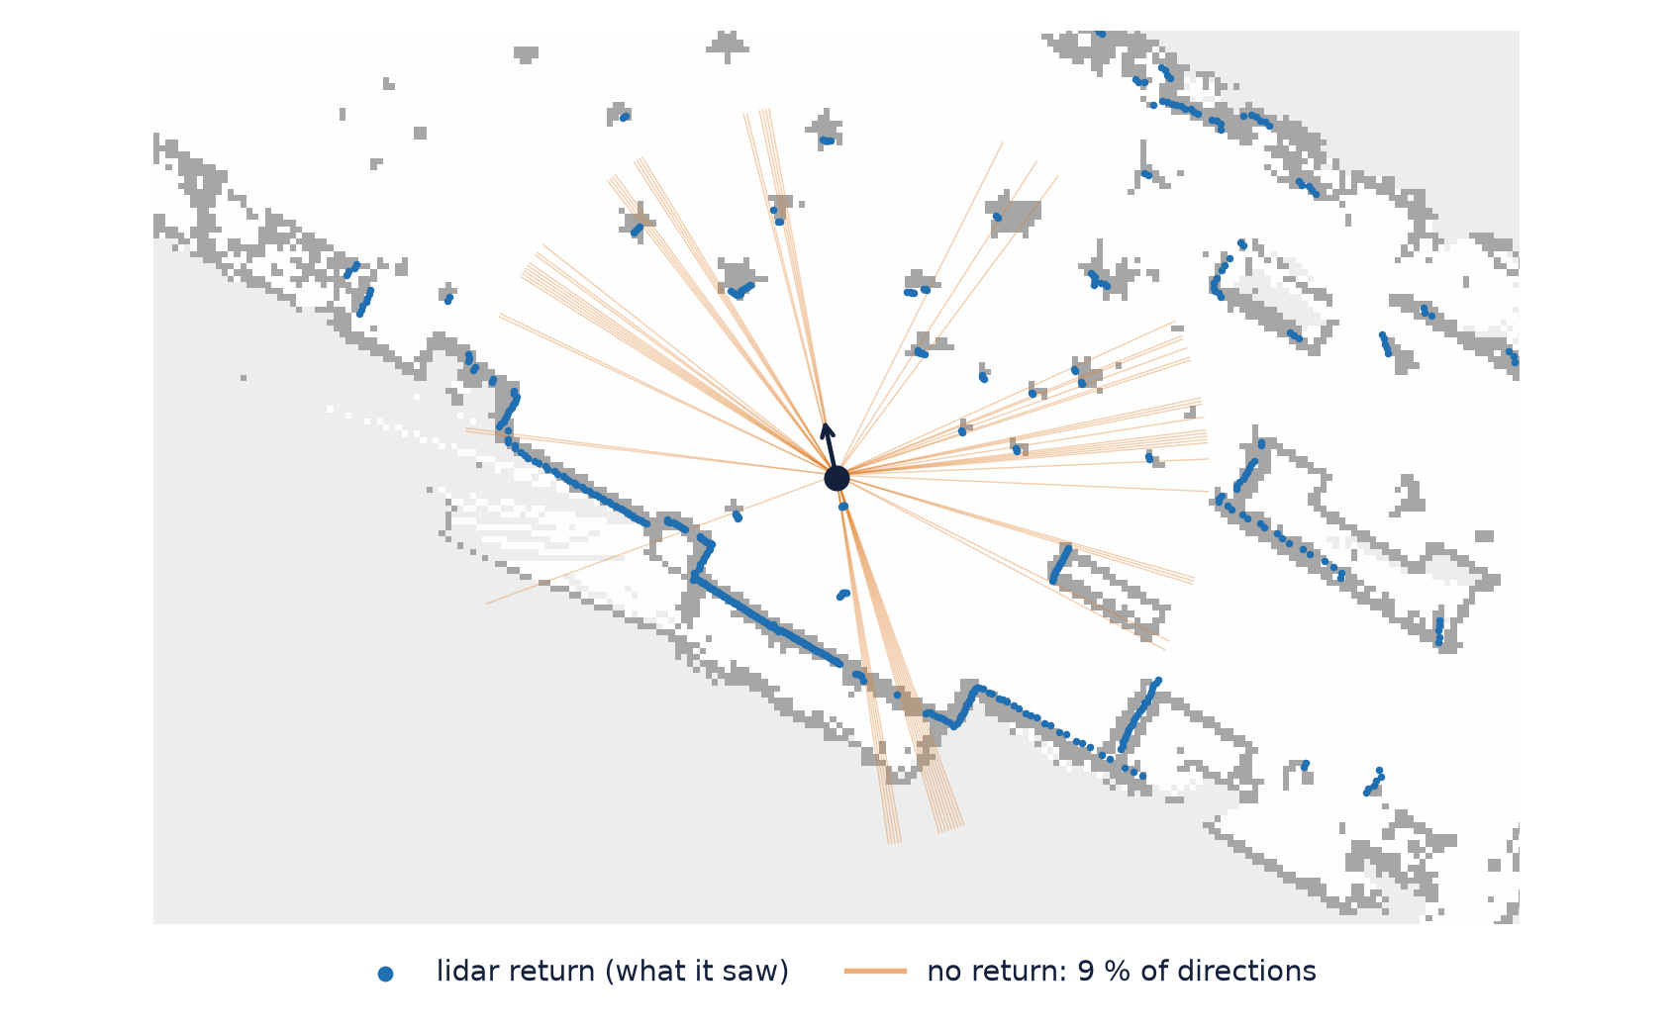
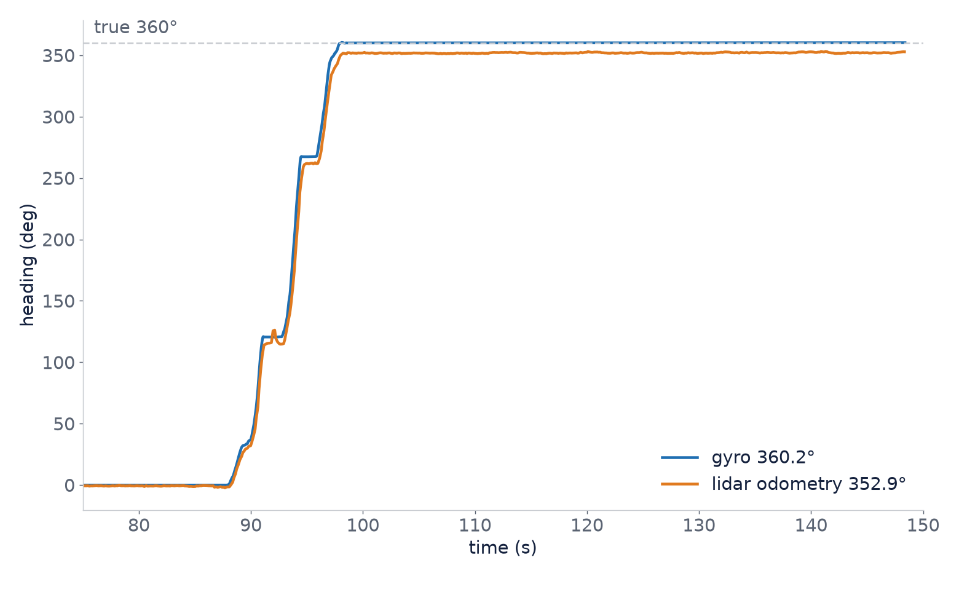
We made two cheap sensors trustworthy
Fixes: fitted noise values for rf2o, EKF at 20 Hz
≈ 25 %
of pings empty, following glass and dark surfaces
360.2° vs 352.9°
gyro vs rf2o, one full turn by hand
Implementation · Sherman · blocks 1 and 2
14
Notes:
Before any mapping, we measured both sensors. On the left is one real scan on our map. The orange rays found nothing. About a quarter of readings are empty, but the gaps line up with glass and dark surfaces, not a lidar fault. On the right, a full turn by hand: the gyro read 360.2 degrees, the lidar odometry 352.9. That's why the filter trusts the gyro for turning.
The filter needed two fixes. The lidar odometry claimed zero uncertainty, so we gave it measured noise values. And on a busy Pi the filter couldn't keep thirty updates a second, so it runs at twenty.
With sensors we trusted, we built the map.

Slide 15
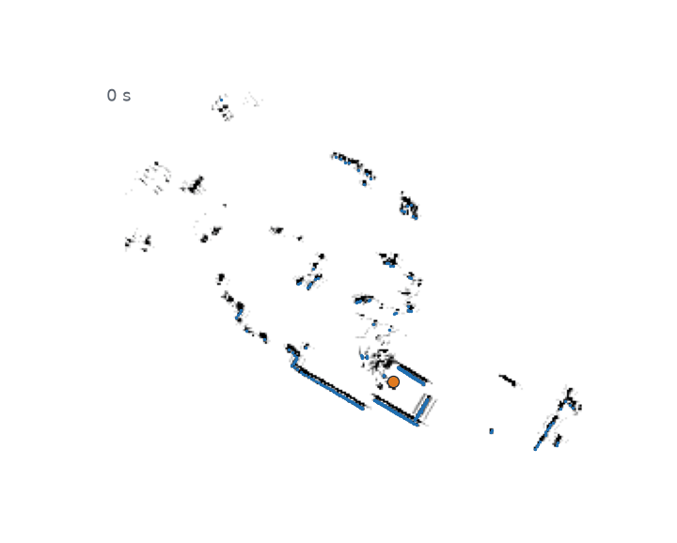
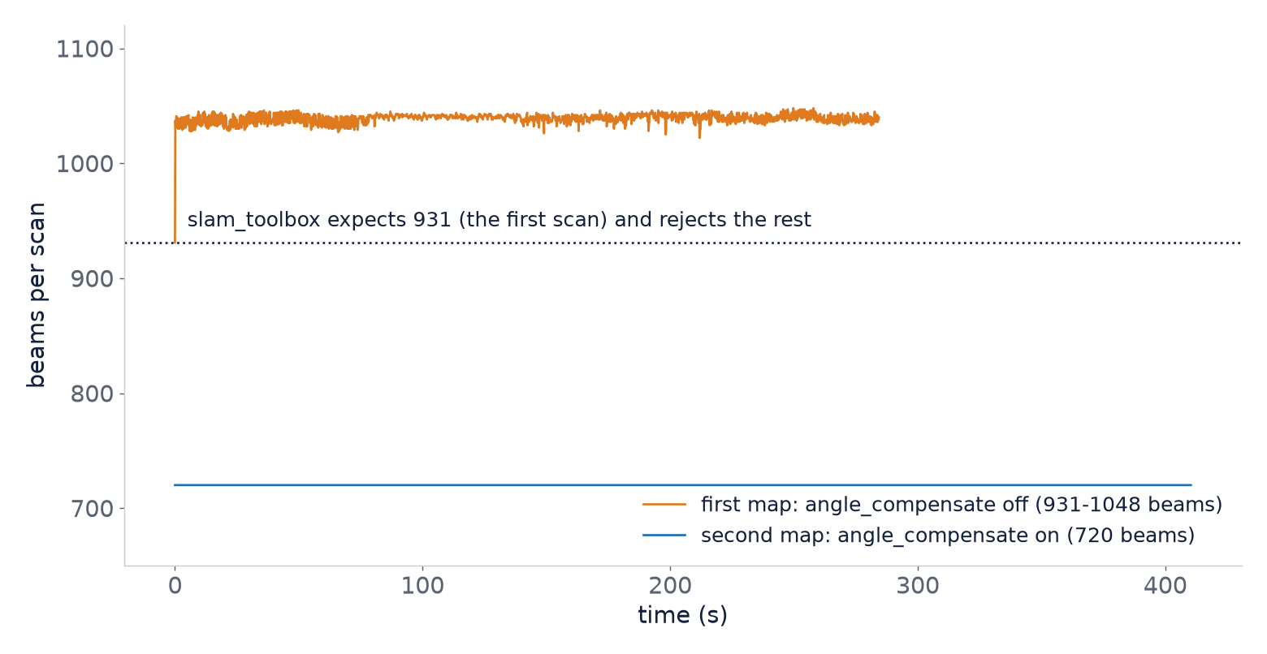
One hand-pushed lap made the map
Once every scan had the same number of beams
Expected 931, got 1041
Fixed at 720 beams
Implementation · Sherman · block 3
15
Notes:
We mapped by pushing the robot by hand around a taped loop, about seven minutes, so any error came from the mapping, not the motors.
The first attempt failed oddly. SLAM Toolbox rejected almost every scan: it expected 931 readings and got 1041. The driver sent a slightly different count every sweep, the orange line, while SLAM Toolbox expects it fixed. One driver setting held it at 720, the flat blue line, and the next lap gave a proper map.
But how good is that map, with nothing to compare it to?

Slide 16
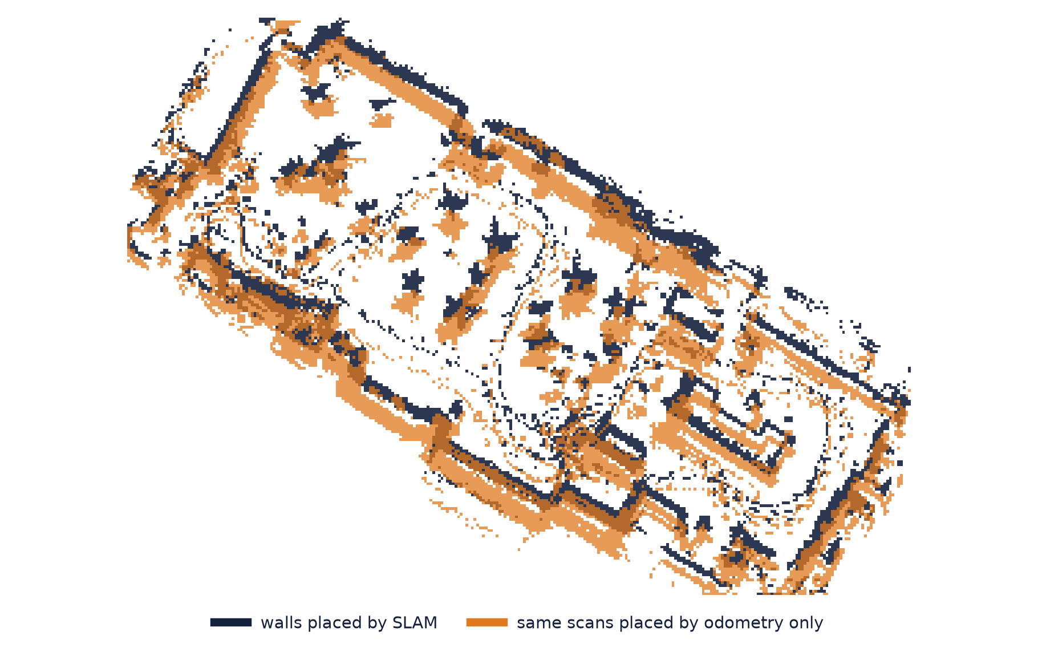
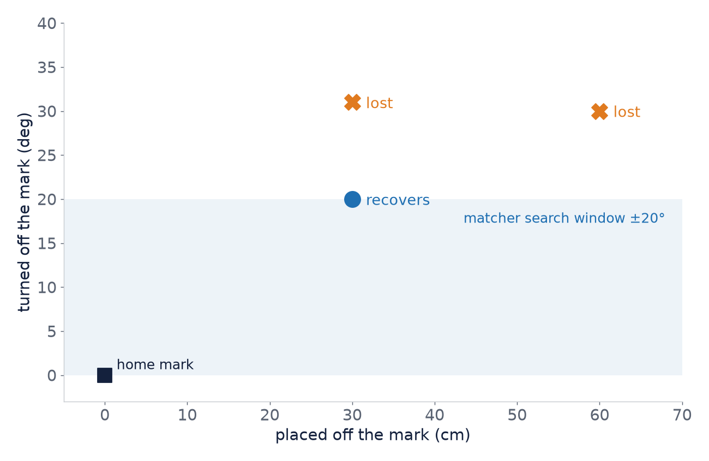
Loop closure kept the walls single
Localisation then finds the robot within 3 cm, if it starts within 20°
0.20 m vs 0.36 m
Start-end gap, SLAM vs odometry (live)
Implementation · Sherman · blocks 3 and 4
16
Notes:
We made our own ground truth. The lap starts and ends on one taped mark, so any gap between start and end is error. Live, SLAM closed to twenty centimetres, odometry alone was thirty-six off. The overlay shows the effect: with SLAM, in dark, walls stay thin. With odometry alone, in orange, they smear and double.
On that map, the robot localises to about three centimetres. But the chart on the right shows a limit. Start thirty centimetres and twenty degrees off, and it recovers. At thirty-one degrees it never does, because matching only searches twenty degrees each way. So the robot always starts on a taped home mark.
Then, partway through, the odometry started giving very wrong answers.

Slide 17
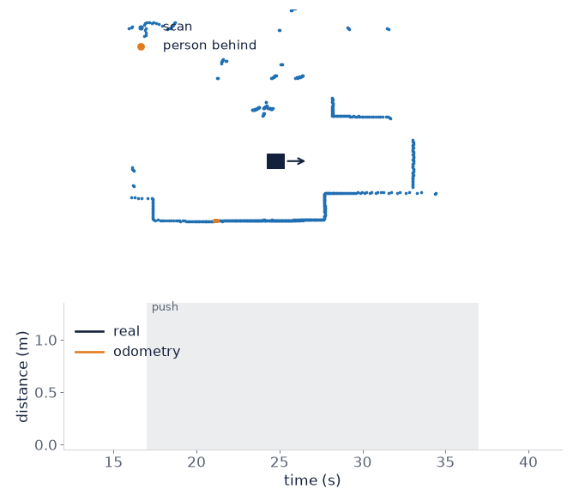
A person behind the robot fooled the odometry
A 1 m push read 24 % of the distance, twice
RULED OUT
Beam count
Live: 101 %, 96 %
RULED OUT
CPU, timing
Slow replay: same
CAUSE
Person behind
127–152 points vs 16–18
FIX, OFFLINE
Range cut
Ignore under 0.6 m
24 % → 99.5 %
Of the push, after the range cut (offline)
Implementation · Sherman · block 2
17
Notes:
We pushed the robot one metre, and the odometry said twenty-four percent. Same again elsewhere. It looked like a scaling bug.
These cards follow the investigation. We'd just changed the scan format, but live pushes with nobody near read a hundred and one and ninety-six percent, so the format was fine. A slow replay of the bad recording gave the same answer, so it wasn't the Pi being slow either.
What cracked it was counting scan points behind the robot. In the bad pushes, over a hundred sat half a metre behind, moved with it, and vanished when the push ended. It was the person pushing, in orange in the animation. rf2o assumes nothing moves, so someone walking behind tells it the robot is standing still. Ignoring everything within sixty centimetres restored 99.5 percent, so far on recordings.
With a map and a position we could trust, we handed the robot to Nav2.

Slide 18




Nav2 failed seven ways before reaching a goal
Every fix was a setting, not new code
SILENT
Twist vs TwistStamped
Wheels never moved, no error
SLOW PI
Timeouts too short
Raised from 20 ms to 1 s
SLOW PI
Transform data too old
Scans 0.5 s apart, tolerance 0.5 s
STALL FLOOR
Slowed to 0.045 m/s
Minimum speed now 0.10 m/s
OUR TAKE
Navigation defaults assume motors that can crawl and a fast computer. Ours had neither.
Implementation · Sherman · block 5
18
Notes:
Nav2 failed seven ways before reaching one goal. The cards show four.
The first was silent: Nav2 sent commands in one message format, our motor program expected another, so the wheels never moved and nothing complained. Two came from the slow Pi: timeouts too short, and position data arriving half a second late, so we relaxed both. The fourth is the stall floor. Near obstacles, Nav2 slowed to four and a half centimetres a second, below what our wheels can do, so the robot just stopped.
The other three: the home mark sat too close to furniture, and the robot tried to reverse and spin at the goal, so we moved the mark and switched those off. Every fix was a setting, not new code.
For the last block, over to Chloe, who'll show what it took to make the wheels obey.

Slide 19


To drive itself, the robot first needed stable power
Nav2 kept shutting down
The Pi rebooted mid-run on wall power
67.5 %
of power samples under-voltage on the wall supply
0 %
on a power bank: 0 of 60 samples
Loose motor wire
Rebooted the Pi twice
Motor switch
The physical kill switch
Pi power status logged every 2 s while Nav2 ran
Implementation · Chloe · block 6
19
Notes:
Thanks, Sherman. Early on, the Pi kept rebooting and Nav2 kept shutting down mid-run. So we logged the Pi's power every two seconds, and these tiles show the result. On the wall supply it was short of voltage two thirds of the time. On a power bank, zero of sixty samples. A loose motor wire also rebooted it twice. Until power was stable, no driving result meant anything.
With stable power, we could calibrate the motors.

Slide 20
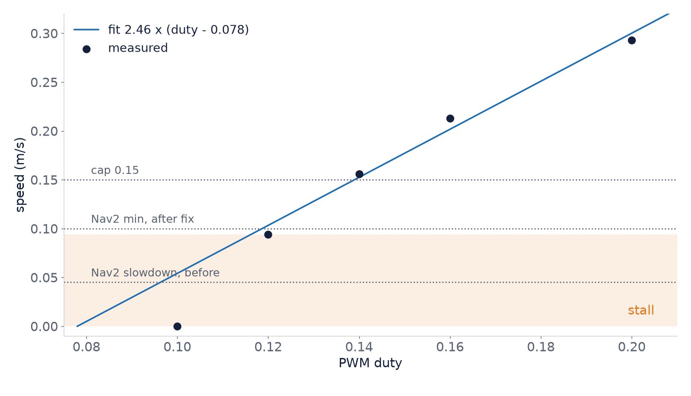
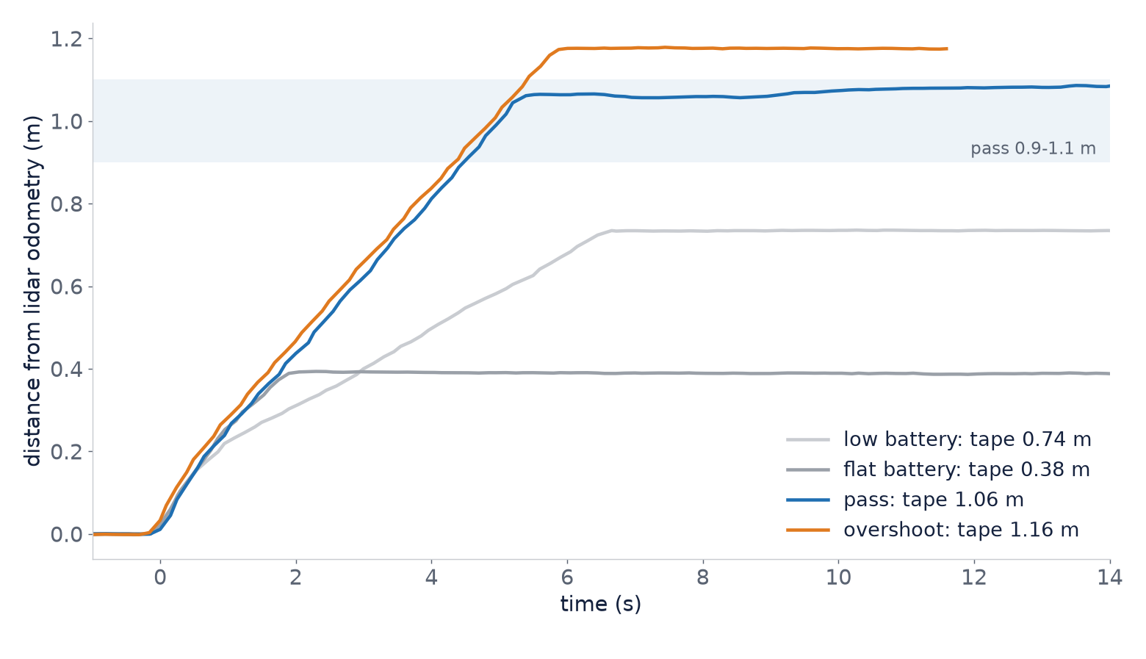
The wheels stall below 0.10 m/s
Fitted: speed = 2.46 × (duty − 0.078)
PWM 1 kHz → 100 Hz
Kick start: 0.30 duty, 0.35 s
Silent: "live" flag never passed
Implementation · Chloe · block 6
20
Notes:
The first drive was rough: the robot curved up to forty degrees, wouldn't start slowly, and sometimes overshot two to three times. The Pi generates the motor signal in software, and when it got busy the timing slipped. Slowing the signal from a thousand to a hundred pulses a second fixed it.
On the left is our calibration. Speed rises in a line with duty cycle, but below ten centimetres a second the wheels stall, the same floor that stopped Nav2, so every start gets a short kick. On the right, two of three one-metre runs landed within ten centimetres, and the flatter lines show the battery fading.
One more silent failure: the setting that turns the motors live was never passed through, so our first live runs didn't move.
With all of that in place, here's what the robot did on its own.

Slide 21
Results

Slide 22
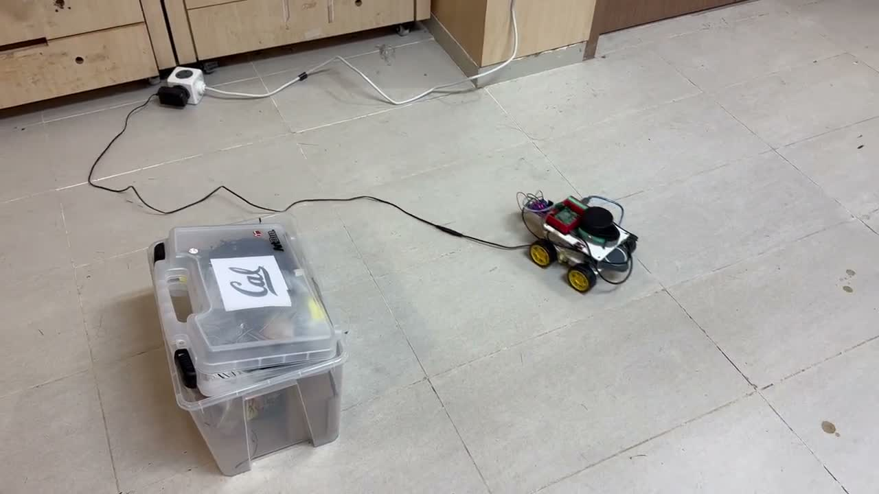
It reached a goal on its own, around a box
Goal succeeded
1.5 m in 93 s, nobody touching it
1 of 8
Goals that evening, the rest cancelled
OUR TAKE
The loop closes. Reliability is not shown yet.
Results · Chloe
22
Notes:
We give Nav2 a goal on the far side of a box. The robot plans around it and drives there with nobody touching it, and after ninety-three seconds Nav2 reports success.
To be upfront: that evening we sent eight goals, and one succeeded. We cancelled the rest as we found faults. So this proves the whole system works together, but not yet that it's reliable.
Looking back, there's a clear pattern in what went wrong.

Slide 23
Almost every challenge was integration
Fourteen challenges in three weeks, grouped by root cause
13 of 14
came from hardware, load, interfaces or process
Cheap hardware
6
Interface mismatch
3
Loaded computer
2
Platform, process
2
8 of 14
were surprises
Algorithm assumption
1
Only one came from an algorithm: the person behind the robot
Results · Chloe
23
Notes:
We logged fourteen challenges in three weeks. Thirteen came from hardware, the slow computer, mismatched programs or process, and the bars show cheap hardware alone caused six. Only one, in coral, came from an algorithm's assumption: the person behind the robot. Eight were surprises.
Two were silent, the message format and the live setting, and the robot just sat there. So our main takeaway: these packages assume better hardware than ours, and every default had to be retested.
So what would we do differently?

Slide 24
What we learned, and what comes next
Lessons
Limits
1
Integration is the hard part
No encoders
One goal reached
Slow computer
One lidar plane
2
Measure physical limits on day one
3
Test live, not on replays
Next
4
No ground truth? Design one
Wheel encoders
Hardware PWM
5
Make silent failures loud
Faster computer
Live people filter
Results · Chloe
24
Notes:
On the left, five lessons. Integration was the hard part, not the algorithms. Measure physical limits like stall speed, power and processing load on day one, because each cost us days. Test on the real robot, not recordings. Without ground truth, design one. And make silent failures loud.
On the right, our limits and next steps: wheel encoders, a hardware motor signal, a faster computer, and running the people filter live.
So, to close.

Slide 25
Verdict
A low-cost robot can map a room and navigate it on its own, once every physical limit is measured and designed around.
Thank you · Questions?
Notes:
Back to our question: yes, a low-cost robot can map a room and navigate it on its own, as long as every physical limit is measured and designed around. Thank you, and we're happy to take questions.

Slide 26
References
Kudriashov et al. 2026. A Real-World Benchmark of Monte Carlo-Assisted EKF Odometry for Online Pose Estimation in 2D LiDAR SLAM. Sensors 26(13), 4264
Merrick and Nandikolla 2026. Evaluating the Impact of Extended Kalman Filter Odometry on the Performance of 2D LiDAR SLAM Algorithms. Sensors 26(17), 5468
Ye et al. 2021. Mapping While Following: 2D LiDAR SLAM in Indoor Dynamic Environments with a Person Tracker. IEEE ROBIO 2021
Salem et al. 2023. arXiv preprint 2303.07312 (de-skewing scans from low-rate 2D lidars)
Jaimez et al. 2016. IEEE ICRA 2016 (rf2o, range-flow planar laser odometry)
Macenski and Jambrecic 2021. Journal of Open Source Software 6(61) (SLAM Toolbox)
Ran et al. 2025. Remote Sensing 17(7), 1214 (review of 2D lidar SLAM)
Overview · Backup

