Slide 1



VIRTUALIZED SECURITY LAB
Build an isolated attack lab — then prove a SIEM catches every move
attacks
the SIEM watches
Samuel Weiss · LIS4905 Directed Individual Study · Fall 2026 · Instructor: E. Randeree

Slide 2
The big idea, in plain terms
Spin up two computers inside one laptop.
One is the attacker. One is a deliberately weak victim.
Attack the victim with real hacker tools.
A SIEM (security monitor) records everything and shows the attack.
Nothing can reach the real internet — totally sealed off.
SIEM watches & records
attacks
KALI
(attacker)
TARGET
(weak on purpose)
Virtualized Security Lab · LIS4905 DIS · S. Weiss
2

Slide 3
The challenge: one small laptop
Everything had to run on a single Apple-Silicon MacBook — which ruled out the easy, standard tools.
8 GB
Apple M1
~34 GB
total RAM
ARM chip
free disk
4 machines share it
no normal x86 software
keep everything lean
Splunk? No ARM build, and x86 emulation failed on this OS. Docker/emulation for the monitor? Too heavy and flaky.
The fix: run a native ARM Elastic SIEM, and get creative with install workarounds.
Virtualized Security Lab · LIS4905 DIS · S. Weiss
3

Slide 4

How the lab is wired
Host-Only network · 192.168.128.0/24 · no route to the internet
attacks (scan → exploit)
KALI — attacker
192.168.128.2
Metasploitable2 — target
192.168.128.4
Elastic SIEM (on the Mac) · 192.168.128.1 — captures all traffic
Virtualized Security Lab · LIS4905 DIS · S. Weiss
4

Slide 5
Why isolation is the whole point
Safe to attack. You can run real exploits without risk.
Nothing escapes. The victim can’t phone home or spread.
No collateral damage. The campus/home network is never touched.
Proven, not assumed. The SIEM shows only lab IPs — no outside traffic.
SEALED LAB
no way in or out
Virtualized Security Lab · LIS4905 DIS · S. Weiss
5

Slide 6
Meet the three players
Kali Linux
Metasploitable2
Elastic + Kibana
The attacker
The target
The SIEM (monitor)
ARM64, runs headless over SSH
Tools: nmap, hydra, Metasploit
Captures its own traffic
Ubuntu 8.04 — ancient on purpose
23 old, exploitable services
Safe punching bag
Native ARM, runs on the Mac
Packetbeat feeds it packets
Dashboards reveal the attack
Virtualized Security Lab · LIS4905 DIS · S. Weiss
6

Slide 7
Step 1 — knock on every door (recon)
nmap scans all 65,535 TCP ports on the target — like knocking on every door to see which open.
Result: 23 open, outdated services (FTP, Samba, UnrealIRCd, a root bind shell, and more).
65,596
distinct destination ports contacted — the entire port range
target = a building
full of doors (ports)
Virtualized Security Lab · LIS4905 DIS · S. Weiss
7

Slide 8
Step 2 — break in (exploitation)
Service | Technique / CVE | What we got
FTP (port 21) | T1110 — brute force | Cracked login msfadmin : msfadmin
UnrealIRCd (6667) | CVE-2010-2075 | Remote shell on the target
Samba (445) | CVE-2007-2447 | Remote shell (runs as root)
Bind shell (1524) | T1190 — exposed backdoor | Instant root — uid=0, no password
Four different front doors — a weak password, two unpatched services, and a literal backdoor.
Virtualized Security Lab · LIS4905 DIS · S. Weiss
8

Slide 9
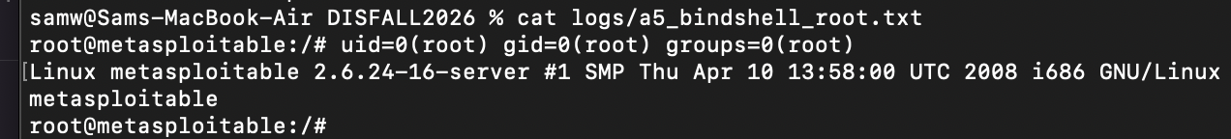
Proof: we became root
The real terminal output from the attack — captured as evidence.
uid=0(root) = complete control of the target machine.
hydra guessed the FTP password in seconds: msfadmin : msfadmin.
Virtualized Security Lab · LIS4905 DIS · S. Weiss
9

Slide 10
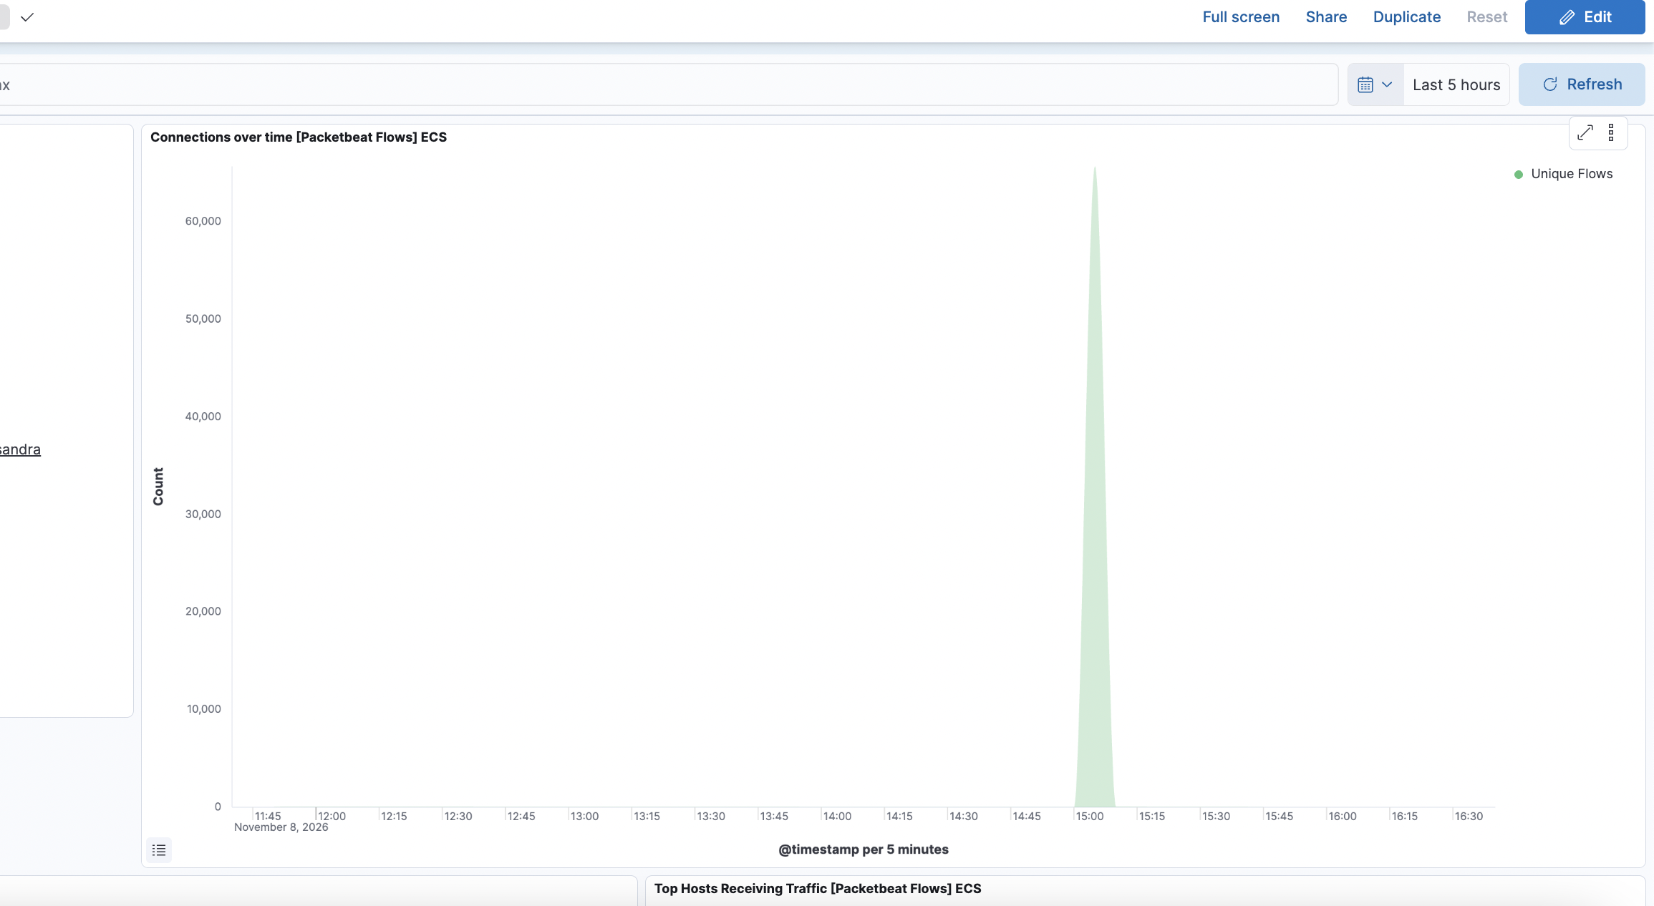
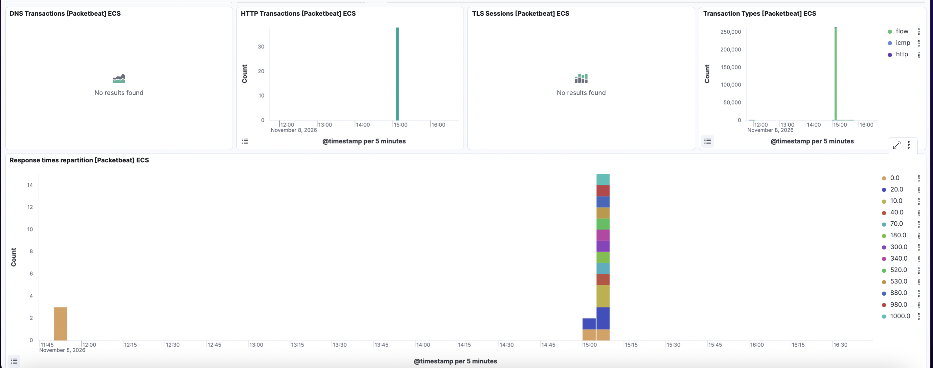
Step 3 — the SIEM sees it all
Packetbeat records every packet. The attack is impossible to miss.
▲ ~260,000 flow events indexed during the attack window.
▲ The port scan: one giant spike to ~65k flows.
Virtualized Security Lab · LIS4905 DIS · S. Weiss
10

Slide 11
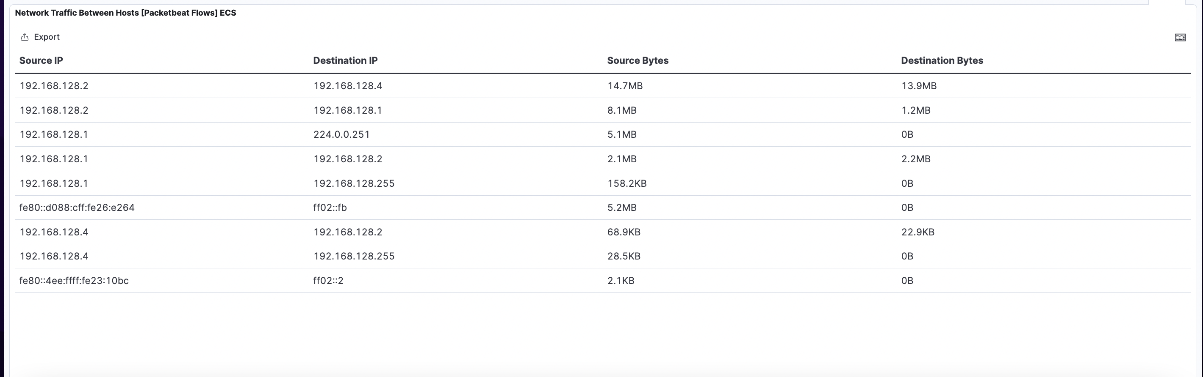
Isolation, proven by the data
Only three IPs appear:
.1 (SIEM) · .2 (attacker) · .4 (target)
No public internet address is anywhere in the traffic — the lab really is sealed.
Virtualized Security Lab · LIS4905 DIS · S. Weiss
11

Slide 12
Every attack → how the SIEM caught it
Attack | MITRE ATT&CK | What the SIEM showed
Port scan | T1046 | 65,596 distinct ports from .2 → .4
FTP brute force | T1110 | 72 flows to port 21 (burst)
UnrealIRCd backdoor | T1190 | 25 flows to 6667 + reverse shell
Samba usermap | T1190 | 8 flows to 445 + reverse shell
Root bind shell | T1190 | 30 flows to unusual port 1524
Prevention is only half the job — detection is what makes it a security lab.
Virtualized Security Lab · LIS4905 DIS · S. Weiss
12

Slide 13
What it proves — and what’s next
A complete security loop — build → attack → detect — on one 8 GB laptop.
Five real exploits (incl. CVE-2010-2075 & CVE-2007-2447), all captured.
ARM + emulation forced creative fixes: serial-console install, native Elastic.
Documenting the failures was the real learning.
Next steps
Custom detection/alert rules · richer dashboards · more attack scenarios · finalize the report.
github.com/samweiss6/virtualized-security-lab

